Slide 1
Boosting Algorithm
Ada Boost
Is the meta-ensembler

Slide 2
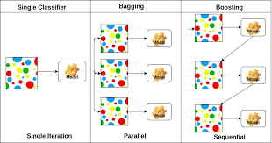
Comparison bw Bagging and Boosting

Slide 3
Bagging | Boosting
Independent Model | Dependent Model
parallel learner | sequential learner
Most occurred result will be the best model | Uses an Interactive approach to learn from mistake

Slide 4
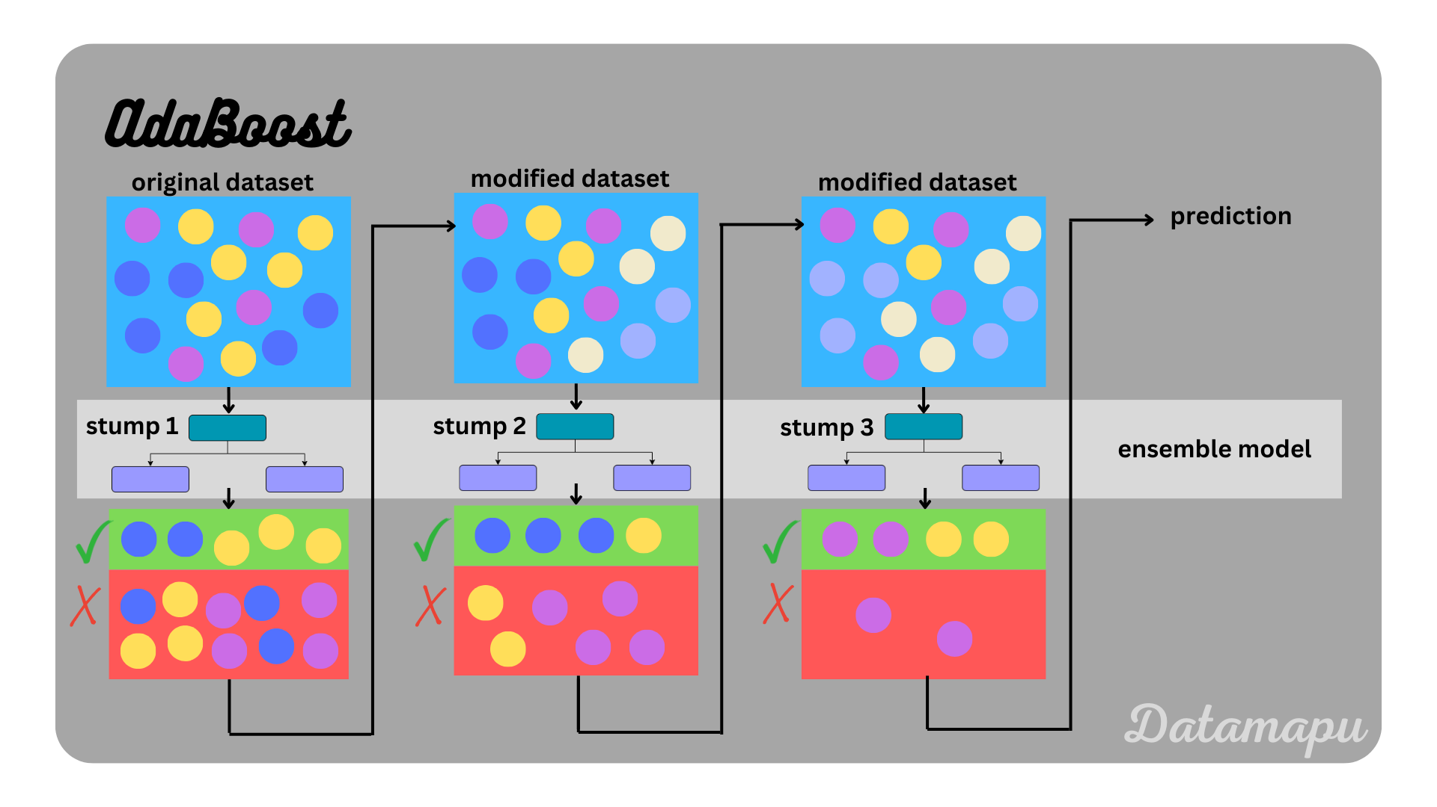
Ada Boost
Base learner (stump)1 will be selected based on entropy
Incorrect classifier send to next stump 2

Slide 5
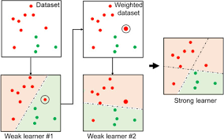
Weight changes
Initially same weight will be assigned to all dataset
Weight will be increased for incorrect response
And decreased for correct response, it will be calculated based on some formula
Overall efficiency will be increased

