Slide 1

Project Title: Analyzing Amazon Sales Data
Importance of Sales Management in Business
Nagarjun Patimi

Slide 2
Introduction
Overview of the project and its importance.
Focus on sales management, competition, distribution methods, cost reduction, and profit increase.
Sales management is crucial for business success, driving competition, efficient distribution, and increased profits.
Deeper understanding of sales management intricacies.

Slide 3
Data Cleaning in Python
Data cleaning process using Python, Pandas, and Matplotlib.
Specific steps: converting 'Order Date' to datetime, extracting month, year, and year-month.
Visualization of monthly sales trends using Matplotlib.
Visualization of yearly sales trends using Matplotlib.

Slide 4
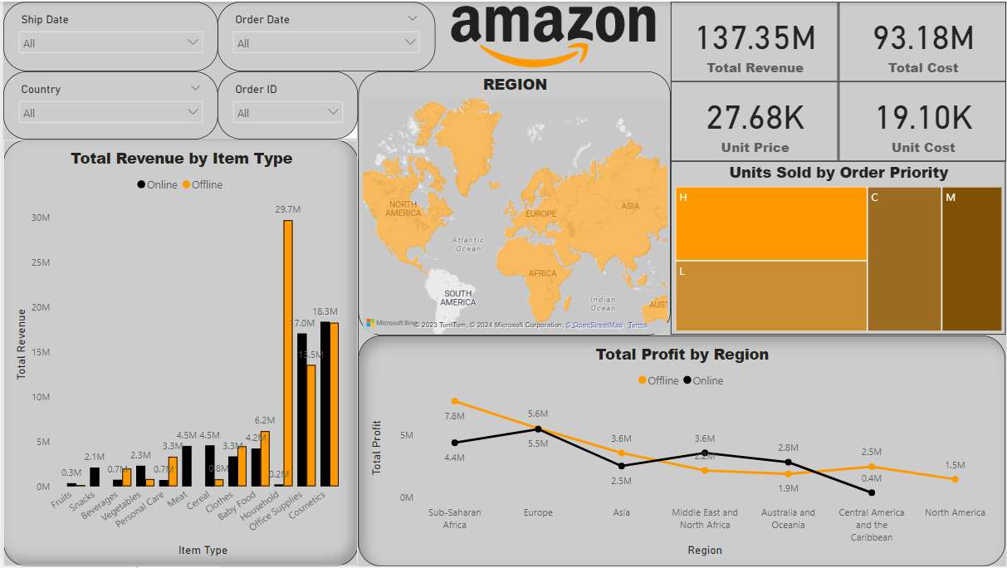
My Dashboard

Slide 5
Data Insights
Monthly Sales Trends:
Highest sales in February (Month 2) with $24,740,517.77.
Lowest sales in August (Month 8) with $1,128,164.91.
Seasonal variations in sales are observed.
Yearly Sales Trends:
Highest sales in 2012 with $31,898,644.52.
Lowest sales in 2015 with $12,427,982.86.
Overall, there is a fluctuating pattern in yearly sales.
Total Revenue and Costs:
Total Revenue: $137.35 million
Total Cost: $93.18 million
Total Unit Price: $27.68k
Total Unit Cost: $19.10k

Slide 6
Data Insights
Order Priority Analysis:
Order Priority 'H' has sold the most number of units: 154,212
Order Priority 'M' has sold the least number of units: 94,832
Region-wise Profit Analysis:
Sub-Saharan Africa has the highest profit in offline sales (around $7.8 million) but is the second-highest in online sales.
Europe has the highest profit in online sales (around $5.5 million) and the second-highest in offline sales.
Item Type Revenue Analysis:
Household Item type has the highest Total Revenue in Offline sales: Around $29.7 million
Cosmetics item type has the highest Total Revenue in Online sales: Around $18.3 million

Slide 7
Conclusion
Sales Management Significance:
Emphasizing the critical role of sales management in navigating the challenges of increasing competition and optimizing distribution methods.
Recognizing sales management as the cornerstone of success in the commercial and business landscape.
Data Cleaning and EDA Excellence:
Achieving excellence in data cleaning using Python, Pandas, and Matplotlib, ensuring the dataset's integrity and reliability.
Harnessing the power of Exploratory Data Analysis (EDA) to uncover hidden patterns, trends, and correlations, providing a solid foundation for meaningful insights.
Dynamic Dashboard Creation:
Showcasing the power of visual representation through a dynamic Power BI dashboard.
Utilizing a diverse set of visualizations, including clustered column charts, line charts, tree maps, filled maps, slicers, and cards, to present a comprehensive view of sales data.
Knowledge Gain and Skill Development:
Acquiring a wealth of knowledge in data science, encompassing data cleaning techniques, advanced analytics, and the utilization of DAX functions for dynamic visualizations in Power BI.
Strengthening skills in extracting actionable insights from complex datasets, contributing to informed decision-making.
Sales Insights and Strategic Impact:
Unearthing insights into monthly and yearly sales trends, unit sales correlations, regional profit dynamics, and order priority analysis.
Enabling strategic decision-making in sales strategies, inventory management, and resource allocation.

