Slide 1
MentorHub
INFO6150 - WEB DESIGN / USER EXPERIENCE FINAL PROJECT
Apoorva Kulkarni
Arjun Raja Yogidas
Manoj Chandrasekaran
Nagarjun Mallesh

Slide 2
Purpose
Leverage the vast and diverse network of Student, faculty and alumni of Northeastern University.
Provide a platform for ease of communication and real-time networking.
Provide a platform to connect with like minded people and have conversations about the commonalities.
Provide a platform for mentors to share posts and articles and make it available for the subscribed mentees.

Slide 3
Application Functionality
Allows the synchronized communications between the Mentee and the respective Mentor
Provides personalized notes to the users to note down important meeting points
Provides Quick Icebreakers Tips - to initiate conversation between the Mentee and Mentor
Allows Mentees to schedule an appointment with Mentors based on Mentor Availability
Allows users to opt for Mentors based on Interests and Ratings; provides an overview of the User Profiles

Slide 4
Underlying Technologies
FRONT-END
Redux
Tailwind CSS
Ant Design
Thunk
Slice
Axios
NestJS
TypeScript
BACKEND
NestJS
TypeScript
NodeMailer
Argon
JWT Tokens for authentication
joi Schema validation
Mongoose
Passport
Handle Bar
NodeJS
Mongo DB

Slide 5
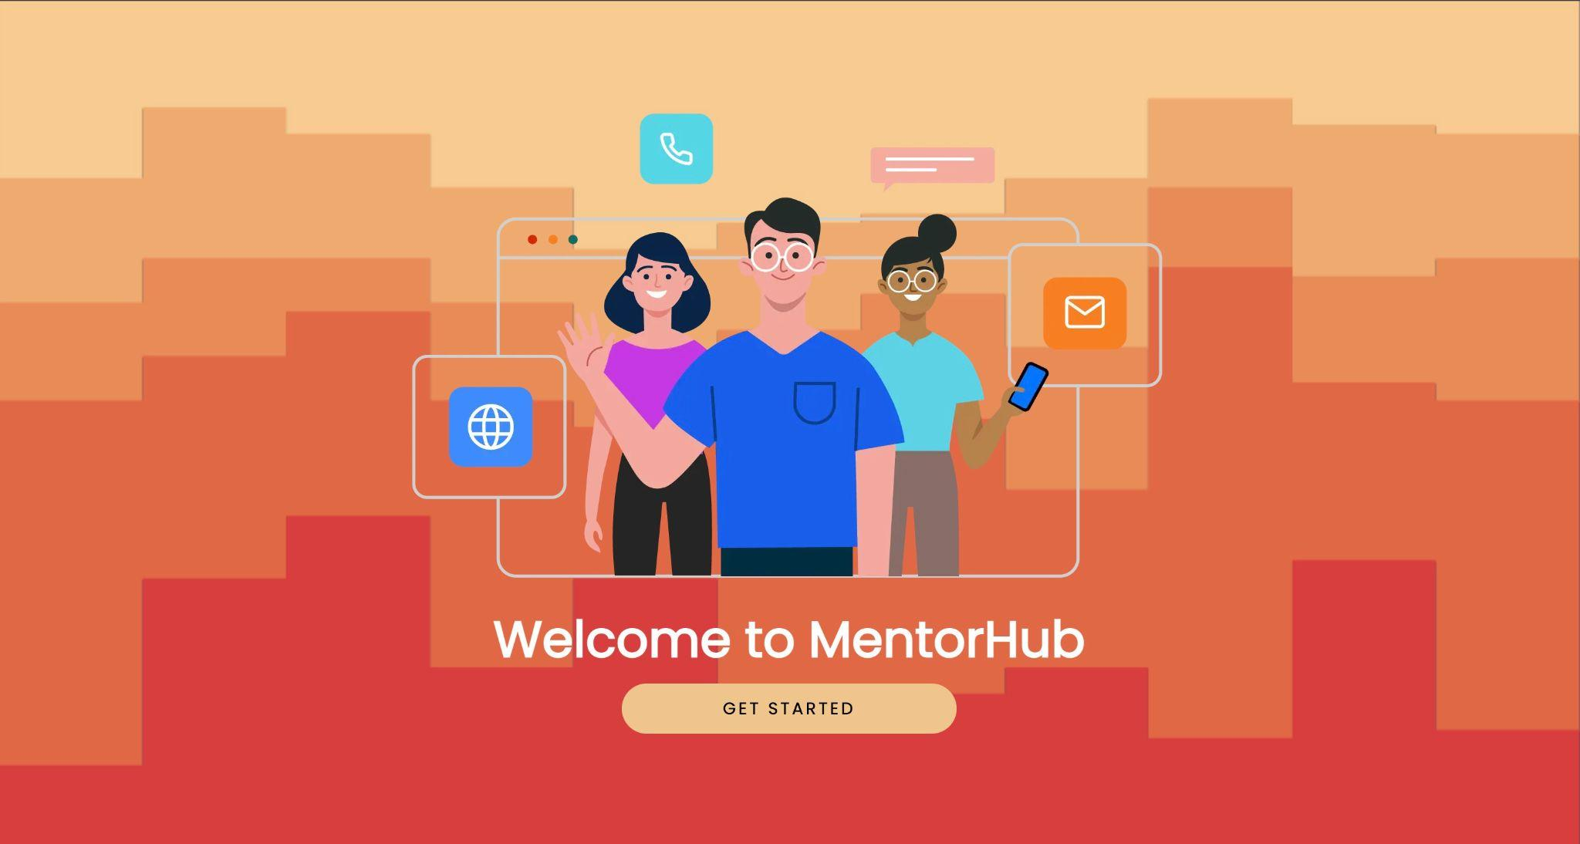
Application Snippets
Landing Page

Slide 6
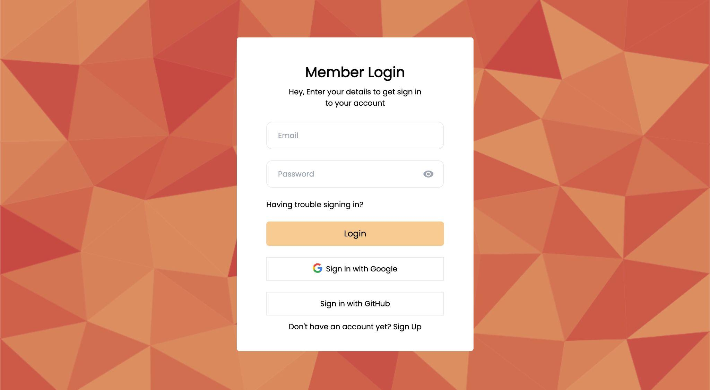
Login Page

Slide 7
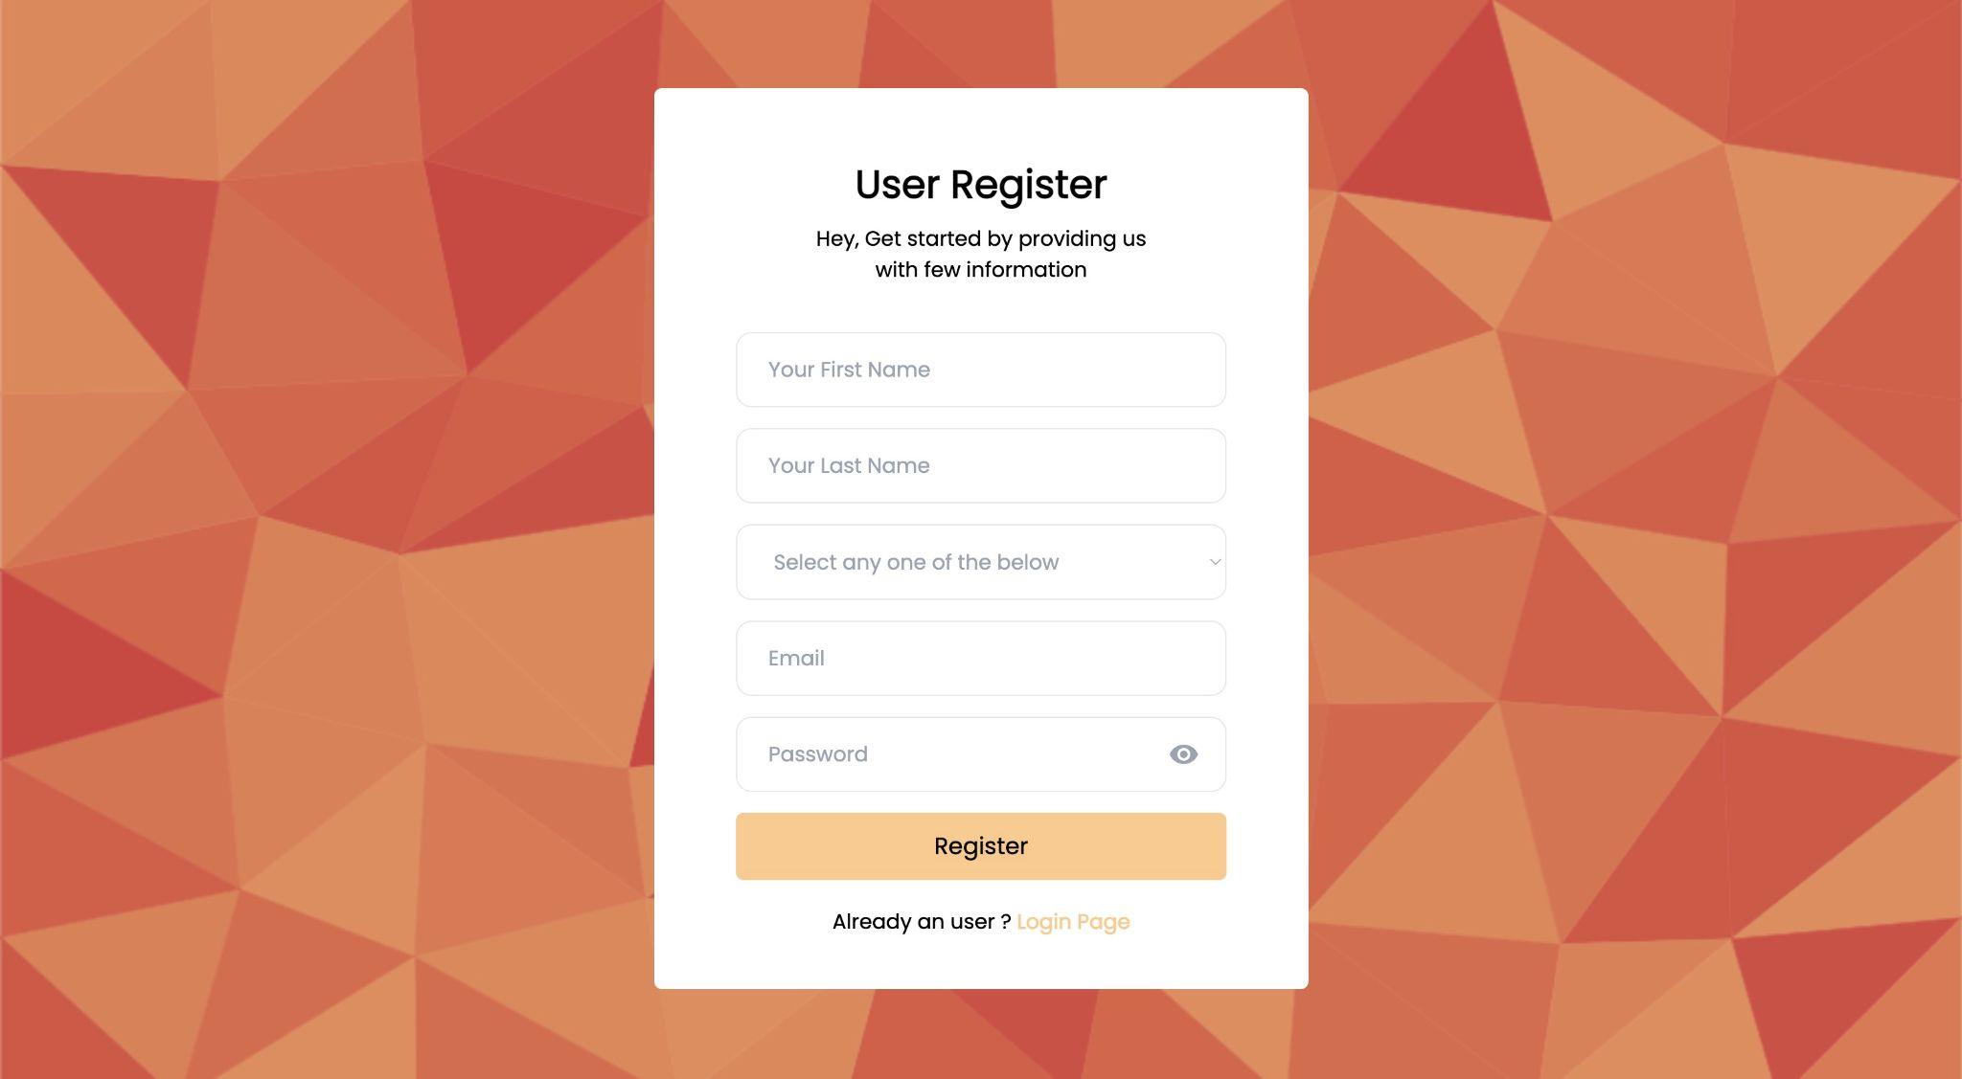
Registration Page

Slide 8
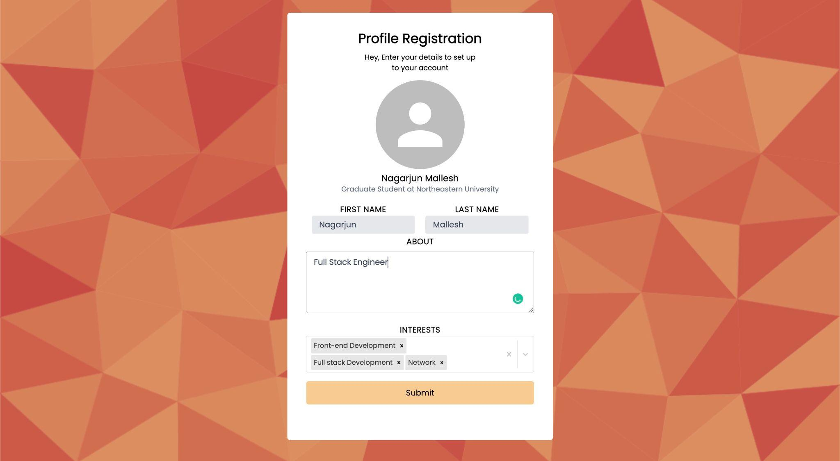
Profile Registration Profile

Slide 9
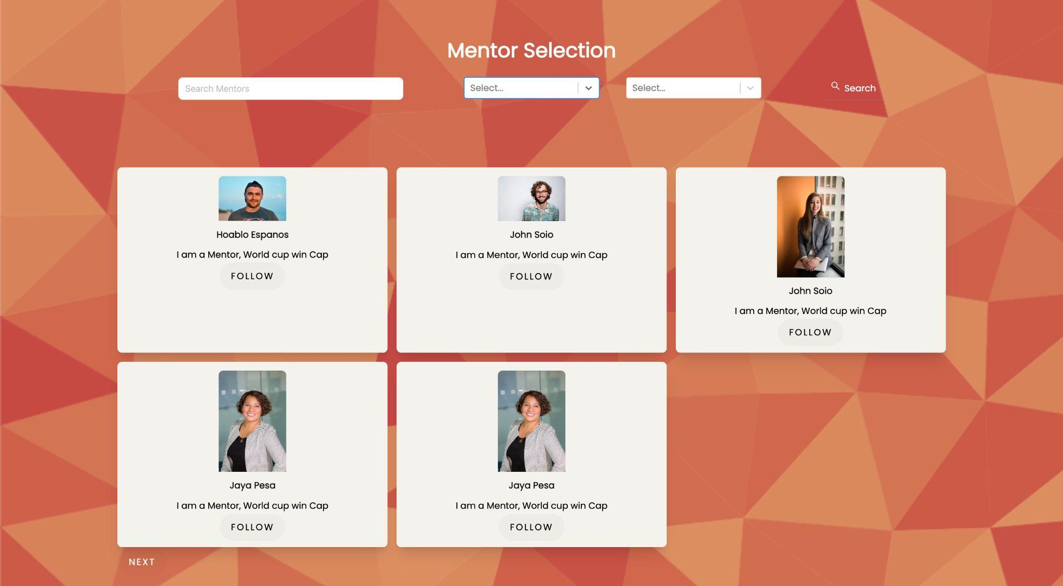
Mentor Selection Profile

Slide 10
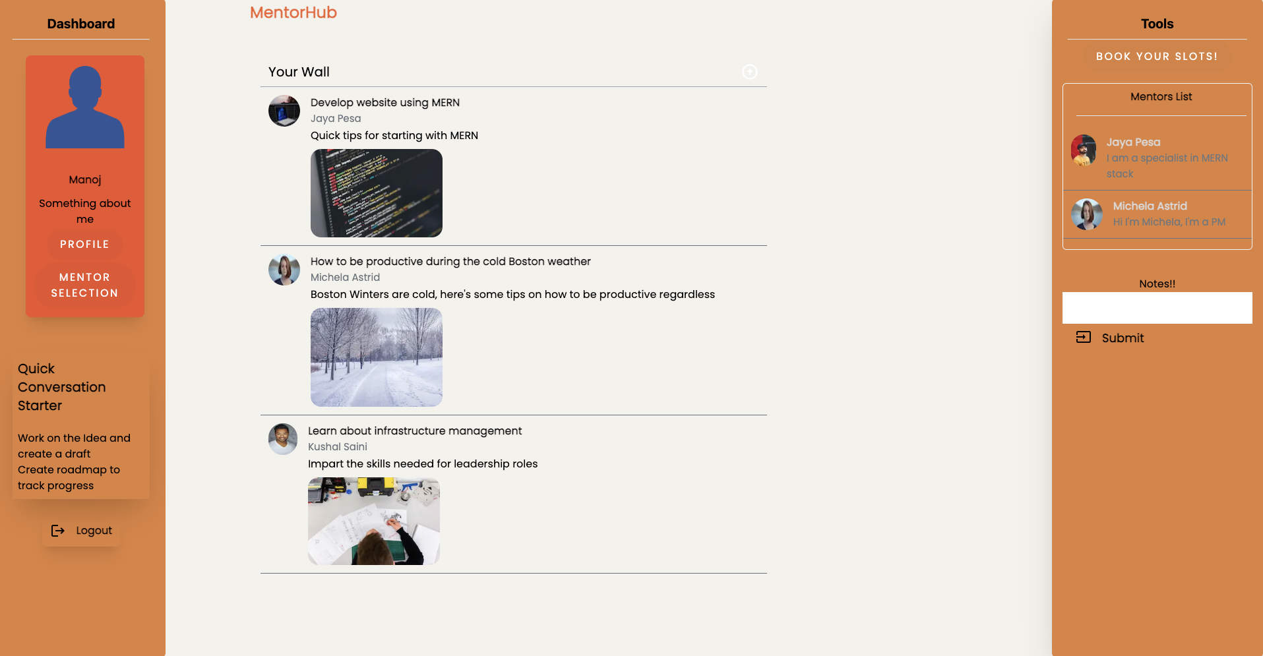
Mentee Dashboard

Slide 11
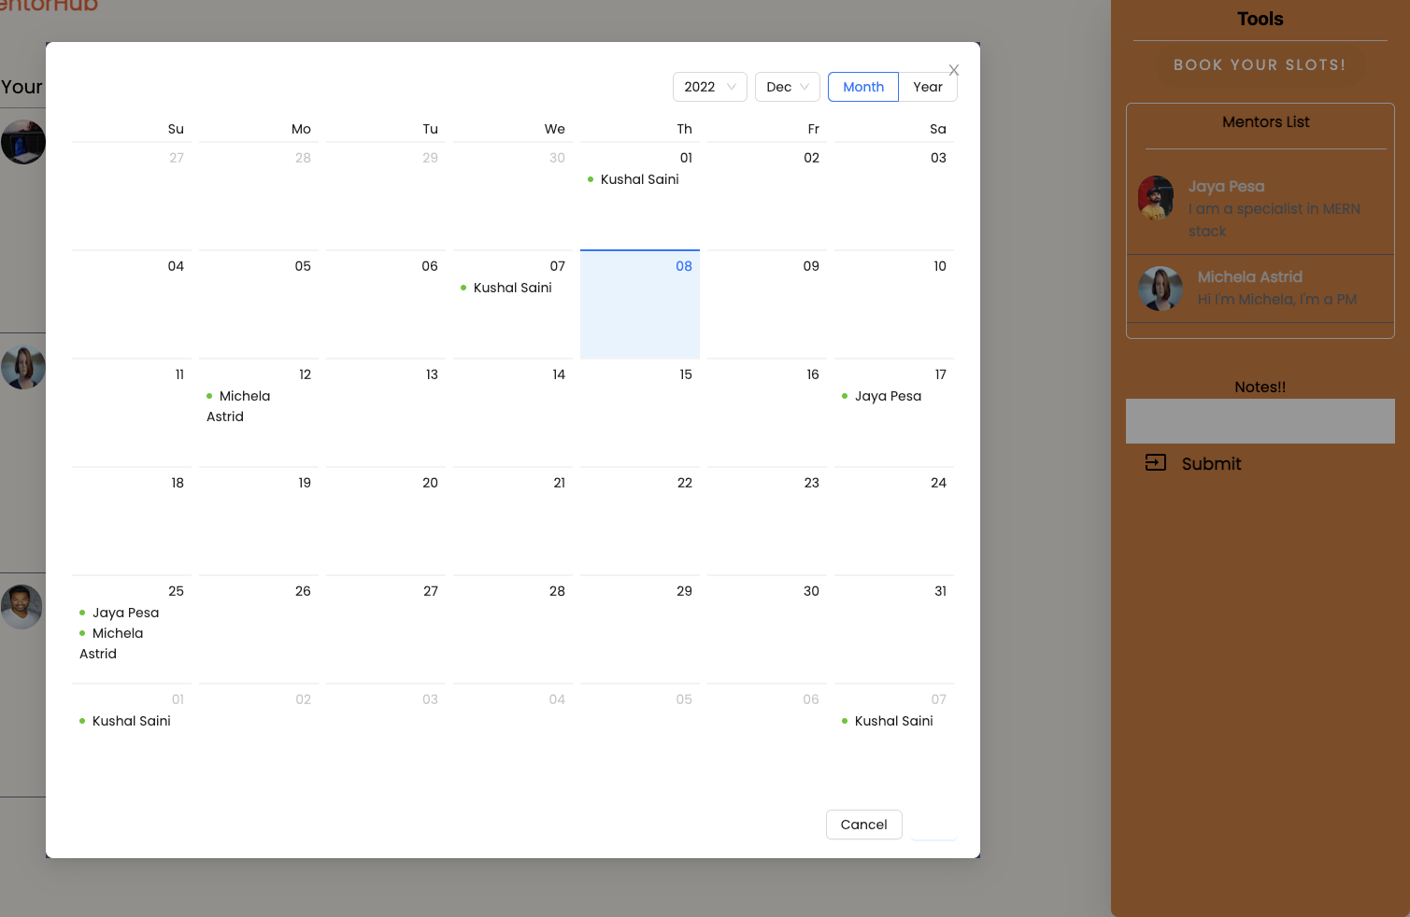
Mentor Scheduling

Slide 12
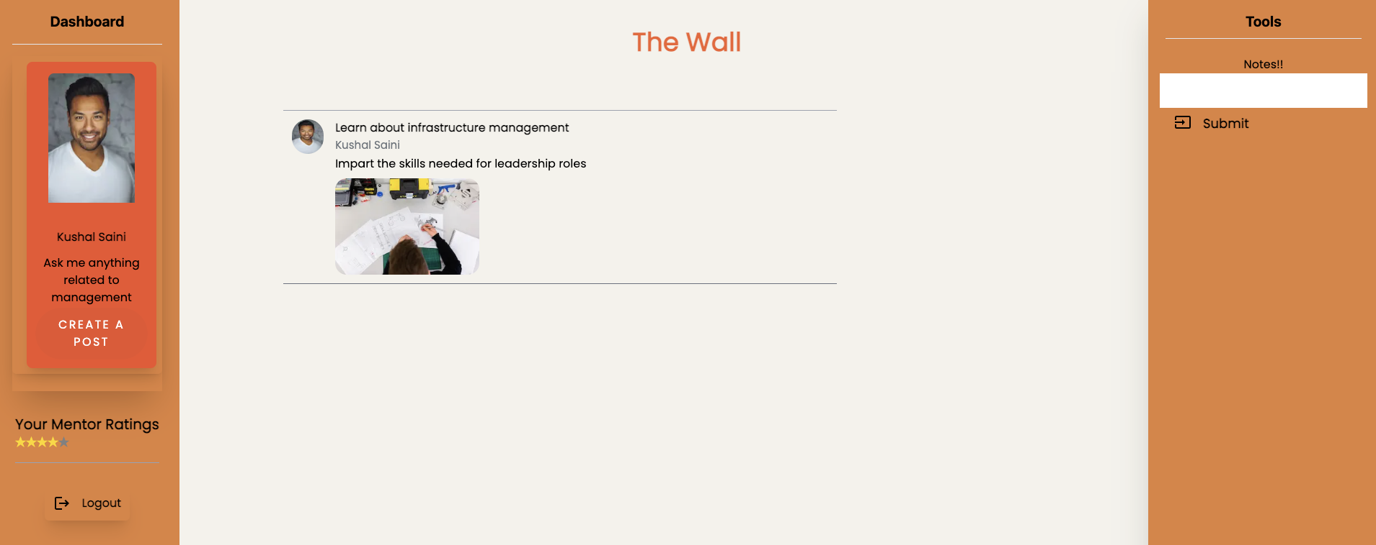
Mentor Dashboard

Slide 13
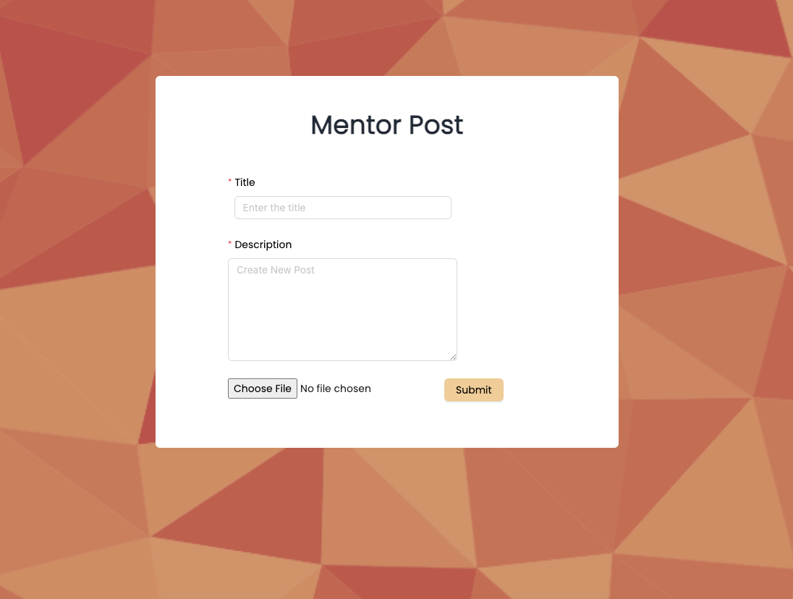
Mentor Post Upload Page

