Slide 1


RESUME PROJECT CHALLENGE
#CHALLENGE - 6
Presentation by: Nagarjun M
Created on: 15/07/2023

Slide 2

INTRODUCTION:
Challenge : Provide Insights to the Marketing Team in Food & Beverage Industry
Domain : F & B
Function : Marketing
Company Name : CodeX
Tools Used: MySQL, Power BI

Slide 3
About CodeX:
CodeX is a German beverage company that is aiming to make its mark in the Indian market.
A few months ago, they launched their energy drink in 10 cities in India.
Their Marketing team is responsible for increasing brand awareness, market share, and product development. They conducted a survey in those 10 cities and received results from 10k respondents.
Objective:
As a marketing data analyst our task is to convert these survey results to meaningful insights which the team can use to drive actions.

Slide 4
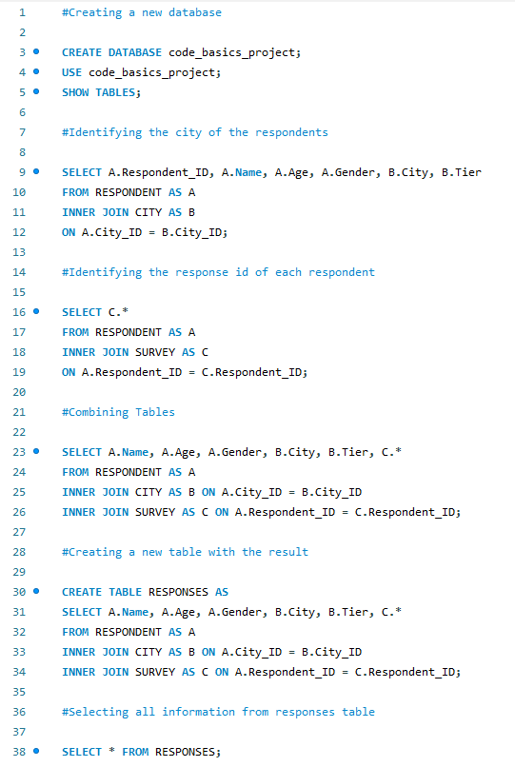
CREATING A DATABASE AND TABLE IN MySQL:
We have written a query that creates a new database named “code_basics_project”.
After creating a database we combine three individual tables into a new table named “RESPONSES”.
This helps us to use one single table for all queries

Slide 5
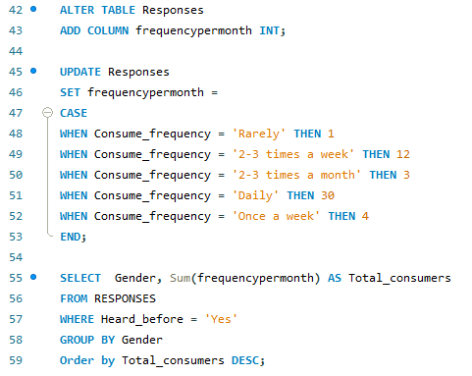

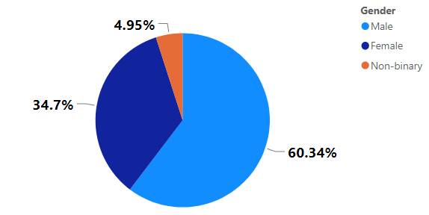
DEMOGRAPHIC INSIGHTS:
Who prefers energy drink more? (male/female/non-binary?)
QUERY:
Output:
Insights:
SOLUTION:
This shows that energy drinks are consumed more by males. Hence, male prefers energy drink more.

Slide 6
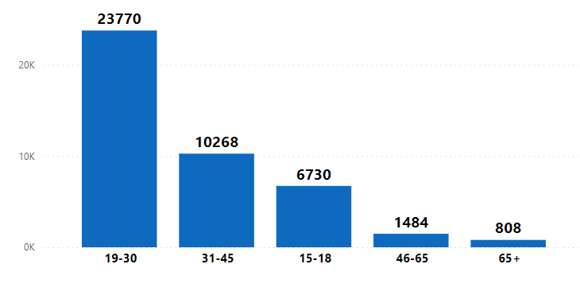
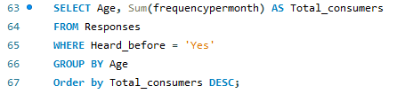
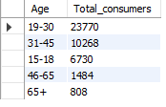
DEMOGRAPHIC INSIGHTS:
Which age group prefers energy drinks more?
QUERY:
Output:
Insights:
SOLUTION:
People with the age of 19 – 30 prefers energy drink more.

Slide 7
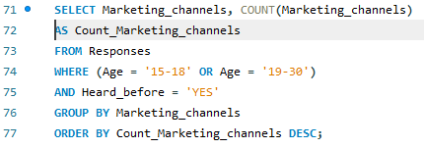
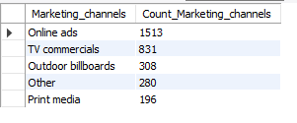
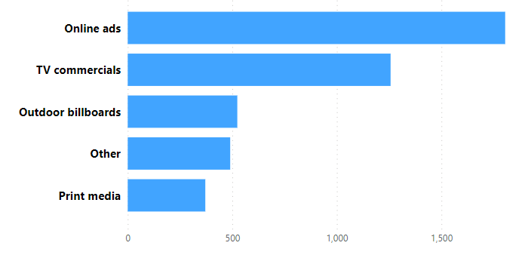
DEMOGRAPHIC INSIGHTS:
Which type of marketing reaches the most Youth (15-30)?
QUERY:
Output:
Insights:
SOLUTION:
Online ads is the marketing channel which reaches the youth more followed by TV commercials.

Slide 8
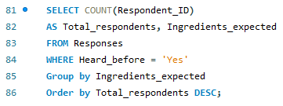
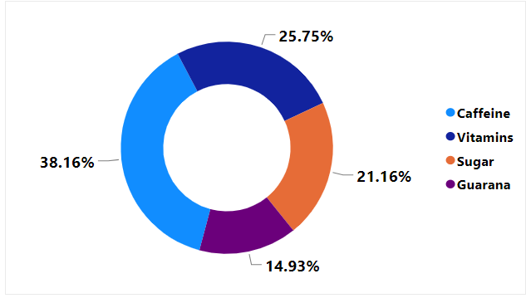
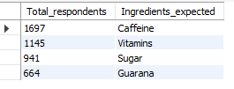
CONSUMER PREFERENCES:
What are the preferred ingredients of energy drinks among respondents?
QUERY:
Output:
Insights:
SOLUTION:
The most preferred ingredients in energy drink is Caffeine.

Slide 9
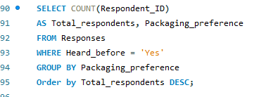
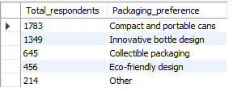
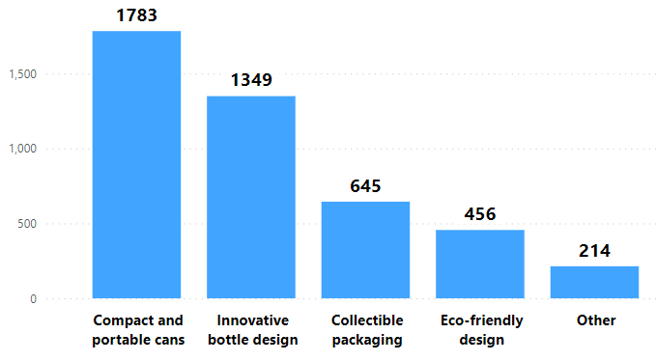
CONSUMER PREFERENCES:
What packaging preferences do respondents have for energy drinks?
QUERY:
Output:
Insights:
SOLUTION:
Most respondents preferred packaging is Compact and portable cans.

Slide 10
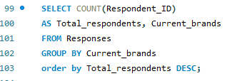
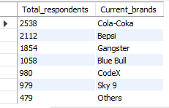
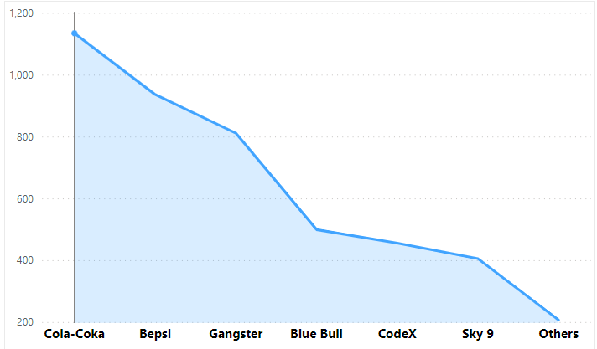
Competition Analysis:
Who are the current market leaders?
QUERY:
Output:
Insights:
SOLUTION:
The current market leaders are Cola-Coka and Bepsi

Slide 11
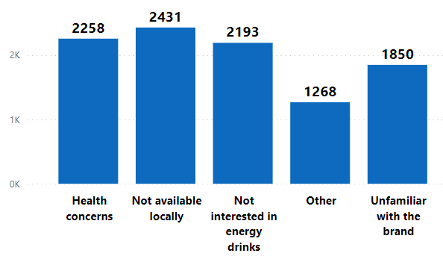
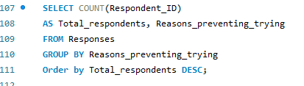
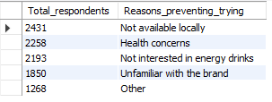
Competition Analysis:
What are the primary reasons consumers prefer those brands over ours?
QUERY:
Output:
Insights:
SOLUTION:
The primary reason for choosing other brand over ours is not available locally.

Slide 12
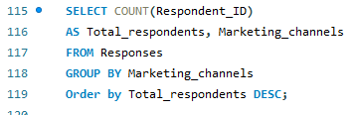
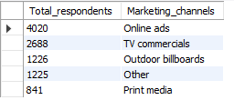
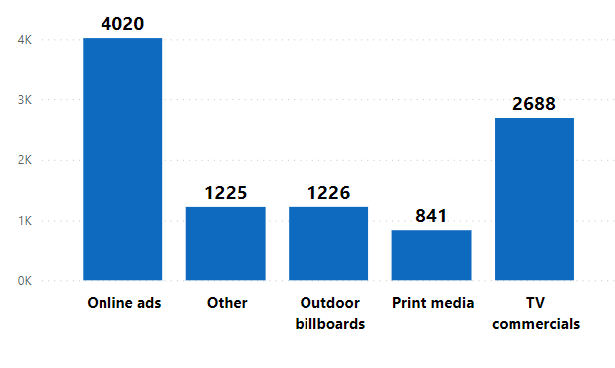
Marketing Channels and Brand Awareness
Which marketing channel can be used to reach more customers?
QUERY:
Output:
Insights:
SOLUTION:
Online ads can be used to reach more customers.

Slide 13
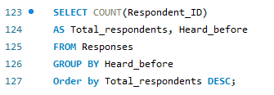

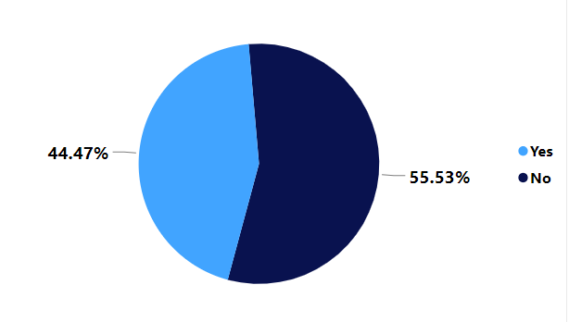
Marketing Channels and Brand Awareness
How effective are different marketing strategies and channels in reaching our customers?
QUERY:
Output:
Insights:
SOLUTION:
This shows most of the respondents haven’t heard about us. So, our marketing strategies are not effective in reaching customers.

Slide 14
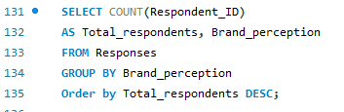

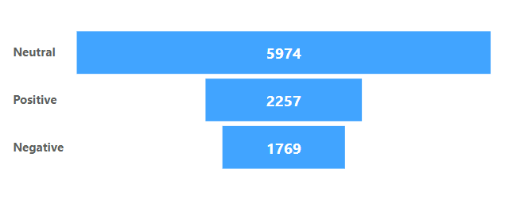
Brand Penetration
What do people think about our brand? (overall rating)
QUERY:
Output:
Insights:
SOLUTION:
Most of the peoples perception of our brand was neutral.

Slide 15
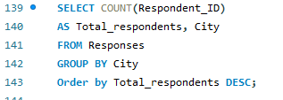
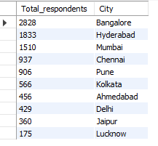
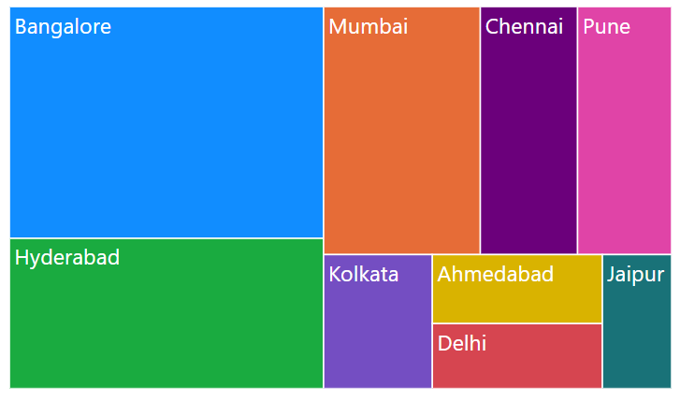
Brand Penetration
Which cities do we need to focus more on?
QUERY:
Output:
Insights:
SOLUTION:
As Bangalore has the highest amount of respondents we need to focus there more.

Slide 16
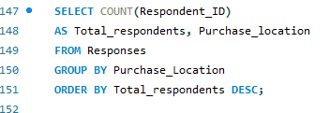
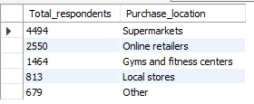
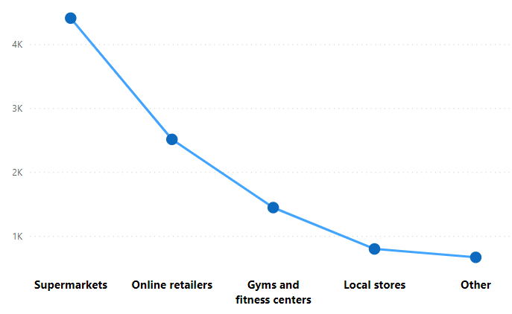
Purchase Behaviour
Where do respondents prefer to purchase energy drinks?
QUERY:
Output:
Insights:
SOLUTION:
Most of the people prefer to buy energy drinks at supermarkets.

Slide 17
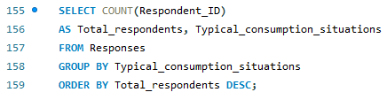
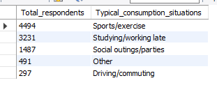
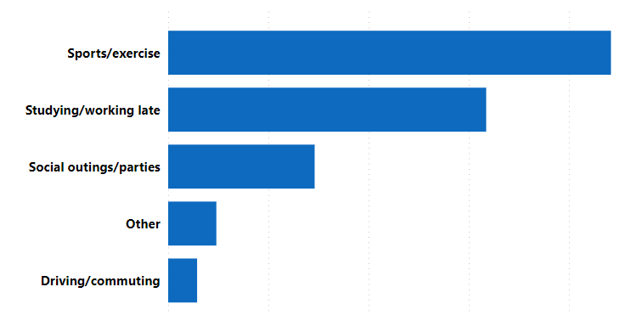
Purchase Behaviour
What are the typical consumption situations for energy drinks among respondents?
QUERY:
Output:
Insights:
SOLUTION:
The most common typical consumption situations for energy drinks among respondents were during sports/exercise.

Slide 18
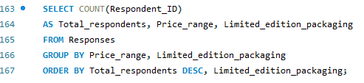
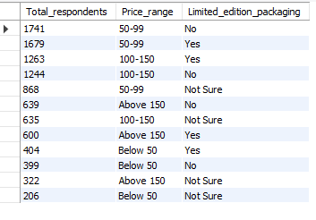
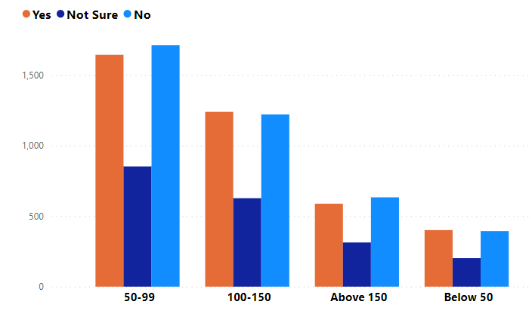
Purchase Behaviour
What factors influence respondents' purchase decisions, such as price range and limited edition packaging?
QUERY:
Output:
Insights:
SOLUTION:
Price ranging between 50-99 with or without limited edition packaging are expected more and influences the customers purchase decision.

Slide 19
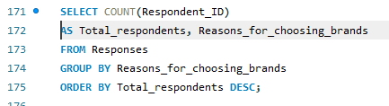
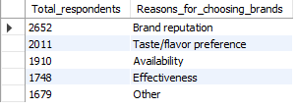
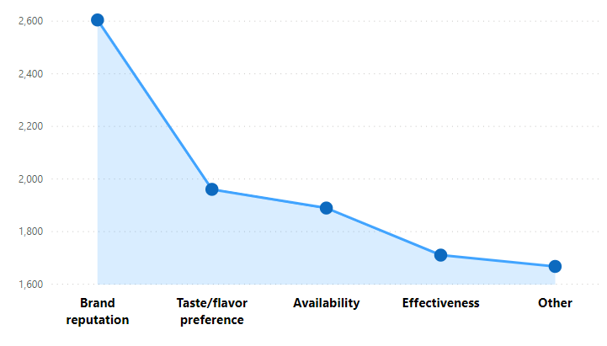
Product Development
Which area of business should we focus more on our product development? (Branding/taste/availability)
QUERY:
Output:
Insights:
SOLUTION:
The major reason for choosing a brand is brand reputation. So, we need to focus more on branding to improve the business.

Slide 20
Recommendations for CodeX:
● What immediate improvements can we bring to the product?
We can reduce the sugar content and use more natural ingredients
● What should be the ideal price of our product?
Pricing the product in the range of 50-99 would be ideal
● What kind of marketing campaigns, offers, and discounts we can run?
We can run online ads and TV commercials
● Who can be a brand ambassador, and why?
Any sportsperson/athlete or fitness influencers can be a brand ambassador because most people
consume energy drinks while sports/exercise
● Who should be our target audience, and why?
Our target audience should be male with the age of 19-30, because most of our respondents lies under this
category

Slide 21
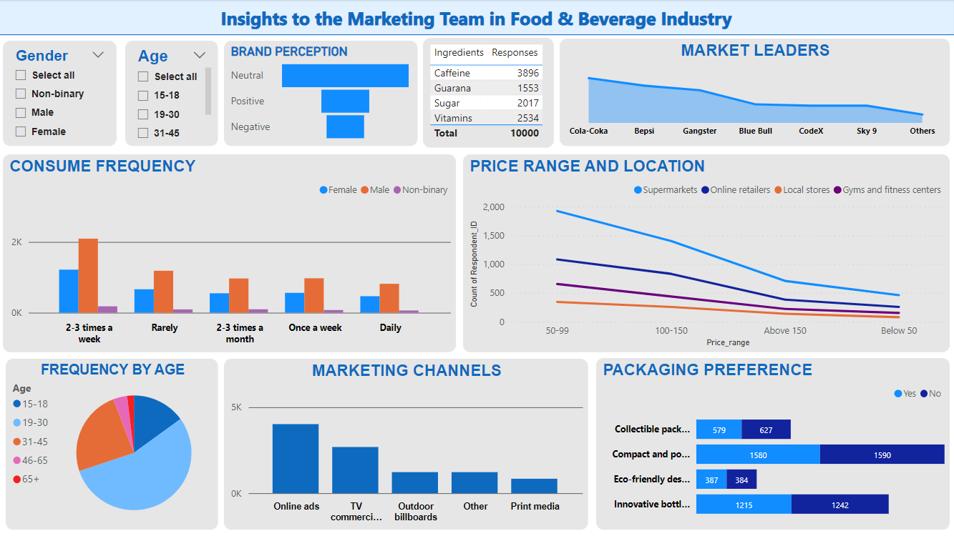

Slide 22
THANK YOU

