Slide 1
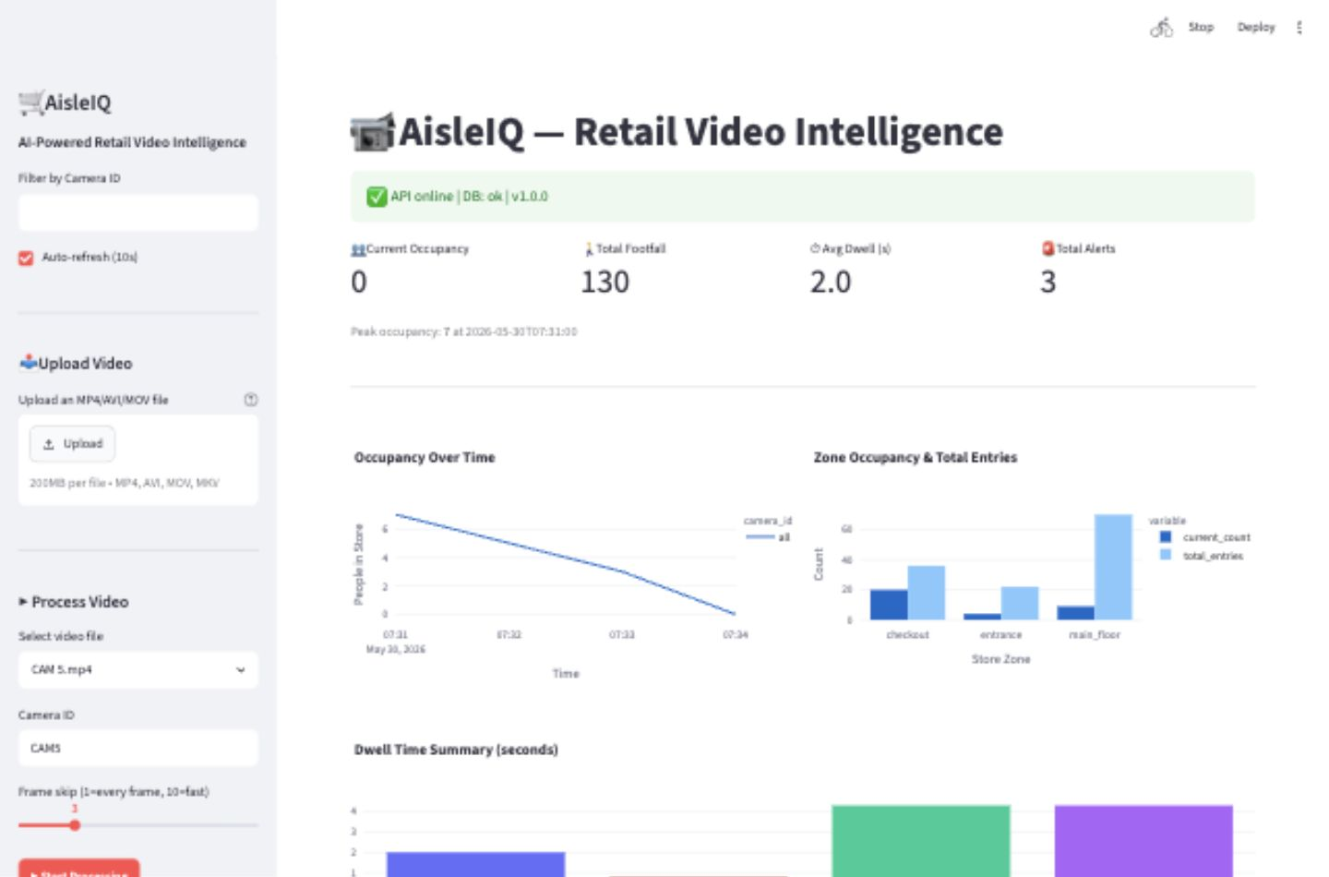
AI-POWERED RETAIL VIDEO INTELLIGENCE
AisleIQ
Turns store camera footage into decisions an operations team can act on.
The project combines a video-processing backend, documented APIs, and a live dashboard for occupancy, events, alerts, and processing history.
Live dashboard overview
Video
API
55
Footage becomes structured events
Integration-ready endpoints
Tests passed in verification
Submission-ready artifact: dashboard snapshots, API docs, GitHub repo, and this pitch deck.

Slide 2
PROBLEM
AisleIQ targets the gap between recorded footage and fast store-level action.
Retail video is abundant; store signals are still trapped in manual review.
CCTV footage
Human review
Late action
The information exists, but it rarely becomes structured, searchable, or operational in time.
Crowding is hard to catch live
Queues lack structured history
Dwell anomalies stay invisible
Peak occupancy and bottlenecks can build before staff notices, especially across multiple zones or cameras.
Managers see the symptom, not the timeline of when it started, how long it lasted, or where it repeated.
Loitering, unusual zone behavior, and repeated high-dwell patterns need event-level intelligence.
AisleIQ pitch deck
02

Slide 3
SOLUTION
The solution is designed as a product platform, not only a single demo screen.
AisleIQ converts raw footage into events, analytics, alerts, and APIs.
Camera footage
Detection and tracking
Store intelligence
API and dashboard
Upload or process store video.
Identify shoppers and persist movement across frames.
Generate occupancy, zone movement, dwell, queue, and alert signals.
Expose results through FastAPI docs and a Streamlit operations console.
Result: retail teams get a searchable, measurable operating layer on top of existing video infrastructure.
AisleIQ pitch deck
03

Slide 4
DASHBOARD PROOF
Screenshot captured from the running local app.
The dashboard gives store operators a live view of traffic, zones, and processing.
Operational KPIs
Top-level counts summarize processed jobs, shopper events, active alerts, and tracked zones.
Video workflow
Users can upload video, start processing, and refresh dashboard state without leaving the app.
Analytics surfaces
Occupancy trends and zone analytics make video output measurable instead of anecdotal.
Dashboard overview
AisleIQ pitch deck
04

Slide 5
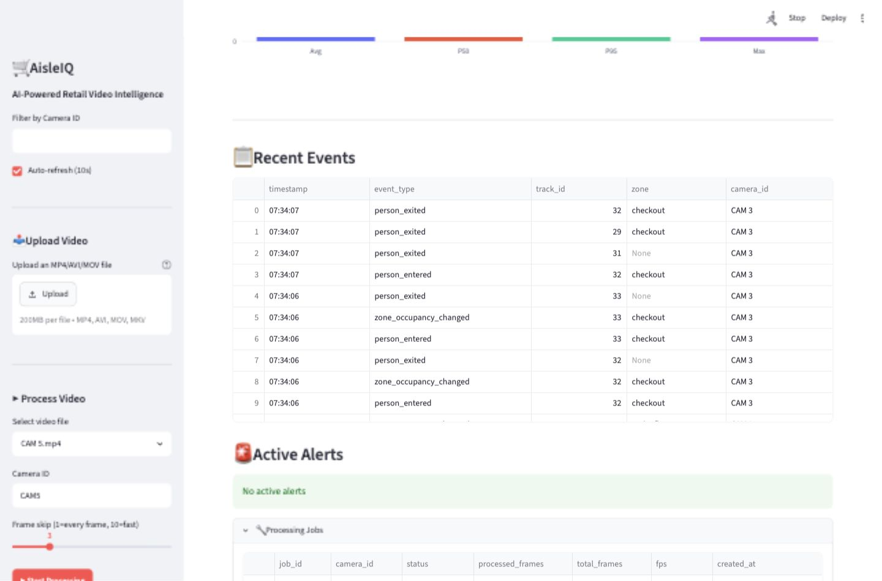
OPERATIONS LAYER
The app keeps recent activity visible so teams can inspect what happened and when.
Events, alerts, and jobs turn model output into an auditable workflow.
01
Recent events
Entries, exits, zone movement, and dwell updates become timestamped records.
02
Active alerts
Crowding, queue buildup, and unusual dwell patterns can be triaged from one view.
03
Processing jobs
Completed and running jobs keep batch video processing transparent.
Events, alerts, and processing jobs
Proof point: AisleIQ already has the surfaces a store team would expect to monitor after upload.
AisleIQ pitch deck
05

Slide 6
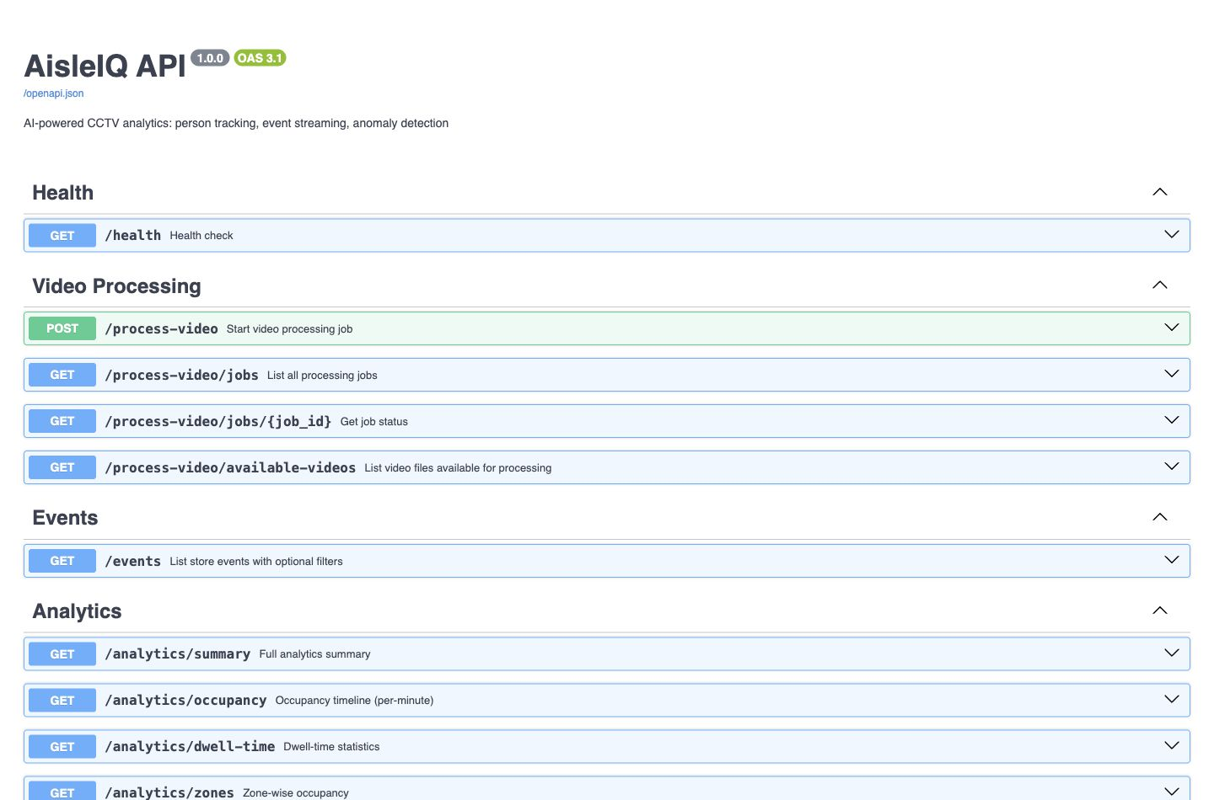
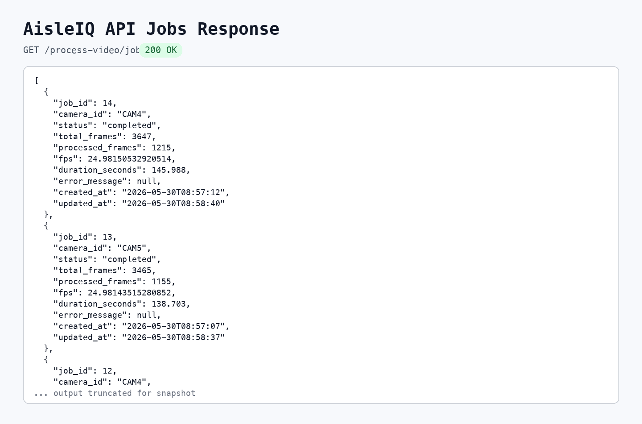
API LAYER
FastAPI docs are captured in light mode for submission readability.
Documented endpoints make the intelligence reusable beyond the dashboard.
Swagger API documentation
Jobs API response
/health
/events
/analytics
/alerts
/process-video/jobs
service readiness
structured shopper events
zone and occupancy summaries
risk and anomaly surfacing
processing history
AisleIQ pitch deck
06

Slide 7
INTELLIGENCE
Editable diagram based on the project feature set.
The model output is shaped into retail concepts: zones, dwell, occupancy, and anomalies.
Store floor abstraction
Derived intelligence signals
Occupancy
Zone dwell
Entrance
Checkout
Queues
Alerts
Entrance flow
Shopping zone
Checkout load
Dwell anomaly
AisleIQ is built to make computer vision useful in store-language terms.
AisleIQ pitch deck
07

Slide 8
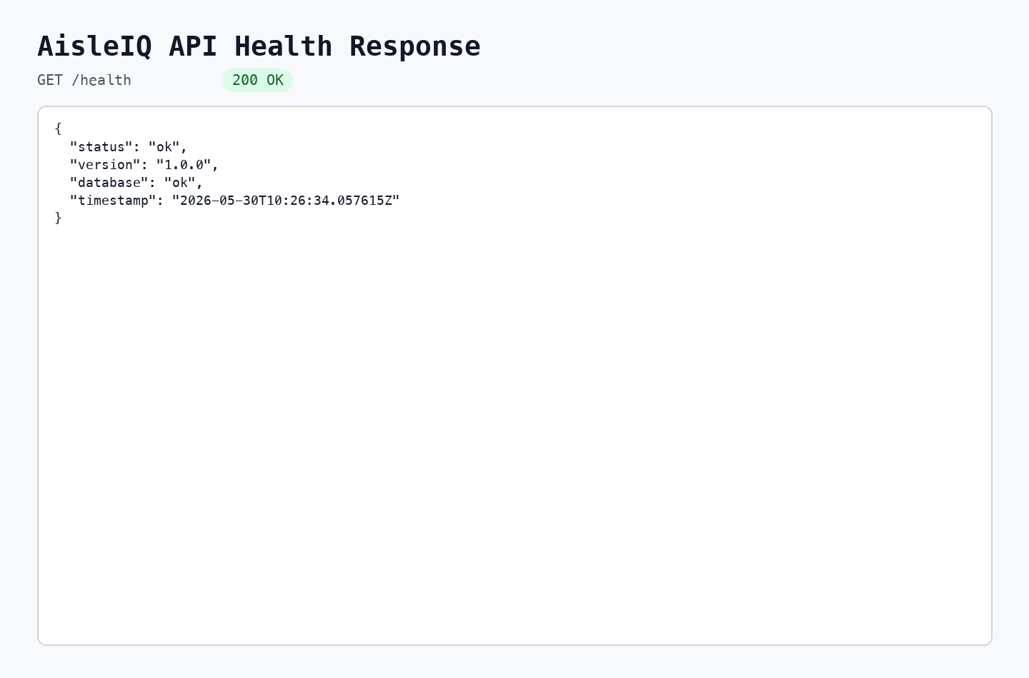
READINESS
Verification includes the running services and automated tests.
The project has enough product, API, and test evidence for submission.
Backend
FastAPI service with documented routes and SQLite persistence
Dashboard
Streamlit interface for upload, processing, analytics, events, alerts, and jobs
Computer vision
YOLO-based detection path plus fallback detector for local execution
API checks
Health and jobs endpoints validated through live docs and responses
Health endpoint response
Tests
55 tests passed with one non-blocking dependency warning
The demo is not just visual: the API, docs, dashboard, snapshots, and code are all in the repo.
AisleIQ pitch deck
08

Slide 9
SUBMISSION
Use this deck as the Presentation upload file.
AisleIQ is packaged for review: title, description, snapshots, deck, and GitHub repo.
01
Submit
02
Demo
03
Extend
Upload this PPTX, the screenshots under docs/submission-snapshots, and the title/description from docs/SUBMISSION.md.
Run the dashboard at localhost:8501 and the API docs at localhost:8000/docs for live walkthroughs.
Connect more cameras, add multi-store reporting, and train store-specific alert thresholds.
GitHub repository
github.com/Nagarjuna-Singarapu/aisleiq
Core thesis: existing store cameras can become a real-time operating layer when video is converted into structured events and decision surfaces.
AisleIQ pitch deck
09

