Slide 1


Mifos Summer Intern 2025 – Midterm Showcase
Mifos Mobile - End User Application v8.0
Midterm Presentation by B. Nagarjuna

Slide 2
Project Overview
Project Scope
Scheduled Payments: Allow users to schedule recurring payments and transfers.
Transaction Categorization: Automatic categorization of expenses for better financial tracking.
Redesign Dashboard with given Figma designs and Customizable Dashboard: Let users arrange and prioritize frequently used features.
In-App Customer Support: Real-time chat and customer support for immediate user assistance.
Release on IOS, Desktop platform
Midterm Goals
Migrate the project to KMP and CMP
Redesign entire application adopting new ui design
Resolve major bugs in existing codebase.

Slide 3

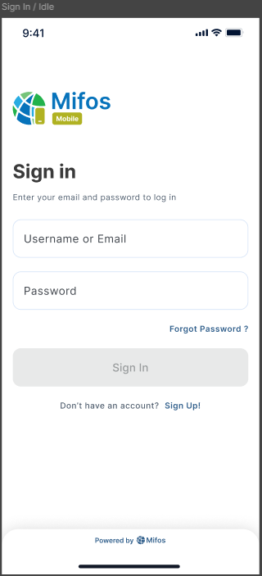
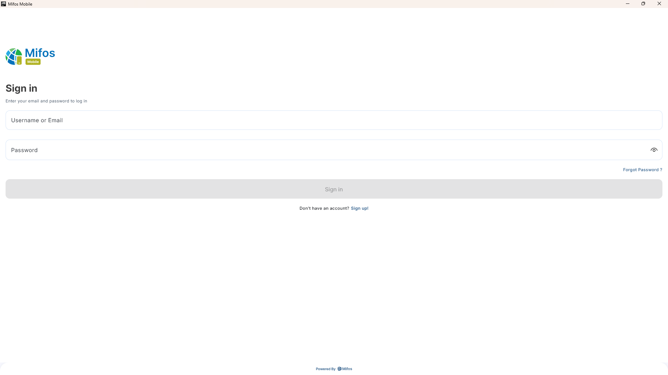
Kotlin Multiplatform Powering the Future
Write Once, Run Everywhere: Android • iOS • Web • JS • WASM
Android & iOS
Web & JS & WASM
Shared business logic across platforms, enabling consistent behavior and faster development cycles.
Native UI for each target, ensuring optimal user experience and performance on every device.

Slide 4
Modules Migrated to Kotlin Multiplatform
All modules were migrated with commonMain, androidMain, iosMain folder structures and expect/actual logic where needed.
Core Modules
Feature Modules
PR #2735 core-logs
PR #2772 feature-auth
PR #2739 core-network
PR #2785 feature-home
PR #2747 core-data
PR #2786 feature-loan
PR #2751 core-QrCode
PR #2799 feature-clientCharge
PR #2801 feature-tpt
PR #2803 feature-transferProcess
PR #2807 feature-beneficiary
PR #2809 feature-qr
PR #2815 feature-userProfile

Slide 5
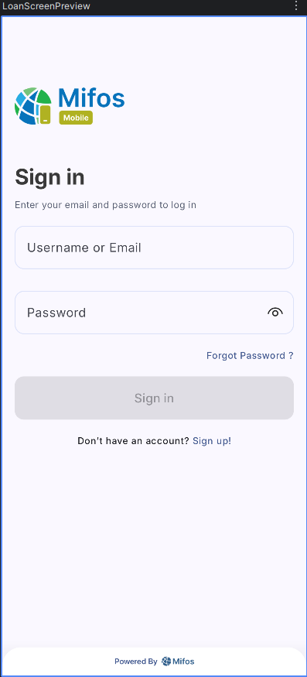
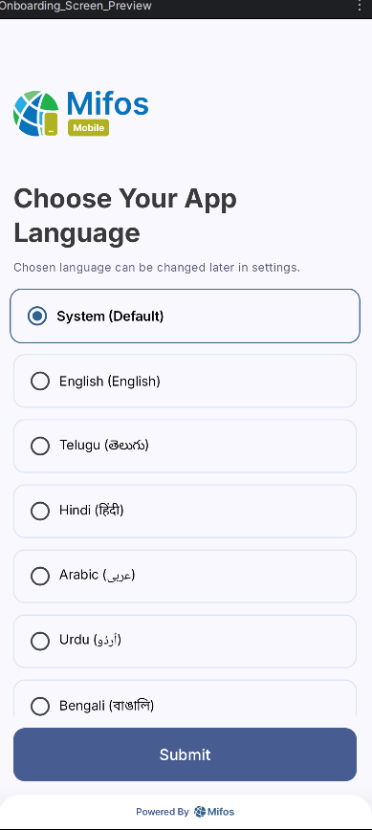

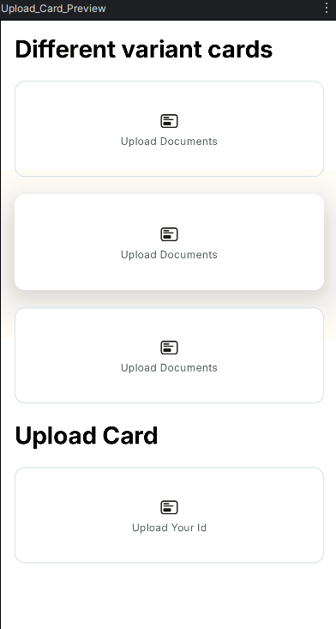

What I Have Done During Redesigning application UI
Designing the navigation architecture for smooth and seamless user flow across all app screens.
Created components
Created reusable UI components and implemented a consistent theme to ensure visual uniformity and efficiency across the application’s interface. These components enhance modularity, simplify maintenance, and align with the overall design system.
Redesigning Screens
Redesigned screens by closely following Figma designs to enhance user experience and maintain design consistency across the app.

Slide 6
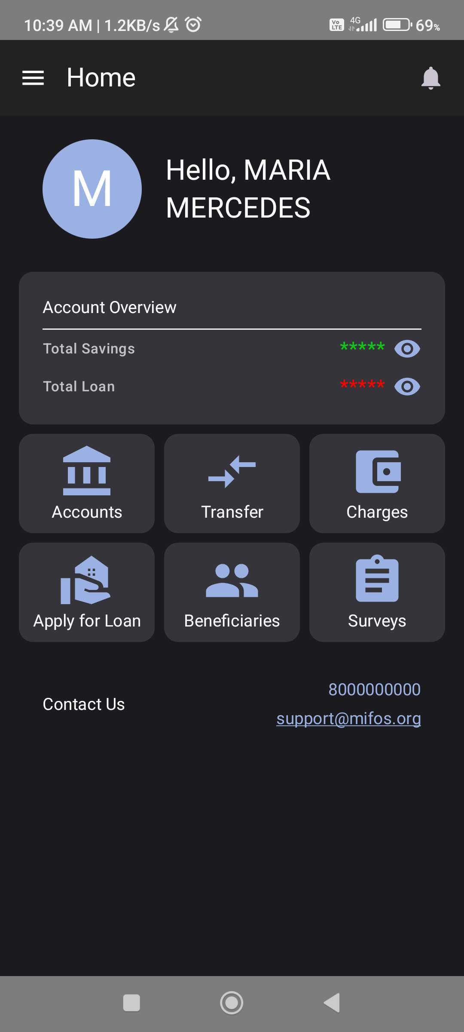
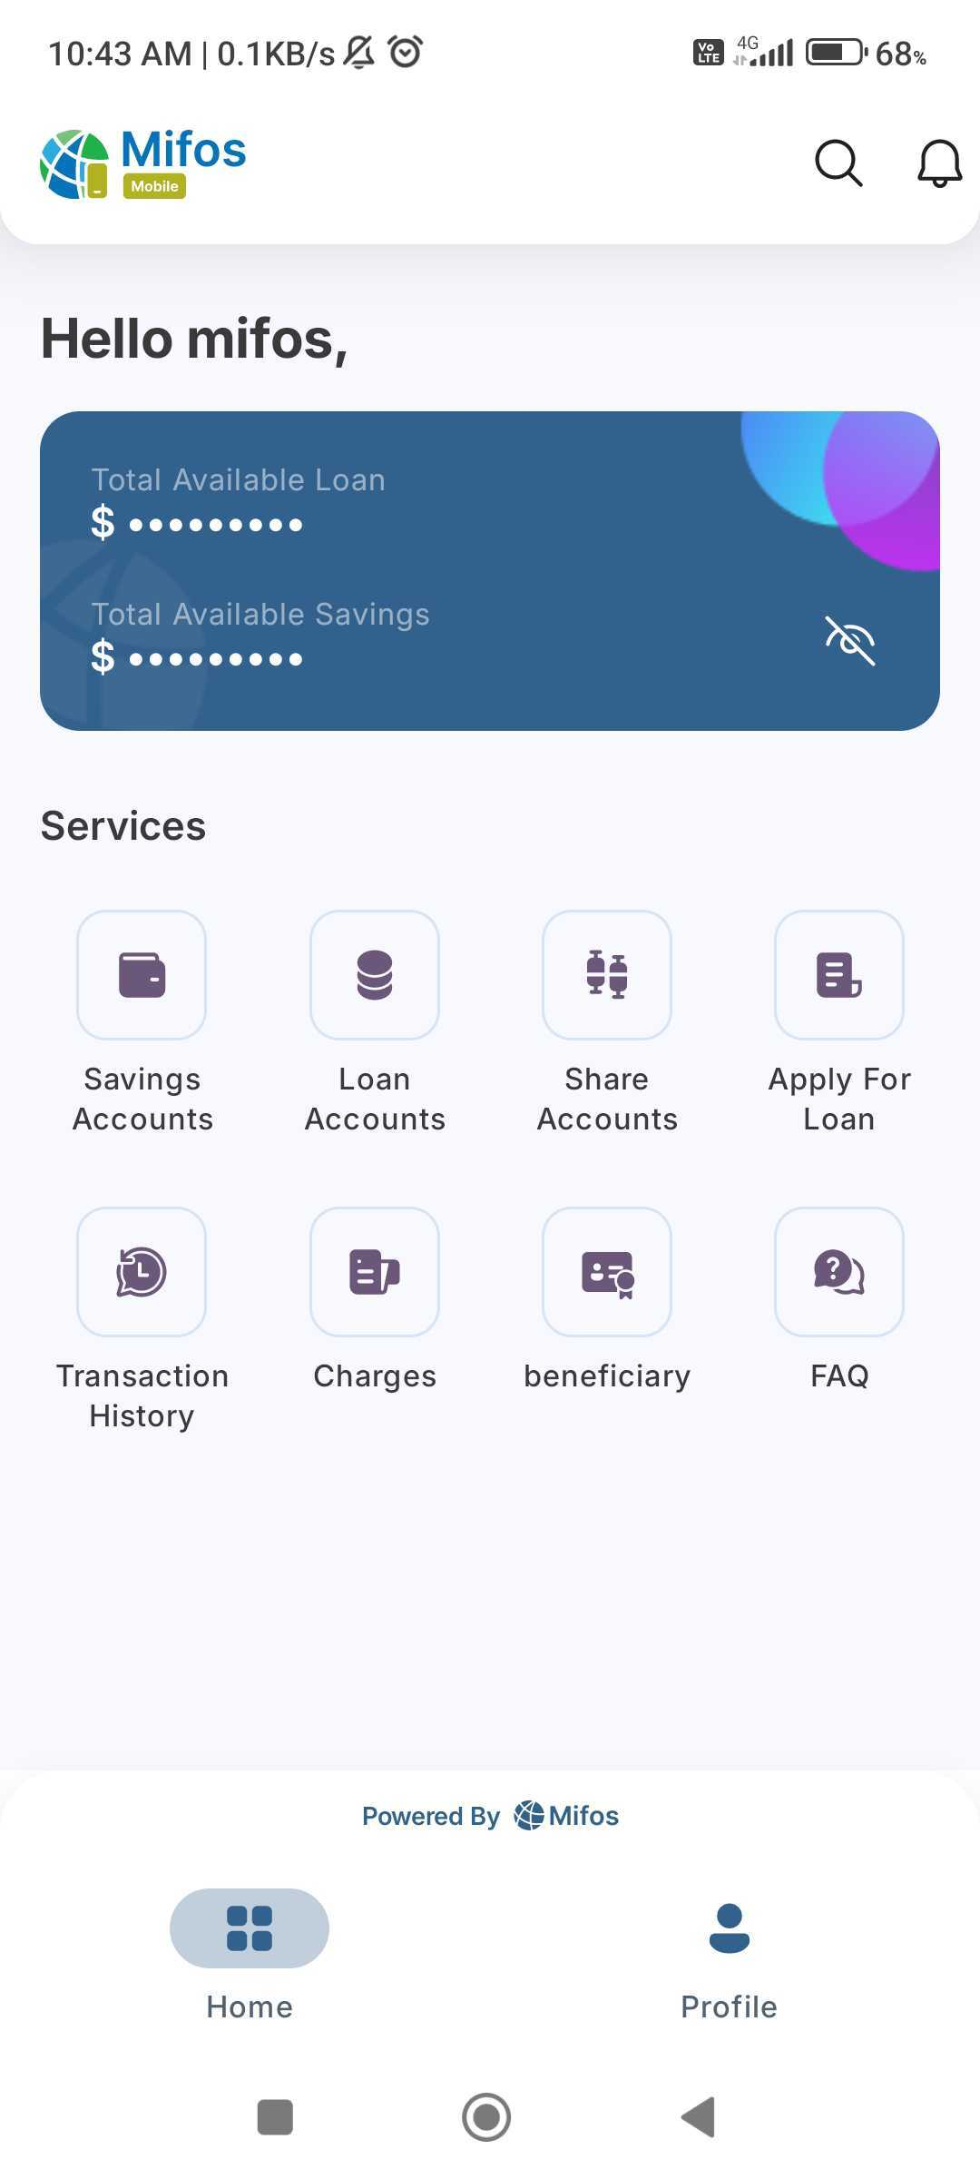

Home Dashboard

Slide 7
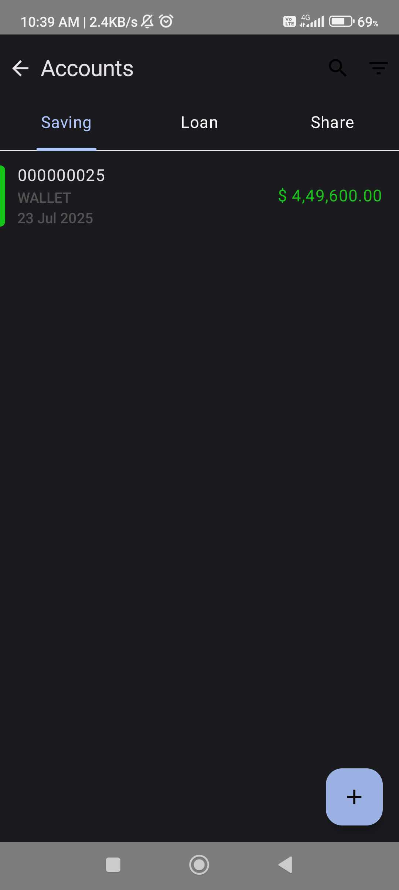
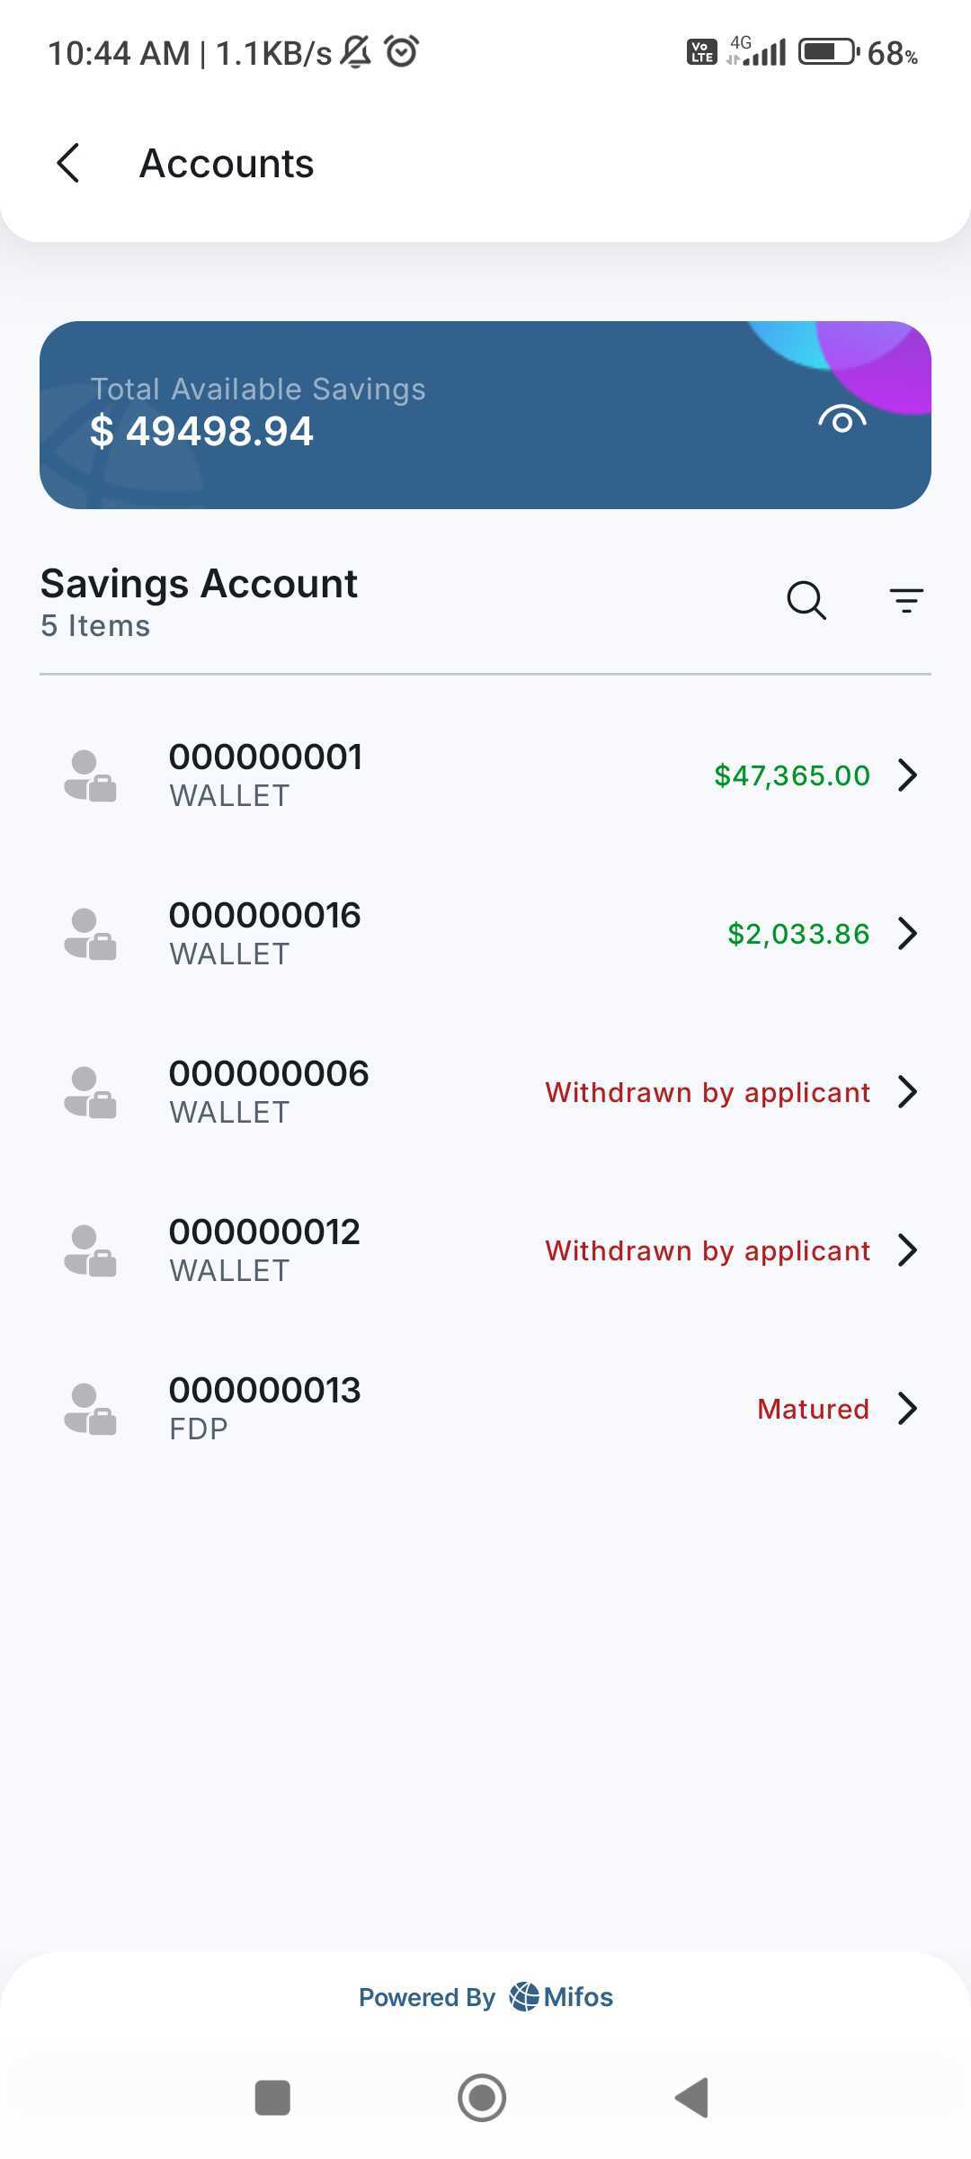
Accounts Screen

Slide 8
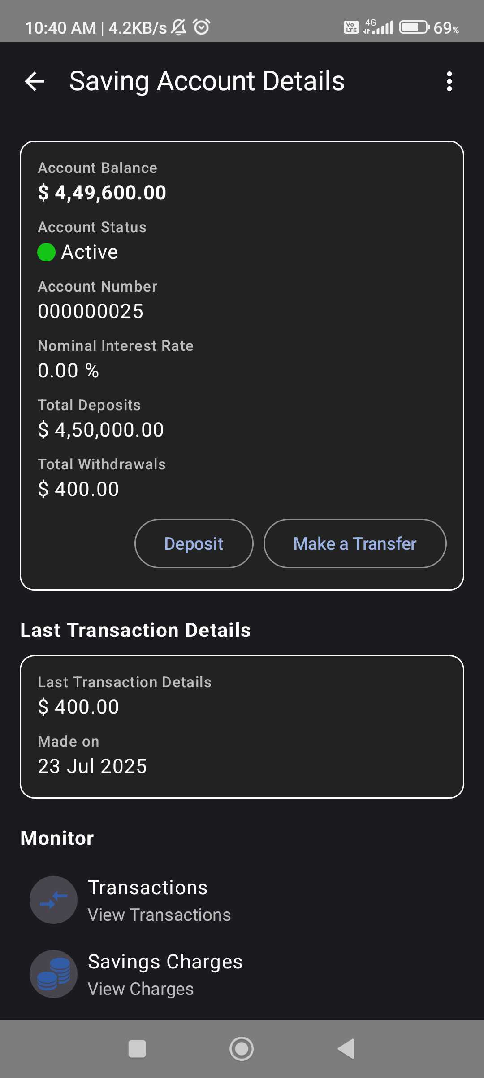
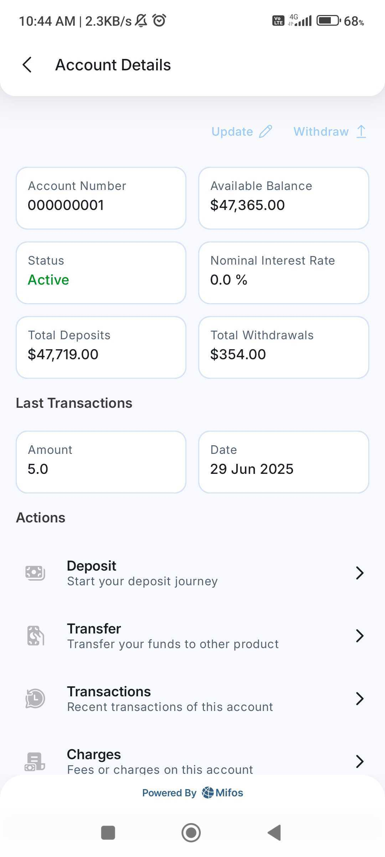
Saving Account Details

Slide 9
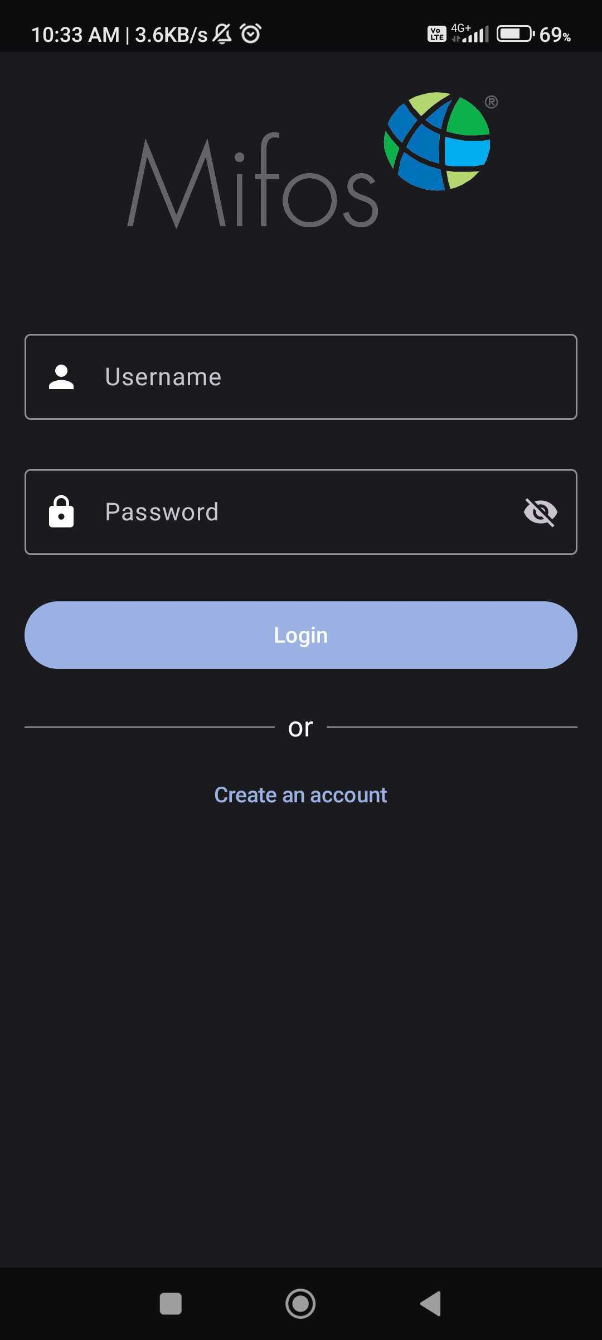
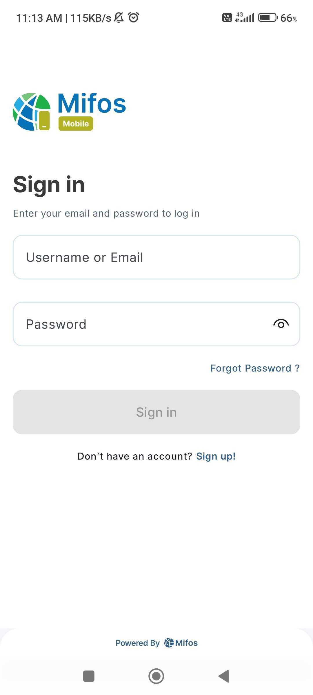
Sign in Screen

Slide 10
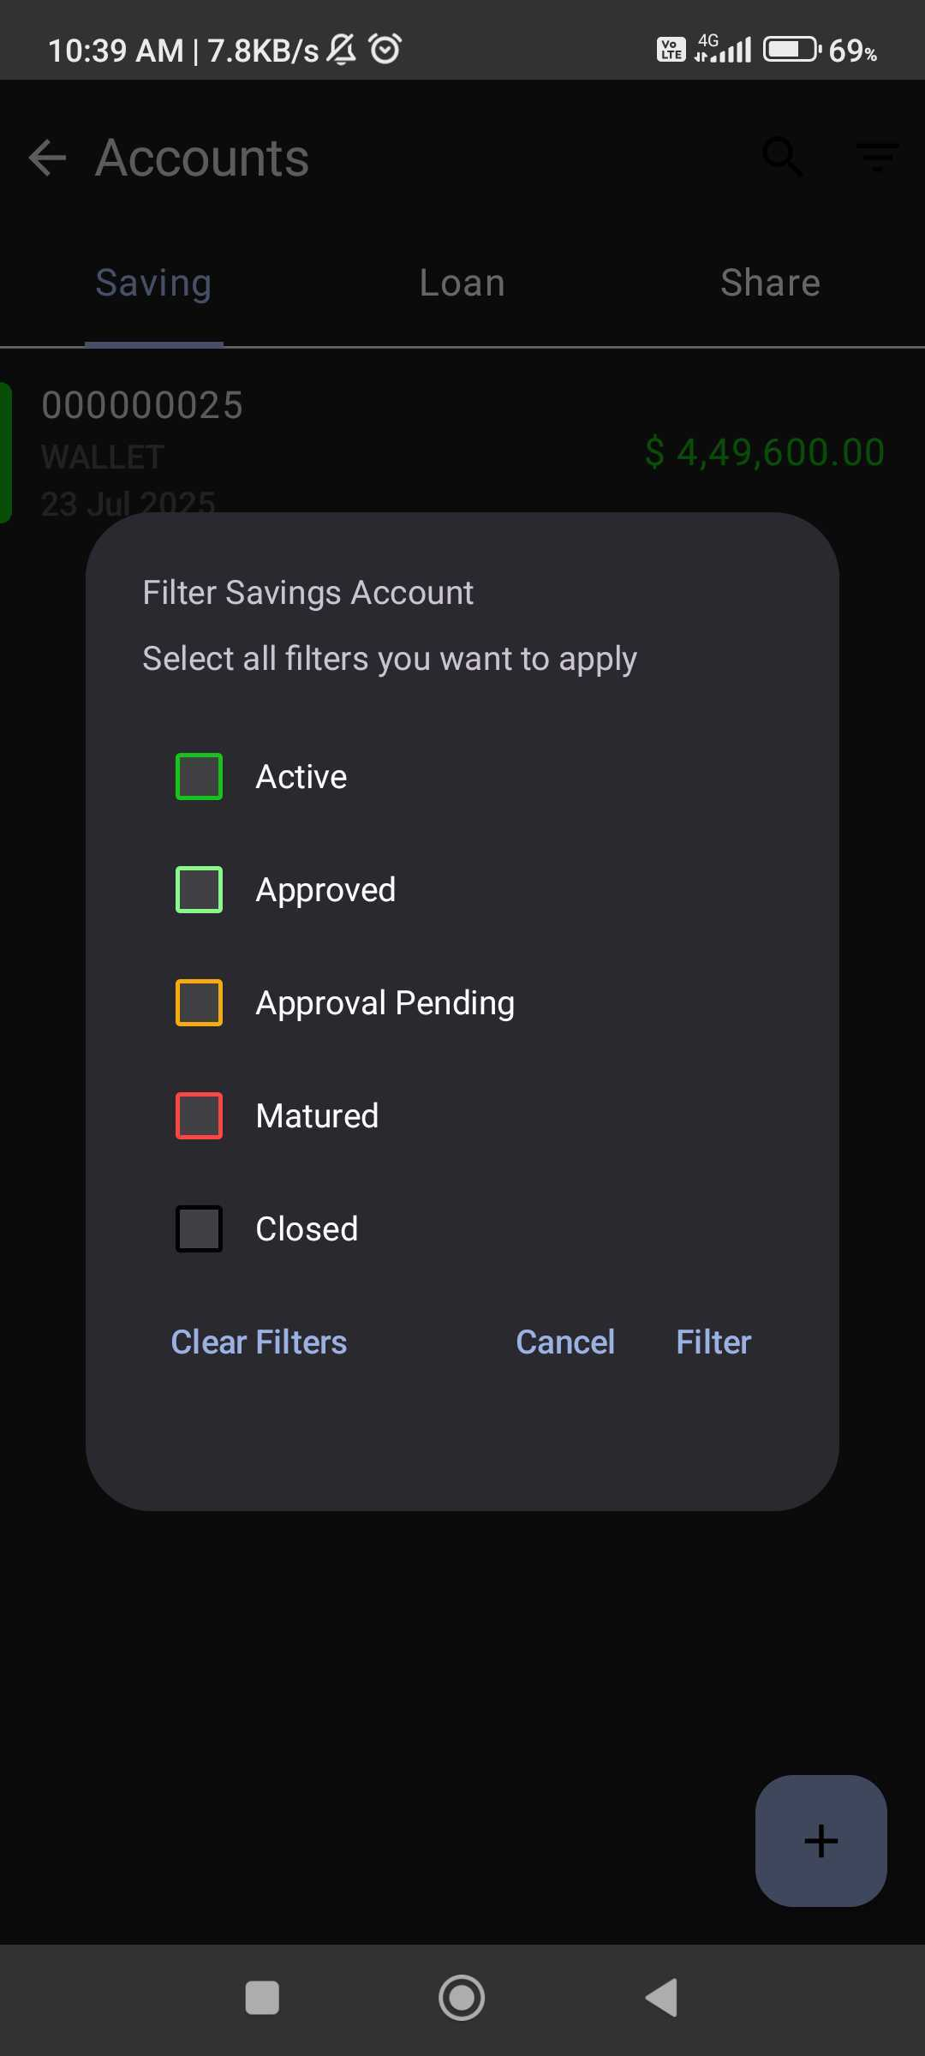
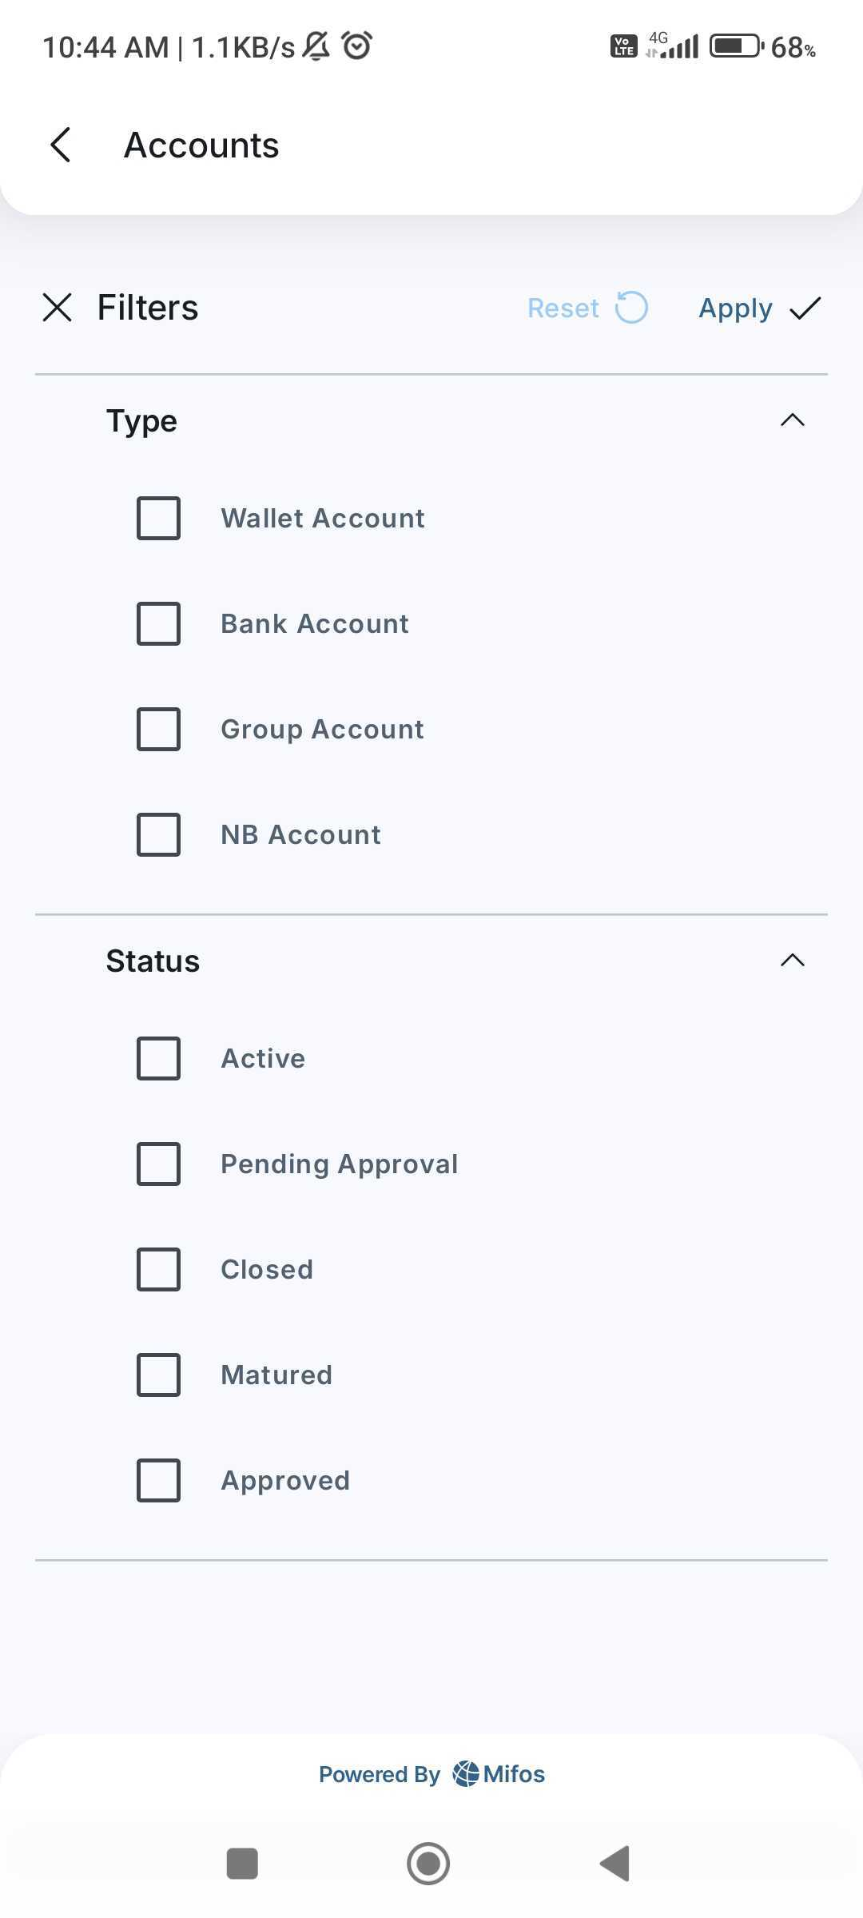
Account Filters

Slide 11
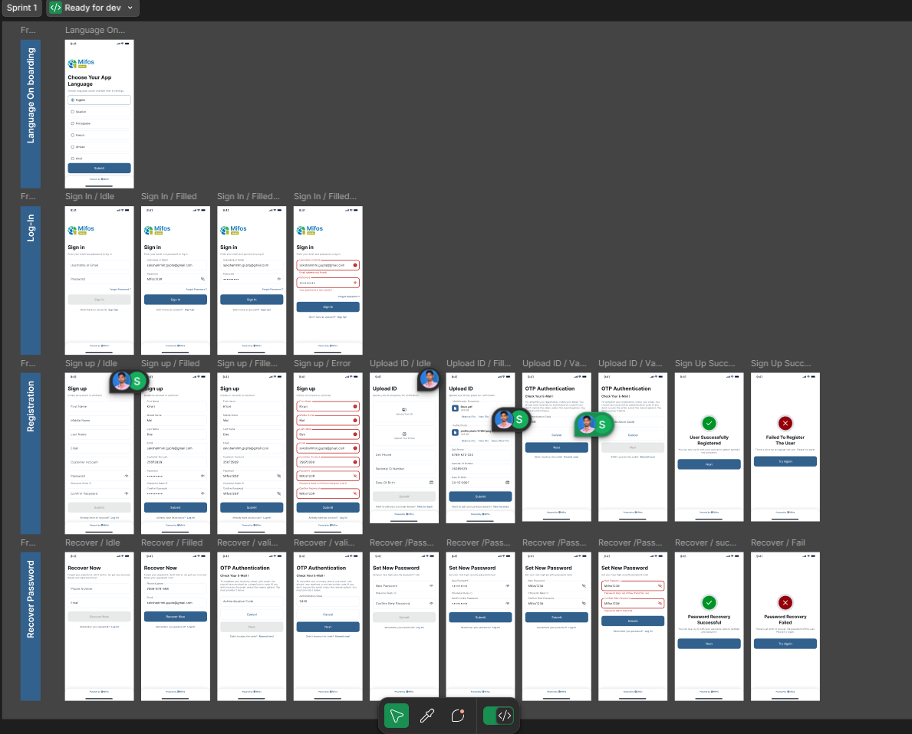
Sprint 1

Slide 12
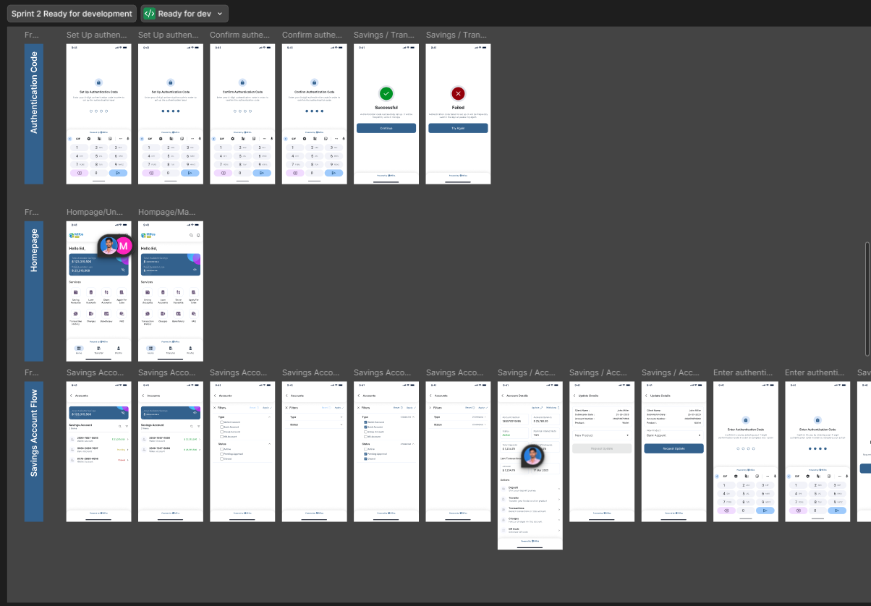
Sprint 2

Slide 13
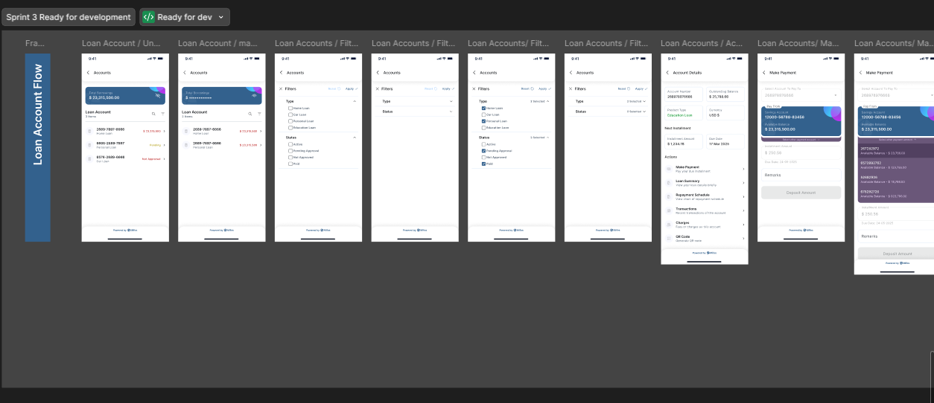
Sprint 3
We are heading into Sprint 4 and Sprint 5 of the Figma mockup phase, aiming to complete the remaining designs efficiently and stay aligned with our development timeline.

Slide 14
Bug Fixes & Contributions in Mifos Mobile
feat: setup theme and typography
8
feat: status component
1
[PR # 2846]
[PR # 2852]
refactor: radio button component
9
feat: Sign up UI view model
2
[PR # 2847]
[PR # 2853]
feat: Customized Card
10
feat: upload id ui & viewModel
3
[PR # 2848]
[PR # 2854]
feat: uploaded state component
11
feat: otp authentication ui & viewModel
4
[PR # 2849]
[PR # 2855]
feat: onboarding language screen ui & viewModel
12
feat: recover password ui & viewModel
5
[PR # 2850]
[PR # 2856]
Sign in ui and view model
13
feat: set new password ui & viewModel
6
[PR # 2851]
[PR # 2857]

Slide 15
Bug Fixes & Contributions
14
refactor: enhance navigation & screens
20
refactor: signup flow
[PR # 2858]
[PR # 2868]
fix: desktop compose plugin version & navigation
21
feat: account label card
15
[PR # 2859]
[PR # 2870]
feat: home ui & viewModel
22
feat: account details ui & viewModel
16
[PR # 2860
[PR # 2872]
feat: passcode ui & viewModel
23
feat: update account ui & viewModel
17
[PR # 2861]
[PR # 2875]
feat: savings account ui & viewModel
24
18
feat: withdraw savings account ui & viewModel
[PR # 2862]
[PR # 2877]
feat: savings account filters & generic account module
25
feat: loan account ui & viewModel
19
[PR # 2879]
[PR # 2865]

Slide 16
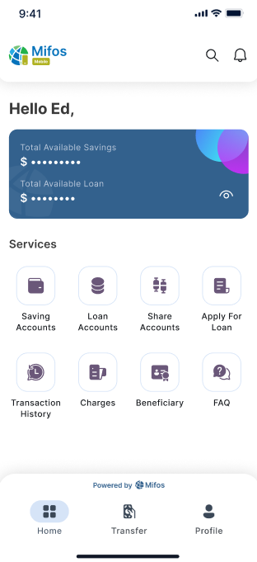



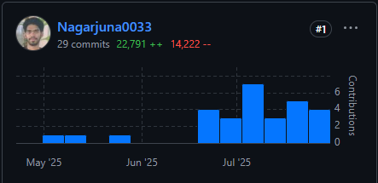
UI Refactoring
Modern Layouts
Refactored multiple screens using the latest Figma UI designs.
Replaced outdated UI with modern layouts and components.
Type-Safe Navigation
Migrated to type-safe navigation for better structure and maintainability.

Slide 17
Phase 2 – Future Plans
1
Scheduled Payments
Allow users to schedule recurring payments and transfers.
2
Transaction Categorization
Automatic categorization of expenses for better financial tracking.
3
Release on IOS, Desktop platform

Slide 18
Grateful for the Opportunity
I sincerely thank the Mifos Initiative and my mentors for their unwavering support and guidance.
🙏 Looking forward to continuing this journey and making meaningful contributions ahead!

