Slide 1

San Francisco building permits time prediction.
Nagarjuna Gottipati

Slide 2
Overview
In-house permits
The Department of Building Inspection of San Francisco reviews every building permit application for life safety and building code compliance. We review complex projects In-House. We accept In-House Projects for electronic plan review (EPR) or with paper plans.

Slide 3
Problem Statement
The Objective of this task is to predict permit issue times of various building permits so as to identify which ones matter more and also be able to draw conclusions on the city's development plans based on the San Francisco Building Permits data.

Slide 4
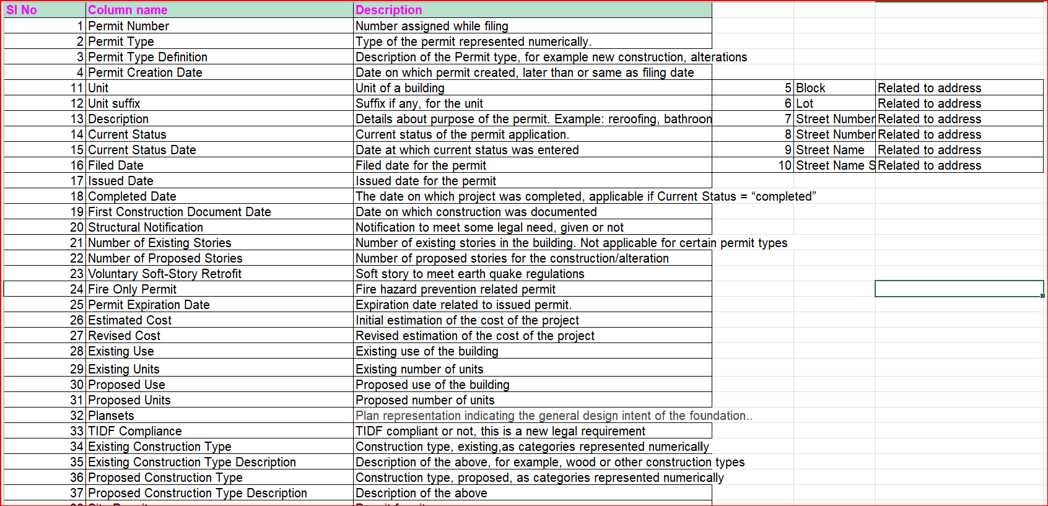
Dataset Info
https://sf.gov/information/building-construction-type-definitions

Slide 5
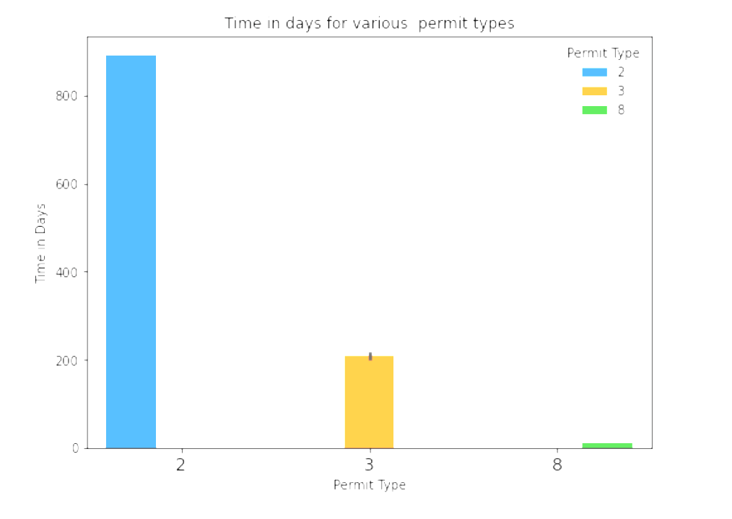
EDA
It can be observed that Permit type of category 8 take the least time to process, followed by permit type 3 while permit type 2 take the most time on average to process.

Slide 6
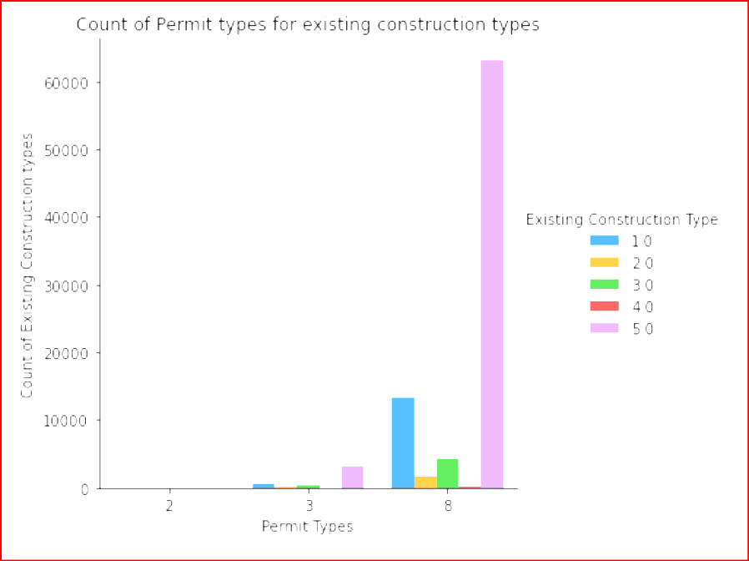
EDA
The most construction types permits issued belong to Existing Construction type 5.0 which is reflected across the major permit types 8 and 3, then followed by construction type 1.0 ,3.0,2.0 and least number of permits belong to construction type 4.0.

Slide 7
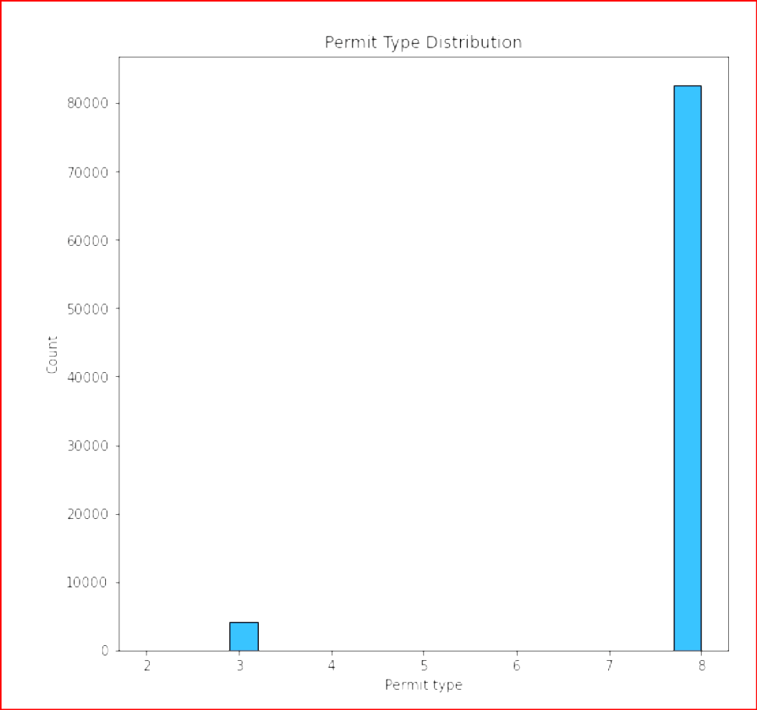
EDA
The histogram above shows that other permit types categories 2,4,5,6,7 do not have a significant count of records. Permit types categories 8 and 3 are the common permit types to be issued.

Slide 8
Most Important features in prediction.
1) Permit Type_8
2) Permit Type Definition addition
6) Plansets
5) Permit Type_3
3) repairs Permit Type
4) Definition otc alterations permit

