Slide 1
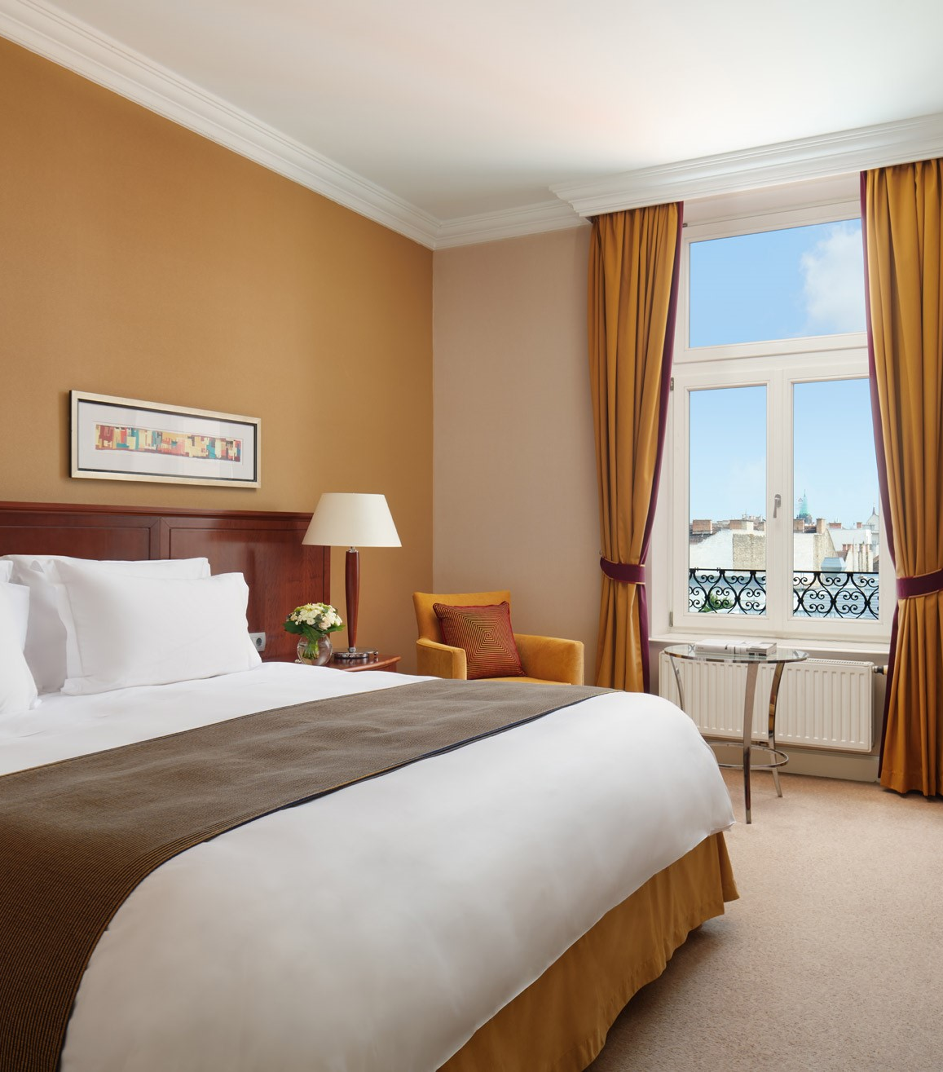

Predicting Hotel Booking Cancellations
Nagarjuna Gottipati
Source: allaboutberlin.com. (n.d.).

Slide 2
Overview
According to D-Edge Hospitality Solutions, part of the Accor-owned hotel technology group, global hotel cancellation rates on bookings have reached 40% on average. Booking cancellations are always a headache for hotels, in turn causing hotels to lose profits. It is thus imperative from a cost-saving perspective to find out what causes hotel booking cancellations to rise, and how to mitigate this rise.

Slide 3

Problem Statement
Predicting booking cancellations of customers beforehand to attend the concerned customer problems.
Source : n26.com. (n.d.)

Slide 4
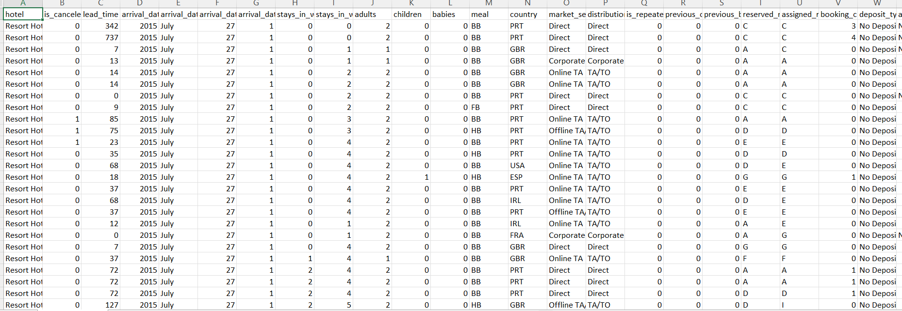
Dataset Info
Source : n26.com. (n.d.)

Slide 5
Questions to be Answered
1) How many bookings were canceled?
6) Which month has the highest number of cancellations?
2) Which month has the highest number of visitors?
5) Which customer type contributes to the most hotel booking cancellations?
3) What is the monthly average daily rate per person over the year?
4) Which country has the most number of hotel visitors?

Slide 6
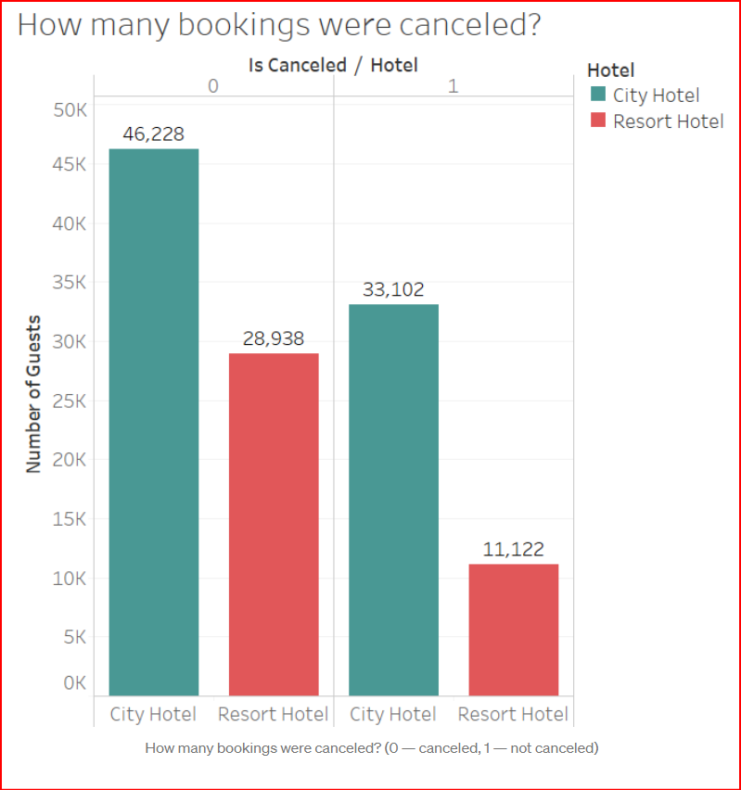
EDA
Out of 119,390 hotel bookings, a total of 37.04% of bookings were canceled.

Slide 7
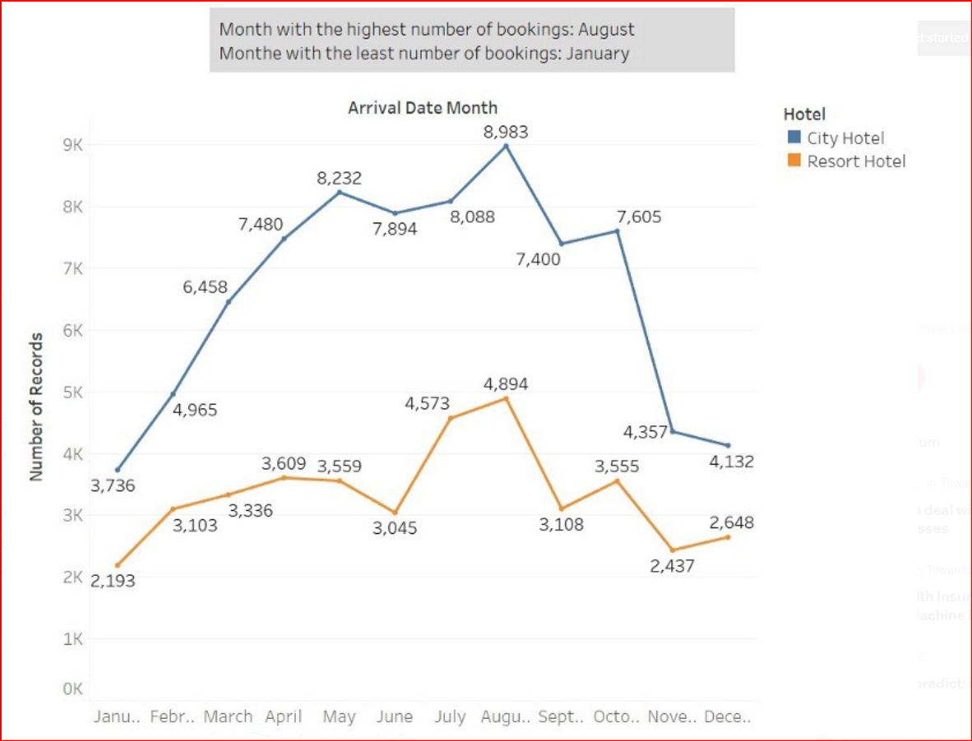
EDA
There is steady increase in bookings from January to August, with a slight dip in June and peak in August.
This is followed by a sharp fall in bookings from August back to January.

Slide 8
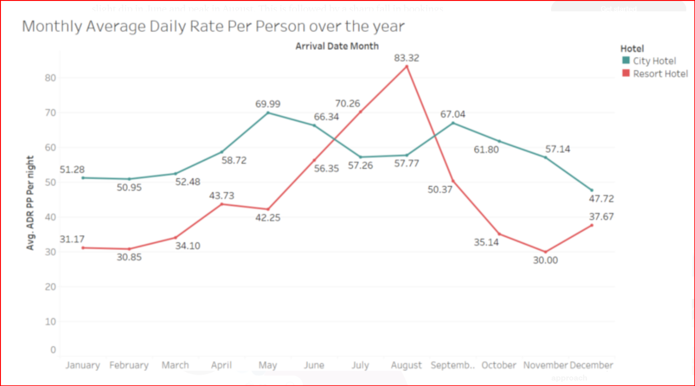
EDA
The monthly average daily rate per person (ADR PP) closely follows the volume of bookings per month, with the highest ADR PP in August and lowest ADR PP in January.

Slide 9
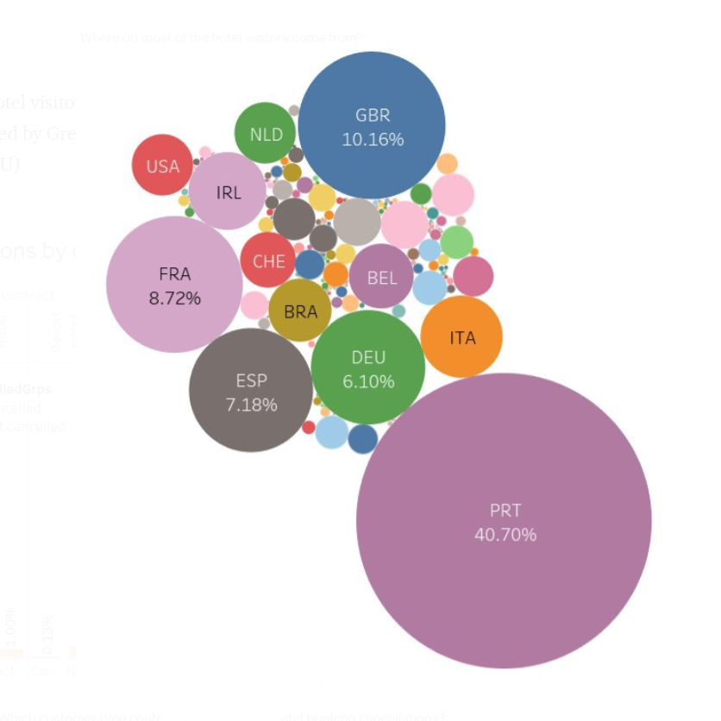
EDA
Most of the hotel visitors are Europeans, with a majority coming from Portugal (PRT), followed by Great Britain (GBR), France (FRA), Spain (ESP) and Germany (DEU).

Slide 10
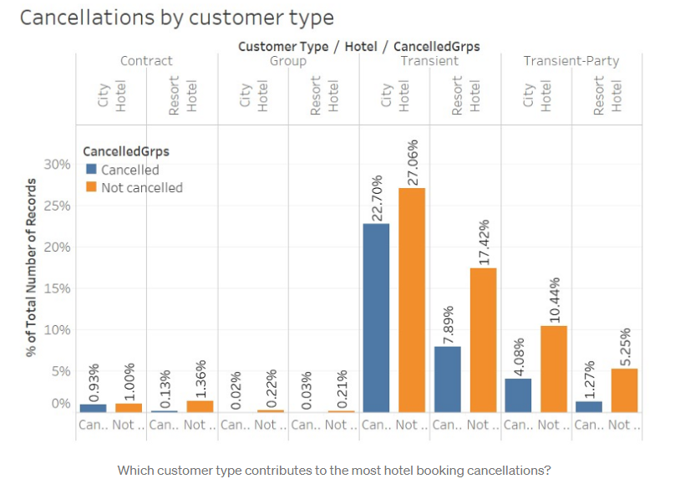
EDA
The largest percentage of customers who cancel bookings belong to the Transient customer type (Transient — when the booking is not part of a group or contract and is not associated with other transient bookings).

Slide 11
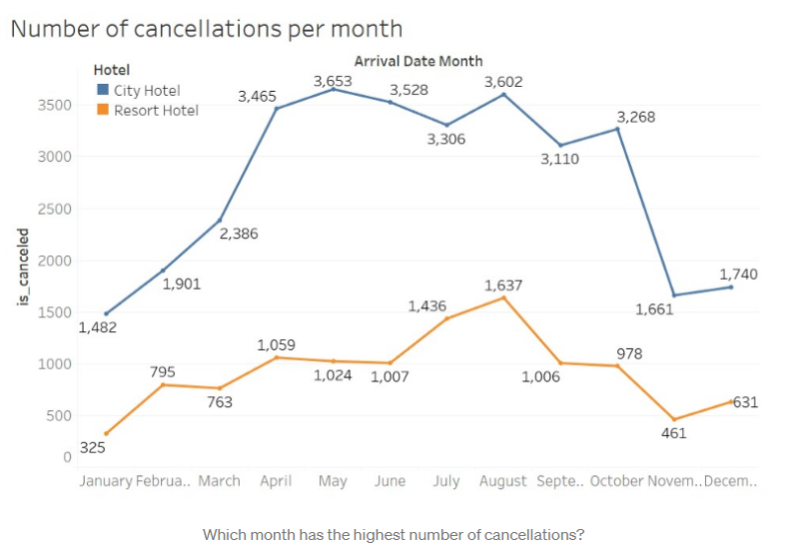
EDA
August sees the highest number of cancellations. This is also unsurprising, given that the number of cancellations per month closely follows that of the volume of bookings per month.

Slide 12
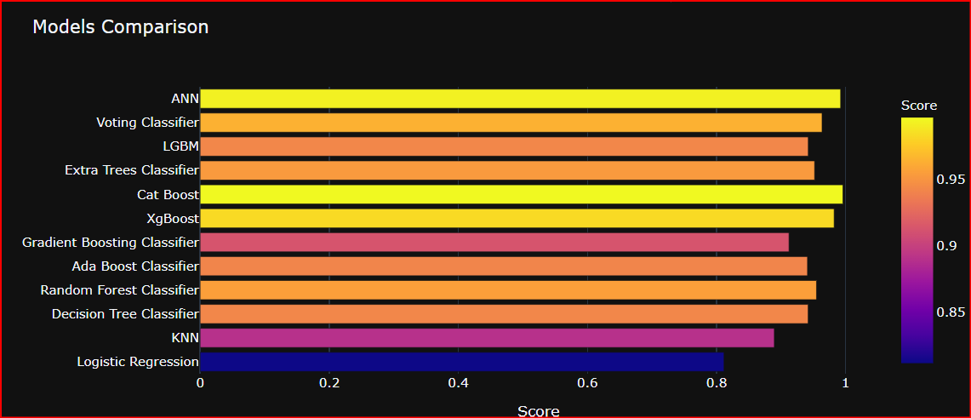
Model Comparison
After building Various types of models, we found that XG boost is best for modelling the problem.
Source : The World Bank (2021)

Slide 13
Strategies to tackle booking cancellations
Hotels can look into the specific time periods when cancellation rate is high and price accordingly. During periods with high cancellation rates, hotels can oversell by implementing some time-related discounts or certain cancellation conditions to optimize the occupancy rate. Implementing this strategy would help to mitigate the consequences of last-minute cancellations.
Looking into the lead time can help to reduce hotel cancellations. Hotels can consider changing their cancellation conditions, through setting a maximum advance booking restriction. For instance, guests can only book rooms at most 2 months in advance, hence reducing high lead times and a reduction in the number of cancellations. However, it is important to note that setting such restrictions could have possible negative consequences on the hotel’s sales and bottom line.
Hotels can take into account the total number of special requests to reduce the possibility of cancellations. They can do so by improving their customer service, such as being able to cater to most of the customers’ special requests.
Using arrival_date_week_number
Using lead_time
Using Total_of_special_requests
Source: Anon, (2018)

Slide 14
Business Summary
From our EDA we observed that a majority of the hotel customers were transient customers, with less than 5% of bookings from groups or contracts. So investing more resources in establishing contracts with event companies or attracting travel groups.
Hotels should also dive deeper into operational processes during their peak season, such as August, to ensure that they are no bottlenecks that are preventing them from maximizing their occupancy rate during this season.
Diversification of customer mix
Booking Trends
Source: Magana, G. (n.d.)

