Slide 1
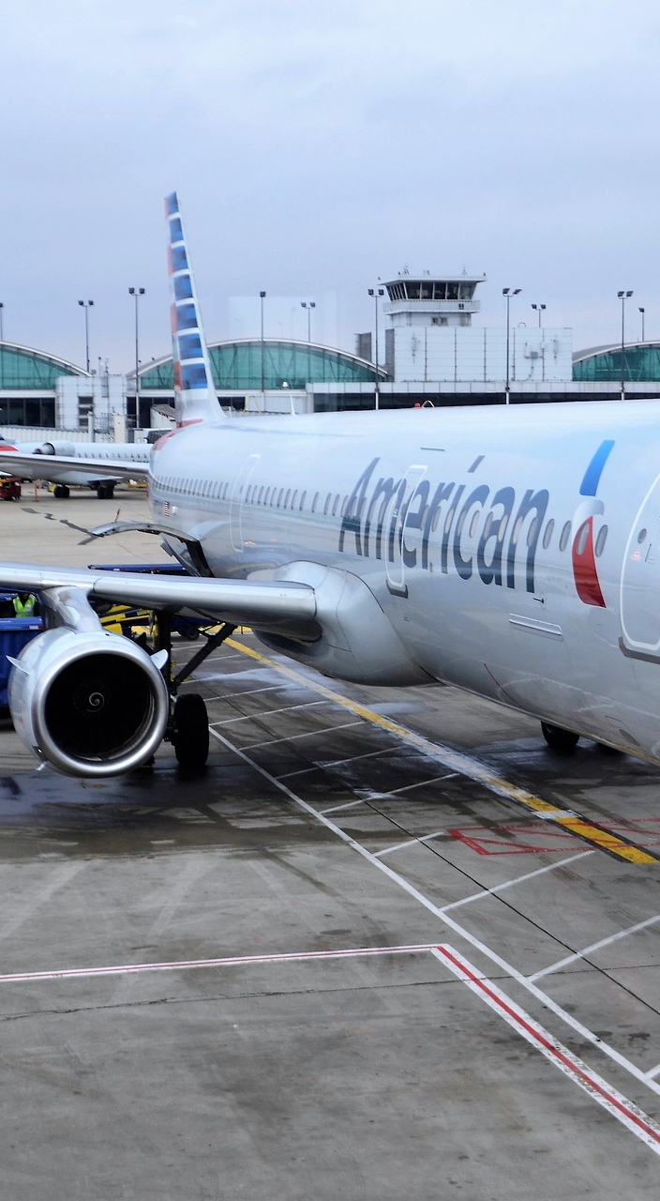
Predicting Satisfaction of Airline Passengers
Nagarjuna Gottipati

Slide 2
1. Introduction
Obtained about 130k of flight satisfaction surveys from Kaggle.
Data is taken from passengers from a US airline.
Goal: Identify critical factors that ensure satisfaction.
Focus on Precision of our machine learning model.

Slide 3
2. Data Overview
Target
 | Satisfaction | Gender | Customer Type | Age | Type Of Travel | Class | Flight Distance | Inflight Wifi Service | Departure/ Arrival Time Convenience | Ease Of Online Booking | Gate Location | Food And Drink | Online Boarding | Seat Comfort | Inflight Entertainment | On-board Service | Leg Room | Baggage Handling | Checkin Service | Inflight Service | Cleanliness | Total Delay
0 | Neutral/ Dissatisfied | Male | Returning Customer | 13 | Personal Travel | Economy | 460 | 3 | 4 | 3 | 1 | 5 | 3 | 5 | 5 | 4 | 3 | 4 | 4 | 5 | 5 | 43.0
1 | Neutral/ Dissatisfied | Male | First-time Customer | 25 | Business travel | Business | 235 | 3 | 2 | 3 | 3 | 1 | 3 | 1 | 1 | 1 | 5 | 3 | 1 | 4 | 1 | 7.0
2 | Neutral/ Dissatisfied | Female | Returning Customer | 25 | Business travel | Business | 562 | 2 | 5 | 5 | 5 | 2 | 2 | 2 | 2 | 2 | 5 | 3 | 1 | 4 | 2 | 20.0
3 | Satisfied | Male | Returning Customer | 61 | Business travel | Business | 214 | 3 | 3 | 3 | 3 | 4 | 5 | 5 | 3 | 3 | 4 | 4 | 3 | 3 | 3 | 0.0
4 | Neutral/ Dissatisfied | Female | Returning Customer | 26 | Personal Travel | Economy | 1180 | 3 | 4 | 2 | 1 | 1 | 2 | 1 | 1 | 3 | 4 | 4 | 4 | 4 | 1 | 0.0
... | ... | ... | ... | ... | ... | ... | ... | ... | ... | ... | ... | ... | ... | ... | ... | ... | ... | ... | ... | ... | ... | ...
69061 | Neutral/ Dissatisfied | Female | First-time Customer | 36 | Business travel | Economy | 432 | 1 | 5 | 1 | 3 | 4 | 1 | 4 | 4 | 5 | 2 | 5 | 2 | 3 | 4 | 0.0
69062 | Neutral/ Dissatisfied | Male | First-time Customer | 34 | Business travel | Business | 526 | 3 | 3 | 3 | 1 | 4 | 3 | 4 | 4 | 3 | 2 | 4 | 4 | 5 | 4 | 0.0
69063 | Neutral/ Dissatisfied | Female | Returning Customer | 17 | Personal Travel | Economy | 828 | 2 | 5 | 1 | 5 | 2 | 1 | 2 | 2 | 4 | 3 | 4 | 5 | 4 | 2 | 0.0
69064 | Satisfied | Male | Returning Customer | 14 | Business travel | Business | 1127 | 3 | 3 | 3 | 3 | 4 | 4 | 4 | 4 | 3 | 2 | 5 | 4 | 5 | 4 | 0.0
69065 | Neutral/ Dissatisfied | Female | Returning Customer | 42 | Personal Travel | Economy | 264 | 2 | 5 | 2 | 5 | 4 | 2 | 2 | 1 | 1 | 2 | 1 | 1 | 1 | 1 | 0.0

Slide 4
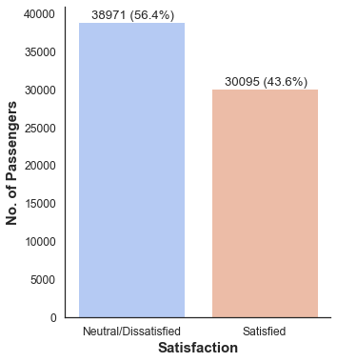
3. EDA and Feature Selection
The sample is more or less balanced .

Slide 5
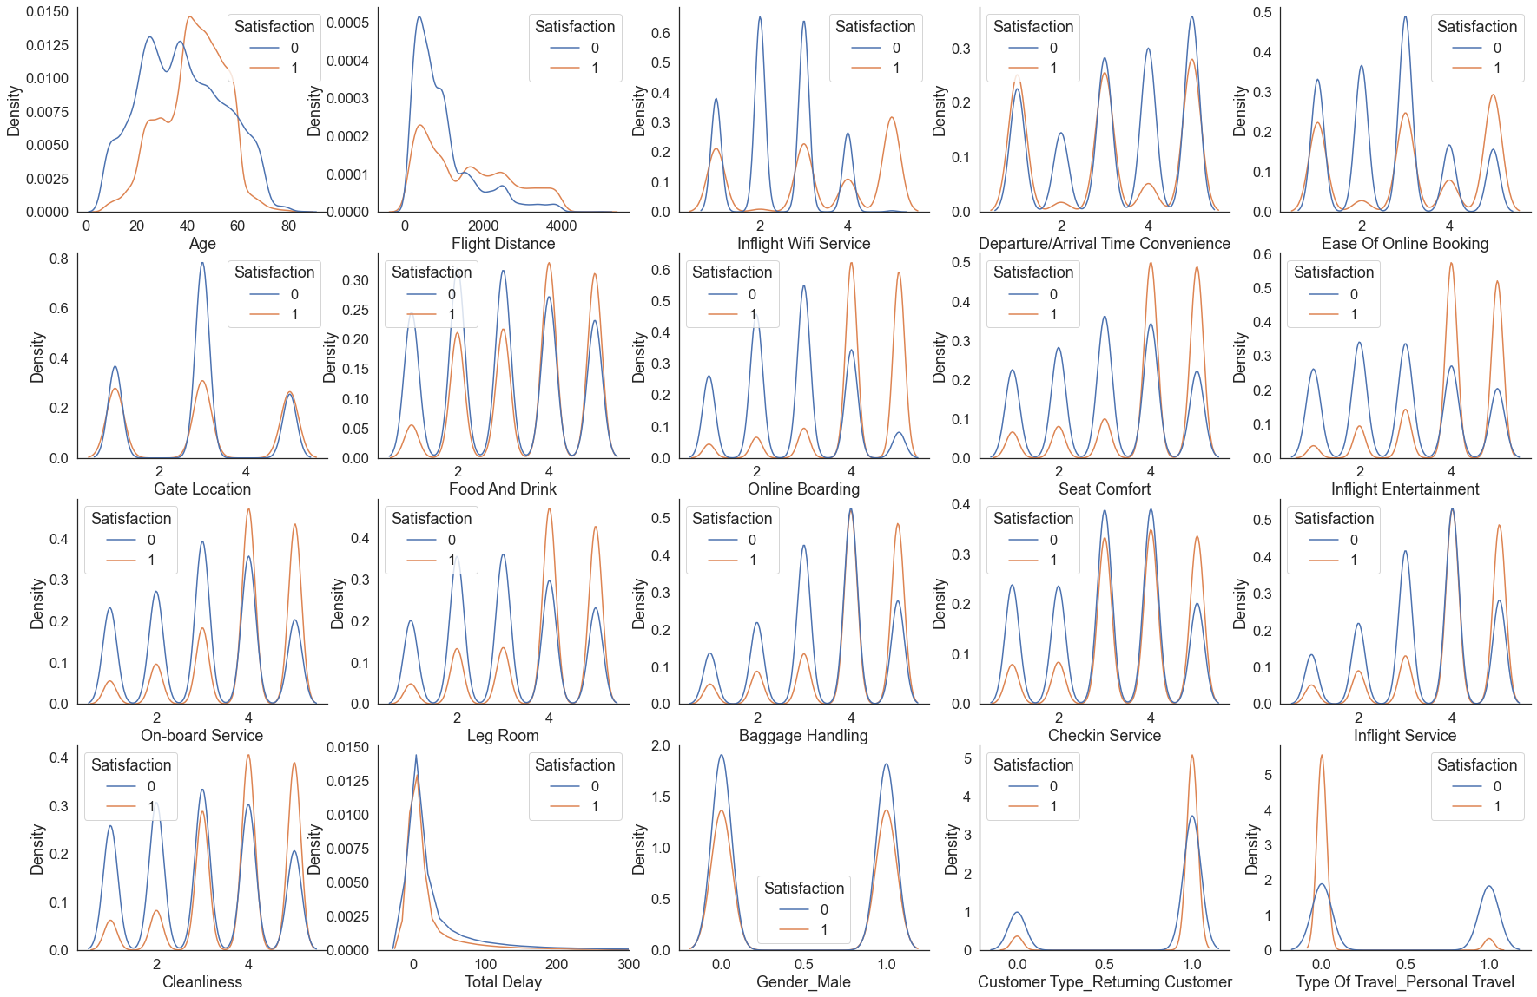
2. EDA and Feature Selection

Slide 6
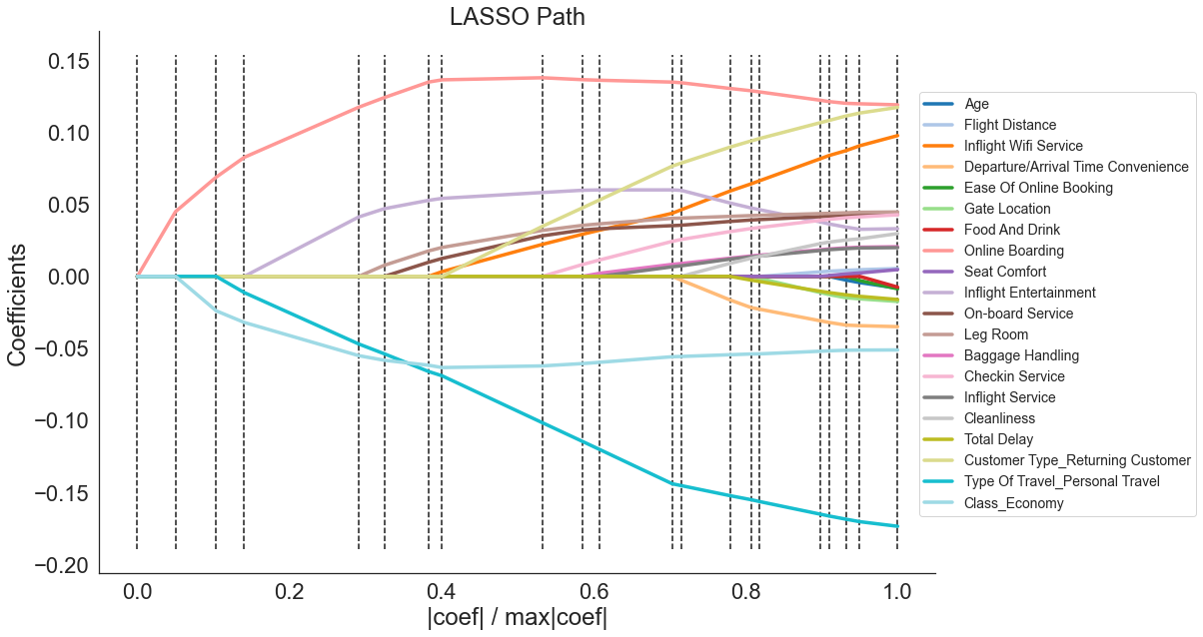
2. EDA and Feature Selection

Slide 7
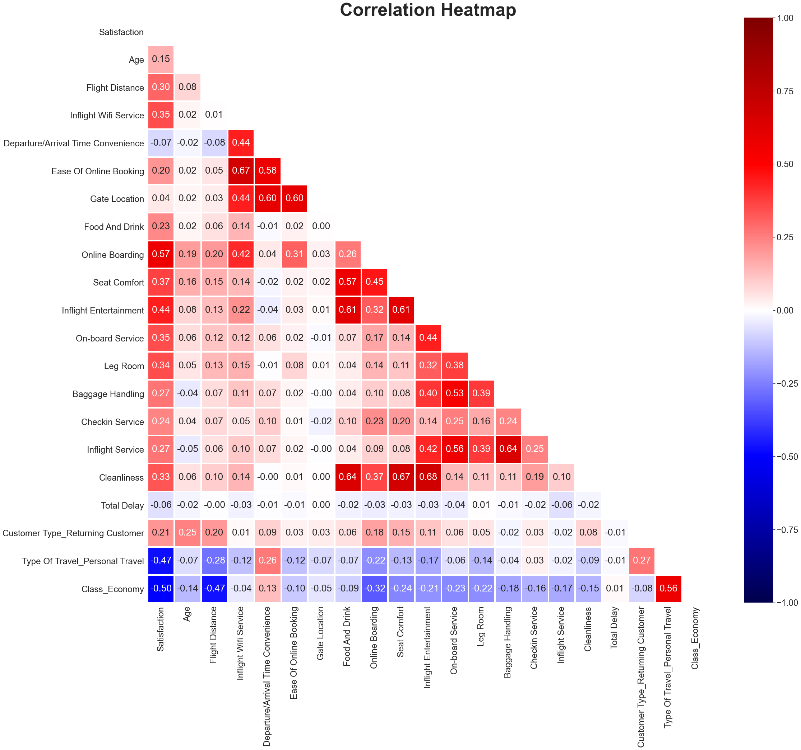
Final Feature Selection
Features to drop:
Gender
Age
Gate Location
Total Delay
Flight Distance
Departure/Arrival Time Convenience

Slide 8
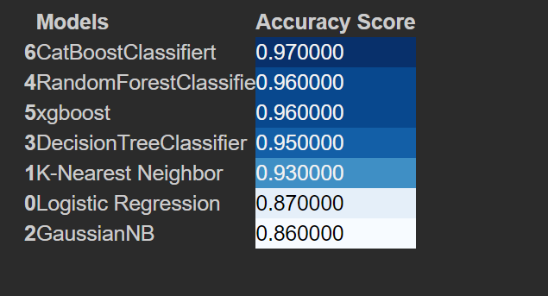
3. Model Selection
Cat boost is the best model after parameter tuning.

Slide 9
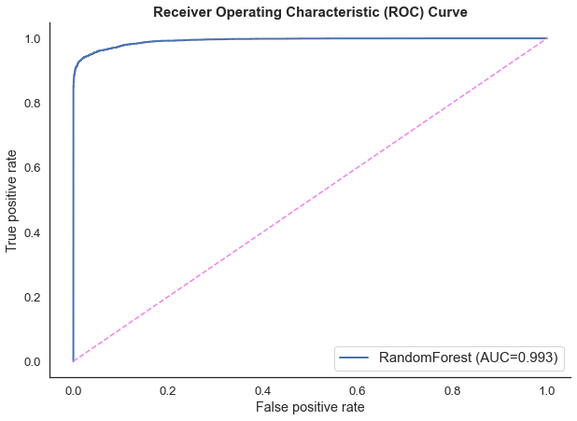
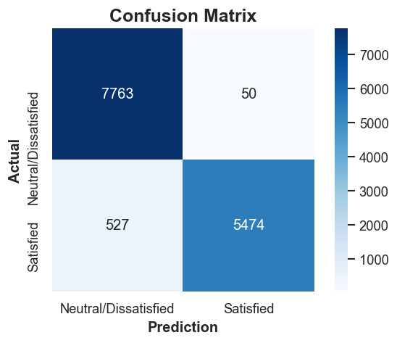
5. Model Evaluation – Test Set
PRECISION = 99.1%

Slide 10
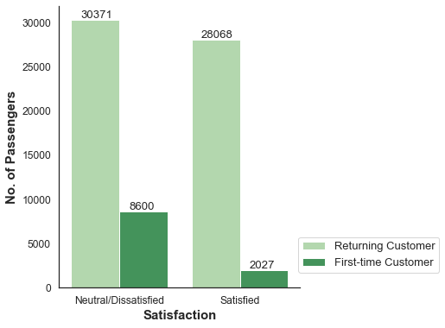
6. Business Problem
How to ensure satisfaction in first-time customers?

Slide 11
6. Business Problem
Economy Class & Personal Travel - First-time customers
Predicted Satisfaction | Inflight Wifi Service | Ease Of Online Booking | Food And Drink | Online Boarding | Seat Comfort | Inflight Entertainment | On-board Service | Leg Room | Baggage Handling | Checkin Service | Inflight Service | Cleanliness
Neutral/ Dissatisfied | 3 | 3 | 3 | 3 | 3 | 3 | 3 | 3 | 3 | 3 | 3 | 3
Satisfied | 5 | 3 | 3 | 3 | 3 | 3 | 3 | 3 | 3 | 3 | 3 | 3
Neutral/ Dissatisfied | 4 | 5 | 5 | 5 | 5 | 5 | 5 | 5 | 5 | 5 | 5 | 5
Neutral/ Dissatisfied | 3 | 5 | 5 | 5 | 5 | 5 | 5 | 5 | 5 | 5 | 5 | 5

Slide 12
6. Business Problem
Business Class & Business Travel - First-time customers
Predicted Satisfaction | Inflight Wifi Service | Ease Of Online Booking | Food And Drink | Online Boarding | Seat Comfort | Inflight Entertainment | On-board Service | Leg Room | Baggage Handling | Checkin Service | Inflight Service | Cleanliness
Neutral/ Dissatisfied | 3 | 3 | 3 | 3 | 3 | 3 | 3 | 3 | 3 | 3 | 3 | 3
Satisfied | 5 | 3 | 3 | 3 | 3 | 3 | 3 | 3 | 3 | 3 | 3 | 3
Satisfied | 3 | 5 | 5 | 5 | 5 | 5 | 5 | 5 | 5 | 5 | 5 | 5
Neutral/ Dissatisfied | 3 | 4 | 4 | 4 | 4 | 4 | 4 | 4 | 4 | 4 | 4 | 4
Satisfied | 3 | 5 | 4 | 4 | 4 | 4 | 4 | 4 | 4 | 4 | 4 | 4
Neutral/ Dissatisfied | 3 | 4 | 5 | 5 | 5 | 5 | 5 | 5 | 5 | 5 | 5 | 5

Slide 13
7. Conclusion & Future Work
Engineered a highly precise model that predicts satisfaction.
Airlines should highly focus on inflight wi-fi experience.
Ease of online booking is important for business customers.
In the future, collect even more data.
Apply neural networks for both high precision and recall.

Slide 14
7. Conclusion & Future Work
Customers whose flight distance is long tend to fly in business class.
The more distance an airplane passenger travels (respectively, the longer they are in flight), the more satisfied they are with in-flight entertainment and extra legroom (on average).
Apply neural networks for both high precision and recall.

