Slide 1
Telecom Customer Churn
Nagarjuna Gottipati

Slide 2
Overview
Customer churn is defined as when customers or subscribers discontinue doing business with a firm or service.
Customers in the telecom industry can choose from a variety of service providers and actively switch from one to the next. The telecommunications business has an annual churn rate of 15-25 percent in this highly competitive market.

Slide 3
Problem Statement
Identifying the customer who has high probability of leaving and zero down on the reason for it. An analysis of the past records of the customers can give great insights on who might leave and what is the cause.

Slide 4
Questions to be answered
1) What's the % of Churn Customers and customers that keep in with the active services?.
6) Many more questions that will arise during the analysis
2) Is there any patterns in Churn Customers based on the gender?
3) Is there any patterns/preference in Churn Customers based on the type of service provided
5) Which features and services are most profitable?
4) What's the most profitable service types?

Slide 5
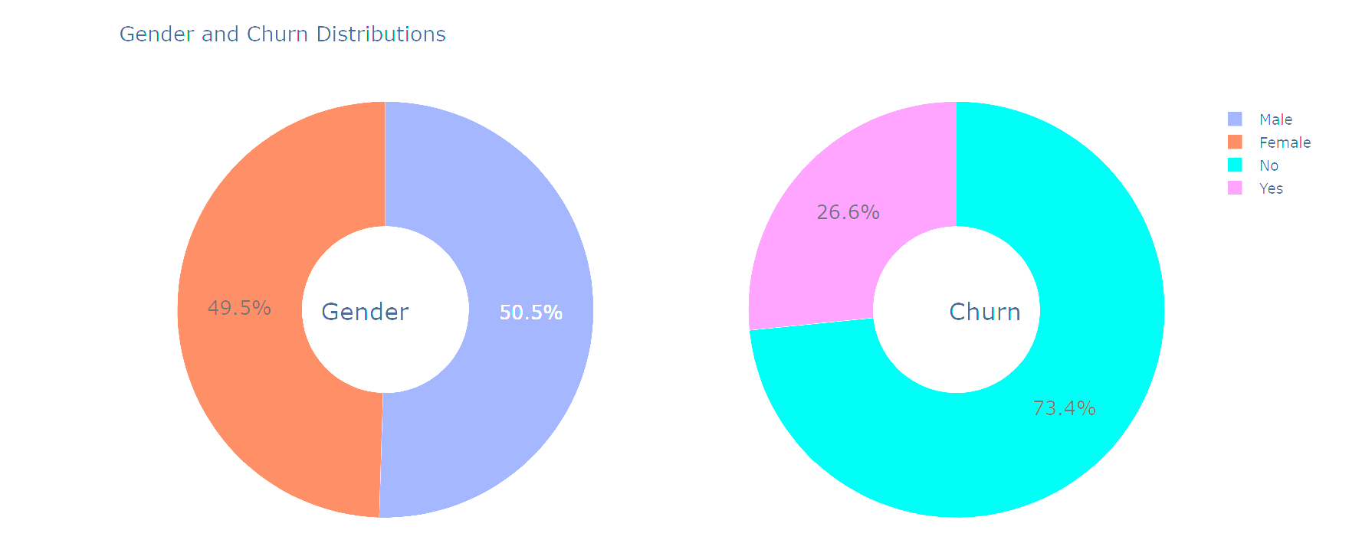
EDA
1) 26.6 % of customers switched to another firm.
2) Customers are 49.5 % female and 50.5 % male.

Slide 6
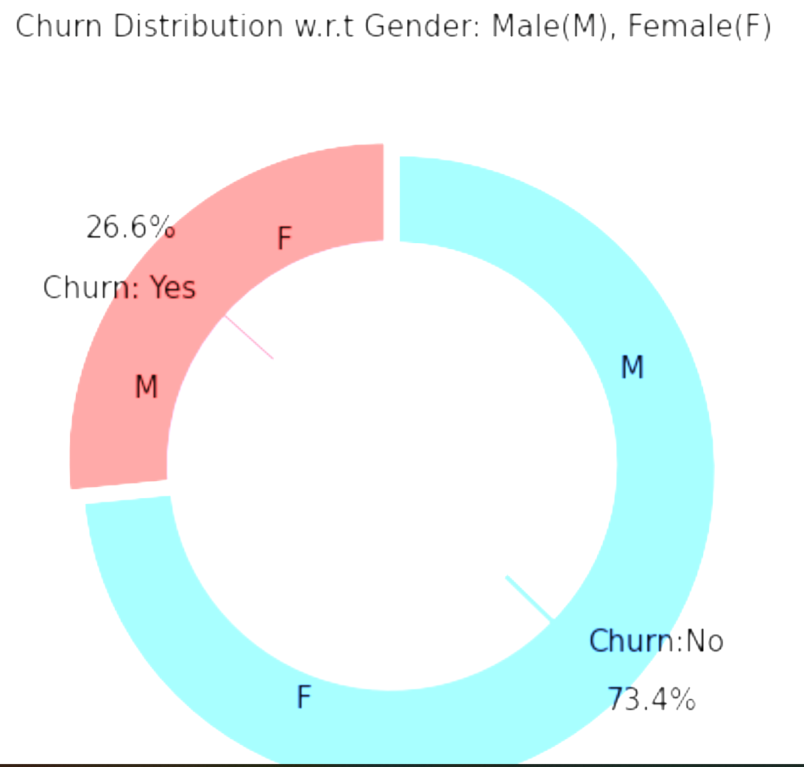
EDA
There is negligible difference in customer percentage/ count who changed the service provider. Both genders behaved in similar fashion when it comes to migrating to another service provider/firm.

Slide 7
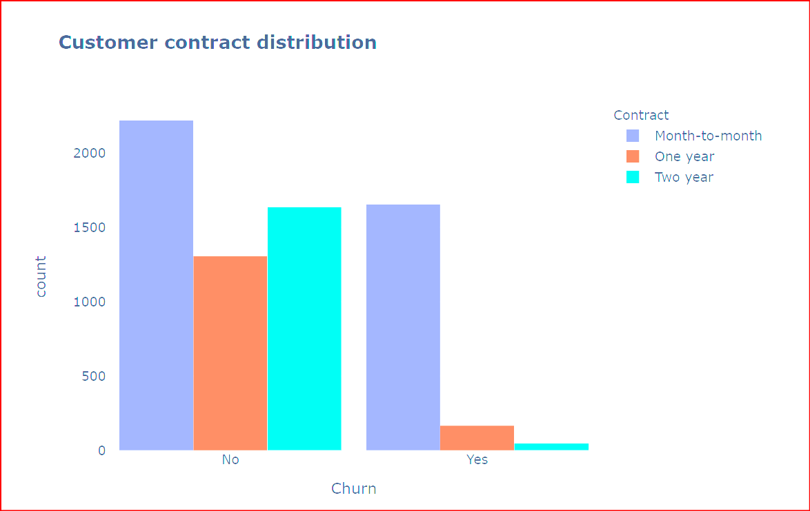
EDA
About 75% of customer with Month-to-Month Contract opted to move out as compared to 13% of customers with One Year Contract and 3% with Two Year Contract.

Slide 8
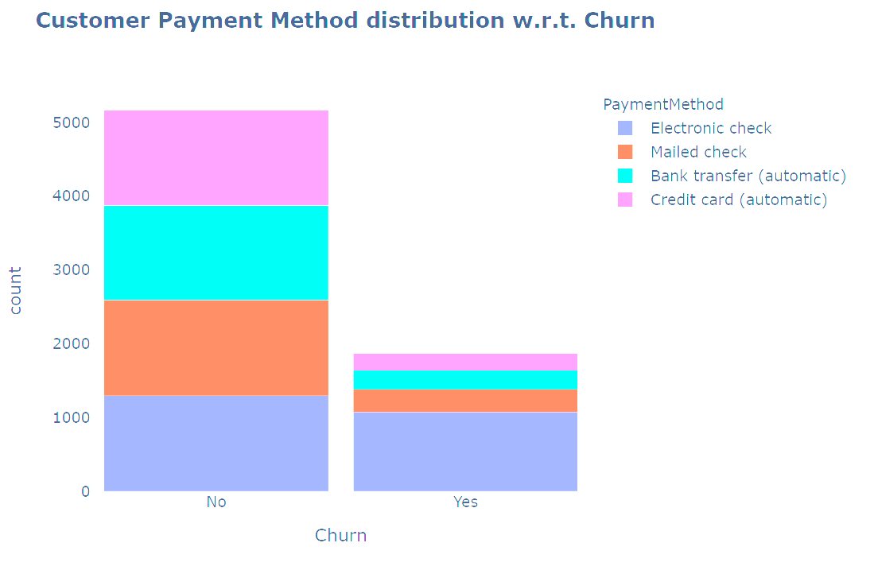
EDA
1) Major customers who moved out were having Electronic Check as Payment Method.
2) Customers who opted for Credit-Card automatic transfer or Bank Automatic Transfer and Mailed Check as Payment Method were less likely to move out.

Slide 9
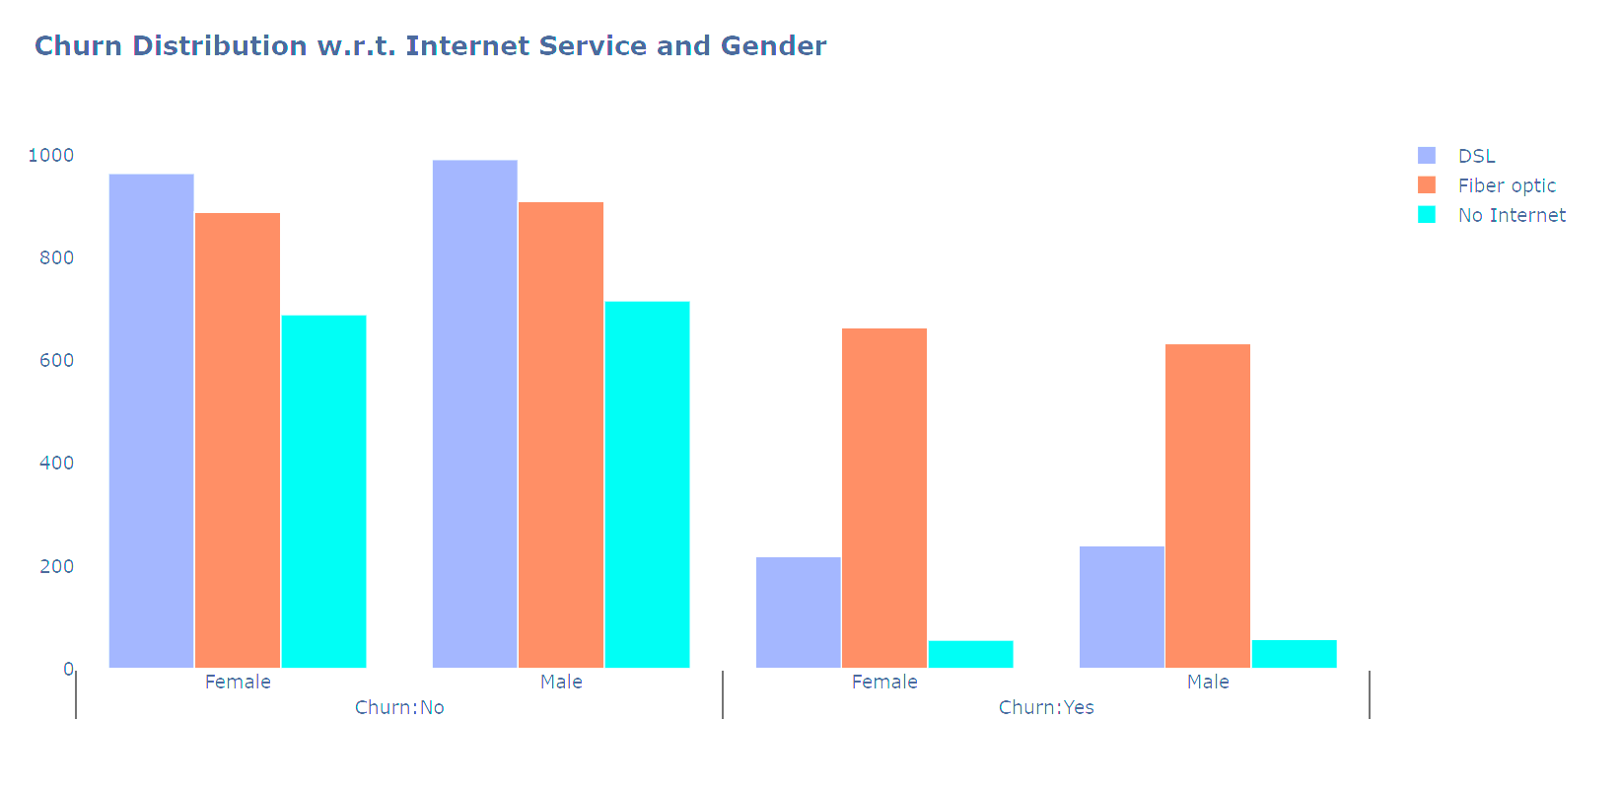
EDA
A lot of customers choose the Fiber optic service and it's also evident that the customers who use Fiber optic have high churn rate, this might suggest a dissatisfaction with this type of internet service.
2) Customers having DSL service are majority in number and have less churn rate compared to Fiber optic service.

Slide 10
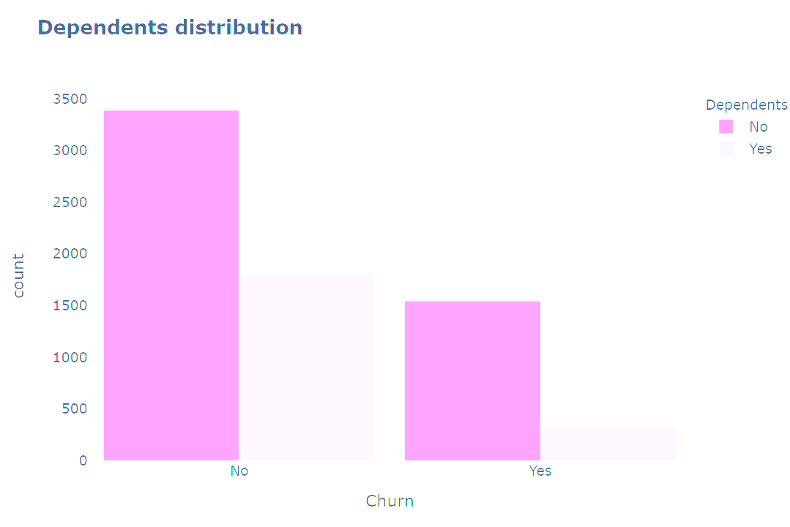
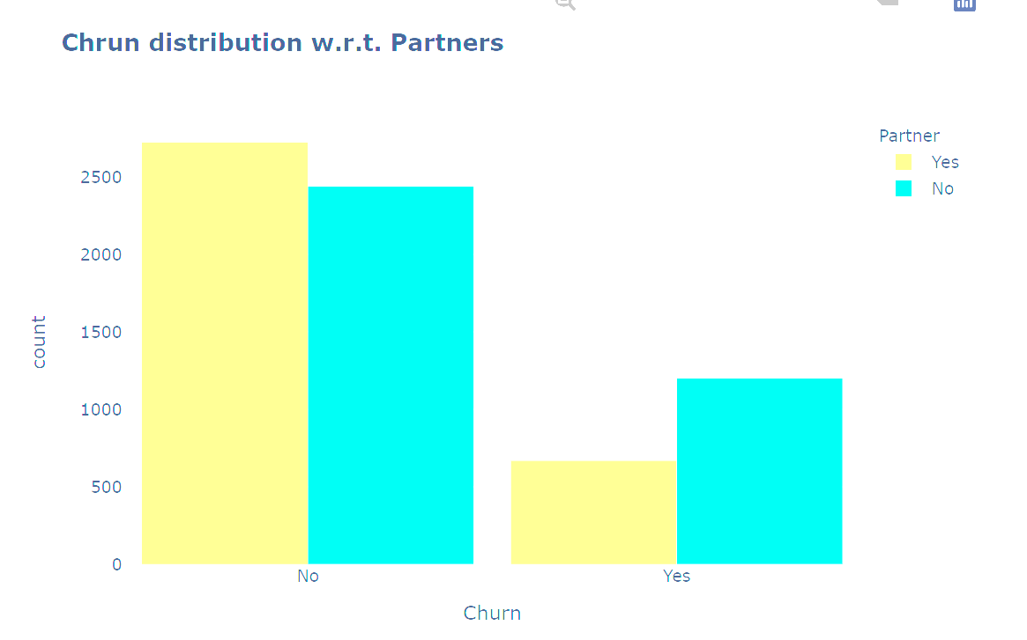
EDA
Customers without dependents are more likely to churn.
Customers that doesn't have partners are more likely to churn.

Slide 11
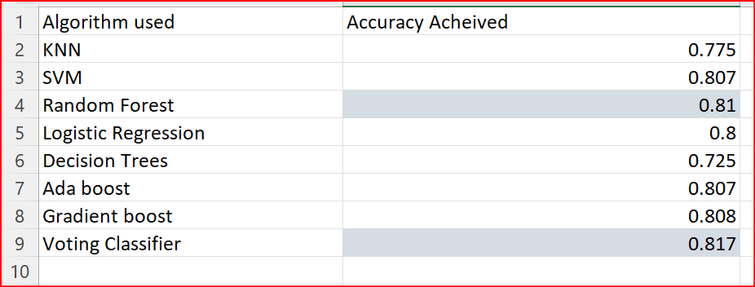
Model Performance Comparison
Random forest is used as Base model for prediction.

Slide 12
Recommendations to retain Customers
Try striking a longer contract with new customers: two year or one year in that order of preference.
Leverage the time to improve the quality of services, on the high-cost ones like Fiber optic.
Improve on the Technical support on all services like streaming, phone connection and internet. Be up-to-date with current technology.
Collect customer feedback and act on it immediately to prevent new customer churn.

