Slide 1

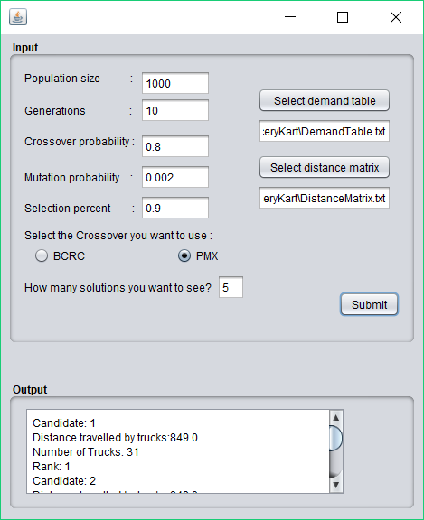
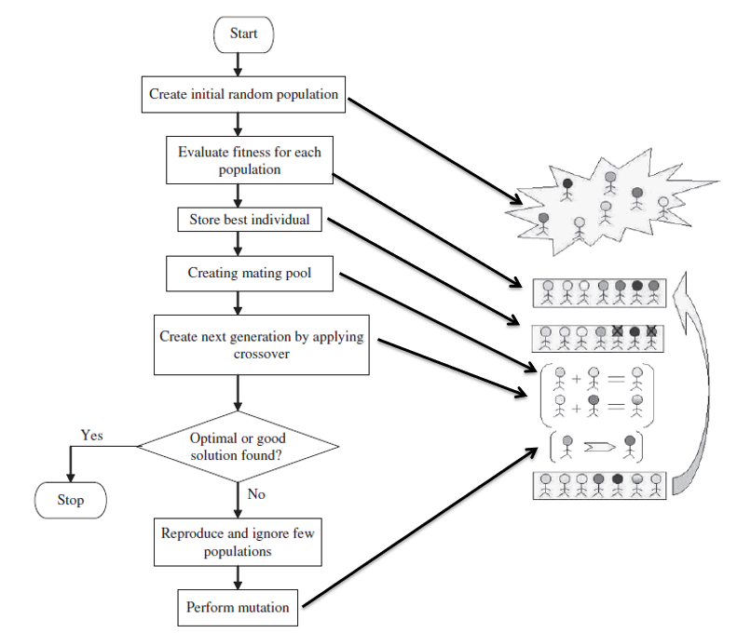
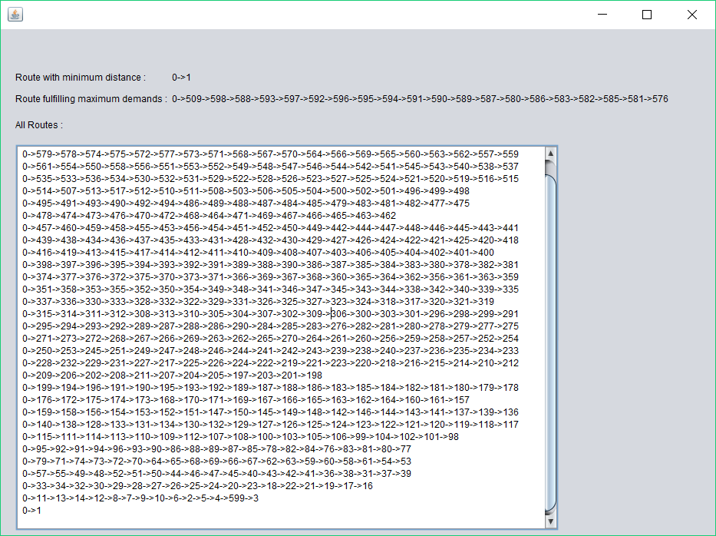
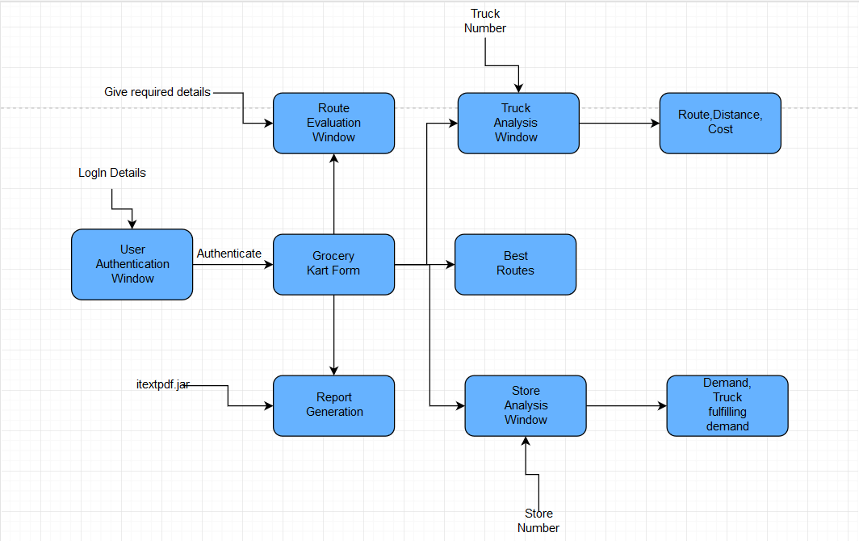
Transportation Service System for Grocery Kart using GA
Deepank Kartikey| Prof. Vanmathi C.| SITE
Motivation/ Introduction
Results
Transportation is a major problem domain in logistics, and so it represents a substantial task in the activities of many companies. In some market sectors, transportation means a high percentage of value added to goods. Therefore, the utilization of computerized methods for transportation often results in significant savings ranging from 5% to 20% in the total costs. For this high complexity problem without any known sophisticated solution technique, a genetic approach is well suited. GA generates solutions to optimization problems using techniques inspired by natural evolution, such as selection, crossover and mutation.
The two types of crossover were the basis of analysis and for the comparison of the results.
From the results shown above which were compiled after the execution of the program we concluded that BCRC gives more optimum distance and takes more time for the execution and the population taken is less. Whereas for PMX gives less optimum distance and takes less time for the execution and the population taken is more.
From these conclusions we cannot judge the best out of the two but can be done in a aspect.
BCRC is better than PMX in providing more optimum solution.
PMX is better than BCRC as the execution time is less.
PMX |  | BCRC
Distance | Time Taken | Distance | Time Taken
818.1 | 1 min | 799.8 | 20 min
819.4 | 40 Sec | 807.8 | 12 min
821.5 | 30 Sec | 812.1 | 2 min
SCOPE of the Project
Core objective of this project is to reduce Time complexity and optimize the resources involved in routing techniques consisting of large data-sets using Genetic Algorithm. A genetic algorithm (GA) is a method for solving both constrained and unconstrained optimization problems based on a natural selection process that mimics biological evolution. Transportation Service System for Grocery kart is a multi objective optimization problem, which needed a suitable approach to obtain a global optimum solution. So, for this high complexity problem without any known sophisticated solution technique, a genetic approach was well suited. Same technique can be used to solve Location Allocation Problems, Network designing and routing problems etc.
Methodology
In proposed system, when application user clicks submit after filling GroceryKart form and selects data-sets and desired algorithm then the general steps of a Genetic Algorithm are carried out shown as shown in Fig 1. Here two crossover methods have been used: BCRC and PMX.
The BCRC was used not only to maintain candidates’ good nature but also improve it to obtain better solutions by manipulating existing good candidates.
The PMX aims at keeping as many positions from parents as possible. To achieve this, a sub-string is swapped like in two-point crossover and values are kept in all non-conflicting positions. The conflicting positions are replaced by values which were swapped to other offspring.
Fig 1: Genetic Algorithm Working
Fig 2 explains the basic architecture of the system. There are various modules like Authentication, GroceryKart form, Route evaluation, Store Analysis, Truck Analysis and Report generation.
Authentication module provide application security. GroceryKart form takes all required inputs and generates list of optimum routes. Truck Analysis gives route, distance and cost for specific truck number. Store Analysis gives demand of store and truck number which fulfils the demand for that specific store. Report generation generates a pdf file containing ten best routes of all generated routes.
Fig 2: Architecture diagram
Conclusion
Here, initially generated a Random Population to maintain diversity and a Greedy Population to get optimal solutions. Then for the Selection used Tournament Rank selection which further optimised our dataset. Weighted Sum approach and Pareto Ranking (to get the alternative solutions of same nature) are the Fitness Evaluation procedure used.BCRC maintains and improves the candidates’ good nature to drive the force of obtaining a better solution by manipulating existing good candidates.PMX aims at keeping the most number of possible positions from the parents. With help of the genetic algorithm the system implemented was able to find the optimized routes as well as minimum costs to reach other stores from a specified store or a warehouse.
Contact Details
deepankkartikey@gmail.com
Acknowledgments/ References
Thanks to VIT.

