Slide 1
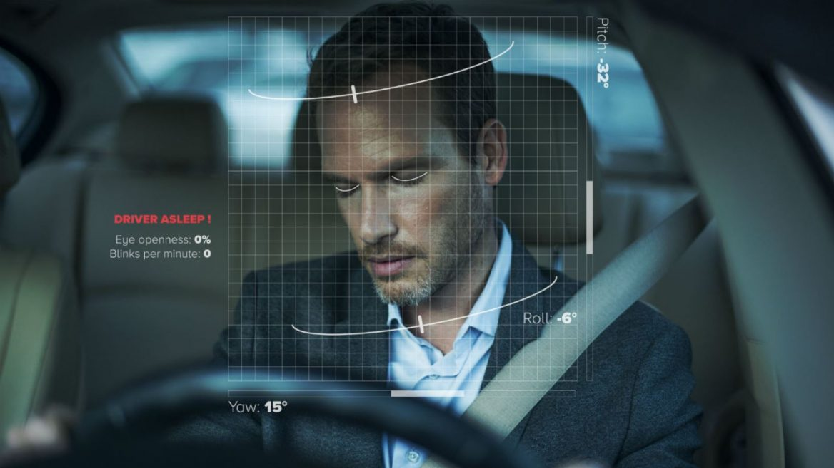
DRIVER DROWSINESS DETECTION
By:
M Saranya - 19MIS7008
R Naga Rohith - 19MIS7109
Guided By:
Prof. Beebi Naseeba

Slide 2
Contents
Plan of Action
Libraries
About Libraries
Code for Mouth shape detection
Output

Slide 3
Plan of Action
Review 1
Project Identification.
Libraries required.
Installing Libraries and dataset.
Eye shape detection.
Review 2
Mouth shape detection.
Calculating Eye Aspect Ratio(EAR) and Mouth Aspect ratio(MAR)
Creating a Frame or GUI using tkinter.
Final Review
Analysing threshold values and coding the necessary conditions for beep.
Creating a log file that stores the data of the drivers inactivity.
Final Testing.

Slide 4
Libraries
Scipy.spatial
Imutils
Dlib
Cv2
tkinter

Slide 5
About Libraries
To detect the shape of the eye and mouth we used 3 libraries, they are:
Cv2: We used cv2 library for video capturing and perfect detection of drivers left eye and right eye using cv2.convexHull() function.
Imutils: We used imutils library for image processing purpose such as resizing. We also used face_utils package in it for finding left and right eye landmarks and mouth landmark.
Dlib: We used dlib for highly accurate face detection, that can detect the driver face while the video is being captured.
To find the MAR and EAR values accurately we used 1 library, that is:
Scipy.spatial: We calculated the end to end distance of eye and mouth using dist function in scipy library.
To create the GUI we used 1 library, that is:
Tkinter: We created a frame with a button assigned at the center of the page, when clicked on button, the model starts working.

Slide 6
Code for Eye Mouth shape Detection
from scipy.spatial import distance as dist
from imutils import face_utils
import imutils
import dlib
import cv2
import tkinter
page = tkinter.Tk()
page.title("Driver Drowsiness Monitoring")
page.geometry("{}x{}".format(page.winfo_screenwidth(), page.winfo_screenheight()))
font = ('times', 17, 'bold')
title = tkinter.Label(page, text='Driver Drowsiness Detection', anchor='center', justify='center')
title.pack(fill='both', expand=True)
title.config(bg='black', fg='white')
title.config(font=font)
title.config(height=3, width=120)
title.place(x=0,y=5)

Slide 7
Code
def EAR(drivereye):
point1 = dist.euclidean(drivereye[1], drivereye[5])
point2 = dist.euclidean(drivereye[2], drivereye[4])
# computing the euclidean distance between the horizontal
distance = dist.euclidean(drivereye[0], drivereye[3])
# computing the eye aspect ratio
eye_aspect_ratio = (point1 + point2) / (2.0 * distance)
return eye_aspect_ratio
def MOR(drivermouth):
# computing the euclidean distances between the horizontal
point = dist.euclidean(drivermouth[0], drivermouth[6])
# computing the euclidean distances between the vertical
point1 = dist.euclidean(drivermouth[2], drivermouth[10])
point2 = dist.euclidean(drivermouth[4], drivermouth[8])
# taking average
Ypoint = (point1+point2)/2.0
# computing mouth aspect ratio
mouth_aspect_ratio = Ypoint/point
return mouth_aspect_ratio

Slide 8
Code
def startDetection():
webcamera = cv2.VideoCapture(0)
svm_predictor_path = 'SVMclassifier.dat'
svm_detector = dlib.get_frontal_face_detector()
svm_predictor = dlib.shape_predictor(svm_predictor_path)
(lStart, lEnd) = face_utils.FACIAL_LANDMARKS_IDXS["left_eye"]
(rStart, rEnd) = face_utils.FACIAL_LANDMARKS_IDXS["right_eye"]
(mStart, mEnd) = face_utils.FACIAL_LANDMARKS_IDXS["mouth"]
while True:
ret, frame = webcamera.read()
frame = imutils.resize(frame, width=640)
gray = cv2.cvtColor(frame, cv2.COLOR_BGR2GRAY)
rects = svm_detector(gray, 0)
for rect in rects:
shape = svm_predictor(gray, rect)
shape = face_utils.shape_to_np(shape)
leftEye = shape[lStart:lEnd]
rightEye = shape[rStart:rEnd]
mouth = shape[mStart:mEnd]

Slide 9
Code
leftEAR = EAR(leftEye)
rightEAR = EAR(rightEye) ear = (leftEAR + rightEAR) / 2.0 mar = MOR(mouth)
leftEyeHull = cv2.convexHull(leftEye)
rightEyeHull = cv2.convexHull(rightEye)
mouthHull = cv2.convexHull(mouth)
cv2.drawContours(frame, [leftEyeHull], -1, (0, 255, 255), 1)
cv2.drawContours(frame, [rightEyeHull], -1, (0, 255, 255), 1)
cv2.drawContours(frame, [mouthHull], -1, (0, 255, 0), 1)
cv2.putText(frame, "EAR: {:.2f}".format(ear), (480, 30),cv2.FONT_HERSHEY_SIMPLEX, 0.7, (0, 0, 255), 2)
cv2.putText(frame, "MAR: {:.2f}".format(mar), (480, 60),cv2.FONT_HERSHEY_SIMPLEX, 0.7, (0, 0, 255), 2)
cv2.imshow("Frame", frame)
key = cv2.waitKey(1) & 0xFF
if key == ord("q"):
break
cv2.destroyAllWindows()
webcamera.release()

Slide 10
Code
font1 = ('times', 15, 'bold')
button = tkinter.Button(page, text="Start Detecting", command=startDetection)
# button.place(x=50,y=200)
button.place(relx=0.5, rely=0.5, anchor='center')
button.config(font=font1)
pathlabel = tkinter.Label(page)
pathlabel.config(bg='DarkOrange1', fg='white')
pathlabel.config(font=font1)
pathlabel.place(x=50,y=250)
page.config(bg='chocolate1')
page.mainloop()

Slide 11
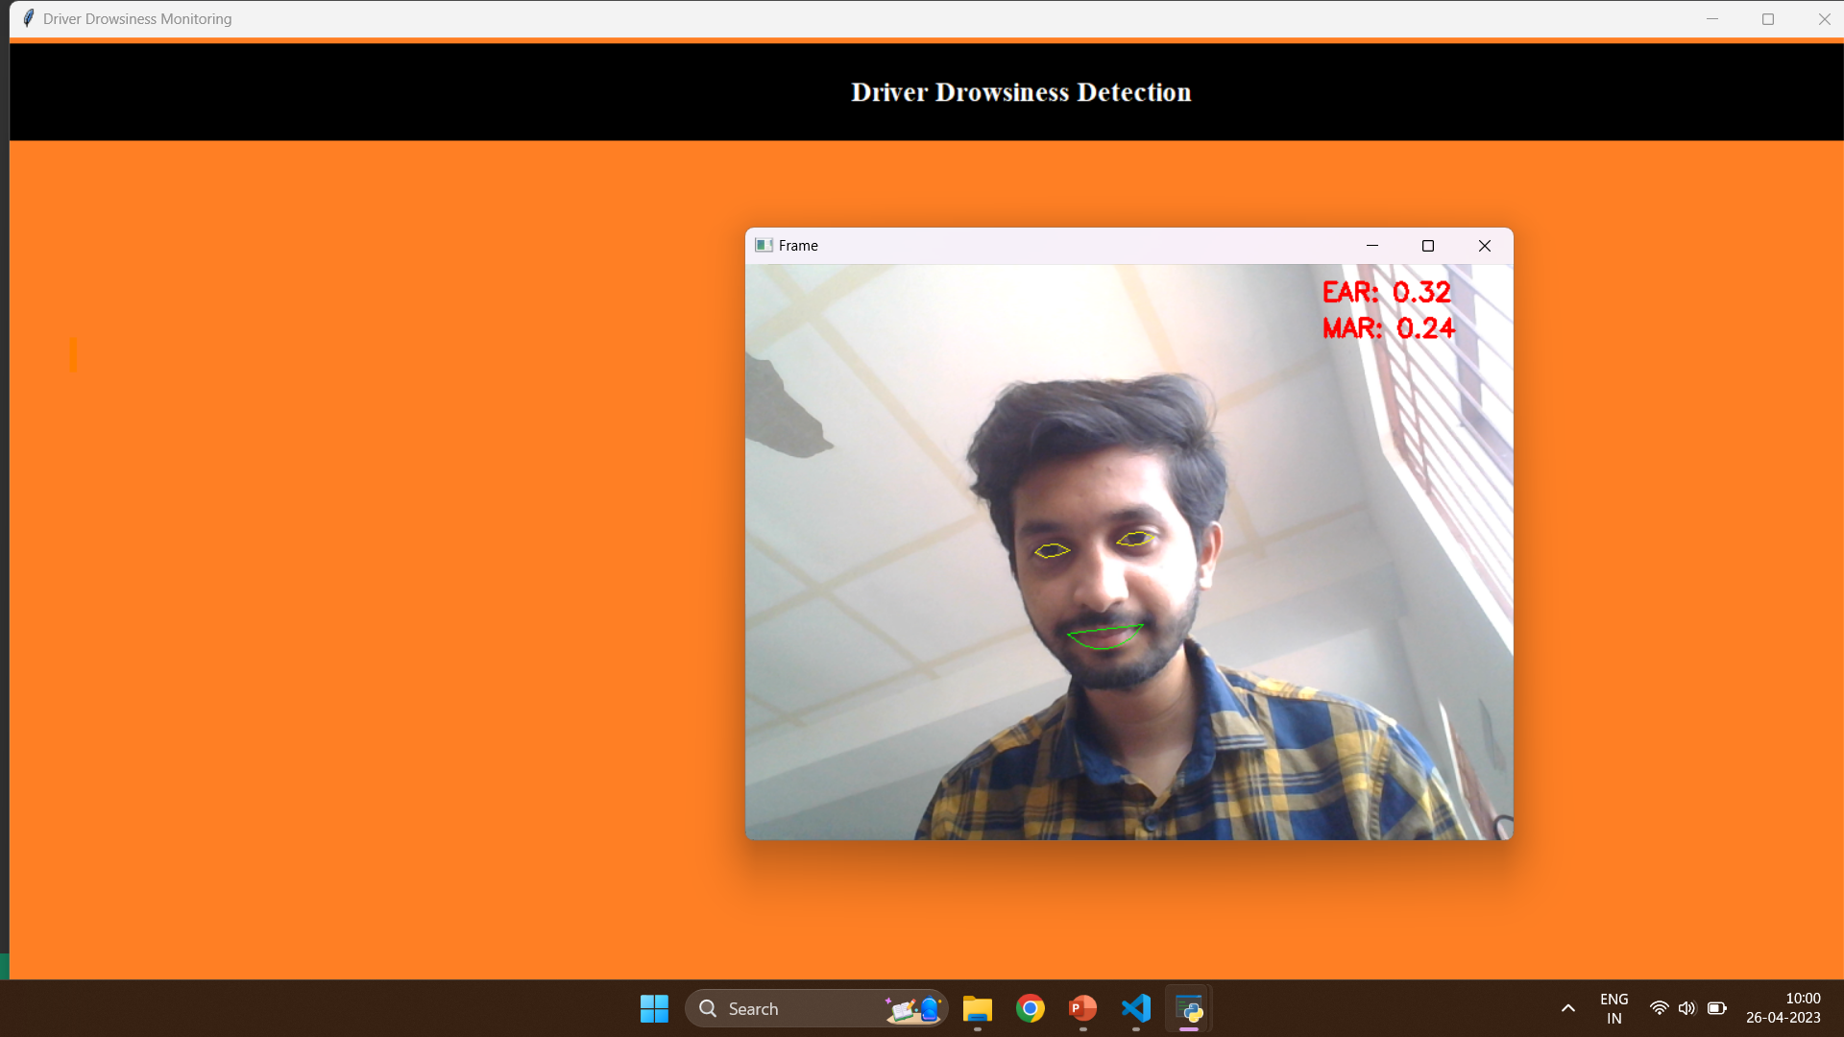
Output

Slide 12
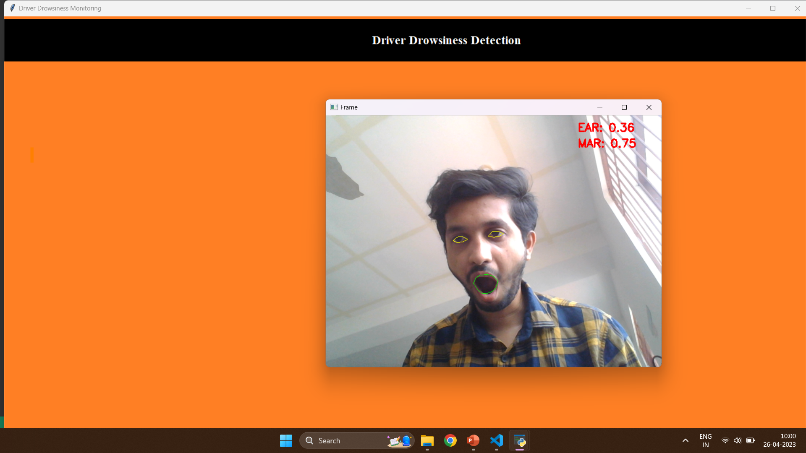
Output

Slide 13

Output

Slide 14


