Slide 1
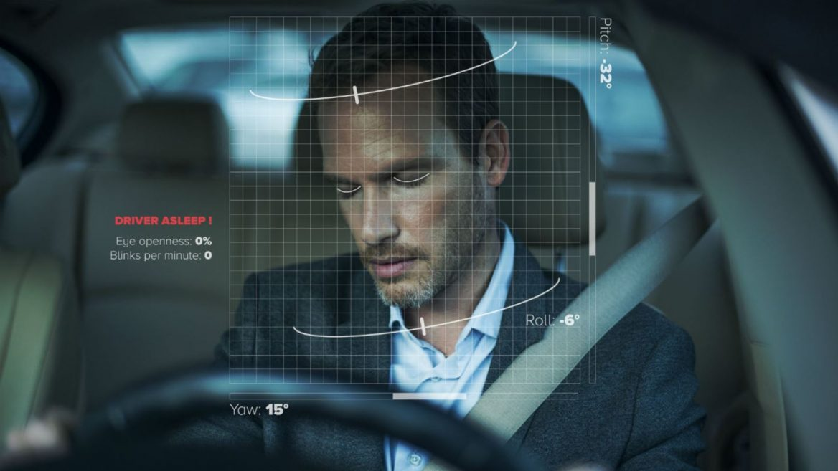
DRIVER DROWSINESS DETECTION
By:
M Saranya - 19MIS7008
R Naga Rohith - 19MIS7109
Guided By:
Prof. Beebi Naseeba

Slide 2
Contents
Plan of Action
Libraries
About Libraries
Final Code
Output

Slide 3
Plan of Action
Review 1
Project Identification.
Libraries required.
Installing Libraries and dataset.
Eye shape detection.
Review 2
Mouth shape detection.
Calculating Eye Aspect Ratio(EAR) and Mouth Aspect ratio(MAR)
Creating a Frame or GUI using tkinter.
Final Review
Analysing threshold values and coding the necessary conditions for beep.
Creating a log file that stores the data of the drivers inactivity.
Final Testing.

Slide 4
Libraries
Scipy.spatial
Imutils
Dlib
Cv2
Tkinter
Datetime
Os
Winsound
Numpy
Pandas

Slide 5
About Libraries
To detect the shape of the eye and mouth we used 3 libraries, they are:
Cv2: We used cv2 library for video capturing and perfect detection of drivers left eye and right eye using cv2.convexHull() function.
Imutils: We used imutils library for image processing purpose such as resizing. We also used face_utils package in it for finding left and right eye landmarks and mouth landmark.
Dlib: We used dlib for highly accurate face detection, that can detect the driver face while the video is being captured.
To find the MAR and EAR values accurately we used 1 library, that is:
Scipy.spatial: We calculated the end to end distance of eye and mouth using dist function in scipy library.
To create the GUI we used 1 library, that is:
Tkinter: We created a frame with a button assigned at the center of the page, when clicked on button, the model starts working.

Slide 6
About Libraries
To save data of the alerts we used 3 libraries, they are:
datetime: This library is used for working with date and time, we used this library to get the date and time stamp when the alert is generated.
numpy: This library is used for scientific computing and data analysis, we used this library to append the alerts to the lag that we have created.
pandas: This library is used for loading and manipulating data, we used this library to create log file or to read the data from the log file that has been created.
To find :
Winsound: This library is used to play sound effects and tones from the windows operating system, we used this library to play beeps when driver’s drowsiness is detected.
Os: This library is used to provide a way to interact with the operating system and perform various operating system-related tasks.

Slide 7
Final Code
import datetime
import os
import winsound
import numpy as np
import pandas as pd
from scipy.spatial import distance as dist
from imutils import face_utils
import imutils
import dlib
import cv2
import tkinter
page = tkinter.Tk()
page.title("Driver Drowsiness Monitoring")
# page.geometry("550x400")
page.geometry("{}x{}".format(page.winfo_screenwidth(), page.winfo_screenheight()))
font = ('times', 17, 'bold')
# title = tkinter.Label(page, text='Driver Drowsiness Detection',anchor=tkinter.W, justify=tkinter.CENTER)
title = tkinter.Label(page, text='Driver Drowsiness Detection', anchor='center', justify='center')
title.pack(fill='both', expand=True)

Slide 8
Code
title.config(bg='black', fg='white')
title.config(font=font)
title.config(height=3, width=120)
title.place(x=0,y=5)
def EAR(drivereye):
point1 = dist.euclidean(drivereye[1], drivereye[5])
point2 = dist.euclidean(drivereye[2], drivereye[4])
# computing the euclidean distance between the horizontal
distance = dist.euclidean(drivereye[0], drivereye[3])
# computing the eye aspect ratio
eye_aspect_ratio = (point1 + point2) / (2.0 * distance)
return eye_aspect_ratio
def MOR(drivermouth):
# computing the euclidean distances between the horizontal
point = dist.euclidean(drivermouth[0], drivermouth[6])
# computing the euclidean distances between the vertical
point1 = dist.euclidean(drivermouth[2], drivermouth[10])
point2 = dist.euclidean(drivermouth[4], drivermouth[8])
# taking average
Ypoint = (point1+point2)/2.0
# computing mouth aspect ratio
mouth_aspect_ratio = Ypoint/point
return mouth_aspect_ratio

Slide 9
Code
def createLog(message):
# current_time = datetime.datetime.now()
current_time = datetime.datetime.now()
date_str = current_time.strftime("%d-%m-%y")
time_str = current_time.strftime("%H:%M:%S")
if os.path.exists("log.xlsx") == True:
data = pd.read_excel("log.xlsx")
data = data.values
data = np.vstack([data, [message, str(date_str), str(time_str)]])
else:
data = []
data.append([message, str(date_str), str(time_str)])
data = np.asarray(data)
df = pd.DataFrame(data, columns=['Alert','Date','Time'])
df.to_excel("log.xlsx", index=False)
def beep():
frequency = 2500 # Set Frequency To 2500 Hertz
duration = 1000 # Set Duration To 1000 ms == 1 second
winsound.Beep(frequency, duration)

Slide 10
Code
def startDetection():
webcamera = cv2.VideoCapture(0)
svm_predictor_path = 'SVMclassifier.dat'
svm_detector = dlib.get_frontal_face_detector()
svm_predictor = dlib.shape_predictor(svm_predictor_path)
(lStart, lEnd) = face_utils.FACIAL_LANDMARKS_IDXS["left_eye"]
(rStart, rEnd) = face_utils.FACIAL_LANDMARKS_IDXS["right_eye"]
(mStart, mEnd) = face_utils.FACIAL_LANDMARKS_IDXS["mouth"]
eyeThreshValue = 0.25
eyeRelativeFrames = 10
mouthThreshValue = 0.75
frameCount = 0
yawnStatus = False
yawnCount = 0
while True:
ret, frame = webcamera.read()
frame = imutils.resize(frame, width=640)
gray = cv2.cvtColor(frame, cv2.COLOR_BGR2GRAY)
rects = svm_detector(gray, 0)
recentYawnStatus = yawnStatus

Slide 11
Code
for rect in rects:
shape = svm_predictor(gray, rect)
shape = face_utils.shape_to_np(shape)
leftEye = shape[lStart:lEnd]
rightEye = shape[rStart:rEnd]
mouth = shape[mStart:mEnd] leftEAR = EAR(leftEye)
rightEAR = EAR(rightEye) ear = (leftEAR + rightEAR) / 2.0 mar = MOR(mouth)
leftEyeHull = cv2.convexHull(leftEye)
rightEyeHull = cv2.convexHull(rightEye)
mouthHull = cv2.convexHull(mouth) cv2.drawContours(frame, [leftEyeHull], -1, (0, 255, 255), 1)
cv2.drawContours(frame, [rightEyeHull], -1, (0, 255, 255), 1)
cv2.drawContours(frame, [mouthHull], -1, (0, 255, 0), 1)

Slide 12
Code
if ear < eyeThreshValue:
frameCount += 1
cv2.putText(frame, "Eyes Closed ", (10, 30),cv2.FONT_HERSHEY_SIMPLEX, 0.7, (0, 0, 255), 2)
if frameCount >= eyeRelativeFrames:
cv2.putText(frame, "DROWSINESS ALERT!", (10, 50),cv2.FONT_HERSHEY_SIMPLEX, 0.7, (0, 0, 255), 2)
createLog("Eyes Closed Alert")
beep()
else:
frameCount = 0
cv2.putText(frame, "Eyes Open ", (10, 30),cv2.FONT_HERSHEY_SIMPLEX, 0.7, (0, 255, 0), 2)
cv2.putText(frame, "EAR: {:.2f}".format(ear), (480, 30),cv2.FONT_HERSHEY_SIMPLEX, 0.7, (0, 0, 255), 2)
if mar > mouthThreshValue:
cv2.putText(frame, "Yawning, DROWSINESS ALERT! ", (10, 70),cv2.FONT_HERSHEY_SIMPLEX, 0.7, (0, 0, 255), 2)
yawnStatus = True
output_text = "Yawn Count: " + str(yawnCount + 1)
cv2.putText(frame, output_text, (10,100),cv2.FONT_HERSHEY_SIMPLEX, 0.7,(255,0,0),2)

Slide 13
Code
createLog("Yawning Alert")
beep()
else:
yawnStatus = False
if recentYawnStatus == True and yawnStatus == False:
yawnCount+=1
cv2.putText(frame, "MAR: {:.2f}".format(mar), (480, 60),cv2.FONT_HERSHEY_SIMPLEX, 0.7, (0, 0, 255), 2)
cv2.imshow("Frame", frame)
key = cv2.waitKey(1) & 0xFF
if key == ord("q"):
break
cv2.destroyAllWindows()
webcamera.release()

Slide 14
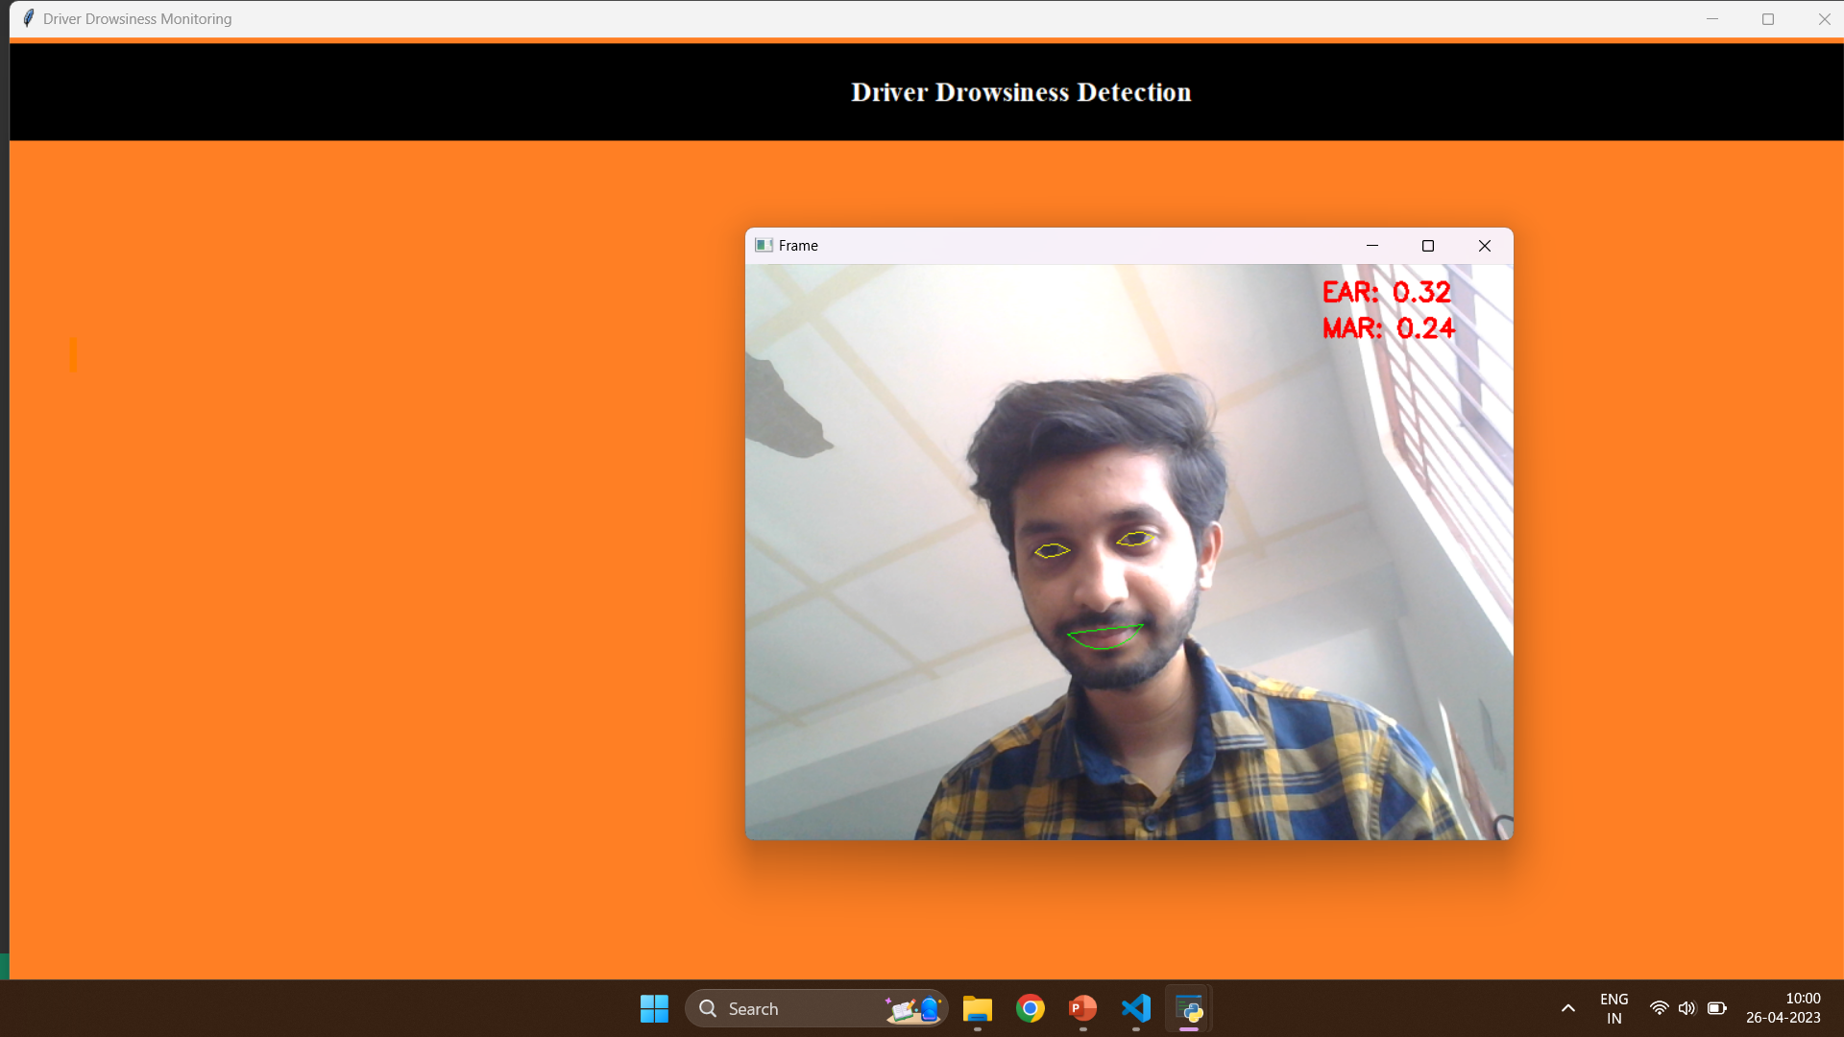
Output

Slide 15
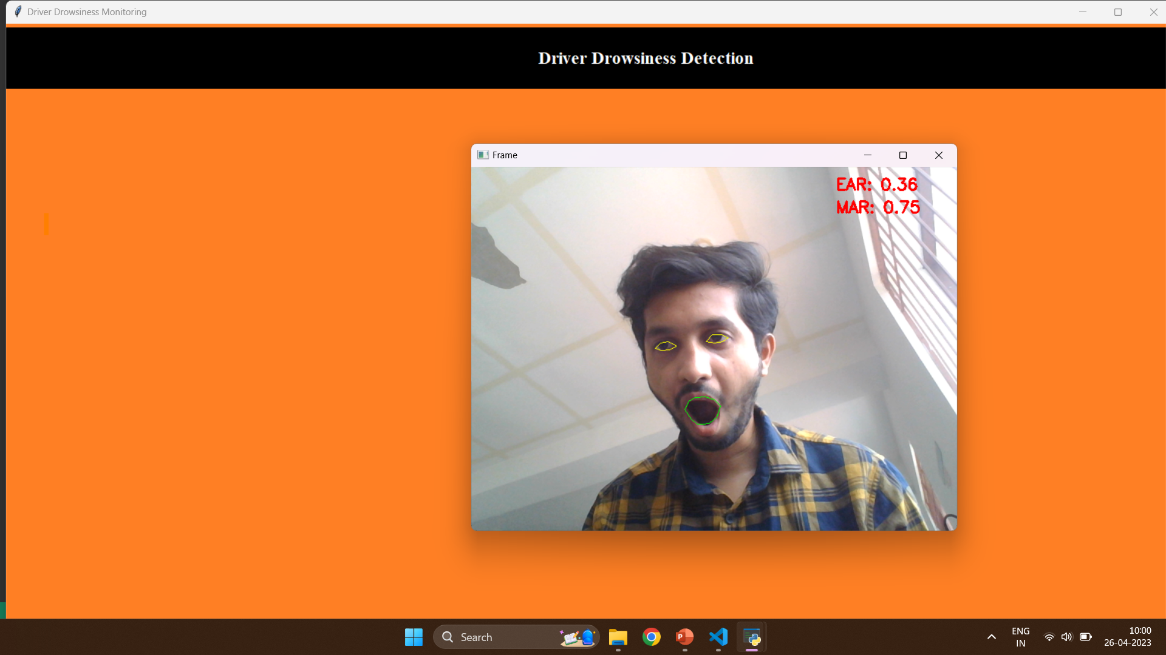
Output

Slide 16

Output

Slide 17
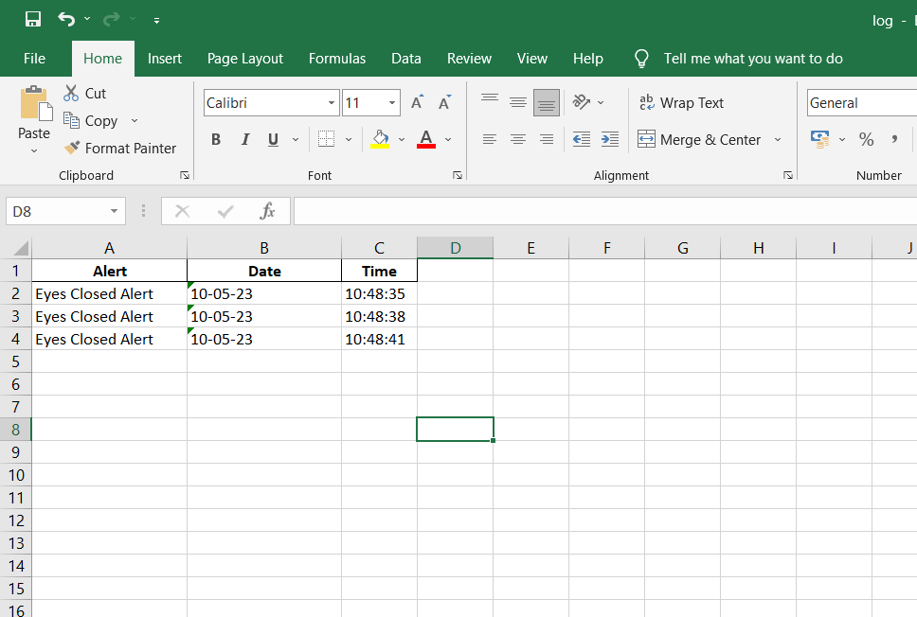

Slide 18


