Slide 1
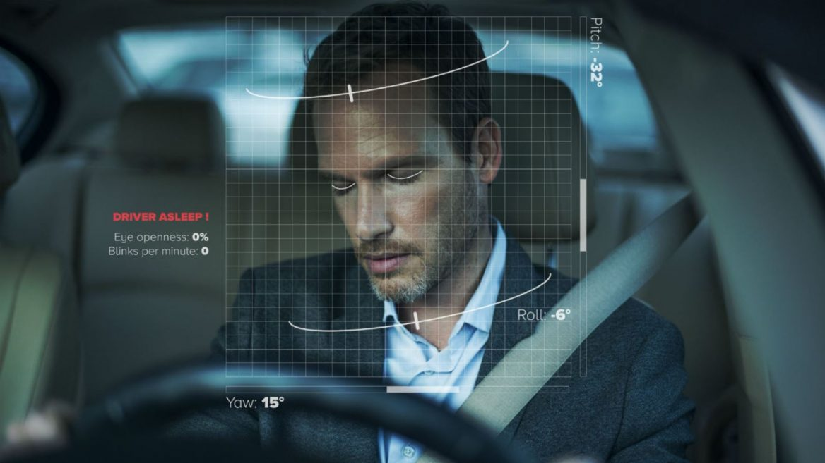
DRIVER DROWSINESS DETECTION
By:
M Saranya - 19MIS7008
R Naga Rohith - 19MIS7109
Guided By:
Prof. Beebi Naseeba

Slide 2
Contents
Introduction
Problem statement
Scope of the project
Libraries and Dataset
Plan of Action
Code for eye shape detection
About Libraries
Output

Slide 3
Introduction
One of the reasons of the accidents happening now and then are due to the driver’s inactivity or driver's fatigue.
So, in order to overcome this problem, we developed a Machine Learning model that captures the live video of the driver while driving and detects the Eye and Mouth moments.
When the driver closes his eyes for more duration or opens his mouth to yawn, the trained model detects the driver’s actions and alerts the driver using sound like strong beep.

Slide 4
Problem Statement and Scope
The problem of:
Driver inactivity while driving
Driver falling asleep while driving.
Being sick or fatigue while driving.
Affects (Scope):
Overcoming the driver’s sleep
Forcing the driver to pay attention.

Slide 5
Libraries
Scipy.spatial
Imutils
Numpy
Dlib
Cv2
Winsound
Os
Pandas
Datetime

Slide 6
Dataset
In this project we are using a single dataset file named SVMclassifier.dat.
The svmclassifier.dat file contains a trained Support Vector Machine (SVM) classifier model of the human face which can be used to perfectly detect the shape of eyes and mouth.
SVM is a popular machine learning algorithm used for classification and regression analysis.

Slide 7
Plan of Action
Review 1
Project Identification.
Libraries required.
Installing Libraries and dataset.
Eye shape detection.
Review 2
Mouth shape detection.
Calculating Eye Aspect Ratio(EAR) and Mouth Aspect ratio(MAR)
Creating a Frame or GUI using tkinter.
Final Review
Analysing threshold values and coding the necessary conditions for beep.
Creating a log file that stores the data of the drivers inactivity.
Final Testing.

Slide 8
Code for Eye shape Detection
from imutils import face_utils
import imutils
import dlib
import cv2
webcamera = cv2.VideoCapture(0)
svm_predictor_path = 'SVMclassifier.dat' svm_detector = dlib.get_frontal_face_detector()
svm_predictor = dlib.shape_predictor(svm_predictor_path)
(lStart, lEnd) = face_utils.FACIAL_LANDMARKS_IDXS["left_eye"]
(rStart, rEnd) = face_utils.FACIAL_LANDMARKS_IDXS["right_eye"]
while True:
ret, frame = webcamera.read()
frame = imutils.resize(frame, width=640)
gray = cv2.cvtColor(frame, cv2.COLOR_BGR2GRAY)
rects = svm_detector(gray, 0)

Slide 9
Code
for rect in rects:
shape = svm_predictor(gray, rect)
shape = face_utils.shape_to_np(shape)
leftEye = shape[lStart:lEnd]
rightEye = shape[rStart:rEnd]
leftEyeHull = cv2.convexHull(leftEye)
rightEyeHull = cv2.convexHull(rightEye)
cv2.drawContours(frame, [leftEyeHull], -1, (0, 255, 255), 1)
cv2.drawContours(frame, [rightEyeHull], -1, (0, 255, 255), 1)
cv2.imshow("Frame", frame)
key = cv2.waitKey(1) & 0xFF
if key == ord("q"):
break
cv2.destroyAllWindows()
webcamera.release()

Slide 10
About Libraries
To detect the shape of the eye we used 3 libraries, they are:
Imutils: We used imutils library for image processing purpose such as resizing. We also used face_utils package in it for finding left and right eye indexes.
Dlib: We used dlib for highly accurate face detection, that can detect the driver face while the video is being captured.
Cv2: We used cv2 library for video capturing and perfect detection of drivers left eye and right eye using cv2.convexHull() function.

Slide 11
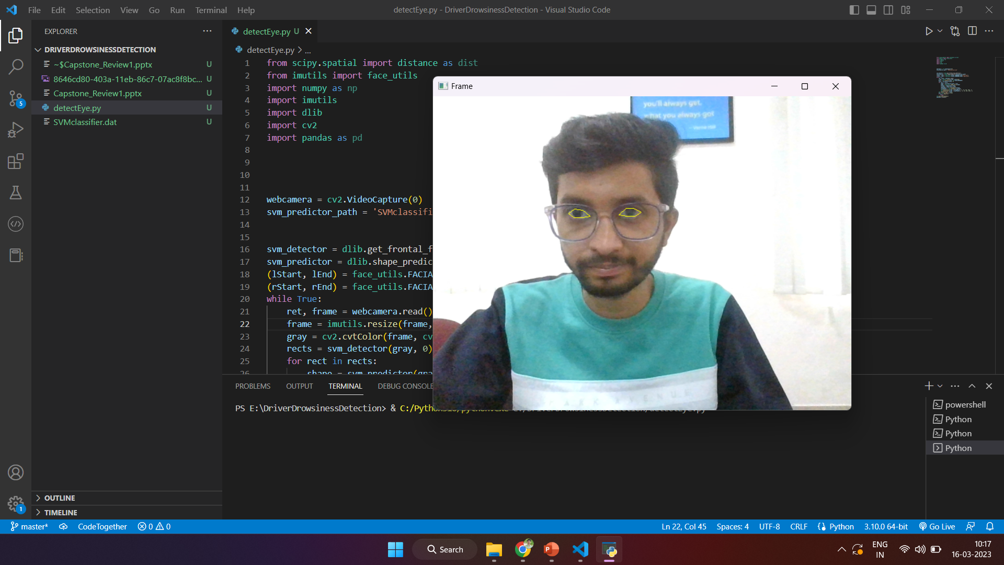
Output

Slide 12


