Slide 1
Scanner App

Slide 2



The scanner application is a tool that empowers you to effortlessly create, manage, and distribute unique QR codes and barcodes, all while keeping your users engaged through email notification, with seamless user experience and easy configurations.
The Scanner App have wide range of application usage, few are listed below:
Businesses: Enhance marketing campaigns, track inventory, and engage customers.
Events: Simplify check-ins, share event details, and collect attendee information.
Education: Distribute resources, share links, and facilitate interactive learning.
Membership Clubs: Manage access, communicate updates, and strengthen community bonds.
Introduction

Slide 3
Generation of QR Code, Bar Code and Data Matrix .
Creation of request manually and Bulk request creation.
Import of records to create request.
Export to excel of created requests.
View mode of created request with download QR.
Email notification with send email in bulk option.
User Management
Basic Configurations
Features

Slide 4
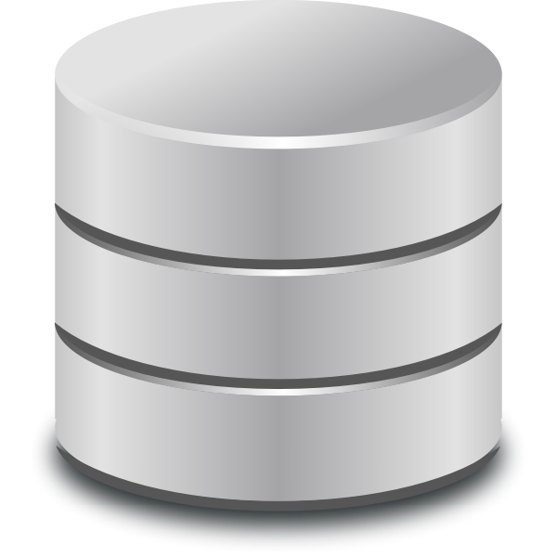



Scanner App Architecture Diagram
Mendix Runtime Engine
Application Logic
Core Modules
Login (SSO)
HTTP Server
Security Layer
User Management
Master Data Management
Model Driven Development
Persistence Layer
QR Code generator
Import/Export Data
Nanoflow
Microflow
Workflow
Java Action
JS Action
Domain Model
PostgreSQL
Browser Access
Email connector
Integration Layer
Integration Layer
Storage
Mail Server Integration
© 2023 — Nagarro
4

Slide 5
Sample mock-up screens

Slide 6
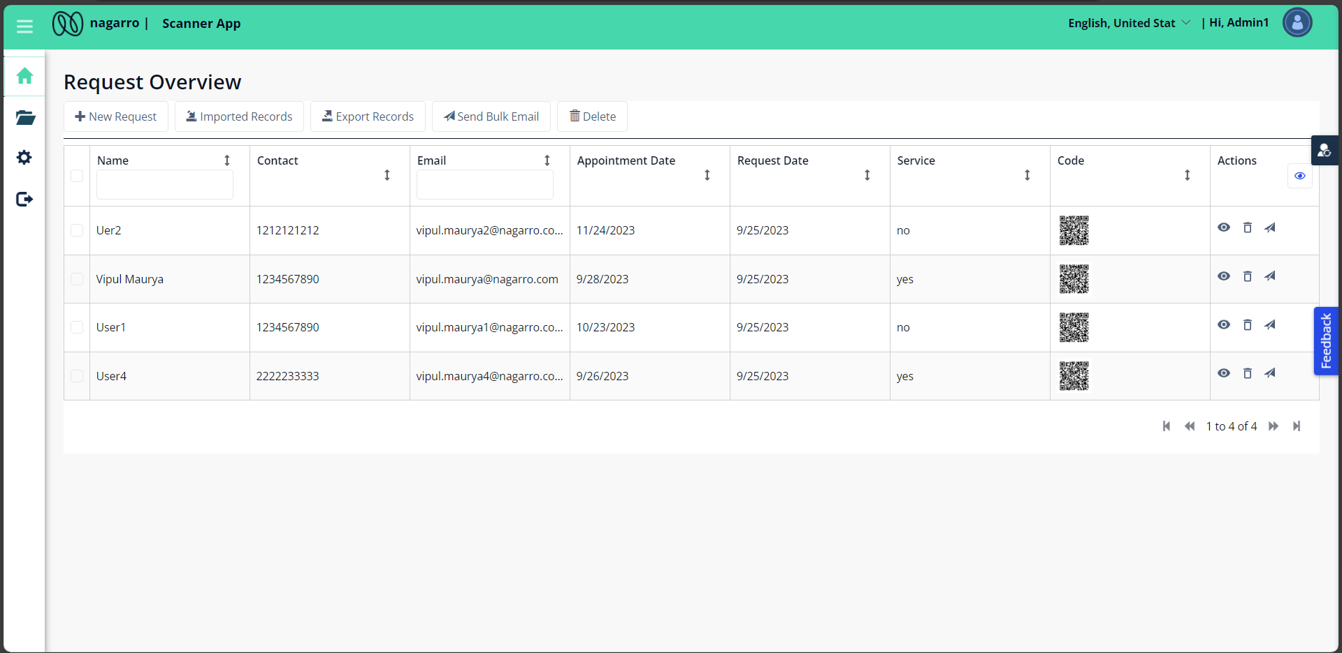
Scanner App: Overview page

Slide 7
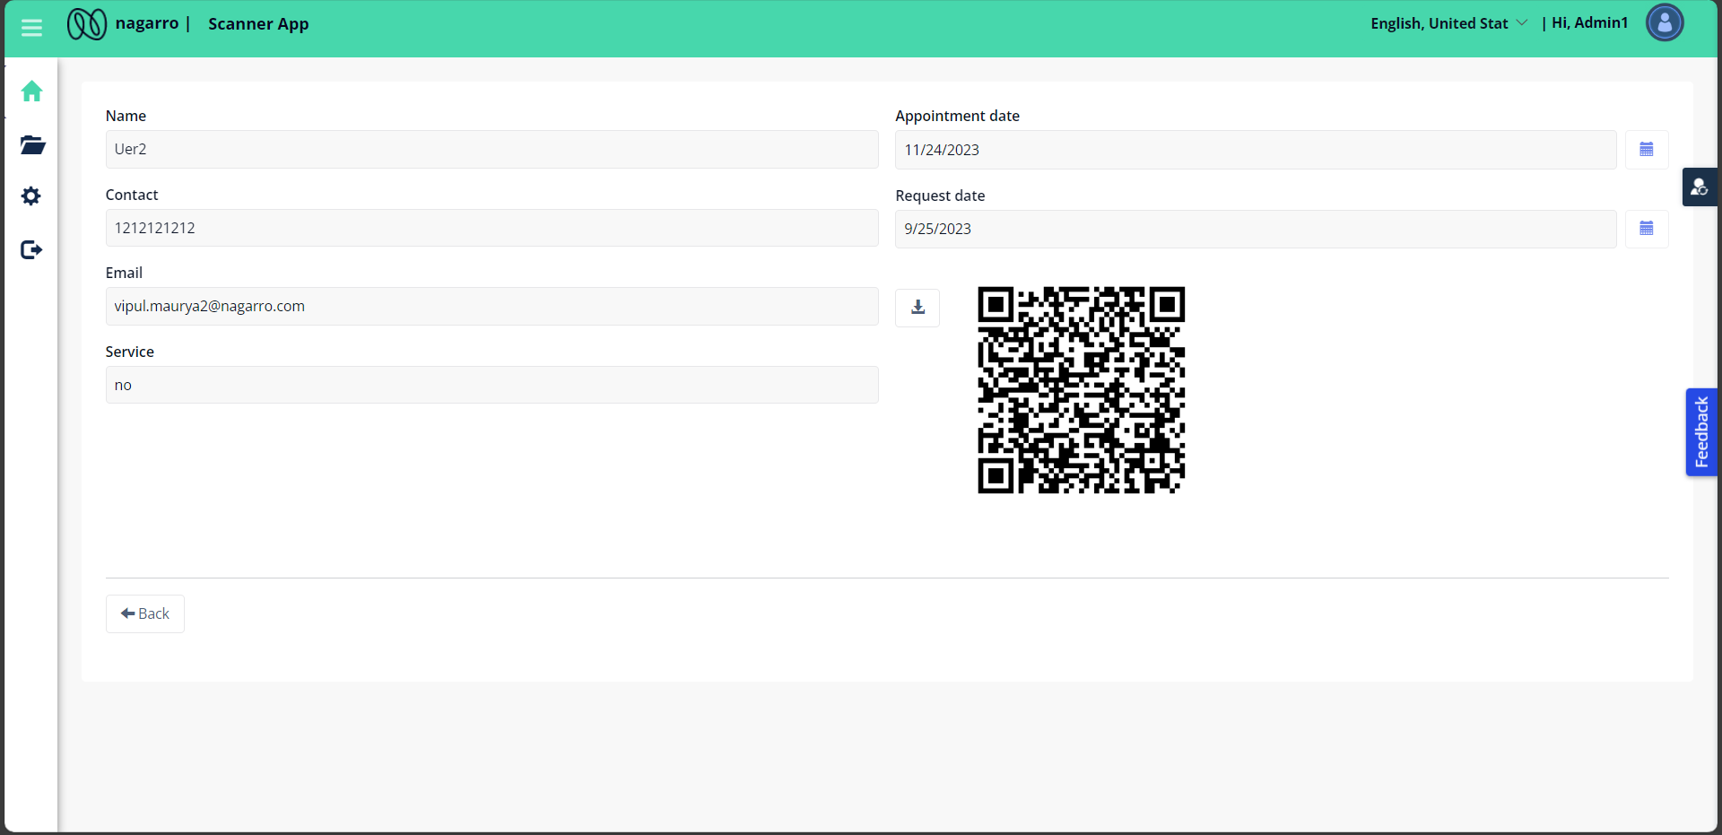
Scanner App: Detailed view

Slide 8
Thank You

