Slide 1
Document Repository

Slide 2



A document management system (document repository) is a software solution designed to efficiently store, organize manage, and retrieve various types of documents and files within an organization. It provides a structured and secure environment for storing documents, making them easily accessible to authorized users within an organization.
Following are the key functions of this tool:
Document capture & Storage
Document retrieval
Versioning
Collaboration and sharing
Access control
Marking documents as favorite
Document upload through rest API
Introduction

Slide 3
Our understanding of detailed functional requirements, integration systems, and key user personas
Requirement summary
Key User
Roles
Admin
Users
Document Capture & Storage | Ability to create the file/directory in the system Upload the document to the desired directory/folder Stores documents in centralized location/repository Support metadata Document upload through rest API (can integrate with other application and receive the document through Rest API)
Document Retrieval | View directories in tree view format Ability to view the list of documents uploaded in the folder/directory Ability to download the documents Provide quick and convenient search to find documents Mark file as favorite so that it can be retrieve easily at anytime Ability to delete the document – deleted document to be sent to recycle bin and can be restored from there User can configure the number of days a document can reside in recycle bin before getting deleted permanently
KEY FUNCTIONALITIES
Versioning | Track and manage multiple versions of a document Latest version is always available in the folder Maintain the history of updates/version of document Historical versions are also available to the users
Collaboration & Sharing | Ability to share the document By Link By mail
Access Control | Role base access control to restrict access to sensitive documents, ensuring data security and compliance Ability to provide the directory level access to the users
Integrations
Siemens Corporate Directory (SCD)
Azure AD
Email Integration
One SRM
SAP
Legends
Current scope
Future scope
External users
Internal users

Slide 4
Document Repository– Key features (1/1)
Features/Functional Package
High-level description
Document capture & Storage
Ability to create the file/directory in the system
Upload the document to the desired directory/folder
Stores documents in centralized location/repository
Support metadata
Document upload through rest API (can integrate with other application and receive the document through Rest API)
Document retrieval
View directories in tree view format
Ability to view the list of documents uploaded in the folder/directory
Ability to download the documents
Provide quick and convenient search to find documents
Mark file as favorite so that it can be retrieve easily at anytime
Ability to delete the document – deleted document to be sent to recycle bin and can be restored from there
User can configure the number of days a document can reside in recycle bin before getting deleted permanently
Versioning
Track and manage multiple versions of a document
Latest version is always available in the folder
Maintain the history of updates/version of document
Historical versions are also available to the users
Collaboration and sharing
Ability to share the document
By Link
By mail
Access control
Role base access control to restrict access to sensitive documents, ensuring data security and compliance
Ability to provide the directory level access to the users

Slide 5




Document Repository Architecture Diagram
Mendix Runtime Engine
Application Logic
Core Modules
Login (SSO)
HTTP Server
Security Layer
User Management
Master Data Management
Model Driven Development
Persistence Layer
Document Lifecycle
Import/Export Data
Nanoflow
Microflow
Workflow
Java Action
JS Action
Domain Model
PostgreSQL
Browser Access
Audit Trail
Recycle Bin
Integration Layer
Metadata Management
Document History
Integration Layer
Storage
Mail Server Integration
© 2023 — Nagarro
5

Slide 6
Sample mock-up screens

Slide 7
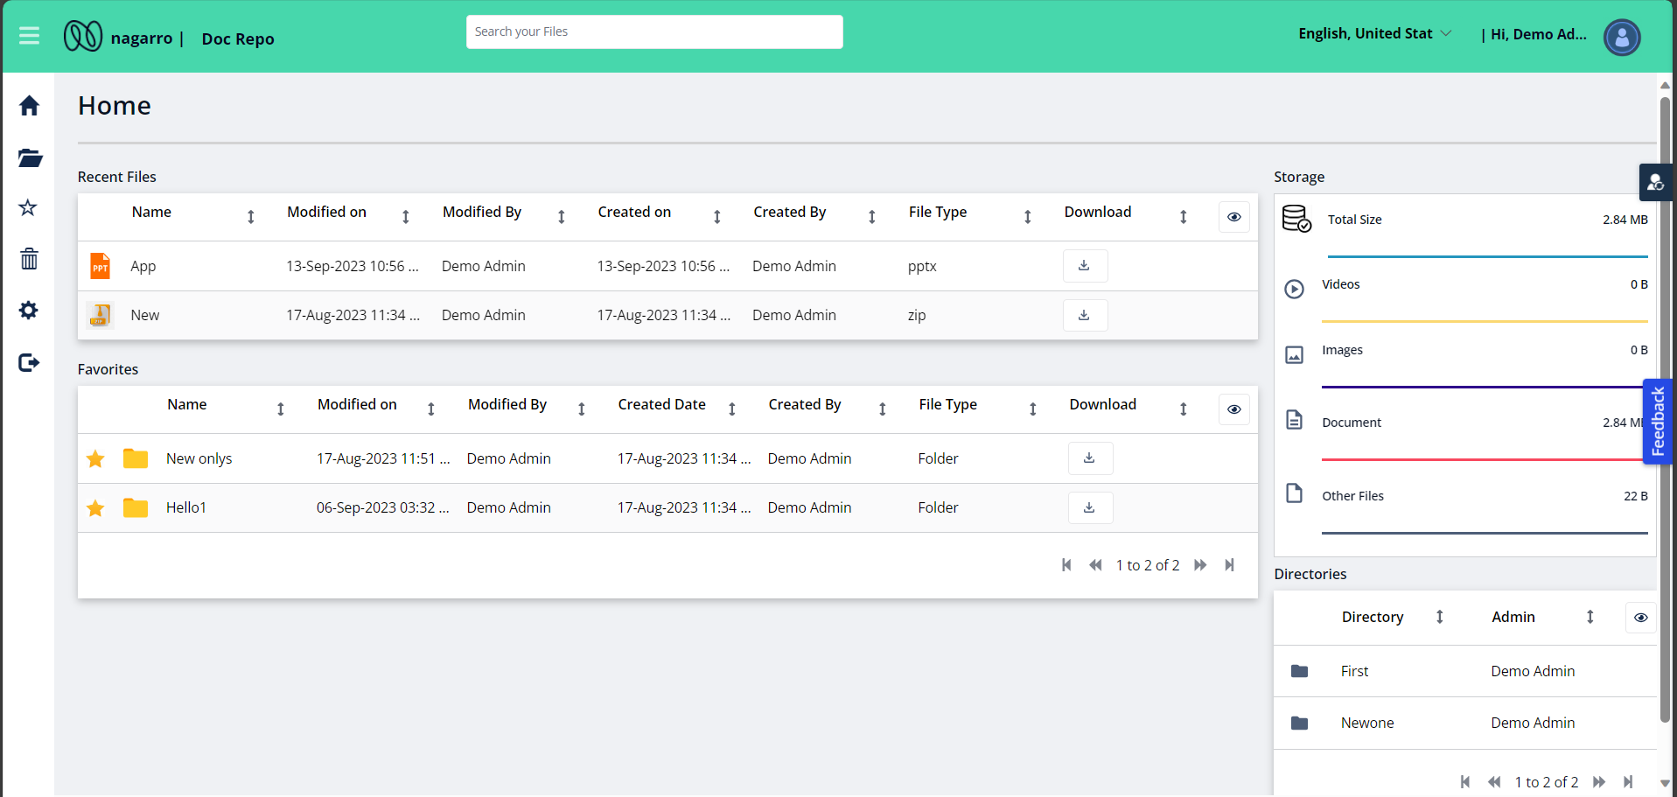
Document Repository– Home Page

Slide 8
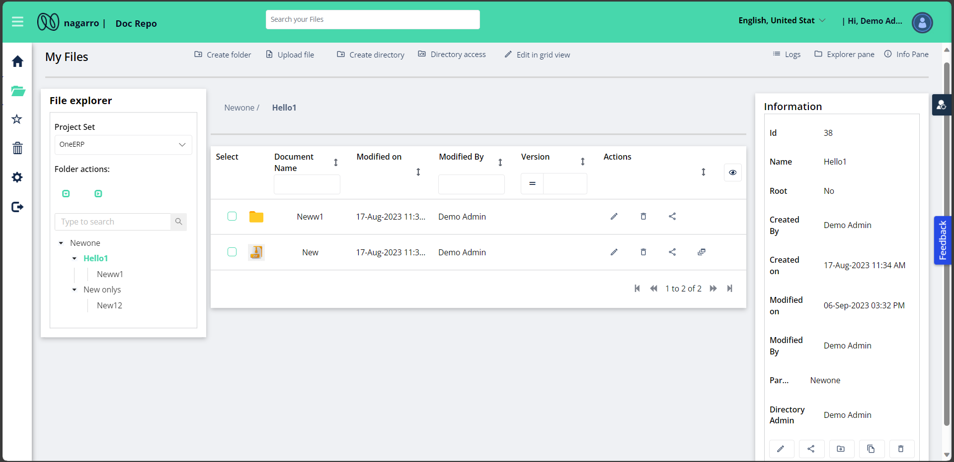
Document Repository– Directory overviw

Slide 9
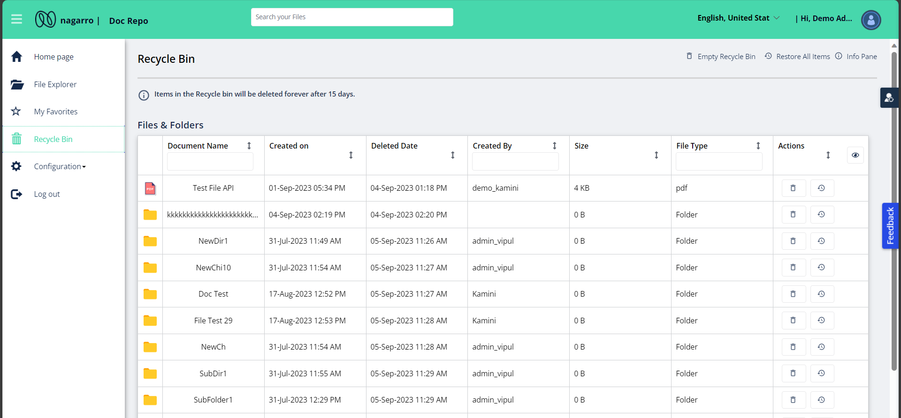
Document Repository– Recycle Bin

Slide 10
Thank You

Slide 11
Document Repository– Key features (2/2)
Features/Functional Package
High-level description
Multilingual Support
Application can support below languages:
English
German
Spanish
Other languages can be configured if required
Access control

Slide 12
A document repository is a centralized location or software platform used to store, organize, manage, and retrieve various types of electronic documents. It provides a structured and secure environment for storing documents, making them easily accessible to authorized users within an organization.
Introduction

Slide 13
Create directories or folder
Show directories in tree view format.
Create directories inside any directory.
Set access rule to control the read , write , delete access on directories.
Edit or delete directory.
View files & folder inside directory in detail grid.
Upload new document in any directory.
Download one or multiple files from the directory.
Delete the files from directory and recycle bin.
Mark file as favourite.
Create multiple revisions of one file document.
User management.
Email Notification
Audit trail
Rest API to upload a file in given directory.
Features

