Slide 1
HRMS

Slide 2



A Human Resource Management System (HRMS) is a comprehensive application designed to streamline and optimize various HR related tasks and processes within an organization. This system centralizes employee data, streamlines HR process, improve data accuracy and enhance employee engagement. It is a valuable tool for managing a company’s most important asset- its workforce – effectively and efficiently. Following are the key features/module of this application
Employee information management
Onboarding and offboarding
Timesheet and attendance management
Training and development
Leave management
Employee self service
Additionally, this application includes a chatbot support which is capable of handling almost all the operations that are directly done through the application
Introduction

Slide 3
Our understanding of detailed functional requirements, integration systems, and key user personas
HRMS - Requirement summary
Key User
Roles
Admin
Employee
HR
Manager
Employee information management | Onboard candidates & update his/her information Employee information field update through schedular Extension or shortening of probation period Offboard candidates
Leave Management | Configure different leave types & number of days for each leave type Credit leave for an employee (Monthly/Quarterly/Yearly) through schedular Leave approval configuration for manager approval workflow (else the leave will be auto approved) Configure weekend as needed Leave cancellation and reflection of the same in leave balance Pending approval/rejection of a leave by manager and reflection of the same in leave balance View total leaves and available PL , CL and floating lave balance under leave summary
Chatbot | A web interface to mimic different HRMS modules through text interaction. Able to get following employee and leave information via queries
Employee self services | Raise a service request for different categories Assign a service request for further processing Service request status and priority update Add comments on the existing service request
Master Data management | Employee information master data configuration Leave management master data configuration Skills and Certifications master data configuration
KEY FUNCTIONALITIES
Project and timesheet management | Manager can add project and assign those projects to employee/team Assign multiple projects to an employee User can fill his/her timesheet on daily basis Manager can analyze the daily attendance of a particular employee Employee can modify timesheet post submission
Company Branding | Option to add company branding dynamically for login page image and company logo.
Skills and Certifications | Configure skill category, skill name and experience through master data Add different skills for an employee Add different certifications for a skill
Email notifications | Email notifications on below triggers (but not limited to)​ employee account creation​ when employee submits a service request​ when employee submits a leave request​ employee confirmation
Audit Trail | Feature to log employee action as history for audit
Integrations
Legends
Current scope
Future scope
External users
Internal users

Slide 4
HRMS– Key features (1/3)
Features/Functional Package
High-level description
Employee information management
Option to onboard candidates.
Once the candidate is onboarded his/her information can be updated.
Employee information field update through schedular.
Probation period configurations- Option to extend/reduce probation period.
Option for offboarding candidates
Employee self services
Option to raise a service request for different categories.
Option to assign a service request for further processing
Service request status and priority can be updated accordingly
Option to add comments on the existing service request
Leave Management
Option to configure different leave types and number of days for each leave type.
Option to credit leave for an employee- Monthly/Quarterly/Yearly through schedular
Leave approval configurations – If the leave approval configuration is enabled, then manager approval is required else the leave will be auto approved.
Weekend configurations – Option to configure weekend as needed.
Option to cancel a leave and leave balance will be updated accordingly.
Option to approve/reject pending a leave by manager and leave balance will be updated accordingly.
Show the total number of leaves and available, PL , CL and floating lave balance under leave summary.
Project and timesheet management
Manager can add project and assign those projects to employee/team
Multiple projects can be assigned to an employee
User can fill his/her timesheet on daily basis
Manager can analyze the daily attendance of a particular employee
Employee can modify timesheet post submission

Slide 5
HRMS– Key features (2/3)
Features/Functional Package
High-level description
Skills and Certifications
Option to configure skill category, skill name and experience through master data.
Option to add different skills for an employee.
Option to add different certifications for a skill.
Email notifications
Email notifications on below triggers (but not limited to)​
Notification for employee account creation​
Notification when employee submit a service request​
Notification when employee submit a leave request​
Notification for employee confirmation/probation.
Company Branding
Option to add company branding dynamically for login page image and company logo.
Audit and Trail
Feature to log employee action as history for audit.
Multilingual support
Application can support below languages:
English
German
French
Arabic

Slide 6
HRMS– Key features (3/3)
Features/Functional Package
High-level description
Chatbot
A web interface to mimic different HRMS modules through text interaction.
Able to get following information via queries-
Greetings
Employee Information- Team, Manager, Designation etc
Option to Check remaining leave balance including CL and PL.
Option to apply for a leave .
Option to get list of applied leaves.
Option to raise a ticket and get list of raised tickets.
Option to check holiday calendar
Master Data management
Employee information master data configuration
Department
Designation
Cost Center
Employee band
Employee status
Location
Leave management master data configuration
Leave balance
Public holidays
Leave types
Skills and Certifications
Skill Category
Skill name

Slide 7




HRMS Architecture Diagram
Mendix Runtime Engine
Application Logic
User Management
Master Data Management
Core Modules
Model Driven Development
Persistence Layer
Login via SSO
HTTP Server
Security Layer
Employee Management
Service Request management
Attendance Management
Skill Management
Nanoflow
Microflow
Java Action
JS Action
Domain Model
Database
Learning and Development
Job Offers
Browser Access
Integration Layer
Integration Layer
Storage
Mail Server Integration
© 2023 — Nagarro
7

Slide 8
Sample mock-up screens

Slide 9
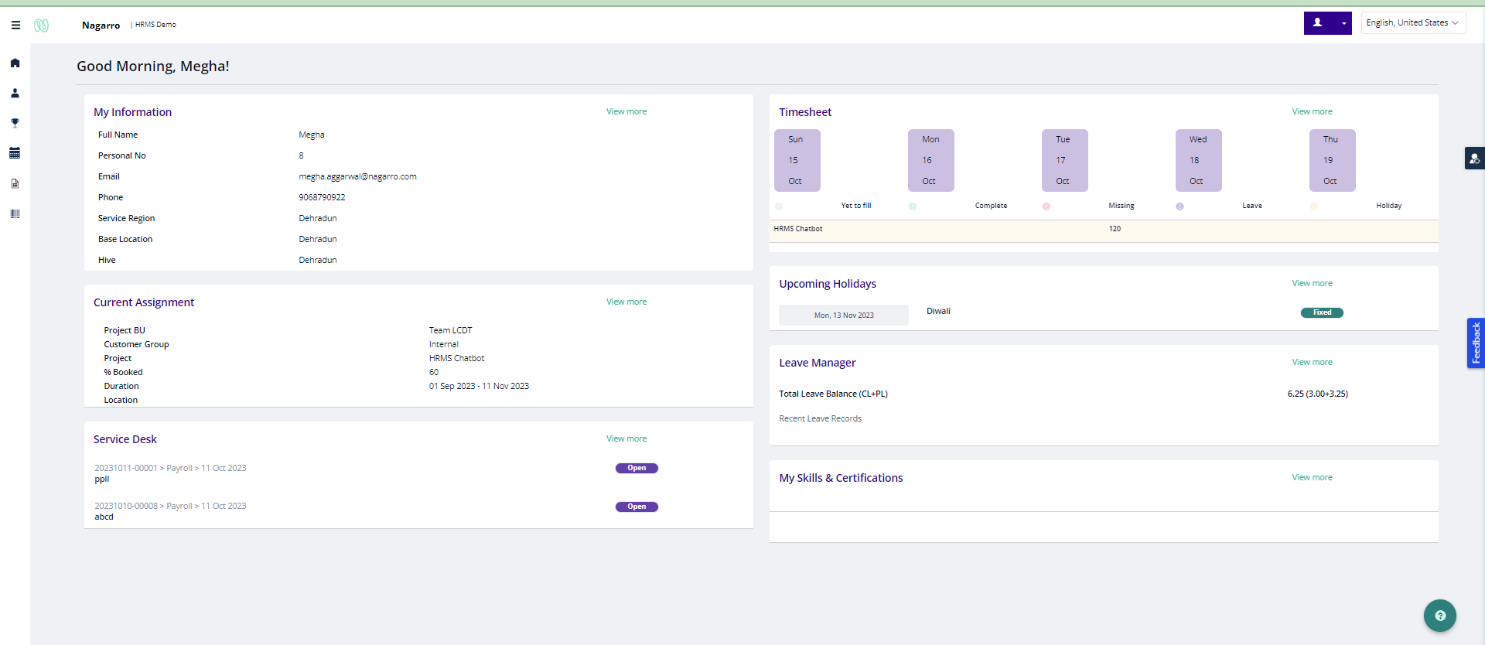
Home Page

Slide 10
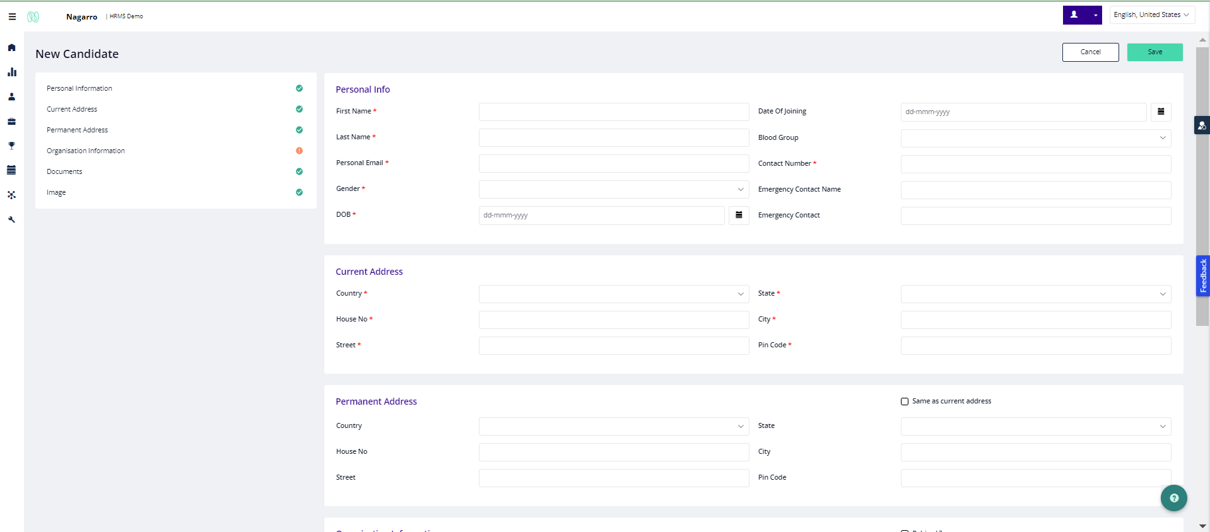
Onboarding

Slide 11
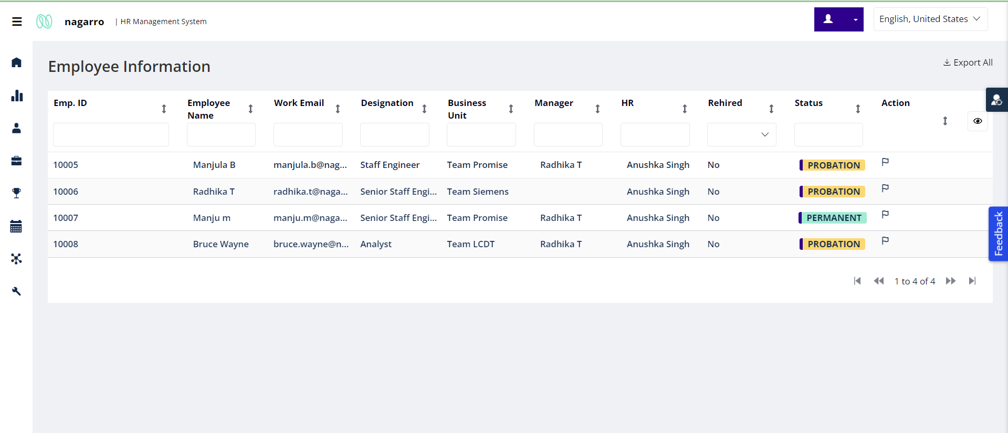
Employee information – List view

Slide 12
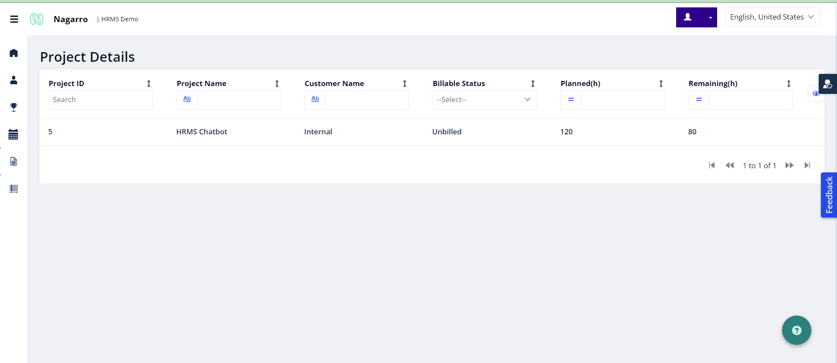
Projects

Slide 13
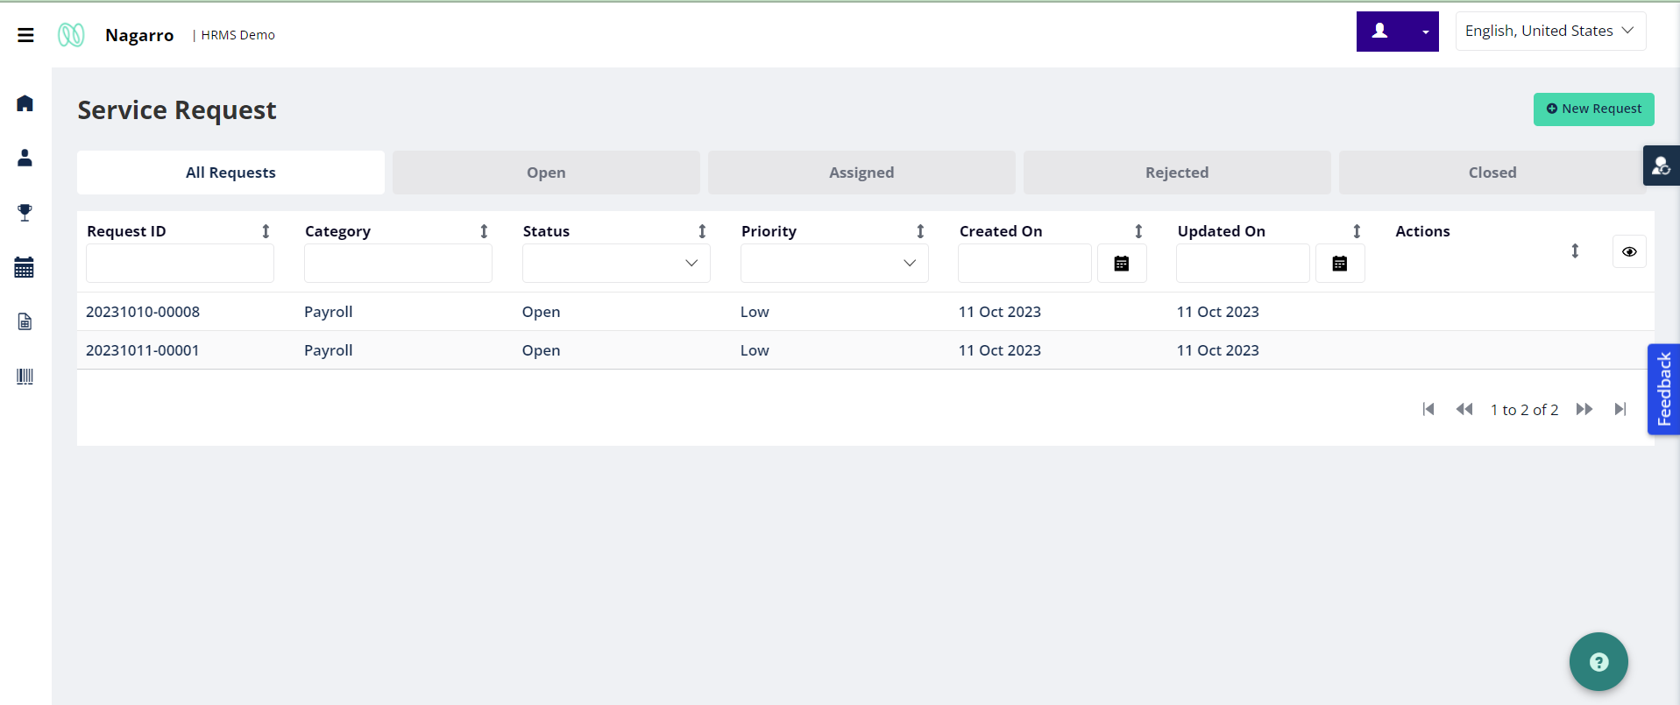
Service request – List view

Slide 14
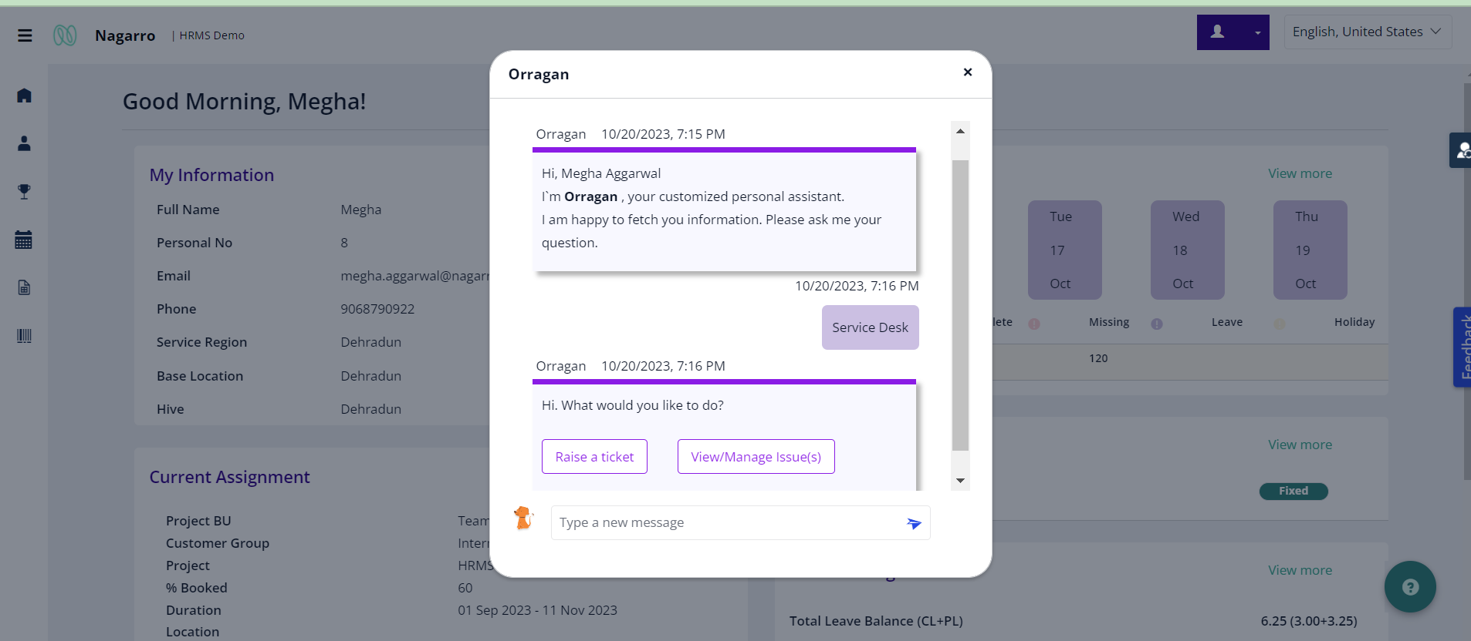
Chatbot

Slide 15
Thank You

Slide 16
Create and store employee information.
Automated UserId and password generation for the new employee which is further sent to the employee through email post HR confirmation.
Employees can log into the system and view their employee information.
Employees can raise request to get their personal information updated.
Employee can create their own skill reports like technical skills , logical skills , soft skills etc.
Schedule the trainings for the employees.
Absence Management-Employee can apply for their leaves on the system which then goes through a streamlined approval process.
Employees can keep a track of their casual, planned and flexible leave balance along with customizable public holiday calendar.
Hr’s can view and manage the curated list of Job Application that they received they're by streamlining the Hiring process.
Features

Slide 17
Timesheet - All the employees can log their timesheet using the application.
Email Notification.
Audit trail.
Multi-language support.
Configurable Branding.
Features

Slide 18
Get Employee Information
My Team info
Manager info
Department info
Designation info
HR info
Check Leave balance including CL, PL , Flexi etc
Apply for leave
Applied leaves
Greetings
Service desk
View and mange issues
Raise Ticket
Check holiday calendar.
Command configuration
Phrases configuration
Upcoming
Send broadcast messages to employees by admin.
Chatbot Features

