Slide 1
Detection of Payload-Free Pretexting Emails Through Claim-Routed Verification Against Email Headers and Thread History
PROBLEM STATEMENT NO. 37 · CYBER SECURITY (BCSE410L)
The claim-routed verification pipeline
PRESENTED BY
FACULTY
M Naga Sai Dattu
Dr. Arun Prasath G
23BCE0757
VIT SCOPE
Notes:
Title. The project detects pretexting emails that carry no link and no attachment, by checking what the email claims about itself against its own headers and its own conversation history.

Slide 2



An email attack with nothing to scan
THE PROBLEM
Some of the most damaging email attacks carry nothing a security scanner can find: no link to a fake website and no attachment with a virus.
Someone writes as your boss, your finance director or a supplier, tells a believable story and asks you to pay, change bank details or send data.
If you believe the story, you do the damage yourself.
WHAT A SCANNER SEES
No link
nothing for a link checker to test
No attachment
nothing to open and inspect
Pretexting: building trust through an invented scenario, with the attacker taking part in the conversation [1].
Business email compromise (BEC): pretexting aimed at money.
Payload-free: no link and no attachment; the whole attack is in the words.
Only a story and a request
the reader is the one who acts
Notes:
Plain version of the problem. The attack is only words. Pretexting means building trust with an invented story. When it is aimed at money it is called business email compromise. Payload-free means there is no link and no attachment, so tools that look for those find nothing.

Slide 3
It looks clean to every check
WHY TODAY'S DEFENCES MISS IT
1
Scanners look for the payload
From: "David Chen - Finance Director" <d.chen.finance@gmail.com>
Reply-To: finance.dept.acme@protonmail.com
Authentication: spf=pass dkim=pass dmarc=pass (all for gmail.com)
Filters inspect links and attachments. This email has neither.
2
Every authentication check passes
Hi Priya, this is David from Finance. I need you to process a wire transfer before 3 PM today. I'm in meetings all day and can't take calls. Please don't loop in anyone else, just get it done.
SPF [2], DKIM [3] and DMARC [4] all pass, because the email really was sent from a gmail.com account.
3
The checks prove only the domain
"This came from gmail.com" is true, and says nothing about whether the writer is the finance director.
A made-up example used throughout. Priya works at acmecorp.com, where the real David is the finance director.
The attack shows only as a disagreement between what the email claims and what its headers prove.
Notes:
SPF, DKIM and DMARC are the standard email authentication checks. They prove which domain sent the message. Here that domain is gmail.com, so they pass. Nothing in them says whether the sender is really David from Finance. The Reply-To quietly sends answers to a third address.

Slide 4


Two kinds of attacker
WHO WE DEFEND AGAINST
The outside impersonator
The attacker inside a real account
Writes from a free mailbox, a lookalike domain or a forged copy of your own domain, often with a misleading display name and Reply-To.
Has taken over a real mailbox, a supplier's account or an ongoing thread. Mail comes from the real sender's domain, so every header check passes.
WHAT GIVES IT AWAY
WHAT GIVES IT AWAY
The headers do not support the identity the email claims.
The conversation changes: new urgency, new bank details, a new way of sending.
CHECKED BY
CHECKED BY
The header verifier (N3)
The thread verifier (N2)
Out of scope: an attacker who has read the mailbox and copies the real sender's reply identifiers, sending details and calm tone. No rule here can catch that message.
Notes:
Two attackers need two kinds of evidence. From outside, the headers give the impersonator away. From inside a real account, the headers are genuine, so only the history of the conversation can show that something changed.

Slide 5
What earlier detectors leave open
EXISTING WORK
Work | What it does | What it leaves open
Ho et al. [5] | Detects phishing sent from hijacked accounts inside an organisation | Focuses on emails with a malicious link; the authors note that attacks without one are likely underestimated
BEC-Guard, Cidon et al. [6] | Judges impersonation from the organisation's header history, then reads the body with names and signatures removed | The statements that say who is writing are never compared with the headers
ChatSpamDetector, Koide et al. [7] | Asks GPT-4 to look for impersonation and header spoofing | Its data exclude emails without a link, and each email costs one model call
Paul et al. [8] | Label warning signs such as the organisation a sender claims | Leave the comparison of the claim with the metadata to a later verification step
Karki et al. [9]; Tooher and Lallie [10] | Find persuasion principles in the email text | Read the body only
Our aim: check each claim of a payload-free email against its own headers and its own thread, and give the reason for every alarm.
Notes:
Each of these works covers part of the problem. None checks, for an email with no link, what the body claims against both the headers and the thread, with a stated reason for each alarm. ChatSpamDetector already compares the sender name with the address, so we do not claim to be the first to compare a claimed sender with the headers.

Slide 6


Check the email the way a fact-checker would
PREMISE
Automated fact-checking splits the work into finding claims, gathering evidence and giving a verdict with its reason [11]. We apply the same steps to an email.
CLAIM
EVIDENCE
VERDICT
What the email says about itself
What can confirm or contradict it
Contradiction, consistent or not checkable
"this is David from Finance", "process a wire"
its own headers and, for a reply, the earlier messages of its thread
each with the rule and the evidence written out
CLAIM CONDITIONING: THE SAME HEADER MEANS DIFFERENT THINGS UNDER DIFFERENT CLAIMS
A private Gmail user writes to a friend
"This is David from Finance", sent from gmail.com
dmarc=pass for gmail.com
dmarc=pass for gmail.com
Nothing is claimed, so this is normal.
Contradiction, high: the claim is internal, the sender is a free mailbox.
Tactics such as urgency only raise the weight of a contradiction; they never create one.
Notes:
This is the central idea. A header value is not good or bad on its own. dmarc=pass for gmail.com is normal for a private Gmail user, and a contradiction when the body claims to be a colleague. We call this claim conditioning: the claim decides what the header means.

Slide 7
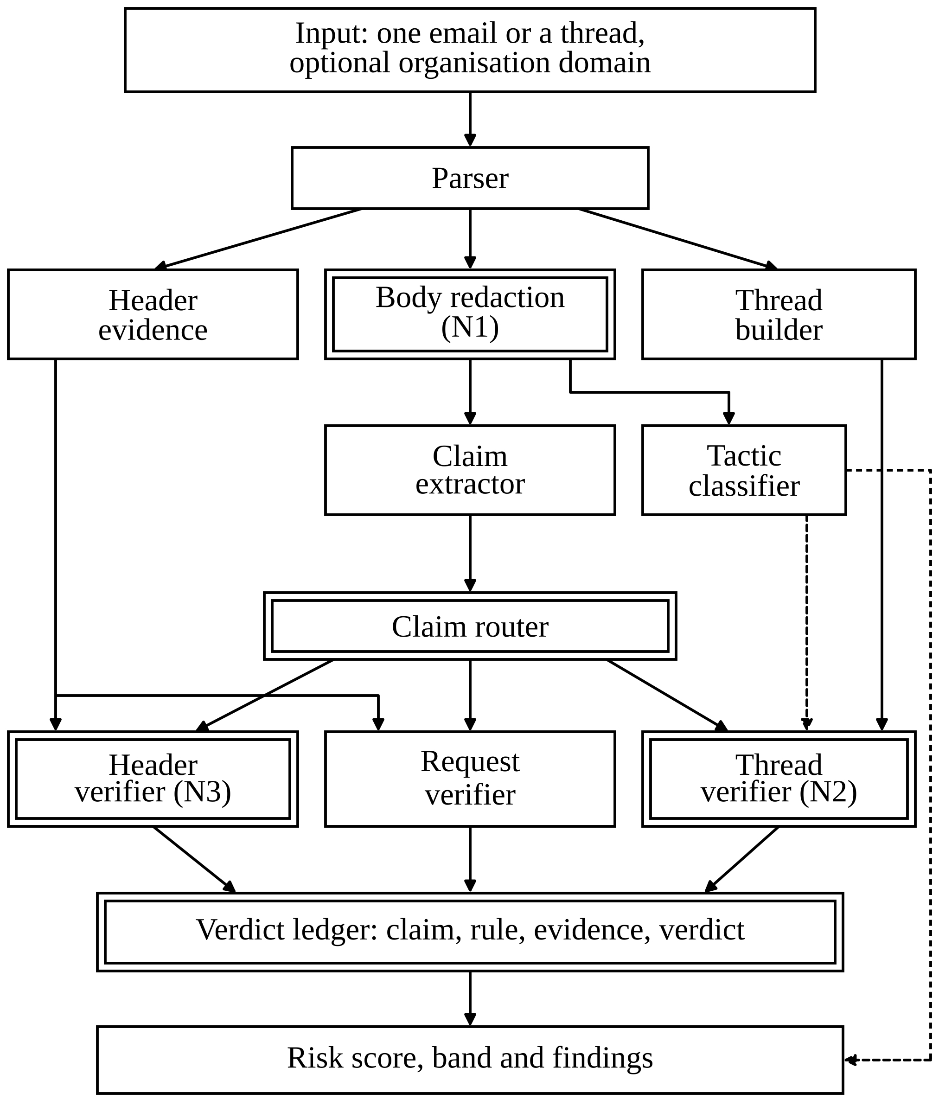
The claim-routed verification pipeline
ARCHITECTURE
1
Split
The parser splits each message into headers, body and thread links. Three branches follow: header evidence, body redaction and the thread builder.
2
Read the body
Links, addresses, domains and file names become placeholders before any model reads the text (N1). A claim extractor finds typed claims; a tactic classifier scores seven tactics, such as urgency and secrecy.
3
Route and check
The router sends each claim to the verifier that can test it: the header verifier (N3), the request verifier or the thread verifier (N2).
4
Record and score
Every verdict is a ledger row naming the claim, the rule and the evidence. The risk score is computed from the ledger.
In the figure, double borders mark the parts introduced in this work; dashed lines carry tactic probabilities to the thread verifier and the score.
Notes:
This is Fig. 1 of the paper. The key step is the router: each claim goes only to the checker that has the evidence to test it. Tactics go to no verifier, because no header can prove or disprove urgency.

Slide 8



What each verifier asks
ARCHITECTURE
Header verifier (N3)
Request verifier
Thread verifier (N2)
Do the headers support who the email claims to be?
Who is asking for the money or the data?
Does this reply fit its own conversation?
Compares the From domain, the domain that authentication vouched for and the domain the claim implies.
Flags requests from a free mailbox, a lookalike sender, a failed DMARC check or a Reply-To to another domain.
Looks for first urgency or secrecy, new bank details, a new sending path and reply links that point to nothing.
THREE POSSIBLE VERDICTS
Contradiction: high, medium or low
Consistent
Not checkable (evidence missing)
Only contradictions add points: high 60, medium 35, low 5. The strongest finding counts in full; each further claim counts half as much.
Low risk: below 35
Suspicious: 35 to 69
High risk: 70 and above
Notes:
Each verifier answers one question. A change of bank details can never be confirmed by headers, so it is left to the thread. When evidence is missing, for example the organisation's own domain is unknown, the verdict is not checkable rather than guessed. Only contradictions add to the score.

Slide 9
The fake David, checked claim by claim
WORKED EXAMPLE
Claim found in the body | Checked by | Evidence | Verdict
"this is David from Finance" (internal affiliation) | Header verifier | From gmail.com, a free mailbox; authenticated as gmail.com; organisation acmecorp.com | Contradiction, high 60 points
"process a wire" (payment request) | Request verifier | Payment request from a free mailbox outside acmecorp.com | Contradiction, high +30 points (counts half)
90
How the score adds up
Strongest claim, a high contradiction: 60 points.
Second claim, also high, counts half: 30 points.
Urgency and secrecy, when detected, raise it further; the score is capped at 100.
High risk
Why no row for the Reply-To? It sends answers to protonmail.com, but the body makes no claim about where replies should go, so it appears in the findings and adds no row. The claim decides what a header means.
before any tactic counts
Notes:
The report for this email lists two rows. Each names the claim, the checker, the evidence and the verdict, so a person can see exactly why the email was flagged and check it.

Slide 10
A hijacked supplier thread
WORKED EXAMPLE
1
Marta, the supplier, sends invoice 4471 with the usual bank account.
WHAT THE THREAD VERIFIER SEES
Request drift: a bank account that never appeared in the thread replaces the usual one
2 to 4
An ordinary exchange about delivery and a return fee.
Tactic onset: urgency and secrecy appear for the first time
Sending-path drift: a different mail program from Marta's earlier messages
5
From Marta's real address. SPF, DKIM and DMARC pass.
"Our bank has changed this week ... Please use our new account for invoice 4471 ... Pay today, it is urgent ... please do not mention it to anyone at our company and reply only to me."
Thread integrity: consistent: the attacker is inside the real account, so the IDs and quotes are real
Message 5 is marked as the point where the thread flipped. With an honest fifth message instead, the result is Low risk.
A made-up demo thread: all names, companies and account numbers are invented.
Notes:
This is the case no single-message check can see. The account is genuine, so every authentication check passes. Only the history of the conversation gives it away: new bank details, urgency and secrecy appearing for the first time, and a different mail program.

Slide 11
Nine public sources and how each is used
DATA
99,324
Role | Sources
Phishing attacks | Nazario phishing corpus [12]; phishing_pot honeypot samples [13]
Fraud attacks | Nigerian Fraud file of a merged public corpus [14]
Legitimate mail and spam | CEAS-08, Enron [15] and Ling files of the merged corpus [14]; SpamAssassin public corpus [16]
Modern legitimate mail with authentication headers | Apache Kafka and Tomcat user mailing lists [17]
unique emails from nine public sources
20,313
of them attacks
70 / 15 / 15
ALSO BUILT
1,591 real threads rebuilt from Enron and the Apache lists, for the thread tests
690 emails labelled for tactics and claims by two language models of one family, 140 of them in the test split
Synthetic emails and pairs (an attack and a benign twin), always reported apart from real mail
split by source and category: 69,542 train, 14,879 validation, 14,903 test
No source holds both attacks and legitimate mail, so a pooled score mixes corpus and detection. Results are therefore also given per source.
Notes:
No public collection of real payload-free fraud exists, so the evaluation uses public phishing and fraud collections plus synthetic cases. The Apache lists add modern legitimate mail with real authentication headers. Emails on one subject stay in the same split so near-copies cannot leak from training into testing.

Slide 12
How we tested
EVALUATION
THE RULES WE KEPT
LINKS (N1)
THREADS (N2)
The test split was frozen before it was read: a hash of every frozen file, checked by every script.
Each script was rehearsed on validation data first, and every test run was logged.
95% intervals from 1,000 bootstrap resamples of whole groups; differences between systems are paired.
When an interval includes 0, no system is called better.
Pitfalls checked against Arp et al. [18].
DistilBERT [19] trained on raw text (A) and on redacted text (B). How much does each lose when links are hidden?
Synthetic takeover replies placed in real threads. Thread rules against header and request rules alone.
Measure: F1 on the attack class
Measure: cases detected; false alarms
CLAIMS AGAINST HEADERS (N3)
THE PARTS
The routed score against four logistic regressions given the same information.
Tactic classifier and claim extractor against LLM labels; the score's false alarm budget.
Measure: F1, recall, false alarm rate, AUC
Measure: macro F1; share of legitimate mail flagged
F1 balances catching attacks against raising false alarms. AUC measures how well a score ranks attacks above legitimate mail, without a cut-off.
Notes:
The test data were locked before anything was measured, so no rule or threshold could be tuned on them. Every number comes with a 95% interval; if the interval of a difference includes zero, we do not call either system better.

Slide 13
Part of a normal detector's accuracy comes from reading links
RESULT 1 · LINKS (N1)
+0.073
A's drop minus B's drop, 95% interval [+0.061, +0.086]
The same direction holds for TF-IDF with logistic regression: +0.035 and +0.028.
Training on redacted text keeps most of the accuracy: B on redacted text scores 0.932, A on raw text 0.935.
The loss sits in the phishing sources; on Nigerian fraud A's recall stays at 99.4%.
A: +0.059 [+0.050, +0.069]. B: −0.014 [−0.019, −0.009]. F1 on the attack class.
Corpus labels; one training sample of 9,856 emails; two seeds.
Notes:
Model A learned from text with links, model B from text with links replaced by placeholders. When links are hidden at test time, A loses accuracy and B does not. So part of a normal detector's accuracy is link-reading, which real pretexting does not offer.

Slide 14
Thread checks catch takeovers that header checks miss
RESULT 2 · THREADS (N2)
18 of 25
48 of 51
Apache takeovers found: 72.0% [52.0%, 88.0%]
Enron takeovers found: 94.1% [88.2%, 100.0%]
Header and request rules alone found 5 of 25 and 0 of 51.
False alarms on the real next reply: 0 of 25 on Apache, 1 of 51 on Enron.
Lookalike swaps and forged threads were also caught; these mainly confirm that the rules work as specified.
The injected messages are synthetic, so this tests the rules against the construction, not against real attackers.
Notes:
A takeover reply comes from the real account, so the header checks have nothing to contradict. The thread rules compare the reply with the earlier messages and find most of these cases, with few false alarms on the genuine next reply.

Slide 15
As a plain detector, the pipeline is not the best
RESULT 3 · DETECTION
0.238
routed F1 [0.204, 0.277], recall 13.6%, against 0.882 for parallel fusion
Its AUC is also the lowest: 0.812, against 0.949 to 0.993.
It can flag only emails with a checked claim, and 788 of the 3,045 attacks have one. On those, its F1 is 0.679 [0.633, 0.734]: not distinguishable from text only or headers only, still behind fusion.
The learned systems saw attack labels, and a headers-only model can partly learn which corpus an email came from. Neither removes the gap.
3,045 test attacks against 6,357 legitimate test emails. Learned systems held to the routed score's false alarm rate, with a 0.5% floor.
Notes:
This is the honest negative result. On pooled public data the routed score finds fewer attacks than four simpler systems given the same information. The main reason is that it can only flag an email with a claim it can check, and most attacks in these collections have none.

Slide 16
Every alarm comes with its reason
RESULT 4 · EXPLAINED ALARMS
442 of 442
flagged test emails have a claim, a rule and evidence behind them
None of the flat classifier's 1,819 flags names a claim.
This is a property of the design, not a measured gain.
Headers only flags every attack and every twin: it cannot tell them apart. The routed score flags 19 attacks (61.3% [45.2%, 77.4%]) and no twins. Text and headers in this arm are synthetic.
Notes:
Each pair is an impersonation attack and a benign twin from the real company domain. A model that reads headers alone flags both, because it does not know what the email claims. The routed score uses the claim, so it flags attacks and leaves the twins alone. This arm is synthetic, so it shows the idea works as designed, not how often it would on real mail.

Slide 17
Tactics, claims and false alarms
RESULT 5 · THE PARTS
TACTICS
CLAIMS
0.479 vs 0.500
0.568
Macro F1 of the DistilBERT tactic classifier against a keyword baseline. The difference, −0.021 [−0.144, +0.091], includes 0: neither is better.
Macro F1 of the claim extractor over five claim types, with a 95% interval of [0.470, 0.646]. Weakest: internal affiliation, 2 of 12 found.
FALSE ALARM BUDGET
REWORDING
4 of 5
18 of 24
groups of legitimate mail stayed within budget. CEAS-08 ham was over at 5.60% of 268, with an interval [3.42%, 9.03%] that includes the budget.
flags kept after a language model reworded 144 attack bodies. Headers were untouched, so header findings survive by construction.
Tactic and claim scores: 140 labelled test emails, with labels from language models of one family, not people.
Notes:
The tactic classifier ties with a simple keyword baseline, so we do not claim it is better. The claim extractor is moderate, and the labels it is measured against come from one model family. The false alarm budget held in four of five groups.

Slide 18



Built to explain, and to keep nothing
IMPLEMENTATION
The pipeline
SERVICE PROTECTIONS
Written in Python. The only trained model used during analysis is the tactic classifier, a DistilBERT model [19] fine-tuned on labelled emails. The claim extractor uses a pretrained name recogniser and 85 hand-written token patterns. No language model runs during analysis.
An API key on every request
A rate limit per client
A size limit on each email
A strict schema for every request
Each report checked against its ledger before it is returned
Nothing stored after the request
The web page
Paste an email or a thread and get a risk score from 0 to 100, a band and each finding with its claim, rule, evidence and reason in plain English.
Privacy
No database. Each email is held in memory for one request and then forgotten.
Notes:
The system runs as a small API with a web page. No language model is called during analysis, so no email is sent to an outside service.

Slide 19






What these results do not show
LIMITATIONS
Never run at a real company. No public set of real payload-free BEC exists.
Tactic and claim labels come from language models of one family, not people (annotator kappa 0.501 and 0.458). Such labels need validation against human labels [20].
No source holds both attacks and ordinary mail, so pooled numbers mix corpus and detection.
Hijack cases and impersonation headers are synthetic: they show that the rules work as defined, not how often real attackers behave that way.
The link test rests on one training sample and two seeds. English only. Internal-affiliation checks need the organisation's domain.
An attacker who copies a real thread's identifiers, sending details and tone is not caught by any rule here.
Notes:
These limits are stated in the paper as well. The most important: no real payload-free BEC data, labels from language models rather than people, and synthetic hijack cases.

Slide 20
Conclusion and future work
CONCLUSION
WHAT WE FOUND
WHAT WOULD TEST IT ON REAL ATTACKS
Checking what an email claims against its own headers and thread gives every alarm a stated reason.
It finds synthetic takeover replies in real threads that header and request rules miss.
Redacting links is cheap and removes a shortcut.
On pooled detection over public data sets, it is behind all four learned classifiers.
Labelled payload-free BEC emails
Real hijacked threads that keep the receiving side's authentication headers
A sample of emails labelled by people for tactics and claims
Notes:
The design gives reasons and catches synthetic takeovers, but it does not by itself detect more attacks on these public data sets. The next step is real data: labelled payload-free BEC, real hijacked threads and human labels.

Slide 21
References
REFERENCES
[1] Verizon, “2026 data breach investigations report,” 2026. Accessed: Oct. 12, 2026. [Online]. Available: https://www.verizon.com/business/resources/reports/dbir/
[2] S. Kitterman, “Sender Policy Framework (SPF) for authorizing use of domains in email, version 1,” RFC 7208, Apr. 2014, doi: 10.17487/RFC7208.
[3] D. Crocker, T. Hansen, and M. Kucherawy, Eds., “DomainKeys Identified Mail (DKIM) signatures,” RFC 6376, Sep. 2011, doi: 10.17487/RFC6376.
[4] T. Herr and J. Levine, Eds., “Domain-based message authentication, reporting, and conformance (DMARC),” RFC 9989, May 2026, doi: 10.17487/RFC9989.
[5] G. Ho et al., “Detecting and characterizing lateral phishing at scale,” in Proc. 28th USENIX Security Symp., Santa Clara, CA, USA, 2019, pp. 1273–1290.
[6] A. Cidon, L. Gavish, I. Bleier, N. Korshun, M. Schweighauser, and A. Tsitkin, “High precision detection of business email compromise,” in Proc. 28th USENIX Security Symp., Santa Clara, CA, USA, 2019, pp. 1291–1307.
[7] T. Koide, N. Fukushi, H. Nakano, and D. Chiba, “ChatSpamDetector: Leveraging large language models for effective phishing email detection,” arXiv:2402.18093, 2024.
[8] M. Paul, G. Bartlett, J. Mirkovic, and M. Freedman, “Phishing email detection using inputs from artificial intelligence,” arXiv:2405.12494, 2024.
[9] B. Karki, F. Abri, A. Siami Namin, and K. S. Jones, “Using transformers for identification of persuasion principles in phishing emails,” in Proc. IEEE Int. Conf. Big Data, Osaka, Japan, 2022, pp. 2841–2848.
[10] P. Tooher and H. S. Lallie, “A two-stage deep learning framework for AI-driven phishing email detection based on persuasion principles,” Computers, vol. 14, no. 12, Art. no. 523, 2025.
[11] Z. Guo, M. Schlichtkrull, and A. Vlachos, “A survey on automated fact-checking,” Trans. Assoc. Comput. Linguistics, vol. 10, pp. 178–206, 2022.
[12] J. Nazario, “Phishing corpus.” Accessed: Oct. 12, 2026. [Online]. Available: https://monkey.org/~jose/phishing/
[13] rf-peixoto, “phishing_pot: A collection of real phishing samples collected via honey pots,” GitHub repository. Accessed: Oct. 12, 2026. [Online]. Available: https://github.com/rf-peixoto/phishing_pot
[14] A. Al-Subaiey, M. Al-Thani, N. A. Alam, K. F. Antora, A. Khandakar, and S. M. A. U. Zaman, “Novel interpretable and robust web-based AI platform for phishing email detection,” Comput. Electr. Eng., vol. 120, Art. no. 109625, 2024.
[15] B. Klimt and Y. Yang, “The Enron corpus: A new dataset for email classification research,” in Machine Learning: ECML 2004. Berlin, Germany: Springer, 2004, pp. 217–226.
[16] Apache SpamAssassin Project, “SpamAssassin public corpus.” Accessed: Oct. 12, 2026. [Online]. Available: https://spamassassin.apache.org/old/publiccorpus/
[17] Apache Software Foundation, “users@kafka.apache.org and users@tomcat.apache.org mailing-list archives.” Accessed: Oct. 12, 2026. [Online]. Available: https://lists.apache.org/
[18] D. Arp et al., “Dos and don’ts of machine learning in computer security,” in Proc. 31st USENIX Security Symp., Boston, MA, USA, 2022, pp. 3971–3988.
[19] V. Sanh, L. Debut, J. Chaumond, and T. Wolf, “DistilBERT, a distilled version of BERT: Smaller, faster, cheaper and lighter,” arXiv:1910.01108, 2019.
[20] N. Pangakis, S. Wolken, and N. Fasching, “Automated annotation with generative AI requires validation,” arXiv:2306.00176, 2023.
Notes:
References are numbered in the order they are first cited in this deck.

