Slide 1
Overbooking Clinic Appointments with Reinforcement Learning
Exploration Schedules, Learning Efficiency and Robustness to Shifts in the No-Show Rate
Topic 7: Appointment Overbooking and No-Show Management
M Naga Sai Dattu (23BCE0757) Prakrit Bahl (23BCE0826)
School of Computer Science and Engineering (SCOPE)
Vellore Institute of Technology, Vellore
Notes:
Speaker: Prakrit. Introduce both of us and the topic. Our project takes Paper 7, which we were given with its code, runs all of its methods on the real Kaggle data, and adds a new method that beats them. Prakrit covers the problem, the data and the methods (slides 1 to 8); Nagasai covers our method, the results and the code (slides 9 to 18).

Slide 2
The problem: patients who do not show up
In the real data, 20.2% of booked patients did not come to their appointment
An empty slot is lost capacity, so clinics overbook: they give out more appointments than they have slots
Book too few extra patients: slots stay idle and the waiting list grows
Book too many: when most patients come, the extra ones are seen in overtime
The right number depends on who is booked, so it changes from session to session
Question: before each session, how many extra patients should the clinic book?
Each choice also changes the waiting list for later sessions, so this is a sequential decision problem, which reinforcement learning (RL) is built for [3]
Notes:
Speaker: Prakrit. Explain what the clinic has to balance. About one in five patients does not come. Booking extra patients fills those slots, but if everyone turns up the clinic works overtime. The decision repeats every session and affects the waiting list, which is why it is modelled as a Markov decision process and solved with RL.

Slide 3
Topic 7 problem statement and where we cover it
Requirement | What we did
Dataset: Medical Appointment No Shows | All results use the real Kaggle table: 110,487 appointments from 2016 [17]
State: slots filled + predicted no-show risk band | Slots filled (3 bands) × predicted risk band from a classifier (4) × waiting list band (5) = 60 states
Action: overbook level | Book 0 to 4 extra patients before each session (5 actions)
Reward: utilisation minus waiting and overtime | shows − 3 × overtime − 0.5 × idle slots − 0.4 × waiting list + 0.3 × patients taken from the waiting list
Futuristic angle: adapts to patient behaviour | The policy reacts to each session's predicted risk and the waiting list; tested when the no-show rate rises or falls
Evaluation: utilisation, wait time, overtime, MC vs Q-learning convergence | All four reported on real scoring weeks (slides 10 to 14)
Notes:
Speaker: Prakrit. Walk through the problem statement line by line. Every requirement is met on the real data: the state uses the classifier's predicted risk band as asked, the action is the overbook level, the reward is Paper 7's reward, and all four evaluation items are reported in slides 10 to 14.

Slide 4
Paper 7: what we were given
What it did
What it found (simulator)
Modelled overbooking as an MDP with 100 states and 5 actions
Ran on a simulator written by hand that copies the dataset's columns (the Kaggle site could not be reached when it was written)
Learned from 150 logged clinic days with DP, Monte Carlo (MC) control and Q-learning
Compared five exploration schedules and tested a change in the no-show rate
Method | Return
Guideline rule | 160.3
DP on estimated MDP | 162.2
Monte Carlo control | 166.6
Q-learning | 164.4
Oracle DP (10x data) | 179.0
The gap: the learners were only +1.9 to +6.3 above the rule, while DP with ten times the data was +18.7 above it, and no real data was used
Our task: run Paper 7's methods on the real data, beat them with a new method, and report both in the same paper
Notes:
Speaker: Prakrit. Paper 7 came with its code. It used a simulator written by hand because the Kaggle site could not be reached when it was written. Its learners were only +1.9 to +6.3 above the rule while DP with ten times the data was +18.7 above it, so the learners were held back by the data, not by the algorithm. Our job: run the same methods on the real data and beat them.

Slide 5
The data: Medical Appointment No Shows (Kaggle)
110,487 appointments of 62,277 patients in 81 neighbourhoods in Brazil, on 26 weekdays from 29 April to 8 June 2016 [17]
20.2% of them were missed; the weekday hardly matters (19.4% to 21.2%)
Booking lead time matters most: 4.7% no-shows when booked the same day, 33.0% when booked 31 or more days ahead
No-show classifier: gradient boosting [18], calibrated with isotonic regression [19], using scikit-learn [20]
  Inputs known at booking: lead time, age, sex, SMS reminder, welfare and condition flags, weekday, earlier appointments and earlier no-shows, neighbourhood
  Trained on appointments before 9 May, calibrated on 9 to 15 May, used from 16 May onwards (no later information leaks in)
  Test AUC 0.728; mean predicted no-show 22.0% against 19.8% observed
Notes:
Speaker: Prakrit. Describe the table and what drives no-shows. The classifier gives each booked patient a no-show probability; the MDP state uses the average risk band of a session. It is trained only on earlier weeks, so nothing from the scoring weeks leaks in.

Slide 6
From the table to an MDP
Session: all appointments of one neighbourhood on one day (at least 5), with 10 regular slots
Episode: 40 sessions drawn from real sessions, keeping the weekday order
State: slots filled (5 to 7, 8 to 9, 10) × predicted risk quartile (4) × waiting list band (5) = 60 states
Action: book 0, 1, 2, 3 or 4 extra patients before the session
Reward per session: shows − 3 × overtime − 0.5 × idle − 0.4 × waiting list + 0.3 × taken from the waiting list (as in Paper 7)
Attendance is real: whether each booked patient comes is what the table records
Time split: learning sessions 16 to 25 May (506); scoring sessions 30 May to 8 June (592), never used for learning
Learning data: 150 logged clinic days, Paper 7's setting
Notes:
Speaker: Prakrit. Explain how the table becomes an MDP. Every policy is learned on the May sessions and scored on the June sessions it never saw, which is how we can measure true performance on real data.

Slide 7
What the table cannot give, and what we did
The table has no... | So we...
overbooking decisions | generate the logs by running Paper 7's behaviour policy on the real sessions; who comes stays real
waiting list | keep Paper 7's waiting list rule (1.5 new patients per session); this is the one simulated part
clinics or slots | treat one neighbourhood on one day as a session with 10 regular slots
times within a day | count overtime and waiting in patients, as Paper 7 does
more than 26 days | draw 150 logged days of 40 sessions from the 506 learning sessions
way to change the no-show rate | flip the recorded outcome of random patients: 18.5% becomes 26.4% or 13.5%
Notes:
Speaker: Prakrit. Be open about this slide; it is the first thing an examiner will ask. Only attendance is real data. The decisions in the logs are generated with Paper 7's own behaviour policy, and the waiting list follows Paper 7's rule because the table has none. The paper says the same in Section 6.1 and in the limitations.

Slide 8
Methods compared
From Paper 7
Baselines from published work
DP (value iteration) on the MDP estimated from the logs
Monte Carlo control on that MDP
Q-learning on that MDP
Guideline rule (books 1 or 2 extra) and the clinician behaviour policy
Oracle DP: DP fitted to 1,500 days, ten times the data
Single session optimiser: best k for the current session from each patient's risk [6]
Threshold double booking (θ = 0.25): one extra booking per high risk patient [7]
Fixed booking: always k = 2 extra
Scoring: 20 replicates (independent logged datasets), 1,000 episodes on the scoring sessions, the same random numbers for every policy; return = discounted reward over 40 sessions
Notes:
Speaker: Prakrit. Paper 7's three learners all estimate the full transition model from the logs. The baselines from published work are simplified versions, and their settings were tuned on the scoring weeks, which favours them. Every method is scored on the same 1,000 episodes with the same random numbers. Hand over to Nagasai for our method.

Slide 9
Our method: a structured model of the clinic
Idea
Steps
Paper 7's methods estimate every transition P(s' | s, a) from counts: 18,300 numbers from 150 days
Booking 3 or 4 extra is rare in the logs, so those estimates are poor
But most of the clinic is known: the slots, the reward, how extra bookings empty the waiting list
So we learn only patient behaviour: 26 numbers
Estimate from the logs: how often each slots and risk cell occurs (12), the waiting list arrival rate (1), and the waiting list lengths in each band (13)
Compute each session's expected reward exactly from the patients' predicted show probabilities
Assemble the transition model from these parts (a factored MDP [13])
Solve it with DP (value iteration); MC and Q-learning can also learn on it
Notes:
Speaker: Nagasai. Paper 7's learners estimate every transition separately, so the actions that matter (booking 3 or 4 extra) are hardly ever seen in the logs. But most of the clinic is known. We learn only patient behaviour, 26 numbers that every logged session informs, and compute everything else from the clinic's rules. This is a factored MDP. The same MC and Q-learning can also run on it.

Slide 10
Main result on the real scoring sessions
Method | Return (± 95% CI) | Utilisation | Overtime per session | Waiting list per session
Paper 7: Guideline rule | 150.8 | 88.9% | 0.20 | 5.28
Threshold double booking (θ = 0.25) | 164.5 | 95.5% | 1.02 | 1.76
Fixed booking (k = 2) | 174.6 | 91.4% | 0.37 | 2.45
Single session optimiser | 182.0 | 93.8% | 0.51 | 1.83
Paper 7: DP on estimated MDP | 170.3 ± 0.99 | 90.4% | 0.39 | 2.46
Paper 7: Monte Carlo control | 162.8 ± 2.26 | 89.2% | 0.38 | 2.86
Paper 7: Q-learning | 167.0 ± 2.11 | 90.1% | 0.42 | 2.53
Paper 7: Oracle DP (10x data) | 173.6 | 91.5% | 0.54 | 1.72
Monte Carlo, structured model | 169.3 ± 1.70 | 92.4% | 0.65 | 2.00
Q-learning, structured model | 175.2 ± 1.05 | 92.8% | 0.59 | 1.81
Structured model DP (ours) | 182.5 ± 0.01 | 93.8% | 0.53 | 1.67
Ours vs Paper 7: +12.3 over DP, +15.5 over Q-learning, +19.7 over MC (all p < 0.001); +8.92 over the oracle with ten times the data
Ours vs the best published baseline: +0.51 (p < 0.001), with the shortest waiting list of all methods
Notes:
Speaker: Nagasai. Read the table from the top: the rule, the published baselines, Paper 7's learners, the oracle, then ours. Ours scores 182.5: +12.3 over DP, +15.5 over Q-learning and +19.7 over MC (all p < 0.001), and even +8.92 over the oracle with ten times the data. Against the single session optimiser the lead is small (+0.51) but consistent; slide 13 shows when it grows. It also has the shortest waiting list.

Slide 11
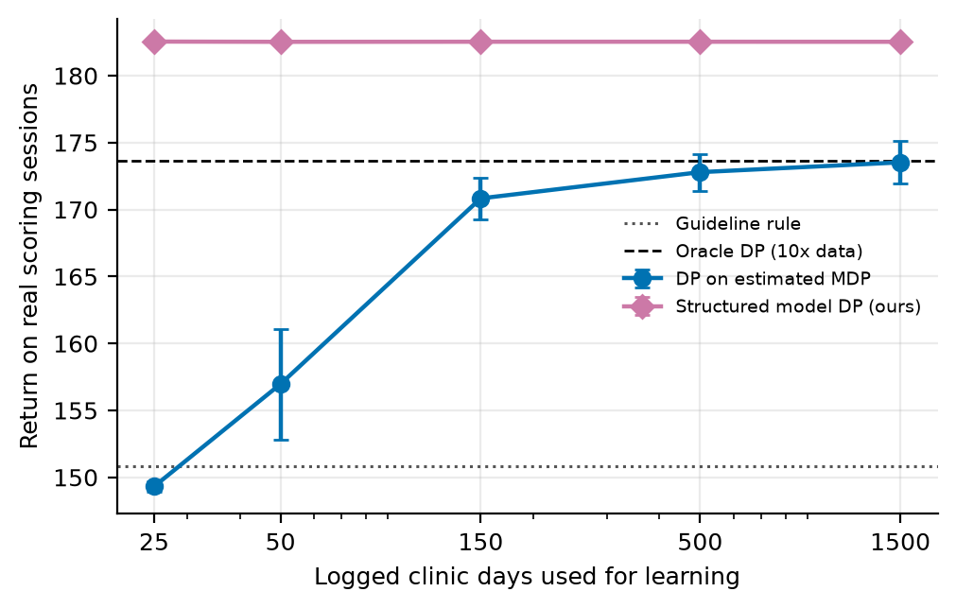
How much logged data is needed
DP on the estimated MDP: 149.3 with 25 days (below the rule, 150.8), 173.5 with 1,500 days
Structured model: 182.5 at every size from 25 to 1,500 days
Reason: it estimates 26 numbers that every logged session informs, not 18,300 transition probabilities
Data coverage, not the learning algorithm, is what held Paper 7's methods back
Notes:
Speaker: Nagasai. This is the clearest picture of why our method wins. DP on the estimated MDP needs hundreds of days to approach its best, and with 25 days it is below the rule. The structured model reaches 182.5 with 25 days because it estimates 26 numbers that every session informs.

Slide 12
Robustness to a change in the no-show rate
Method | Nominal (18.5%) | More no-shows (26.4%) | Fewer no-shows (13.5%)
Guideline rule | 150.8 | 129.3 | 157.4
DP on estimated MDP | 170.3 | 155.6 | 171.5
Monte Carlo control | 162.8 | 147.7 | 165.6
Q-learning | 167.0 | 153.4 | 168.1
Oracle DP (10x data) | 173.6 | 164.1 | 171.5
Single session optimiser | 182.0 | 172.0 | 176.8
Structured model DP (ours) | 182.5 | 173.2 | 177.4
Ours is ahead of every method at all three rates
More no-shows hurt the rule most: 150.8 falls to 129.3
Policies are not retrained; only the patients' outcomes change
Notes:
Speaker: Nagasai. The scoring sessions are rescored after flipping recorded outcomes, so the no-show rate rises to 26.4% or falls to 13.5%. The policies are not retrained. More no-shows hurt the rule most; ours stays ahead of every method at all three rates.

Slide 13
When planning across sessions matters: a busier clinic
Waiting cost | New patients per session | DP on estimated MDP | Best fixed booking | Single session optimiser | Ours | Our gain
0.4 | 1.5 | 170.6 | 174.5 | 181.6 | 182.0 | +0.2%
1.0 | 1.5 | 144.0 | 149.2 | 155.3 | 157.9 | +1.7%
0.4 | 2.5 | 111.8 | 160.1 | 160.0 | 168.4 | +5.3%
1.0 | 2.5 | 42.3 | 110.7 | 94.6 | 126.1 | +33.3%
The single session optimiser looks only at the current session; ours also plans for the waiting list in later sessions
The busier the clinic, the more that matters: our gain over it grows from +0.2% to +33.3%
Waiting cost 0.4 and 1.5 new patients per session is Paper 7's setting (slide 10)
Notes:
Speaker: Nagasai. The single session optimiser only looks at the current session. When waiting costs more or more patients join the list, planning across sessions pays off: our lead grows from +0.2% to +33.3%. DP on the estimated MDP falls apart in the busiest setting because the actions it needs are rarely logged.

Slide 14
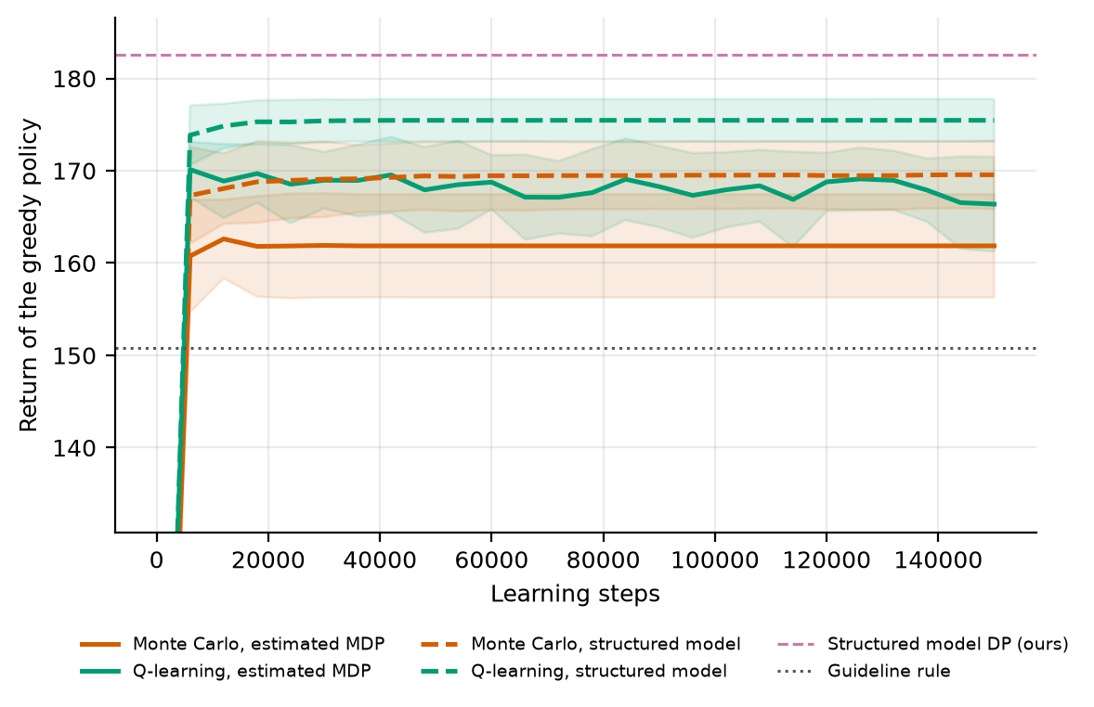
Convergence of Monte Carlo and Q-learning
On the estimated MDP: MC ends at 161.9, Q-learning at 166.4
On our structured model: MC 169.6, Q-learning 175.5; its DP solution is 182.5
Q-learning comes closer to the DP solution than MC on both
Exploration schedules: no schedule reached 90% of the possible improvement in any of 60 runs; near greedy was slowest for Q-learning (AUC -0.16 against 0.29); the ranking differs between MC and Q-learning (rank correlation -0.80)
Notes:
Speaker: Nagasai. The problem statement asks for this comparison. The curves show the true return of the greedy policy as learning goes on. Q-learning ends higher than MC on both models, and both do better on our structured model. Paper 7's exploration schedule study, rerun on real data: no schedule gets 90% of the way to the optimum, so exploration is not the bottleneck; the data is.

Slide 15
Code: how it is built and run
Pipeline (Python)
Models and tools
noshow_data.py: cleans the table, trains the classifier, builds sessions
real_clinic.py: the clinic MDP built from real sessions
planner.py: the structured model (our method)
rl_core.py, common.py, ideas.py: Paper 7's solvers and experiments, reused unchanged
run_real.py: runs every experiment, writes results.json and the figures
paper07_v3.py, paper07_v4.py: build the paper from results.json; check scripts verify it
Gradient boosting classifier with isotonic calibration (scikit-learn)
Value iteration, Monte Carlo control and Q-learning from Paper 7's rl_core
numpy, scipy, matplotlib, python-docx
Repo: github.com/Nagasai-Datta/ml_lab, folder topic7
Reproduce: python topic7/code/run_real.py (fixed seeds)
Paper: version 3 (full) and version 4 (without appendix questions and code)
Notes:
Speaker: Nagasai. Everything is in the public repo, folder topic7. Paper 7's code is reused unchanged; our files only import and call it. One command reruns every experiment, and the paper is built from the results file, so no number in the paper or on these slides is typed by hand.

Slide 16
Limitations
Only attendance is real: the decisions in the logs are generated and the waiting list is simulated
The structured model assumes the clinic knows its own rules (slots, reward weights, how the waiting list empties)
Only about 9% of real sessions have fewer than 10 bookings, so the slots filled part of the state rarely changes
The no-show rate drifted from 21.2% to 18.5%; the classifier predicts 22.0% against 19.8% observed
Waiting is measured by the length of the waiting list; the table has no times within a day
The baselines from published work are simplified versions, tuned on the scoring sessions
The results are about algorithms, not clinics; we make no clinical claim
Notes:
Speaker: Nagasai. State these plainly. The first one matters most: the data records who came, not what a clinic decided, so the decisions are generated with Paper 7's behaviour policy. The method itself would need a clinic that can state its rules.

Slide 17
Conclusion and future work
Conclusion
On real sessions, Paper 7's DP, MC and Q-learning beat the rule (170.3, 162.8 and 167.0 against 150.8) but stop short of the oracle (173.6): the logged data is the limit
Learning only patient behaviour removes that limit: our structured model scores 182.5, ahead of every method at all three no-show rates, with as few as 25 logged days
Its lead over the best published baseline grows from +0.2% to +33.3% as the waiting list comes under pressure
Future work
Logs in which the number of extra bookings is varied on purpose
Overtime and waiting measured from visit times
Reward weights and waiting list dynamics estimated from clinic records instead of assumed
Notes:
Speaker: Nagasai. Summarise in three sentences: Paper 7's methods work on real data but are limited by the logs; learning only patient behaviour removes that limit; and the advantage grows when the clinic is busier. Then the future work, then thank the audience and open questions.

Slide 18
References
[1] Gupta, D. and Denton, B. Appointment scheduling in health care: challenges and opportunities. IIE Transactions 40(9):800-819, 2008.
[2] Zacharias, C. and Pinedo, M. Appointment scheduling with no-shows and overbooking. Production and Operations Management 23(5):788-801, 2014.
[3] Sutton, R. S. and Barto, A. G. Reinforcement Learning: An Introduction, 2nd ed. MIT Press, 2018.
[4] Singh, S., Jaakkola, T., Littman, M. L. and Szepesvari, C. Convergence results for single-step on-policy reinforcement-learning algorithms. Machine Learning 38(3):287-308, 2000.
[5] Brafman, R. I. and Tennenholtz, M. R-max - a general polynomial time algorithm for near-optimal reinforcement learning. Journal of Machine Learning Research 3:213-231, 2002.
[6] Topuz, K., Urban, T. L., Russell, R. A. and Yildirim, M. B. Decision support system for appointment scheduling and overbooking under patient no-show behavior. Annals of Operations Research 342(1):845-873, 2024.
[7] Amalina, N. N. and An, H. Adaptive double-booking strategy for outpatient scheduling using multi-objective reinforcement learning. arXiv:2603.07270, 2026.
[8] Watkins, C. J. C. H. and Dayan, P. Q-learning. Machine Learning 8(3-4):279-292, 1992.
[9] Even-Dar, E. and Mansour, Y. Learning rates for Q-learning. Journal of Machine Learning Research 5:1-25, 2003.
[10] Levine, S., Kumar, A., Tucker, G. and Fu, J. Offline reinforcement learning: tutorial, review, and perspectives on open problems. arXiv:2005.01643, 2020.
[11] Jin, Y., Yang, Z. and Wang, Z. Is pessimism provably efficient for offline RL? Proceedings of the 38th International Conference on Machine Learning (ICML), 2021.
[12] Kumar, A., Zhou, A., Tucker, G. and Levine, S. Conservative Q-learning for offline reinforcement learning. Advances in Neural Information Processing Systems 33, 2020.
[13] Boutilier, C., Dearden, R. and Goldszmidt, M. Stochastic dynamic programming with factored representations. Artificial Intelligence 121(1-2):49-107, 2000.
[14] Bellman, R. Dynamic Programming. Princeton University Press, 1957.
[15] Puterman, M. L. Markov Decision Processes: Discrete Stochastic Dynamic Programming. Wiley, 1994.
[16] Singh, S. P. and Sutton, R. S. Reinforcement learning with replacing eligibility traces. Machine Learning 22:123-158, 1996.
[17] Hoppen, J. Medical appointment no shows. Kaggle dataset, kaggle.com/datasets/joniarroba/noshowappointments, 2016.
[18] Friedman, J. H. Greedy function approximation: a gradient boosting machine. Annals of Statistics 29(5):1189-1232, 2001.
[19] Zadrozny, B. and Elkan, C. Transforming classifier scores into accurate multiclass probability estimates. Proceedings of the 8th ACM SIGKDD International Conference on Knowledge Discovery and Data Mining (KDD), 2002.
[20] Pedregosa, F. et al. Scikit-learn: machine learning in Python. Journal of Machine Learning Research 12:2825-2830, 2011.
Notes:
Speaker: Nagasai. References are numbered as in the paper. The dataset is [17]; the published baselines are [6] and [7]; the factored MDP idea behind our method is [13].

Slide 19
Backup: questions we expect (1 of 3)
Why are the learners so far ahead of the rule on real data?
The rule books one or two extra patients, and with about 19% of patients not coming that leaves 44.3 idle slots per episode and a summed waiting list of 211. The learners book more in some states and cut the waiting list to 98 to 115.
Why does the structured model score more than the oracle fitted to ten times as much data?
The oracle still estimates P(s' | s, a) pair by pair, so with 1,500 days some pairs that the optimum uses remain below the support threshold and the rest carry sampling error. The structured model estimates 26 numbers that every logged session informs and computes the rest from the clinic's rules; its return varies by ±0.01 over 20 data draws.
Notes:
Backup slide for questions. The answers are the same as in Appendix A of version 3 of the paper.

Slide 20
Backup: questions we expect (2 of 3)
Is the comparison fair to the learners?
They receive the same logged days, the same solver for DP and the same scoring episodes. What the structured model has in addition is the clinic's rules, which is one of our limitations (slide 16): a clinic that cannot state them cannot use it.
Why is the margin over the single session optimiser so small?
In the default setting the waiting list stays short under both policies (1.83 and 1.67 patients per session), so little is left to plan for, and the optimiser uses each patient's own risk while the structured model uses a band. When the waiting list is under pressure the margin reaches 33.3% (slide 13).
Notes:
Backup slide for questions. The answers are the same as in Appendix A of version 3 of the paper.

Slide 21
Backup: questions we expect (3 of 3)
Which parts of the results are real?
Attendance is real: every patient in a scored session is a recorded appointment and comes exactly when the table says so, and the scoring weeks are never used for learning. The overbooking decisions in the logs, the waiting list and the reward weights are not in the table and are generated or assumed (slide 7).
Why does no schedule reach 90% of the optimum?
The learners solve a fitted model whose DP solution is worth about 126.6 on the oracle model, against a rule value of 113.6 and an optimum of 144.9. They end near that solution (Q-learning 124.4, MC 117.3), so the target is out of reach for any schedule; the limit is the support of the logged data, not exploration.
Notes:
Backup slide for questions. The answers are the same as in Appendix A of version 3 of the paper.

