Slide 1
TOPIC 7 | APPOINTMENT OVERBOOKING AND NO-SHOW MANAGEMENT
Overbooking Clinic Appointments with Reinforcement Learning
Exploration Schedules, Learning Efficiency and Robustness to Shifts in the No-Show Rate
Marupaka Naga Sai Dattu (23BCE0757)
Prakrit Bahl (23BCE0826)
School of Computer Science and Engineering (SCOPE)
Vellore Institute of Technology, Vellore
Notes:
Speaker: Prakrit. Introduce both presenters and the topic. This project takes Paper 7 and its code, evaluates all of its methods on the real Kaggle data, and proposes a method that outperforms them. Prakrit presents the problem, the data and the methods (slides 1 to 8); Nagasai presents the proposed method, the results and the implementation (slides 9 to 18).

Slide 2
Problem Context: Patient No-Shows and Overbooking
01 INTRODUCTION
Patient no-shows leave scheduled clinic capacity unused; in the dataset studied here, 20.2% of appointments were missed.
Clinics therefore overbook, issuing more appointments than there are regular slots in a session.
Booking too few additional patients leaves slots idle and lengthens the waiting list, whereas booking too many causes overtime when most patients attend.
The appropriate number of additional bookings depends on the patients scheduled, and therefore varies from one session to the next.
Because each decision also affects the waiting list for later sessions, the task is a sequential decision problem and is addressed with reinforcement learning (RL) [3].
20.2%
of the 110,487 recorded appointments were missed
0 to 4
additional patients that the clinic may book before each session
Notes:
Speaker: Prakrit. Explain the balance a clinic has to strike. About one in five patients does not attend. Booking additional patients fills those slots, but if most patients attend, the clinic works overtime. The decision recurs every session and affects the waiting list, which is why it is modelled as a Markov decision process and addressed with reinforcement learning.

Slide 3
Problem Statement and How It Is Addressed
01 INTRODUCTION
Requirement | How this work addresses it
Dataset: Medical Appointment No Shows | All reported results are computed on the public Kaggle table of 110,487 appointments recorded in 2016 [17].
State: slots filled and predicted no-show risk band | Slots filled (3 bands) × risk band predicted by a calibrated classifier (4) × waiting list band (5), giving 60 states.
Action: overbooking level | Between 0 and 4 additional patients are booked before each session (5 actions).
Reward: utilisation less waiting and overtime | shows − 3 × overtime − 0.5 × idle slots − 0.4 × waiting list + 0.3 × patients admitted from the waiting list, as in Paper 7.
Futuristic angle: adaptation to patient behaviour | The policy responds to the predicted risk of each session and to the waiting list, and is evaluated under shifts in the no-show rate.
Evaluation: utilisation, waiting, overtime, convergence of MC and Q-learning | All four measures are reported on scoring weeks never used for learning (slides 10 to 14).
Notes:
Speaker: Prakrit. Go through the problem statement line by line. Every requirement is met on the real data: the state uses the risk band predicted by the classifier, as required; the action is the overbooking level; the reward is Paper 7's reward; and all four evaluation measures are reported on slides 10 to 14.

Slide 4
Paper 7: The Baseline Study
01 INTRODUCTION
Scope of the original study
Reported returns (simulator)
Formulated overbooking as a Markov decision process (MDP) with 100 states and 5 actions.
Evaluated all methods on a simulator specified by hand that reproduces the columns of the dataset, as the Kaggle site could not be accessed at the time.
Learned policies from 150 logged clinic days using dynamic programming (DP), Monte Carlo (MC) control and Q-learning.
Compared five exploration schedules and examined robustness to a change in the no-show rate.
Method | Return
Guideline rule | 160.3
DP on estimated MDP | 162.2
Monte Carlo control | 166.6
Q-learning | 164.4
Oracle DP (10x data) | 179.0
Identified gap: the learned policies improved on the guideline rule by only +1.9 to +6.3, whereas DP with ten times as much data improved on it by +18.7; no real data were used.
Objective of this work: to evaluate Paper 7's methods on the real dataset, to propose a method that outperforms them, and to report both in the same paper.
Notes:
Speaker: Prakrit. Paper 7 was provided with its code. It used a simulator because the Kaggle site could not be reached when it was written. Its learned policies improved on the rule by only +1.9 to +6.3, while DP with ten times the data improved by +18.7; the learners were therefore limited by the data rather than by the algorithm. Our objective follows from this.

Slide 5
The Medical Appointment No Shows Dataset
02 DATA AND METHOD
Dataset characteristics
No-show classifier
110,487 appointments of 62,277 patients across 81 neighbourhoods in Brazil, recorded on 26 weekdays between 29 April and 8 June 2016 [17].
The overall no-show rate is 20.2%, and it varies little by weekday (19.4% to 21.2%).
Booking lead time is the strongest predictor: 4.7% of same day bookings were missed, compared with 33.0% of bookings made 31 or more days in advance.
Before the analysis, one record with a negative age and the 39 appointments held on Saturdays were removed.
Gradient boosting [18], calibrated by isotonic regression [19] and implemented in scikit-learn [20].
Uses only information known at booking: lead time, age, sex, SMS reminder, health and welfare flags, weekday, history and neighbourhood.
Trained on appointments before 9 May, calibrated on 9 to 15 May and applied from 16 May onwards, so no later information is used.
Test AUC of 0.728; the mean predicted no-show rate is 22.0% against 19.8% observed.
Notes:
Speaker: Prakrit. Describe the dataset and the main driver of no-shows. The classifier assigns each booked patient a probability of not attending; the state of the MDP uses the risk band of each session. The classifier is trained only on earlier weeks, so no information from the scoring weeks is used.

Slide 6
Formulating the Problem as a Markov Decision Process
02 DATA AND METHOD
Session
Episode
State
All appointments of one neighbourhood on one day (at least five), with 10 regular slots.
40 sessions drawn from the real sessions while preserving the weekday order.
Slots filled (5 to 7, 8 to 9, 10) × predicted risk quartile (4) × waiting list band (5) = 60 states.
Action
Reward
Data split
The number of additional patients booked before the session: 0, 1, 2, 3 or 4.
shows − 3 × overtime − 0.5 × idle − 0.4 × waiting list + 0.3 × patients admitted from the waiting list.
Learning: 16 to 25 May (506 sessions). Scoring: 30 May to 8 June (592 sessions), unseen in learning.
Attendance of every booked patient is taken directly from the records; policies are learned from 150 logged clinic days, as in Paper 7.
Notes:
Speaker: Prakrit. Explain how the table becomes an MDP. Every policy is learned on the May sessions and evaluated on the June sessions, which it has never seen; this is what allows true performance to be measured on real data.

Slide 7
Limitations of the Data and How They Are Addressed
02 DATA AND METHOD
Not recorded in the dataset | Approach adopted
Overbooking decisions | Logs are generated by applying Paper 7's behaviour policy to the real sessions; attendance remains as recorded.
Waiting list | Paper 7's waiting list rule is retained (1.5 new patients per session); this is the only simulated component.
Clinics and slots | A session is defined as one neighbourhood on one day, with 10 regular slots.
Times within a day | Overtime and waiting are measured in patients, as in Paper 7.
More than 26 days of data | 150 logged days of 40 sessions are sampled from the 506 learning sessions.
Variation in the no-show rate | Recorded outcomes of randomly selected patients are reversed, moving the rate from 18.5% to 26.4% or 13.5%.
Notes:
Speaker: Prakrit. Present this slide openly; it is the first question an examiner is likely to ask. Only attendance is real data. The decisions in the logs are generated with Paper 7's own behaviour policy, and the waiting list follows Paper 7's rule because the table contains none. The paper states the same in Section 6.1 and in its limitations.

Slide 8
Methods Compared
02 DATA AND METHOD
Methods from Paper 7
Baselines from published work
DP (value iteration) on the MDP estimated from the logged data.
Monte Carlo control and Q-learning on the same estimated MDP.
The guideline rule (one or two additional bookings) and the clinician behaviour policy.
Oracle DP: DP fitted to 1,500 logged days, ten times the standard amount, as a reference.
Single session optimiser: chooses the number of additional bookings that maximises the expected reward of the current session [6].
Threshold double booking (θ = 0.25): one additional booking for each patient whose predicted risk is at least θ [7].
Fixed booking: always books k = 2 additional patients.
Evaluation protocol
Each method is evaluated over 20 replicates (independent logged datasets) and 1,000 episodes of the scoring sessions with common random numbers; the return is the discounted reward over 40 sessions.
Notes:
Speaker: Prakrit. Paper 7's three learners estimate the full transition model from the logs. The published baselines are simplified implementations, and their settings were tuned on the scoring weeks, which favours them. Every method is scored on the same 1,000 episodes with the same random numbers. Hand over to Nagasai for the proposed method.

Slide 9
Proposed Method: A Structured Model of the Clinic
02 DATA AND METHOD
Motivation
Procedure
Paper 7's methods estimate every transition probability P(s' | s, a) from counts: 18,300 quantities from 150 days.
Booking three or four additional patients is rare in the logs, so the estimates for these actions are unreliable.
Most of the clinic's dynamics are known in advance: the slots, the reward and how additional bookings reduce the waiting list.
Estimate only patient behaviour from the logs: cell frequencies (12), the waiting list arrival rate (1) and waiting list lengths within each band (13).
Compute the expected reward of each session exactly from the patients' predicted attendance probabilities.
Assemble the transition model from these components, a factored MDP [13].
Solve it by value iteration (DP); MC and Q-learning can also be trained on it.
26
18,300
Every logged session informs all of the structured model's parameters, which is why it needs far less data than the estimated MDP.
parameters in the structured model
transition probabilities in the estimated MDP
Notes:
Speaker: Nagasai. Paper 7's learners estimate every transition separately, so the actions that matter most (booking three or four additional patients) are rarely observed. Most of the clinic, however, is known. We learn only patient behaviour, 26 parameters informed by every logged session, and derive everything else from the clinic's rules. This is a factored MDP, and MC and Q-learning can also be trained on it.

Slide 10
Main Results on the Real Scoring Sessions
03 RESULTS
Method | Return (± 95% CI) | Utilisation | Overtime | Waiting list
Paper 7: Guideline rule | 150.8 | 88.9% | 0.20 | 5.28
Threshold double booking (θ = 0.25) | 164.5 | 95.5% | 1.02 | 1.76
Fixed booking (k = 2) | 174.6 | 91.4% | 0.37 | 2.45
Single session optimiser | 182.0 | 93.8% | 0.51 | 1.83
Paper 7: DP on estimated MDP | 170.3 ± 0.99 | 90.4% | 0.39 | 2.46
Paper 7: Monte Carlo control | 162.8 ± 2.26 | 89.2% | 0.38 | 2.86
Paper 7: Q-learning | 167.0 ± 2.11 | 90.1% | 0.42 | 2.53
Paper 7: Oracle DP (10x data) | 173.6 | 91.5% | 0.54 | 1.72
Monte Carlo, structured model | 169.3 ± 1.70 | 92.4% | 0.65 | 2.00
Q-learning, structured model | 175.2 ± 1.05 | 92.8% | 0.59 | 1.81
Structured model DP (ours) | 182.5 ± 0.01 | 93.8% | 0.53 | 1.67
182.5
return of the structured model, the highest of all methods
+12.3
over DP, the best of Paper 7's methods (p < 0.001)
+0.51
over the strongest published baseline (p < 0.001)
Return: discounted reward over 40 sessions (mean ± 95% CI over 20 replicates). Overtime and waiting list are per session.
Notes:
Speaker: Nagasai. Read the table from the top: the guideline rule, the published baselines, Paper 7's learners and the oracle, then the structured model. It attains 182.5: +12.3 over DP, +15.5 over Q-learning and +19.7 over MC (all p < 0.001), and +8.92 over the oracle with ten times the data. Its margin over the single session optimiser is small (+0.51) but consistent; slide 13 shows when it grows. It also has the shortest waiting list.

Slide 11
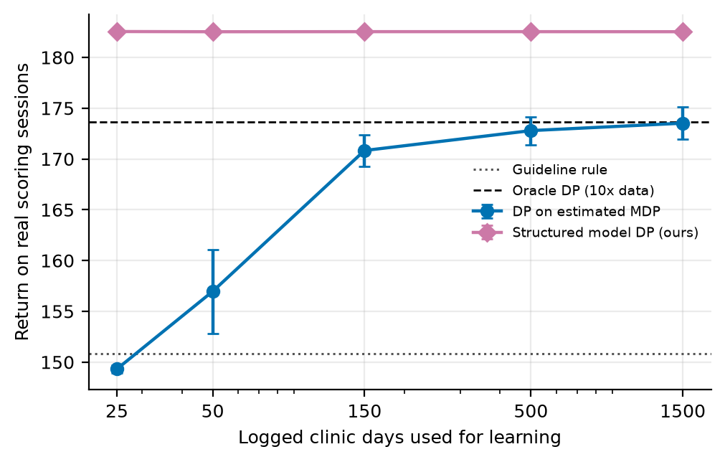
Effect of the Amount of Logged Data
03 RESULTS
With 25 logged days, DP on the estimated MDP attains 149.3, below the guideline rule (150.8); with 1,500 days it reaches 173.5.
The structured model attains 182.5 at every data size from 25 to 1,500 days.
The reason is the number of quantities estimated: 26 parameters instead of 18,300 transition probabilities.
The limitation of Paper 7's methods is therefore the coverage of the logged data, not the learning algorithm.
Notes:
Speaker: Nagasai. This slide explains most clearly why the proposed method performs better. DP on the estimated MDP needs hundreds of days to approach its best value, and with 25 days it falls below the rule. The structured model attains 182.5 with 25 days because it estimates 26 parameters that every session informs.

Slide 12
Robustness to Changes in the No-Show Rate
03 RESULTS
Method | Nominal rate (18.5%) | Higher rate (26.4%) | Lower rate (13.5%)
Guideline rule | 150.8 | 129.3 | 157.4
DP on estimated MDP | 170.3 | 155.6 | 171.5
Monte Carlo control | 162.8 | 147.7 | 165.6
Q-learning | 167.0 | 153.4 | 168.1
Oracle DP (10x data) | 173.6 | 164.1 | 171.5
Single session optimiser | 182.0 | 172.0 | 176.8
Structured model DP (ours) | 182.5 | 173.2 | 177.4
Observations
The structured model has the highest return at all three rates.
Rising no-shows affect the guideline rule most: its return falls from 150.8 to 129.3.
Policies are not retrained; only the recorded attendance outcomes are altered.
Notes:
Speaker: Nagasai. The scoring sessions are rescored after reversing recorded outcomes, so the no-show rate rises to 26.4% or falls to 13.5%. The policies are not retrained. An increase in no-shows affects the rule most; the structured model remains ahead of every method at all three rates.

Slide 13
Benefit of Planning Across Sessions Under Higher Demand
03 RESULTS
Waiting cost | New patients per session | DP on estimated MDP | Best fixed booking | Single session optimiser | Structured model | Gain
0.4 | 1.5 | 170.6 | 174.5 | 181.6 | 182.0 | +0.2%
1.0 | 1.5 | 144.0 | 149.2 | 155.3 | 157.9 | +1.7%
0.4 | 2.5 | 111.8 | 160.1 | 160.0 | 168.4 | +5.3%
1.0 | 2.5 | 42.3 | 110.7 | 94.6 | 126.1 | +33.3%
The single session optimiser considers only the current session, whereas the structured model also accounts for the effect of each decision on the waiting list in later sessions.
This advantage grows with demand: the gain over the single session optimiser rises from +0.2% to +33.3%.
DP on the estimated MDP deteriorates sharply in the busiest setting (42.3), because the actions it requires are rarely observed in the logs.
A waiting cost of 0.4 with 1.5 new patients per session corresponds to Paper 7's setting (slide 10).
Notes:
Speaker: Nagasai. The single session optimiser considers only the current session. When waiting is more costly or more patients join the list, planning across sessions pays off, and the gain grows from +0.2% to +33.3%. DP on the estimated MDP deteriorates in the busiest setting because the actions it needs are rarely logged.

Slide 14
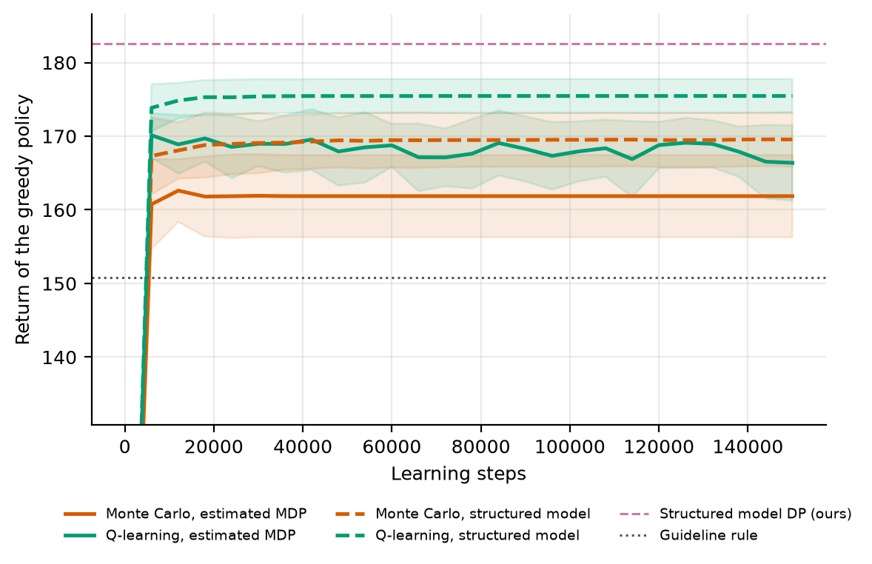
Convergence of Monte Carlo Control and Q-learning
03 RESULTS
On the estimated MDP, MC converges to a return of 161.9 and Q-learning to 166.4.
On the structured model, Q-learning reaches 175.5 and MC 169.6, against 182.5 for its DP solution.
Q-learning approaches the DP solution more closely than MC on both models.
No exploration schedule reached 90% of the possible improvement in any of 60 runs.
For Q-learning, near greedy exploration was the slowest schedule (AUC -0.16 against 0.29).
The ranking of the schedules differs between MC and Q-learning (rank correlation -0.80).
Notes:
Speaker: Nagasai. The problem statement asks for this comparison. The curves show the true return of the greedy policy as learning proceeds. Q-learning ends higher than MC on both models, and both perform better on the structured model. In Paper 7's exploration schedule study, rerun on the real data, no schedule comes within 90% of the optimum, so exploration is not the bottleneck; the data are.

Slide 15
Implementation and Reproducibility
04 IMPLEMENTATION AND DISCUSSION
Software pipeline (Python)
Models, tools and reproducibility
noshow_data.py: data cleaning, classifier training and construction of sessions.
real_clinic.py: the clinic MDP built from the real sessions.
planner.py: the structured model proposed in this work.
rl_core.py, common.py, ideas.py: Paper 7's solvers and experiments, reused without modification.
run_real.py: executes all experiments and writes results.json and the figures.
paper07_v3.py, paper07_v4.py: generate the paper from results.json; check scripts verify it.
Gradient boosting classifier with isotonic calibration (scikit-learn).
Value iteration, Monte Carlo control and Q-learning from Paper 7's rl_core module.
numpy, scipy, matplotlib and python-docx.
Code: github.com/Nagasai-Datta/ml_lab, folder topic7.
Reproduction: python topic7/code/run_real.py reruns every experiment with fixed random seeds.
Notes:
Speaker: Nagasai. All code is in the public repository, folder topic7. Paper 7's code is reused without modification; our files only import and call it. A single command reruns every experiment, and the paper is generated from the results file, so no number in the paper or on these slides is typed by hand.

Slide 16
Limitations
04 IMPLEMENTATION AND DISCUSSION
Only attendance is observed in the data; the overbooking decisions in the logs are generated and the waiting list is simulated.
The structured model assumes that the clinic's rules (slots, reward weights and waiting list dynamics) are known.
Only about 9% of real sessions have fewer than 10 bookings, so the slots filled component of the state rarely varies.
The no-show rate drifted from 21.2% to 18.5% between periods; the classifier predicts 22.0% against 19.8% observed.
Waiting is measured by the length of the waiting list, as the dataset records no times within a day.
The published baselines are simplified implementations whose settings were tuned on the scoring sessions, which favours them.
The findings concern algorithms rather than clinical practice, and no clinical claim is made.
Notes:
Speaker: Nagasai. State these plainly. The first matters most: the data record who attended, not what a clinic decided, so the decisions are generated with Paper 7's behaviour policy. Applying the method in practice would require a clinic that can state its own rules.

Slide 17
Conclusions and Future Work
04 IMPLEMENTATION AND DISCUSSION
Conclusions
On the real sessions, Paper 7's DP, MC and Q-learning outperform the guideline rule (170.3, 162.8 and 167.0 against 150.8) but remain below the oracle (173.6), which shows that the logged data are the limiting factor.
Learning only patient behaviour removes this limitation: the structured model attains 182.5 and remains the best method when the no-show rate rises or falls, with as few as 25 logged days.
Its advantage over the strongest published baseline increases from +0.2% to +33.3% as pressure on the waiting list grows.
Future work
Collect logs in which the number of additional bookings is varied deliberately.
Measure overtime and waiting from recorded visit times.
Estimate the reward weights and waiting list dynamics from clinic records rather than assuming them.
Notes:
Speaker: Nagasai. Summarise in three sentences: Paper 7's methods work on real data but are limited by the logs; learning only patient behaviour removes that limitation; and the advantage grows when the clinic is busier. Then present the future work, thank the audience and invite questions.

Slide 18
References
REFERENCES
[1] Gupta, D. and Denton, B. Appointment scheduling in health care: challenges and opportunities. IIE Transactions 40(9):800-819, 2008.
[2] Zacharias, C. and Pinedo, M. Appointment scheduling with no-shows and overbooking. Production and Operations Management 23(5):788-801, 2014.
[3] Sutton, R. S. and Barto, A. G. Reinforcement Learning: An Introduction, 2nd ed. MIT Press, 2018.
[4] Singh, S., Jaakkola, T., Littman, M. L. and Szepesvari, C. Convergence results for single-step on-policy reinforcement-learning algorithms. Machine Learning 38(3):287-308, 2000.
[5] Brafman, R. I. and Tennenholtz, M. R-max - a general polynomial time algorithm for near-optimal reinforcement learning. Journal of Machine Learning Research 3:213-231, 2002.
[6] Topuz, K., Urban, T. L., Russell, R. A. and Yildirim, M. B. Decision support system for appointment scheduling and overbooking under patient no-show behavior. Annals of Operations Research 342(1):845-873, 2024.
[7] Amalina, N. N. and An, H. Adaptive double-booking strategy for outpatient scheduling using multi-objective reinforcement learning. arXiv:2603.07270, 2026.
[8] Watkins, C. J. C. H. and Dayan, P. Q-learning. Machine Learning 8(3-4):279-292, 1992.
[9] Even-Dar, E. and Mansour, Y. Learning rates for Q-learning. Journal of Machine Learning Research 5:1-25, 2003.
[10] Levine, S., Kumar, A., Tucker, G. and Fu, J. Offline reinforcement learning: tutorial, review, and perspectives on open problems. arXiv:2005.01643, 2020.
[11] Jin, Y., Yang, Z. and Wang, Z. Is pessimism provably efficient for offline RL? Proceedings of the 38th International Conference on Machine Learning (ICML), 2021.
[12] Kumar, A., Zhou, A., Tucker, G. and Levine, S. Conservative Q-learning for offline reinforcement learning. Advances in Neural Information Processing Systems 33, 2020.
[13] Boutilier, C., Dearden, R. and Goldszmidt, M. Stochastic dynamic programming with factored representations. Artificial Intelligence 121(1-2):49-107, 2000.
[14] Bellman, R. Dynamic Programming. Princeton University Press, 1957.
[15] Puterman, M. L. Markov Decision Processes: Discrete Stochastic Dynamic Programming. Wiley, 1994.
[16] Singh, S. P. and Sutton, R. S. Reinforcement learning with replacing eligibility traces. Machine Learning 22:123-158, 1996.
[17] Hoppen, J. Medical appointment no shows. Kaggle dataset, kaggle.com/datasets/joniarroba/noshowappointments, 2016.
[18] Friedman, J. H. Greedy function approximation: a gradient boosting machine. Annals of Statistics 29(5):1189-1232, 2001.
[19] Zadrozny, B. and Elkan, C. Transforming classifier scores into accurate multiclass probability estimates. Proceedings of the 8th ACM SIGKDD International Conference on Knowledge Discovery and Data Mining (KDD), 2002.
[20] Pedregosa, F. et al. Scikit-learn: machine learning in Python. Journal of Machine Learning Research 12:2825-2830, 2011.
Notes:
Speaker: Nagasai. References are numbered as in the paper. The dataset is [17]; the published baselines are [6] and [7]; the factored MDP idea behind the proposed method is [13]. Thank the audience and invite questions.

