Slide 1
Air Quality Prediction Based Machine Learning
Project Guide:
Mr. K. Ashok Babu, M.Tech.,(Ph.D).
Submitted By (Batch: A9)
CH. Naga sai (Y20ACS422)
D. Bindu Madhavi (Y20ACS437)
A. Meenakshi (Y20ACS407)
G. Yaswanth (Y20ACS448)

Slide 2
Abstract
Predicting air quality is necessary step to be taken by government as it is becoming the major concern among the health of human beings.
Air Pollution can cause severe disease like lungs cancer, brain disease and even lead to death.

Slide 3
What is Air Quality Index
India uses National Air Quality Index (AQI) to
predict the quality of the air.
The air quality index is composed of 8 pollutants.
The pollutants are NO2(Nitrogen Dioxide), SO2(Sulfur Dioxide), CO(Carbon Monoxide), O3(Ozone), NH3(Ammonia),Pb(Lead), PM10 and PM2.5

Slide 4
Air Quality Index categories
The Air Quality Index measures the quality of air. It shows the amount and types of gases dissolved in the air. There are 6 categories of the air have been created in this air quality index.
Those categories are :
1)good 2)satisfactory 3)moderate
4)poor 5)very poor 6) severe.

Slide 5
AQI | Associated Health Impacts
Good (0–50) | Minimal Impact
Satisfactory (51–100) | May cause minor breathing discomfort to sensitive people.
Moderately polluted (101–200) | May cause breathing discomfort to people with lung disease such as asthma, and discomfort to people with heart disease, children and older adults.
Poor (201–300) | May cause breathing discomfort to people on prolonged inhaling, and problems to people with heart disease.
Very Poor (301–400) | May cause respiratory illness to the people on prolonged inhaling. Effect may be more severe in people who are living with lung and heart diseases.
Severe (401-500) | May cause respiratory impact even on healthy people, and serious health impacts on people with lung/heart disease. The health impacts may be experienced even during normal walk also.

Slide 6
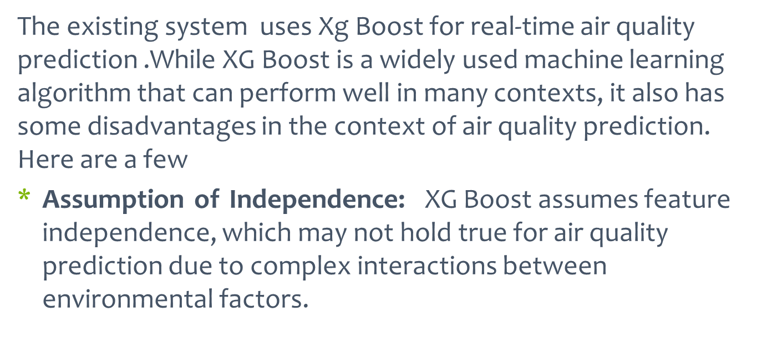
Existing System

Slide 7
Existing System(continued)
Limited Expressiveness: XG Boost has limited expressiveness, which can limit its ability to capture complex relationships and patterns in the data.
Sensitivity to Outliers: XG Boost sensitive to outliers and noise in the data, which can negatively impact its performance.
Limited Robustness: XG Boost can be highly sensitive to changes in the data distribution, which can reduce the robustness of the algorithm in real-world scenarios.

Slide 8
Proposed System
A proposed system for real-time air quality prediction in megacities using Cat Boost can provide several advantages over other methods. Here are a few:
Robustness: Cat Boost algorithm are robust to changes in the data distribution, making them effective in real-world scenarios where data may be variable.
Easy to interpret: Cat Boost is easy to interpret, and the resulting model can be visualized, making it easier to understand and explain to non-experts.

Slide 9
Proposed System (Continued)
High accuracy: Cat Boost algorithm are known to have high accuracy in classification tasks, which is critical for accurate air quality prediction.
Feature selection: Cat Boost algorithm can be used for feature selection, which can help identify the most important features for air quality prediction and streamline the prediction process
Real-time prediction: Cat Boost algorithm can make real-time predictions, which is critical for air quality prediction in megacities, where timely alerts can help prevent negative health outcomes

Slide 10
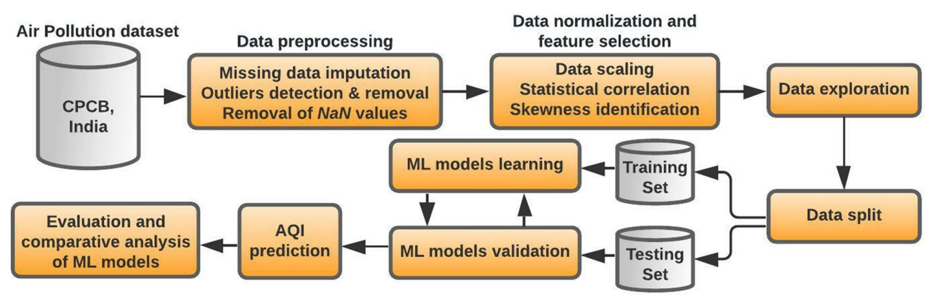
Design

Slide 11
Desing (Continued)
Data collection: Gathering air quality data, meteorological data, and geographical information.
Data preprocessing: Cleaning and preparing the data for modeling.
Model selection: Choosing an appropriate machine learning algorithm for AQI prediction.
Model training: Training the model on historical data.
Model evaluation: Assessing the model's performance on unseen data.
Model deployment: Integrating the model into a system for real-world use.

Slide 12
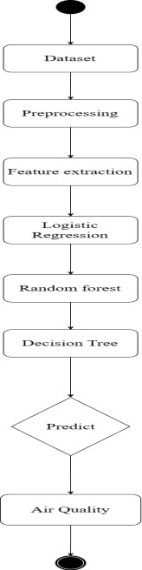
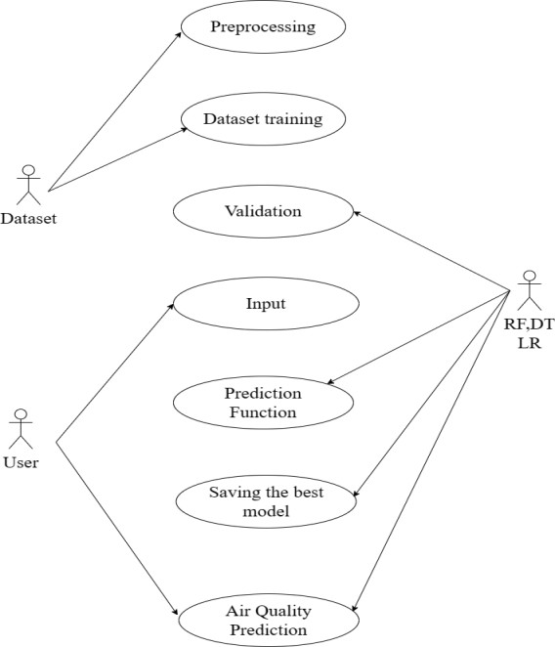
1 Use Case Diagram
2 Activity Diagram

Slide 13
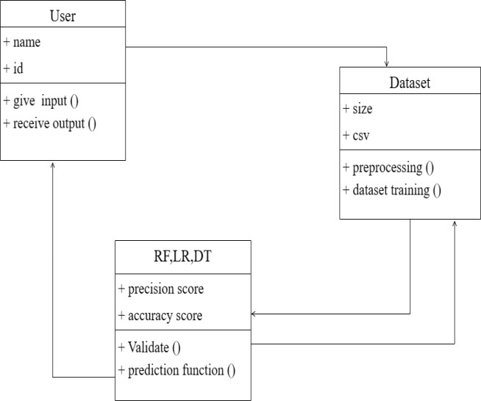
3. Class Diagram

Slide 14
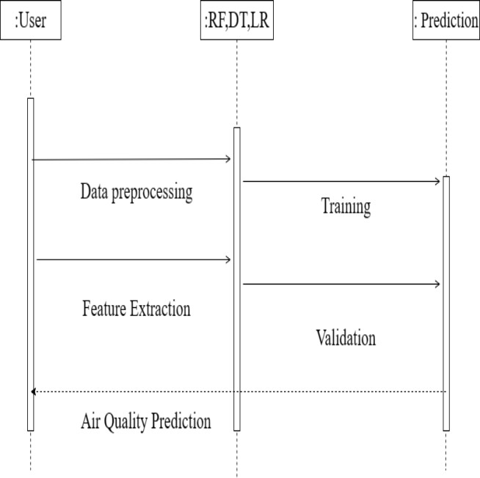
4. Sequence Diagram

Slide 15

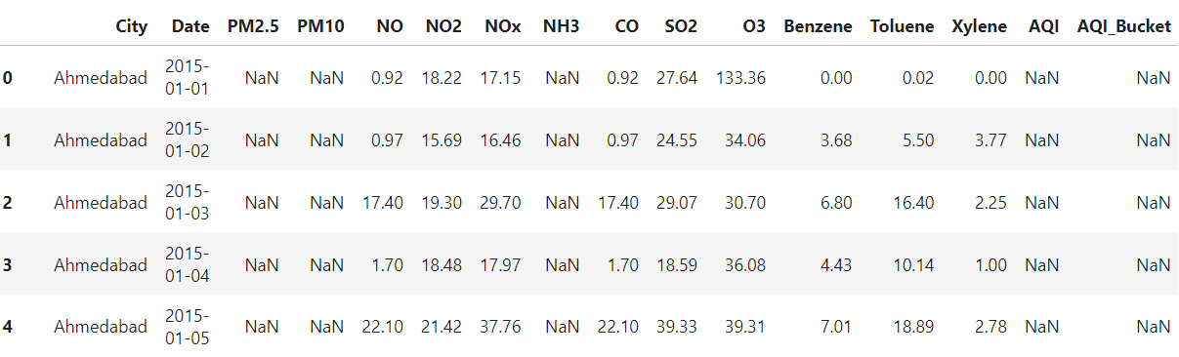
Implementation

Slide 16
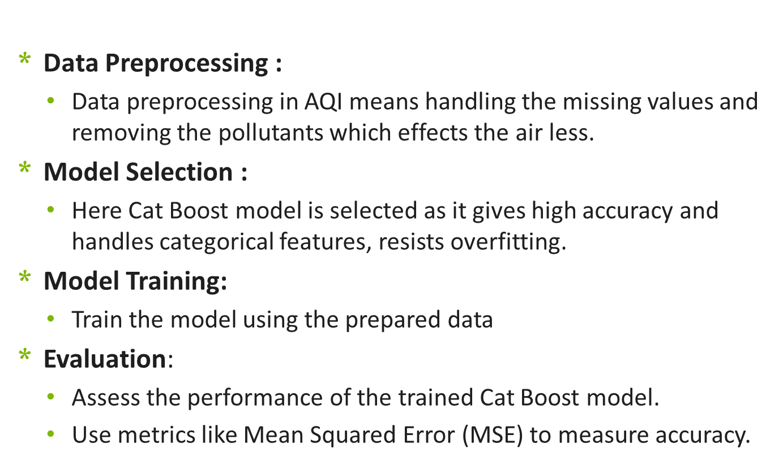
Implementation

Slide 17
Results
Model | RMSE | MAE | R²
XG Boost | 24.31 | 15.03 | 89.23
Random Forest | 28.83 | 15.03 | 91.13
Cat Boost | 23.62 | 14.77 | 93.42

Slide 18
Results(Continued)
By observing the table , when compared to all algorithms the model has lower MAE, lower RMSE and higher r-squared error when built using Cat Boost algorithm.
This indicates that Cat Boost model is good for Predicting the AQI(Air Quality Index.
Finally, by observing performance metrics for all the models, we can say that among all regression models Cat Boost model model performs well in Predicting AQI(Air Quality Index) for given data.

Slide 19
Conclusion
Based on our literature review, Cat Boost was identified as a promising machine learning algorithm for predicting Air Quality Index (AQI).
We preprocessed the data and successfully trained the Cat Boost algorithm.
Performance evaluation of the Cat Boost model was conducted using key metrics including Mean Absolute Error (MAE), Root Mean Square Error (RMSE), and R-squared (R²).
We can conclude that Cat Boost exhibited better performance in predicting AQI, outperforming traditional regression-based algorithms in terms of predictive accuracy and model fit.

Slide 20
Thank You All

