Slide 1


CRUDE OIL PRICE PREDICTION
BY
DURGA MANGA MUDUNURI
2485351077

Slide 2
ABSTRACT
AI techniques like Artificial Neural Networks (ANN) and Support Vector Machines (SVM) are used to improve operations.
AI helps analyze geological data to identify oil and gas resources more accurately.
AI models are used to predict oil and gas prices based on historical and market data
AI helps predict the behavior of oil and gas flow during extraction.
AI and data mining techniques help increase productivity and reduce operational costs in exploration and production.

Slide 3
Existing System
Feature List (Input Data) includes historical price data used for prediction.
Target List (Output Data) represents the predicted crude oil prices.
Linear Regression Model is used as the machine learning algorithm for prediction.
Graph Visualization is generated to display predicted crude oil prices over time.

Slide 4
Disadvantages
Lower Prediction Accuracy compared to the SVR (Support Vector Regression) algorithm.
Limited Performance when using feature list and target list for price prediction.
Poor Handling of Non-Linear Data relationships.
Less Flexibility to capture complex patterns in crude oil price data.
Adding Polynomials or Interaction Terms is difficult and time-consuming

Slide 5
Proposed System
Support Vector Regression (SVR) algorithm is implemented using Python for crude oil price prediction
.
Feature List and Target List are created from the dataset (Days as features, Prices as targets).
Kernel Functions (Linear or Gaussian) are automatically selected based on the data.
Future Price Prediction is performed for 1 day, 30 days, and 365 days from the last dataset value.
Graph Visualization is generated to display the predicted results.

Slide 6
Advantages
Higher Prediction Accuracy compared to other algorithms.
Handles Non-Linear Data effectively using kernel functions.
Prevents Overfitting through the regularization parameter.
Efficient Optimization Methods (e.g., SMO) improve performance.
Widely Used in Many Fields like medical diagnosis,OCR and forecasting

Slide 7
Hardware Requirements
• RAM: 4GB and Higher
• Processor: Intel i3 and above
• Hard Disk: 500GB: Minimum

Slide 8
Software Requirements
• OS: Windows
• Python IDE: python 2.7.x and above
• Pycharm IDE
• Setup tools and pip to be installed for 3.6.x and above

Slide 9
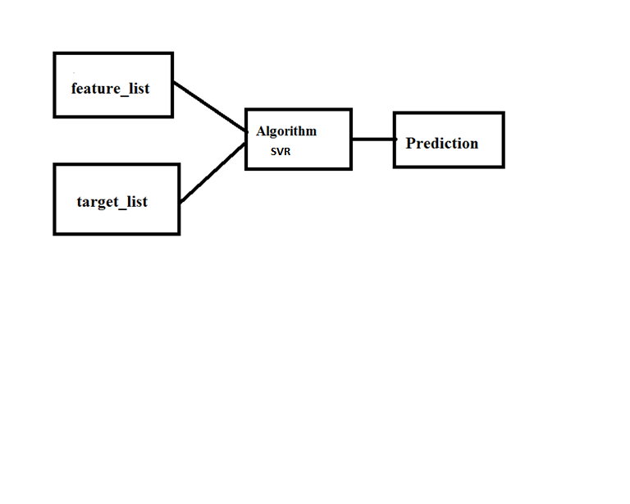
Architecture

Slide 10
THANK YOU

