Slide 1
TASK 4 · EXECUTIVE PRESENTATION
Data Storytelling &
Statistical Validation
Executive summary, statistical evidence, and recommended next steps for ApexPlanet's order-value optimization initiative
1,000
83%
2
Orders Analyzed
Variance Explained (R²)
Significant Drivers
ApexPlanet — Data Storytelling & Statistical Validation
1

Slide 2



Executive Summary
Three core findings shape ApexPlanet's order-value strategy
No Demographic Effect
Price & Quantity Drive Value
Strong Predictive Model
Order value shows no statistically significant difference by Gender or Product Category — segmentation by these variables won't drive AOV gains.
Unit Price and Quantity are the primary, highly significant drivers of order value across the dataset, both at p < 0.001.
The regression model explains roughly 83% of the variance in log(Total Sales), giving high confidence in price/quantity-based forecasting.
p > 0.49
p < 0.001
83%
gender t-test
both predictors
R² (variance explained)
ApexPlanet | Data Storytelling & Statistical Validation
2

Slide 3





Dataset & Methods
How the analysis was built, cleaned, and validated
STATISTICAL TESTS APPLIED
Sales_Dataset
1,000 customer orders
Independent t-test
ANOVA
PREPROCESSING
Compares mean order value between Male and Female customer groups.
Tests whether mean order value differs across product categories.
Parsed and standardized order date fields
Removed rows with missing Total_Sales values (980 retained for modeling)
980
Chi-square Test
OLS Regression
Examines association between Category and High-Quantity orders.
Models log(Total Sales) as a function of Quantity, Unit Price, and Age.
orders used in the final regression model
ApexPlanet | Data Storytelling & Statistical Validation
3

Slide 4
Key Statistical Findings
Hypothesis tests show demographic and category effects are negligible
Gender: T-test on Order Value
Category: ANOVA on Order Value
Mean order value — Male: 141,807 | Female: 136,883
t-statistic = 0.683, p-value = 0.495
Cohen's d = 0.043 → negligible effect size
Tests whether mean order value differs across the 5 product categories
Eta-squared (η²) = 0.0029
Not significant — p > 0.05
Negligible effect — category explains <1% of variance
Chi-Square: Category vs. High-Quantity Orders
4.702
0.319
0.069
No meaningful
association found
Tests whether product category is associated with whether an order has high quantity.
Chi-square (χ²)
p-value
Cramer's V
ApexPlanet | Data Storytelling & Statistical Validation
4

Slide 5

Regression: Drivers of Order Value
OLS model predicting log(Total Sales) from Quantity, Unit Price, and Age
Predictor | Coefficient | t-stat | p-value | Significant?
Intercept | 8.704 | 136.25 | < 0.001 | Yes
Quantity | 0.233 | 42.82 | < 0.001 | Yes
Unit Price | 5.76e-05 | 52.86 | < 0.001 | Yes
Age | -0.0015 | -1.36 | 0.176 | No
MODEL FIT
R² = 0.829
Adjusted R² = 0.828
F-statistic = 1575, p < 0.001
980 observations, 3 predictors
Quantity & Unit Price are highly significant predictors of order value (p < 0.001 for both).
Age is not a significant predictor of order value once price and quantity are accounted for.
The model explains ~83% of variance in log(Total Sales) — a strong fit for pricing-driven forecasting.
ApexPlanet | Data Storytelling & Statistical Validation
5

Slide 6
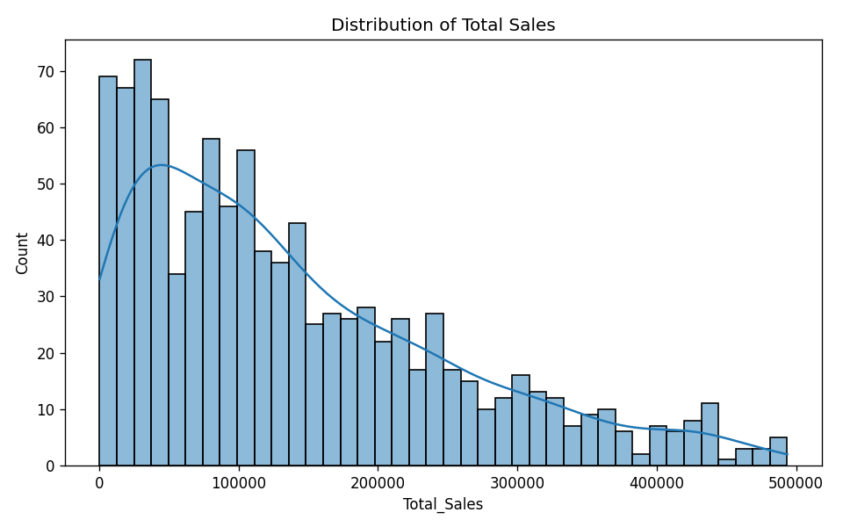

Distribution of Total Sales
Order values are right-skewed, with most orders concentrated at lower totals
WHAT THIS MEANS
Heavy right skew
Most orders fall under 150,000 in total sales, with a long tail of high-value transactions.
Few large outliers
A small number of orders exceed 400,000 — these merit closer profiling for retention.
Modeling implication
Skew motivates the log transform used in the regression on slide 5.
ApexPlanet | Data Storytelling & Statistical Validation
6

Slide 7
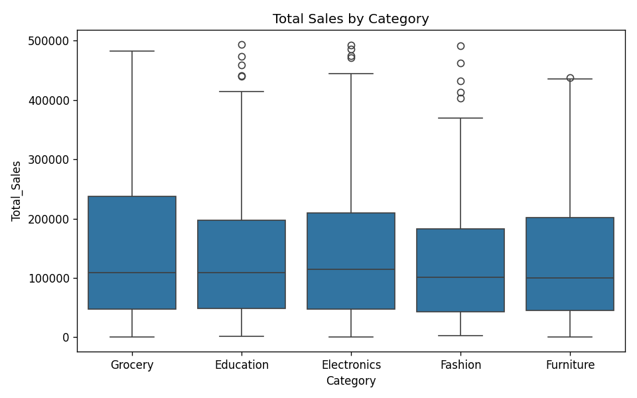

Total Sales by Category
Order-value spread is broadly similar across all five product categories
WHAT THIS MEANS
Overlapping ranges
Median order values and interquartile ranges overlap heavily across categories.
Confirms ANOVA result
Visually consistent with the negligible category effect (η² = 0.0029) found on slide 4.
Strategic takeaway
Category-based pricing differentiation alone is unlikely to move overall AOV.
ApexPlanet | Data Storytelling & Statistical Validation
7

Slide 8
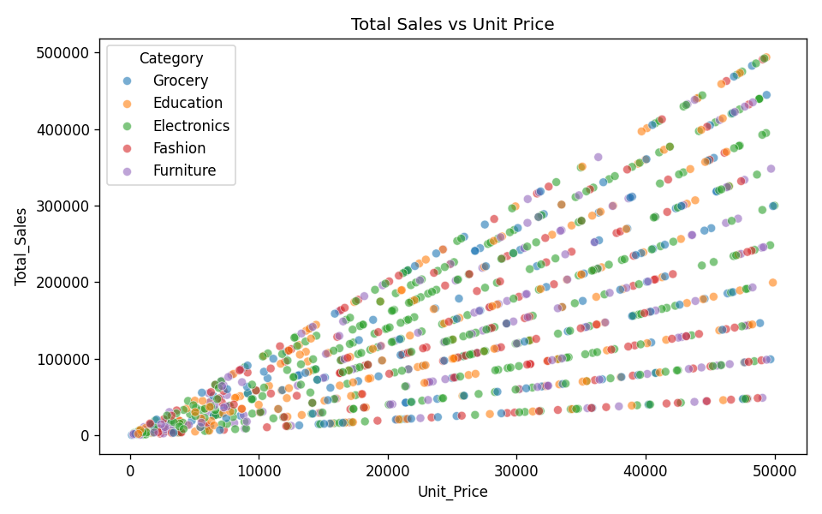
Total Sales vs. Unit Price
A clear positive relationship — higher unit prices drive higher total order value
WHAT THIS MEANS
Linear pattern by category
Each category forms its own diagonal band — total sales scale predictably with unit price and quantity.
Confirms regression
Visual confirmation of Unit Price's strong, significant coefficient (p < 0.001) from slide 5.
Pricing opportunity
Since price scales directly to order value, bundling and price-tier strategies have direct AOV impact.
ApexPlanet | Data Storytelling & Statistical Validation
8

Slide 9

Recommendations & Next Steps
Priority actions to translate statistical findings into AOV growth
01
02
03
Bundling & Volume Discounts
Run A/B Tests
Profile High-Value Orders
Implement product bundles and volume-based discount tiers to increase average order value, leveraging the strong price-to-sales relationship.
Test bundling configurations and upsell experiences against a control group to quantify lift in order value before full rollout.
Build customer profiles around the high-value tail identified in the sales distribution, and design targeted retention programs around them.
ApexPlanet | Data Storytelling & Statistical Validation
9

Slide 10

Deliverables & Files
Complete project artifacts produced as part of this analysis
Statistical Results
Hypothesis Test Script
analysis/stat_results.json
analysis/hypothesis_test.py
Raw output from all hypothesis tests and the regression model.
Python source for t-test, ANOVA, chi-square, and OLS analyses.
Presentation Figures
Validation Report
presentation/figures/*
report/Data_Story_Stat_Validation_Report.md
Distribution, category, and scatter plots used throughout this deck.
Full written narrative connecting findings to business recommendations.
ApexPlanet | Data Storytelling & Statistical Validation
10

