Slide 1
secure data hiding in images using steganography
CAPSTONE PROJECT
Presented By:
CHANDU NAGA SAI DILLIF,
Department of CSE,
Velagapudi Ramakrishna Siddhartha Engineering College

Slide 2
OUTLINE
Problem Statement
Technology used
Wow factor
End users
Result
Conclusion
Git-hub Link

Slide 3
Problem Statement
The Encryption of a secret information is very essential now a days as the cyber crimes are increased a lot. There are many ways for encryption of information including substitutional ciphers where the alphabets are replaced with corresponding algorithm like Casear Cipher, Playfair Cipher etc., But the decryption of Substitional ciphers became easy with the existiong computing power that lead to invention of hash algorithms. The algorithms have potential to keep data secure while transferring. Steganography is the techinque of cryptography that send the data along with the images. This technique involves a secret key that can be shared between only communicating parties that involves merging of photo and data at sender side and the decryption can be done by using passcode at the receiver side.

Slide 4


Technology used
Python IDE
Stego
Libraries used
CV2 - To read and write images in python

Slide 5
Wow factors
The cybersecurity is playing a crucial role now a days as the data is precious in this era.
So, inorder to improve the encryption techniques, steganography came into existence to meet the needs of the people to share data more secretly by just changing the pixels of the image to hide the data in the image.
Steganography with images just deals with the pixel value, by changing the pixel value, it becomes difficult to identify which pixels are changed.
In this way, It is very beneficial to send and receive the data secretly.

Slide 6
End users
End users of steganography implemented with Python could include individuals or organizations looking to discreetly hide sensitive information within seemingly normal digital media like images, audio, or video files, such as:
security researchers
intelligence agencies
journalists

Slide 7
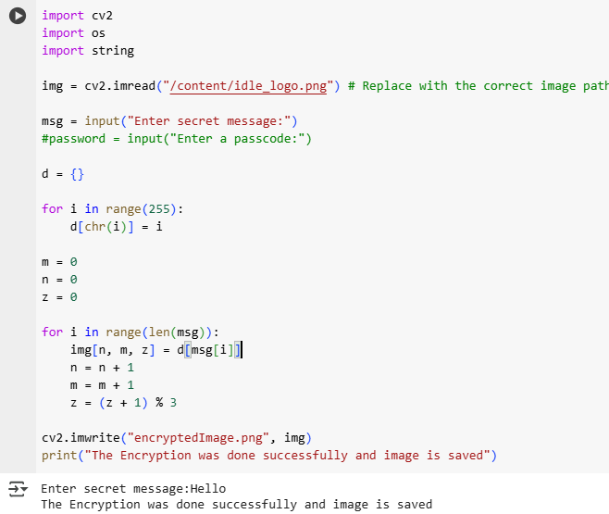
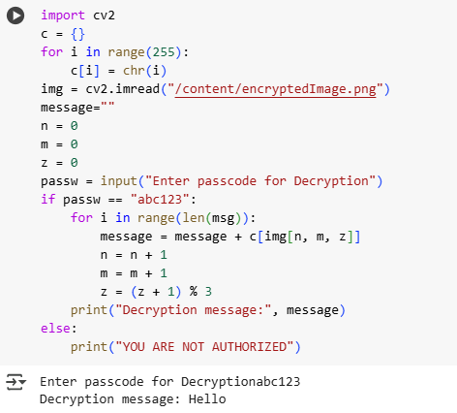
Results
Fig.1 encryption code and output
Fig.2 Decryption code and output

Slide 8
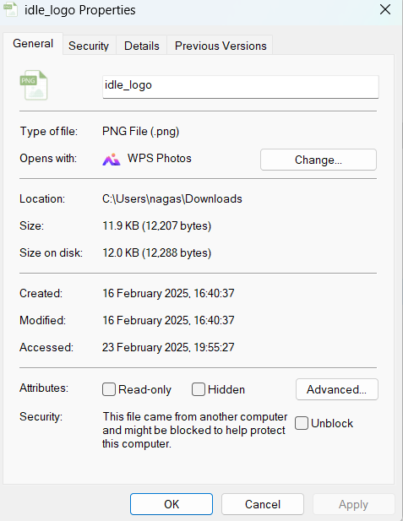
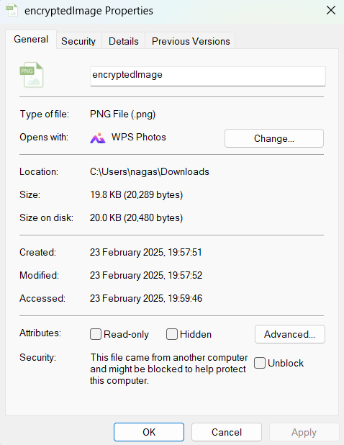
RESULTS(CONTD..)
Fig. 3. Difference in size of the input image and encryped image properties

Slide 9
Conclusion
Steganography is the technique that can be used for encryption and decryption of the data efficiently.
It just needs the image and the data to be shared secretly
The mechanism includes the change in the pixel values which is difficult to detect.
In this way, the encryption and decryption can be done effectively using steganography.

Slide 10
GitHub Link
https://github.com/Nagasaidillif/NSD_aicte_edunetintern

Slide 11
THANK YOU

