Slide 1
MUMAX³ POST-PROCESSING
FMR & Spatial Spin-Wave Mode Analysis
Mathematical formulation
processing/fmr.py · processing/mode_profile.py

Slide 2
OVERVIEW
Two analyses, one Fourier idea
Both paths take a time series, remove its DC component, and Fourier-transform along time.
FMR
Spatial mode
0-D averaged magnetisation vs. swept field
3-D magnetisation snapshots vs. time
Group table.txt rows by field B
DC-remove m(t), FFT per field
Assemble χ(f, B) → heatmap
Slices: A(B) and S(f)
Select / project component m_c
Window + DC-remove per cell
rFFT per cell → P(f, r)
Integrate P_int(f), find peaks f_m
Single-bin map at f_m, average axis

Slide 3
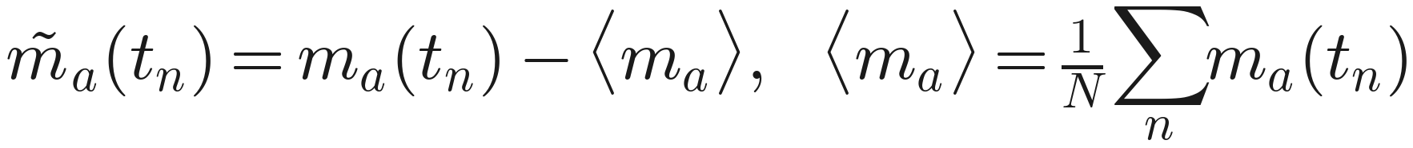
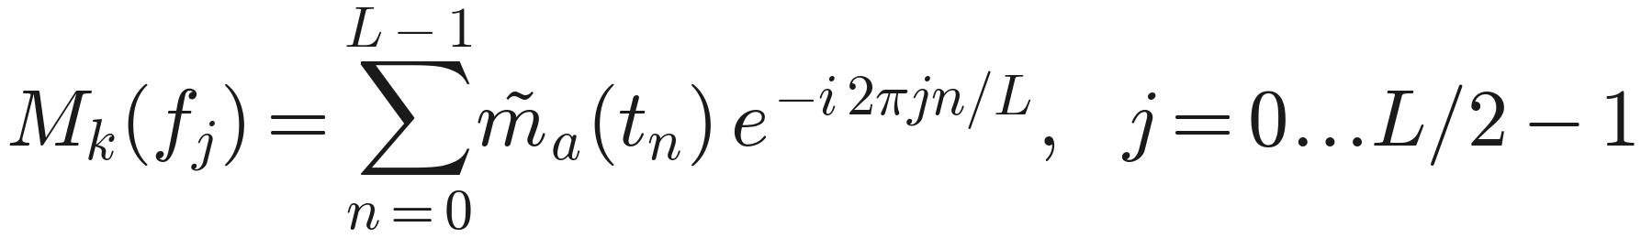
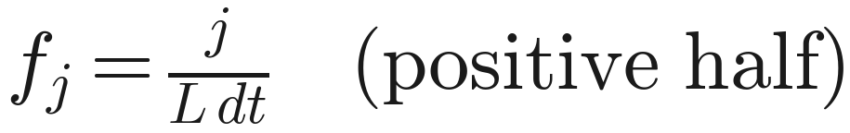
FMR · CORE MATH
Per-field transform → susceptibility
1
DC removal
2
Discrete FT
3
Frequency axis
4
Keep runs
5
Susceptibility

Slide 4
FMR · SLICES
1-D cuts through χ(f, B)
Fixed frequency F → absorption vs. field
(get_absorption_curve)
Fixed field B → spectrum vs. frequency
(get_mfft_at_field)
Heatmap axes: field B (x) · frequency f (y) · colour = |χ|. Field axis in T or Oe (1 T = 10⁴ Oe).

Slide 5
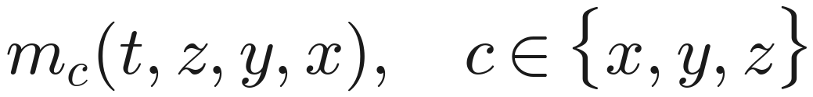
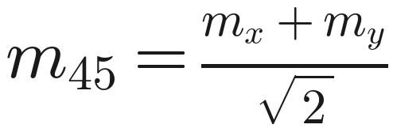
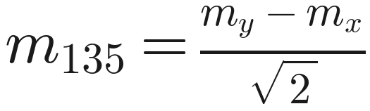
SPATIAL MODE · COMPONENT
Choose or project the component
Data tensor from stacked OVF snapshots:
m ( t , z , y , x , c ) , shape ( Nₜ , n_z , n_y , n_x , 3 )
Axis component
In-plane projection
M45 is along the 45° (bias) axis; M135 along the 135° (MW) axis — projections of the full vector field, computed per cell.

Slide 6
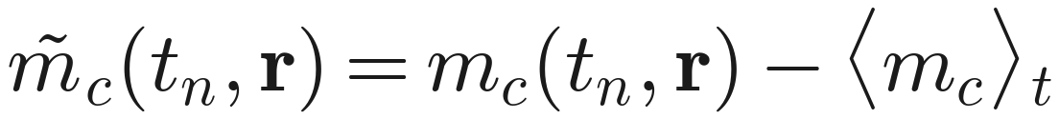
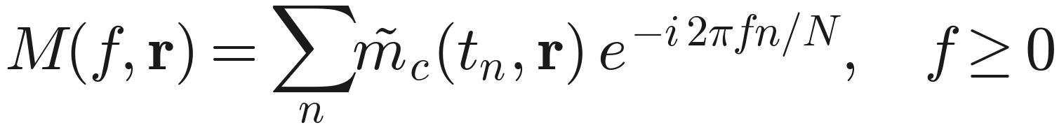
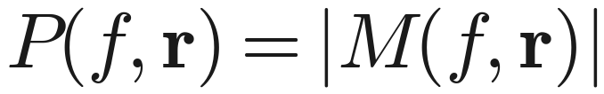
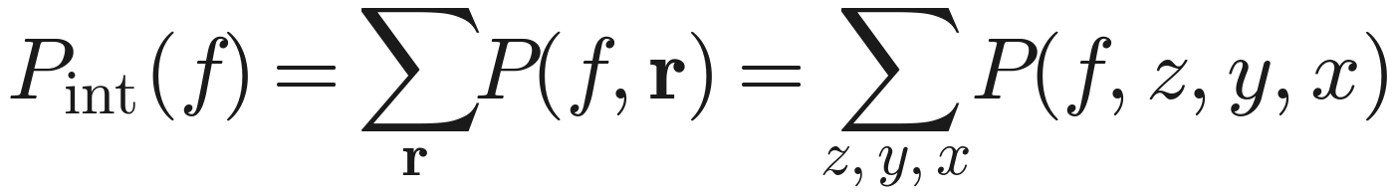
SPATIAL MODE · CORE MATH
Per-cell real FFT → power spectra
1
Time window
2
DC per cell
3
Real FFT / cell
4
Power
5
Integrated

Slide 7
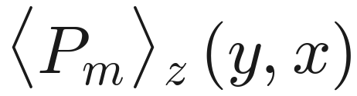
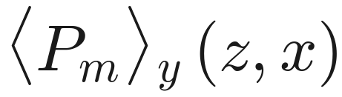
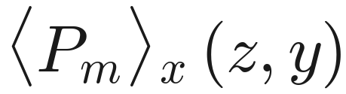
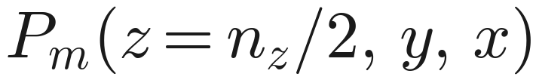
SPATIAL MODE · PROFILE
Peaks and the single-bin mode map
Resonance peaks from the integrated spectrum:
Mode map = the single frequency bin at the peak (no band integration):
Reduce the 3-D block to 2-D by averaging one axis:
Z → XY
Y → XZ
X → YZ
None

Slide 8
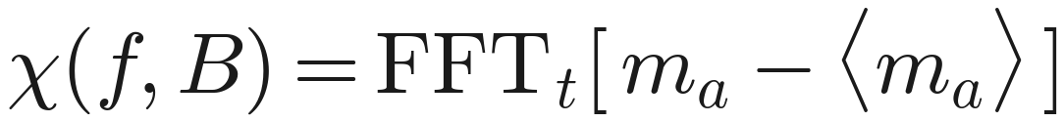
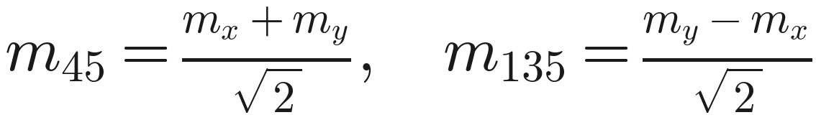
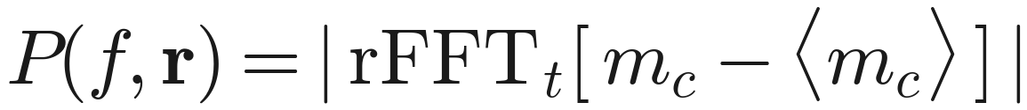
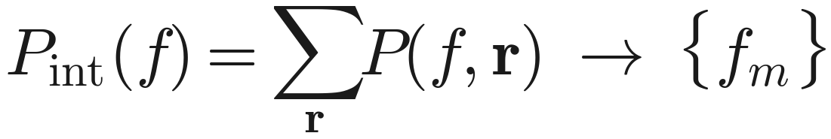
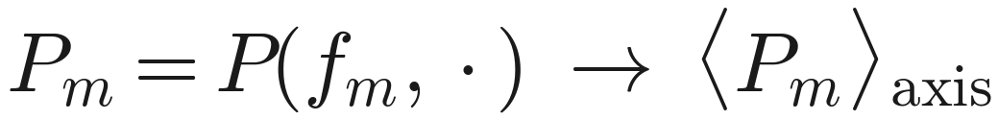
RECAP
The pipeline in five lines
FMR
Projection
Per-cell power
Integrate → peaks
Mode map
FFT_t = DFT along time (positive-frequency half). rFFT = real-input FFT (single precision).

