Slide 1

S J C INSTITUTE OF TECHNOLOGY
DEPARTMENT OF COMPUTER SCIENCE AND ENGINEERING
The Project work Synopsis Review On
“Deep Learning Based Classification Of Bio Degradable And Non Bio Degradable Using CNN”
PRESENTED BY
Kavyashree K S Keerthana S Nagashree C R Navya L
UNDER THE GUIDANCE OF
1SJ20CS068
1SJ20CS069
1SJ20CS092
1SJ20CS094
Prof Ashok K N Assistant professor CSE,SJCIT
Coordinator name
Designation`
CSE, SJCIT
Dr. Manjunatha kumar B H
Professor and HoD
CSE,SJCIT

Slide 2
CONTENTS
ABSTRACT
INTRODUCTION
PROBLEM DOMAIN, PROBLEM STATEMENT AND DETAILED ANALYSIS
STUDY OF THE EXISTING SYSTEMS AND FEASIBILITY OF PROJECT PROPOSAL
OBJECTIVES OF THE PROPOSED WORK
OUTCOMES OF THE PROPOSED WORK
METHODOLOGY
VII. PLANNING OF THE PROJECT WORK

Slide 3
ABSTRACT
The system utilizes a deep learning algorithm based on the CNN model to classify waste materials as biodegradable or non-biodegradable.
Preprocessing techniques are applied to image datasets, including reshaping, resizing, and converting images to arrays.
CNN models consist of convolutional layers with kernel filters that identify patterns and features in input images.
The system aims to achieve high accuracy in waste material classification, which can contribute to effective waste treatment and environmental assessment.

Slide 4
INTRODUCTION
This project is about using smart computer programs (called convolutional neural networks or CNNs) to tell the difference between things that break down in the environment and things that don’t.
It's important because we want to solve the problem of waste being thrown away in the wrong way, which hurts the environment.
We use pictures of these things to teach the computer program, and it learns to recognize them by their colors and textures.
The results show that technology like this can help us manage waste better and take care of the environment.

Slide 5
PROBLEM DOMAIN, PROBLEM STATEMENT AND DETAILED ANALYSIS
Problem Domain: Classification of biodegradable and non-biodegradable materials using deep learning.
Problem Statement: Develop a system to accurately identify and categorize materials based on their ability to naturally decompose or not, addressing environmental and health concerns. Utilize Convolutional Neural Networks (CNN) for image-based classification of these materials.

Slide 6
Detailed analysis:
The project focuses on creating an advanced waste classification system using Convolutional Neural Networks (CNNs).
Various CNN architectures, including Dense, Dropout, Activation, Flatten, Convolution2D, and MaxPooling2D, are employed for training and classifying waste materials.
The dataset comprises images representing both biodegradable and non-biodegradable items. Preprocessing involves reshaping and resizing images.
Performance evaluation identifies the most accurate CNN model based on metrics. The project presents the system architecture and webpage interface, concluding that the developed system is effective for large-scale waste classification and management.

Slide 7
STUDY OF THE EXISTING SYSTEMS AND FEASIBILITY OF PROJECT PROPOSAL
Study of the Existing Systems
We looked at other projects and studies that do similar things.These studies involve sorting things, understanding how things break down, and using computers to tell the difference between them.
These existing studies show that using smart computer programs, like CNNs, can help a lot with waste management and eco-friendly product development. In simple terms, the project looks doable, and existing studies support the idea that smart computer programs can be very useful in managing waste and making environmentally friendly products.

Slide 8
Feasibility of Project Proposal
The project's goal is to create a smart computer program using CNNs to classify images into three categories: Biodegradable, Non-Biodegradable, or normal.
The project involves analyzing data, trying different computer methods, and picking the best one.
Finally, the program will be made into a website using the Django Framework.
Feasibility Conclusion: The project seems possible based on existing studies and technology.

Slide 9
OBJECTIVES OF THE PROPOSED WORK
Objectives:
To develop a deep learning model utilizing the Convolutional Neural Network (CNN) algorithm for the classification of Biodegradable and Non-Biodegradable waste.
To analyze and compare various CNN architectures to attain optimal accuracy levels.
To deploy the developed model using the Django Framework for user interface purposes.
To contribute to the development of sustainable and environmentally friendly products by enabling early consideration of biodegradation aspects in the product development process.
To assess the performance of the developed model and identify areas for future improvement.

Slide 10
OUTCOMES OF THE PROPOSED WORK
Development of an accurate and efficient waste classification model utilizing the Convolutional Neural Network (CNN) algorithm.
Contribution to the development of sustainable and environmentally friendly products by enabling early consideration of biodegradation aspects in the product development process.
Potential for large-scale implementation of the developed model in waste treatment for biodegradable and non-biodegradable categories.
Identification of areas for future improvement and optimization of the developed model.

Slide 11
METHODOLOGY
Convolutional Neural Network (CNN): A CNN is an Artificial Neural Network that includes one or more convolutional layers. It is widely used for processing images and performing tasks such as classification and segmentation.
Preprocessing: Before training a CNN model, the dataset is preprocessed by reshaping and resizing images and converting them to arrays. This ensures that the images are in a suitable format for the CNN model.
Dataset: The dataset used in CNN models consists of four different types of images: Biodegradable and Non-Biodegradable. These images are used to train the CNN model and can also be used for testing.

Slide 12
Convolutional Layers: Each convolutional layer in a CNN model has a set of convolutional kernels or filters. These filters are applied to subsets of input pixel values to identify patterns and features in the images.
Classification: The CNN model is trained to classify materials as either biodegradable or non-biodegradable based on the images. Different algorithms, such as AlexNet, ShuffleNet, SqueezeNet, and GoogleNet, can be evaluated to determine the best performance.
Identification, Sorting, and Processing: The results of the CNN model can aid in the identification, sorting, and processing of waste materials. This can contribute to more efficient waste management and environmental sustainability.
12

Slide 13
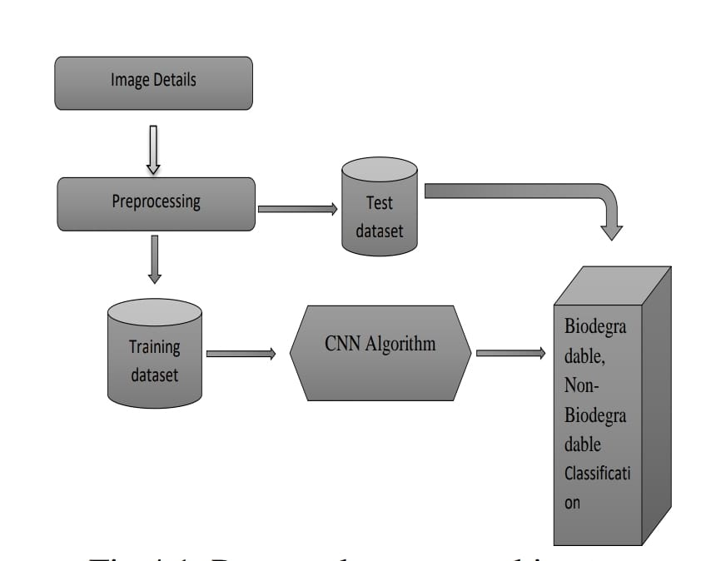
Proposed System Architecture

Slide 14
PLANNING OF THE PROJECT WORK
Project Objective: We aimed to create an accurate deep learning model using CNNs to classify biodegradable and non-biodegradable waste.
Project Requirements: We needed images of biodegradable and non-biodegradable materials, deep learning tools, and computing resources.
Project Plan: Our plan involved collecting data, selecting a deep learning model, designing feature extraction techniques, training the model, evaluating its performance, and deploying it.
Project Implementation: We gathered data, chose the right model, improved how the model understands images, trained it, checked how well it worked, and made it accessible.
Project Monitoring: We kept an eye on the project's progress, solved issues or risks as they came up, and adjusted our plan when necessary.
Dept. of CSE, SJCIT

Slide 15

THANK YOU
Dept. of CSE, SJCIT

