Slide 1
Generating Music with Machine Learning
Mini-Project #22 – UE24CS352A Machine Learning
Nagashri R Patil (PES1UG24CS289) | Nallamalli Kanaka Mani Sai Akhil (PES1UG24CS290)
Based on: Kang, Kim, Ringdahl – Stanford, “Music Composition with Machine Learning” (2018)

Slide 2
Problem statement
• Teach a computer to compose by learning musical structure from MIDI files
• Task 1: predict the next note (pitch + duration) on unseen songs
• Task 2: generate new, playable MIDI pieces (melody + chords)
• Compare LSTM (main model) vs Naive-Bayes-like chord→note vs random (flat) baseline
• Goal from the paper: LSTM sequence modelling should beat independent-note models

Slide 3
Dataset and representation
• Dataset: Nottingham folk MIDI – 1031 songs, 195,537 note events (read from data/, any .mid/.midi)
• Song-level split 80/10/10: 824 train / 103 val / 104 test songs
• Event = [right-hand note (88 keys), duration (8 classes), left-hand chord (63 + other)] – like the paper’s note vectors
• Right hand = highest note ≥ MIDI 60; left-hand chord = pitch-class set of lower notes sounding
• Durations: inter-onset interval quantised to 16th-note grid
• Windows of 64 events; padded targets are ignored in the loss

Slide 4
Models
• Random (flat): uniform over 88 keys / durations / chords – reference level
• Naive-Bayes-like: P(note | chord), notes independent given chord, Laplace smoothing; Markov chain over chords for generation
• LSTM (main): embeddings → 1 LSTM layer (256) → dropout → 3 softmax heads (pitch, duration, chord)
• Training: cross-entropy, Adam lr 0.005 (β₁ .9, β₂ .999), grad clipping, early stopping on validation loss
• Generation: autoregressive sampling → events → MIDI (melody track + chord track)

Slide 5
Pipeline and implementation
• preprocess.py → parse MIDI, split, chord vocabulary, windows
• train.py → LSTM training / validation, checkpoint, loss plot
• evaluate.py → test metrics for all models, generated-music metrics, plots, MIDI export + reload check
• demo.py → generate (and play) a new MIDI composition live
• run_all.py → whole pipeline in one command; PyTorch, CPU-friendly, auto-GPU
• LSTM: 5 epochs, best epoch 5, 46s on cpu

Slide 6
Results: next-event prediction (test set)
Model | Pitch CE | Pitch ppl | Top-1 | Top-5 | Dur. acc
Random (flat) | 4.477 | 88.0 | 0.000 | 0.002 | 0.165
Naive Bayes-like (prev chord) | 2.445 | 11.5 | 0.179 | 0.664 | 0.655
Naive Bayes-like (given chord) | 2.305 | 10.0 | 0.221 | 0.719 | 0.655
LSTM | 1.652 | 5.2 | 0.430 | 0.900 | 0.742
17,093 held-out test events; lower CE / higher accuracy is better.
Naive Bayes ‘given chord’ sees the true concurrent chord (paper protocol) – extra information the LSTM does not get.

Slide 7
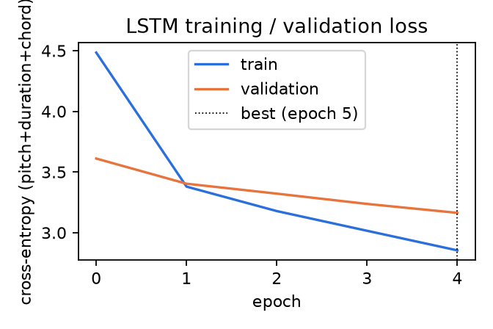
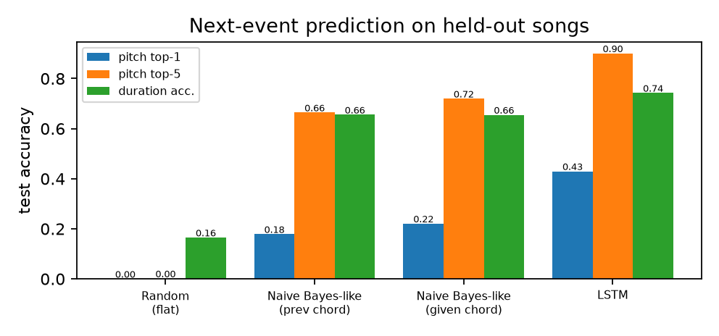
Training curve and model comparison

Slide 8
Results: generated music vs real music
Metric | Real | Random | Naive Bayes | LSTM
Scale consistency | 0.98 | 0.65 | 0.92 | 0.97
Chord-tone rate | 0.75 | 0.28 | 0.74 | 0.64
Repeated-note rate | 0.11 | 0.01 | 0.13 | 0.11
Mean |interval| | 2.62 | 29.58 | 5.36 | 2.60
5-gram novelty | 0.26 | 1.00 | 0.86 | 0.37
Interval JS vs real | 0 | 0.65 | 0.17 | 0.00
Closer to the ‘Real’ column is better. All generated .mid files re-load and play correctly (Random (flat): 5/5, Naive Bayes-like: 5/5, LSTM: 5/5).

Slide 9
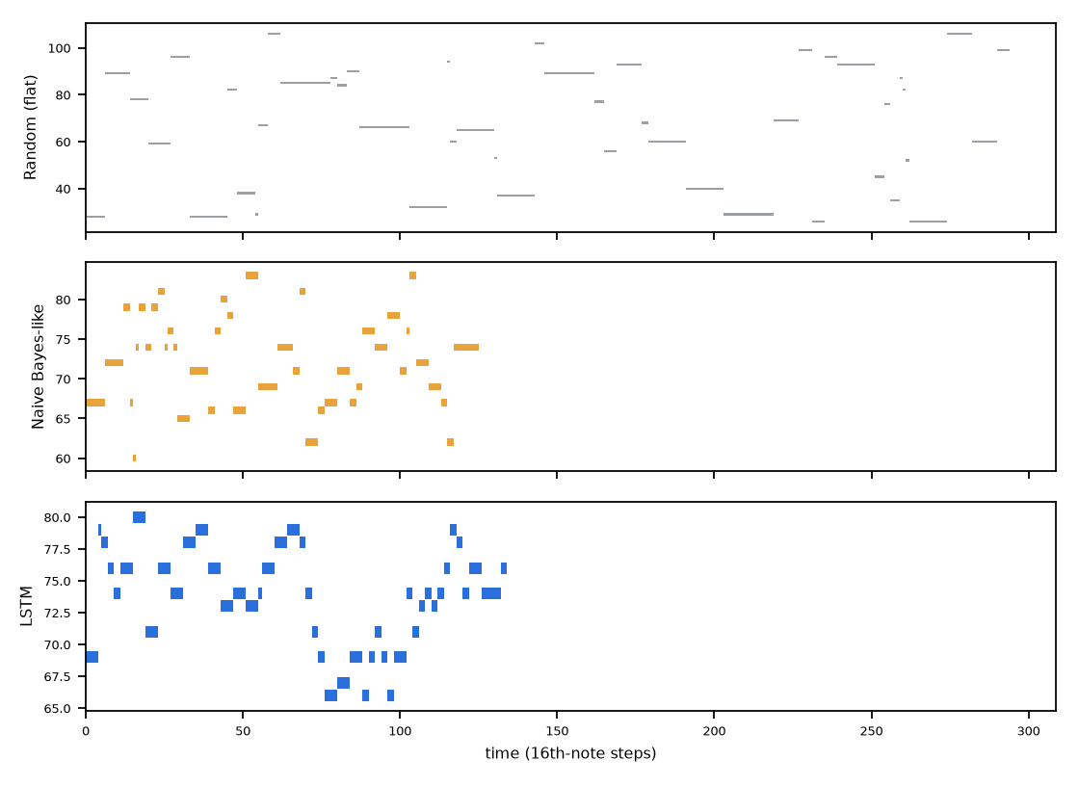
Generated piano rolls (first 48 events)

Slide 10
Conclusions
• LSTM sequence modelling beats Naive-Bayes-like and random models on next-note prediction (see table)
• Generated LSTM melodies match real interval statistics and stay in key; Naive Bayes fits chords best
• Limitations: single-voice melody, coarse chords, no dynamics/velocity, no human Turing test
• Future work (from the paper): Transformer / self-attention models and note velocity
• Live demo: python demo.py --play

