Slide 1
UE22AM241B – Mathematics for Machine Learning
Course Project
ROCK VS MINE PREDICTION
Nagathejas M S : PES1UG22AM098
Bharateesha lvn : PES1UG22AM088
Mohith B : PES1UG22AM096
Malleshappa D Patil : PES1UG22AM090

Slide 2
Topic
Problem Objective: Develop a machine learning model to predict whether an object detected underwater is a rock or a mine based on certain features.
Dataset: Utilize a dataset containing samples of sonar returns, where each sample represents features extracted from sonar signals bounced off different objects (rocks or mines) submerged in water.
Features: Identify key features such as frequency bands, angles, and intensity of the sonar returns as input variables for the predictive model.

Slide 3
Topic
Target Variable: Define the target variable as a binary classification (rock or mine) based on the known classifications of the objects in the dataset.
Model Selection: Explore various machine learning algorithms suitable for binary classification tasks, including logistic regression, decision trees, random forest regressor and XGB regressor.
Evaluation: Assess the performance of the developed models using appropriate metrics such as accuracy, precision, recall, and F1-score.

Slide 4
Uniqueness
Real-world Application
Challenging Data Analysis
Binary Classification
Interdisciplinary Nature
Impactful Outcomes

Slide 5
Dataset
Size: 208 rows X 61 columns
FEATURE ATTRIBUTES :
Frequencies: Measurements of signal frequencies across different bands or spectrums.
Amplitudes: Intensity or strength of the returned sonar signals.
Time-Domain Features: Characteristics related to signal duration, echoes, and temporal patterns.
Statistical Measures: Mean, variance, skewness, kurtosis of signal properties.
Waveform Analysis: Shape analysis of the signal waveform.
Spatial Features: Information about the object's position or orientation relative to the sonar source

Slide 6
SOURCE
Kaggle: Online platforms like Kaggle have curated datasets related to sonar signal processing tasks.
https://www.kaggle.com/datasets/rupakroy/sonarcsv

Slide 7
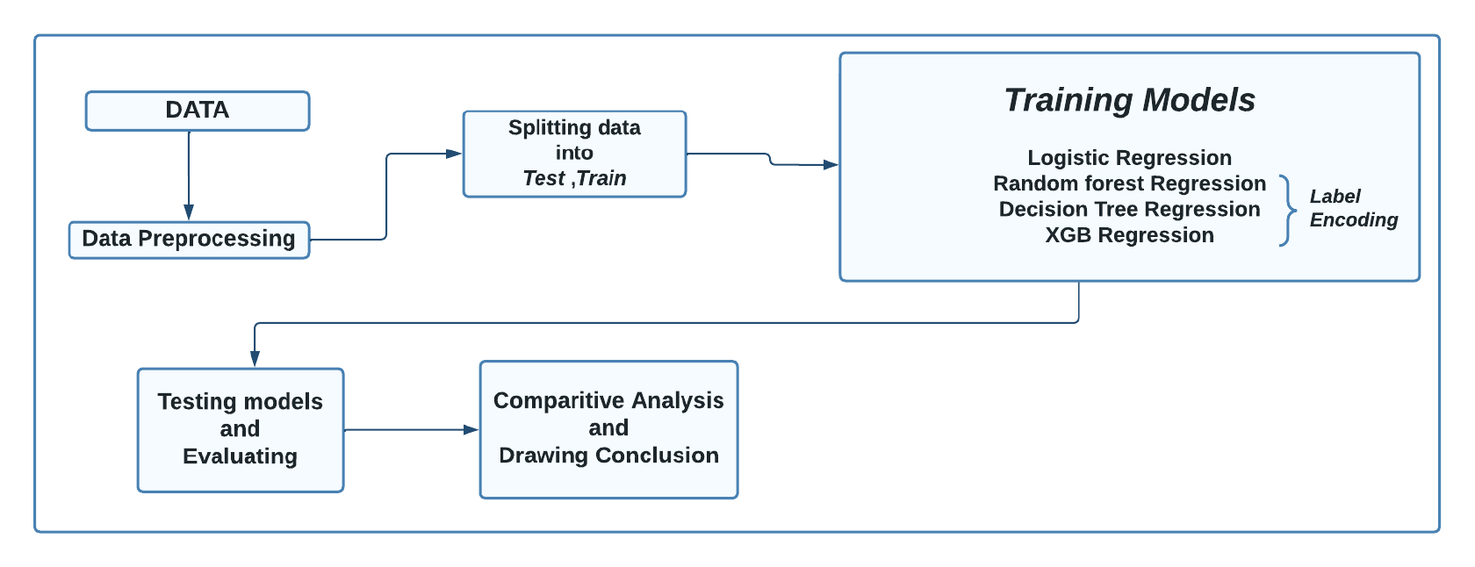
Overall design or approach in a free hand diagram

Slide 8
Final results so far
Any metric ?
According to our problem statement we need to decrease the number of false rock predictions as much as possible ,by observing confusion metrics of the different models, logistic regression and random forest regressor seems to have low false rock predictions , as logistic regression has more accuracy and precision than random forest regressor ,we consider it as best model for our problem statement

Slide 9
Done vs Remaining to be done ?
No | Description | Done or To be done
1 | Data collection and data processing | Done
2 | Training the model | Done
3 | Testing the model | Done
4 | Evaluating the models | Done
5 | Do comparative analysis and conclusion | Done

Slide 10
Quantity and quality of work
no | Code functionality | % Complete | Runs without problem (Y/N) | If there are minor issues, indicate
1 | Data collection and data processing | 100 % | Y | -
2 | Training the model | 100 % | Y | -
3 | Testing the model | 100 % | Y | -
4 | Evaluating the models | 100 % | Y | -
5 | Do comparative analysis and conclusion | 100 % | Y | -

Slide 11
Top few learning
Serial No | Top learning in this project
1 | Utilize advanced data analysis techniques such as data pre-processing ,machine learning algorithms, to classify rock and mine using SONAR data.
2 | Knowledge of ML models – Logistic regression , random forest , decision tree , XGB regressor
3 | Knowledge of comparative analysis of ML models

