Slide 1
UE22AM221B – Learning from Imbalanced Dataset
Course Project
Project Title :
Team member 1 SRN and name:
Team member 2 SRN and name:
Team member 3 SRN and name:
Cerebral Stroke Prediction
PES1UG22AM098 Nagathejas M S
PES1UG22AM096 Mohith B
PES1UG22AM090 Malleshappa D Patil

Slide 2
Topic
Define your problem statement crisply
Our Aim is to use appropriate data cleaning and data balancing techniques to correctly predict and classify people into group of having risk of cerebral stoke or not.

Slide 3
Uniqueness
Why you think this project is interesting or unique
This project tackles one of the most critical healthcare challenges. Cerebral stroke, if not detected early, can prove to be fatal.
By using the required and available data of an individual and by machine learning algorithms and models, we can potentially contribute to proactive healthcare, aiding in early diagnosis.

Slide 4
Dataset
Size, attributes, source, class imbalance etc.
43400 rows and 12 columns
Columns:Id,gender,age,hypertension,heart_disease,ever_married,work_type,Residence_type,avg_glucose_level,bmismoking_status,stroke(target column)
Source- https://data.mendeley.com/datasets/x8ygrw87jw/1

Slide 5
Imbalance Learning Strategy Employed
Strategy 1
By using Random Oversampling and Logistic Regression, Decision tree
Strategy 2
By using SMOTE and Logistic Regression , Decision tree

Slide 6
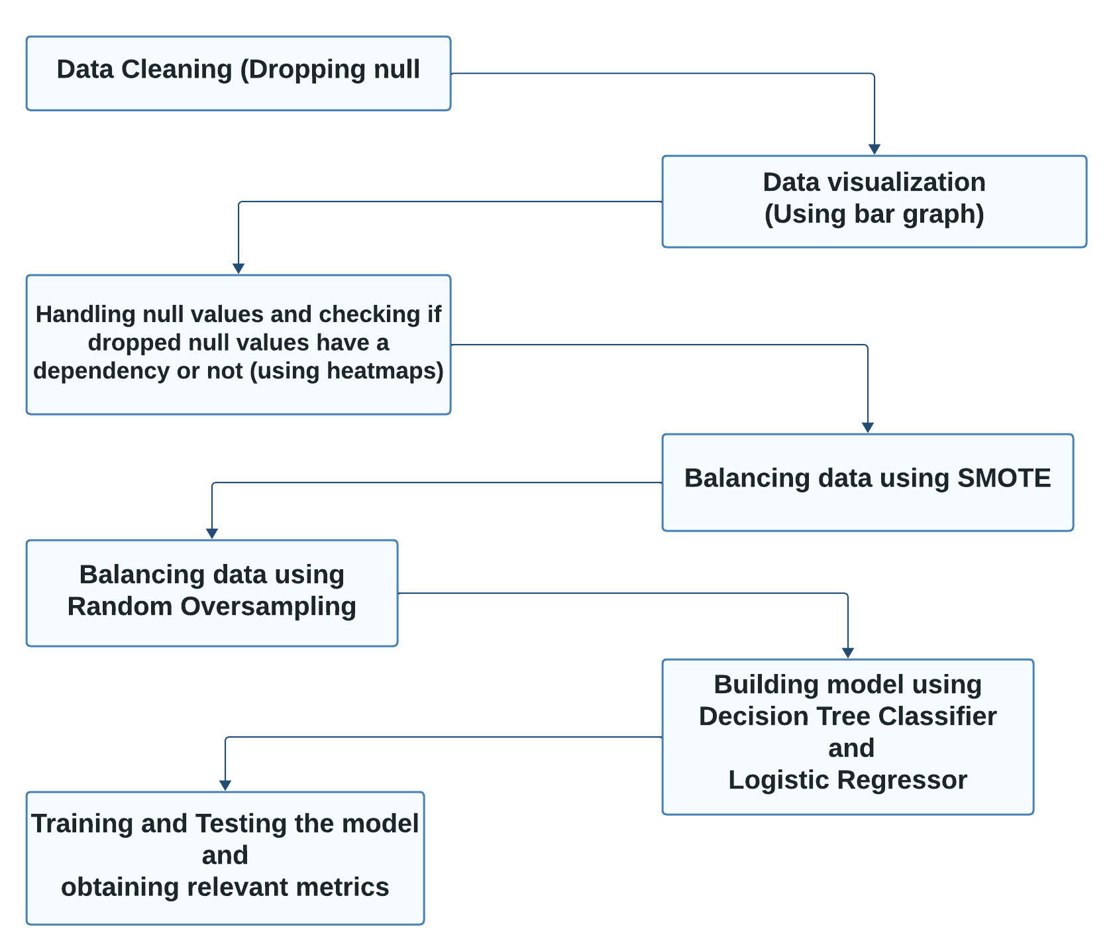
Overall design or approach in a free hand diagram

Slide 7
Final results so far
Metrics
Visualisation
Accuracy
Precision
Recall
F1 Score
Box plots
Loss curve
Heat maps
Bar graphs

Slide 8
Done vs Remaining to be done ?
No | Description | Done or To be done
1 | Data Visualization | Done
2 | Data cleaning | Done
3 | Balancing data using SMOTE | Done
4 | Balancing data using Random Oversampling | Done
5 | Building Model | Done
6 | Training and Testing model | Done

Slide 9
Quantity and quality of work
no | Code functionality | % Complete | Runs without problem (Y/N) | If there are minor issues, indicate
1 | Data cleaning(Dropping null values) | 100 | Y | -
2 | Data visualization(Using bar graph) | 100 | Y | -
3 | Handling null values and checking if dropped null values have a dependency or not (using heatmaps) | 100 | Y | -
4 | Balancing data using SMOTE | 100 | Y | -
5 | Balancing data using Random Oversampling | 100 | Y | -
6 | Building model using Decision Tree Classifier and Logistic Regressor | 100 | Y | -
7 | Training and Testing the model and obtaining relevant metrics | 100 | Y | -

Slide 10
Top few learning
Serial No | Top learning in this project
1 | How to handle dependencies of null values in imbalanced data
2 | Different methods(SMOTE,Random Oversampling) that can be used to balance imbalanced data
3 | Using different data visualization techniques

