Slide 1
CONTENT MANAGEMENT IN HEALTH CARE
Converting Policy Documents
into Computable Assets
A working proof of concept: policy2rules
Naga Venkata Sai Chennu
August 2026

Slide 2
THE PROBLEM
Health care runs on documents
Billing and coding policies, clinical guidelines, and payer contracts decide what gets covered, how it is billed, and who gets paid.
Most of it still lives as plain prose in PDFs and web portals.
So a person reads each policy, works out what it means, and manually turns it into claim edits, audit rules, or prior authorization criteria.
That translation work is slow, expensive, and easy to get wrong.
WHY IT MATTERS FOR COTIVITI
Cotiviti's business depends on encoding thousands of payer policies into accurate claim edits and audit logic.
Policy content is not a back-office concern. It is the raw material of the product.
policy2rules | Content management in health care
1

Slide 3
RELEVANT TRENDS
Three forces make this urgent now
ECONOMICS
Administrative activity is 15–30% of US medical spending (Health Affairs, 2022).
Billing costs reach hundreds of dollars for a single complex inpatient bill (Tseng et al., 2018).
Every hour between policy published and rule deployed adds to that burden.
TECHNOLOGY
Guideline interpretation accuracy rose from 43% to 99% when guidelines were restructured and given to an LLM via RAG (Kresevic et al., 2024).
The raw capability is there. The hard part now is reliability engineering, not the models.
REGULATION
CMS-0057-F: faster prior authorization timelines and specific denial reasons from 2026.
FHIR-based Prior Authorization APIs required by January 1, 2027.
A 72-hour urgent decision window is hard to meet with criteria buried in prose.
Surveys cited by Cotiviti suggest that more than 85% of payers are already using or piloting generative AI, and that available AI could cut payer administrative costs by as much as 25%.
policy2rules | Content management in health care
2

Slide 4
OPPORTUNITIES AND THREATS
Speed on one side, model risk on the other
OPPORTUNITY
When CMS updates a coverage determination, an LLM pipeline can summarize the change, diff it against the prior version, and draft candidate claim edits in hours rather than weeks.
Grows the edit library faster and shortens client onboarding.
Citation-linked rationale on each edit is exactly the explanation CMS-0057-F now expects.
The work compounds: every policy converted becomes reusable structured content for analytics, audit selection, and fraud detection.
THREAT
The same tools lower the barrier for competitors, including startups that move quickly on policy-driven workflows.
Model risk is the more serious issue. A hallucinated or subtly wrong rule conversion can produce improper denials, and with them regulatory exposure and reputational damage.
Human review and audit trails must be built in from the start.
Dependency risk: relying on third-party foundation models raises cost, privacy, and continuity questions.
policy2rules | Content management in health care
3

Slide 5
THE PROOF OF CONCEPT
The model writes rules. It does not decide claims.
policy2rules - a single-file Streamlit app on gpt-4o-mini: summarize a policy, compare two versions, convert policy text into executable claim rules.
Policy text
gpt-4o-mini
JSON mode
Rules JSON
field / operator / value
decision / reason / source
evaluate_claim()
plain Python, no LLM
WHY THE SPLIT MATTERS
The model is used once, offline, to author rules a human can read and approve. Claim adjudication is then deterministic, auditable, and repeatable: the same claim and the same rules always produce the same decision and the same cited reason. No LLM sits in the path of a live coverage decision.
policy2rules | Content management in health care
4

Slide 6
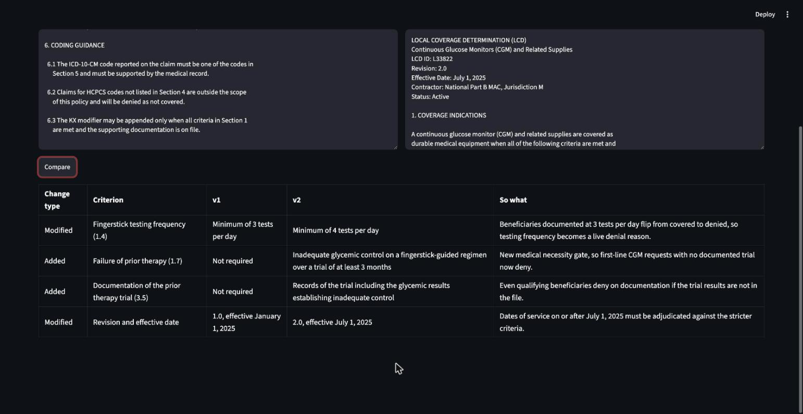
DEMO
Version diff: what changed and who it moves
Two revisions of a Medicare-style CGM policy. Revision 2.0 tightens one criterion (3 to 4 daily fingerstick tests, sec. 1.4) and adds one (documented prior-therapy failure, sec. 1.7). The change report below caught both. Next: revision 2.0 becomes executable rules, live.
policy2rules | Content management in health care
5

Slide 7
WHAT THE BUILD TAUGHT US
Every failure was reliability, not capability
LOGICAL
The model expressed OR across values by repeating a field with == or !=, which the AND-ed rule format cannot represent.
Denied all four claims.
VOCABULARY
Invented claim values such as "multiple_daily_injections" instead of the schema's "mdi".
Every rule missed.
ATTRIBUTION
A criterion with no matching claim field was encoded by borrowing a different field, producing a right decision with the wrong stated reason.
Improper denial rationale.
Three rounds of prompt tightening suppressed each failure without eliminating it, even at temperature 0. Prompt engineering is not reliability engineering.
policy2rules | Content management in health care
6

Slide 8
THE FIX THAT GENERALIZES
Make every rule cite its source
Each rule now carries the policy section its conditions encode, and the claims table shows it alongside the decision.
This is the citation-linked rationale CMS-0057-F expects payers to give with a denial.
It also turns a silent model error into a visible, checkable claim: a rule citing section 1.6 while testing a field from 1.7 is wrong on its face.
The same feature answers the compliance requirement and the model-risk problem.
BEFORE
DENY — "Beneficiary or caregiver must be trained on the use of the device."
Correct decision. Wrong explanation. Nothing on screen revealed it.
AFTER
DENY — section 1.7 — "No documentation of prior therapy failure; criterion 1.7 requires evidence of inadequate control."
Decision, reason, and source travel together and can be checked against the policy.
policy2rules | Content management in health care
7

Slide 9
STRATEGIC OPTIONS
Three paths, no bet on unproven technology
01
INTERNAL POLICY INTELLIGENCE PLATFORM
An LLM pipeline that ingests billing policies, coverage criteria, and contracts; produces structured summaries and version-to-version change reports; and drafts rule candidates that human policy analysts approve before anything is deployed.
Recommended. Speeds up the edit-development lifecycle already at the center of the business, fits the stated augmented-intelligence principle, and turns the corpus of validated policy-to-rule mappings into intellectual property that is hard to copy.
02
CMS-0057-F READINESS SERVICE
Point the same capability outward: convert client medical policies into FHIR-aligned, API-ready prior authorization criteria with citation-linked denial explanations.
The 2026 and 2027 deadlines give this a natural sense of urgency.
03
RELIABILITY AS THE PRODUCT
Formalize the evaluation harnesses, dual-model cross-checks, and consistency-threshold review queues the literature points toward, then market that governance framework to clients.
In a market where one accuracy failure can end a client relationship, provable reliability is a competitive position, not just a safeguard.
First build: programmatic validation - reject any rule whose cited section does not contain the field it tests.
policy2rules | Content management in health care
8

Slide 10
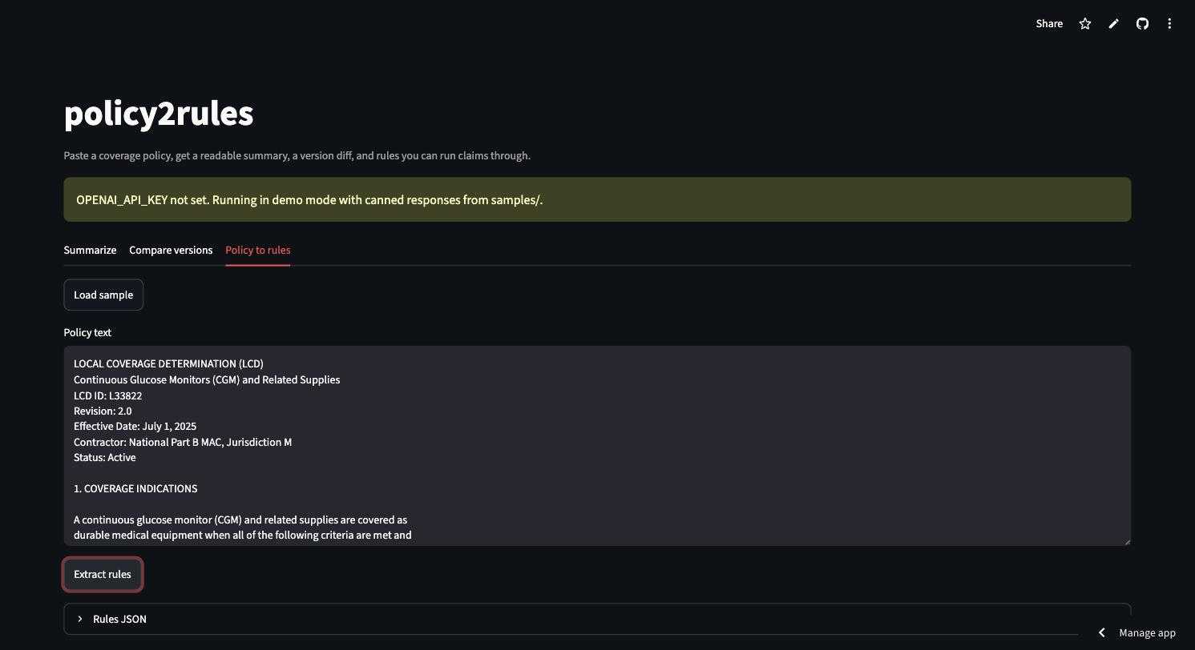
TRY IT
The proof of concept is live
APPLICATION
policy2rules.streamlit.app
Runs offline against canned samples when no API key is configured, so every tab works without cost.
SOURCE
github.com/Nagavenkatasai7/policy2rules
Single file, two dependencies, under 230 lines.
Naga Venkata Sai Chennu | August 2026

