Slide 1

Rang Data II & Sequence Data
Chapter 9-10
Notes:
Range data is used when you have a reference sequence

Slide 2
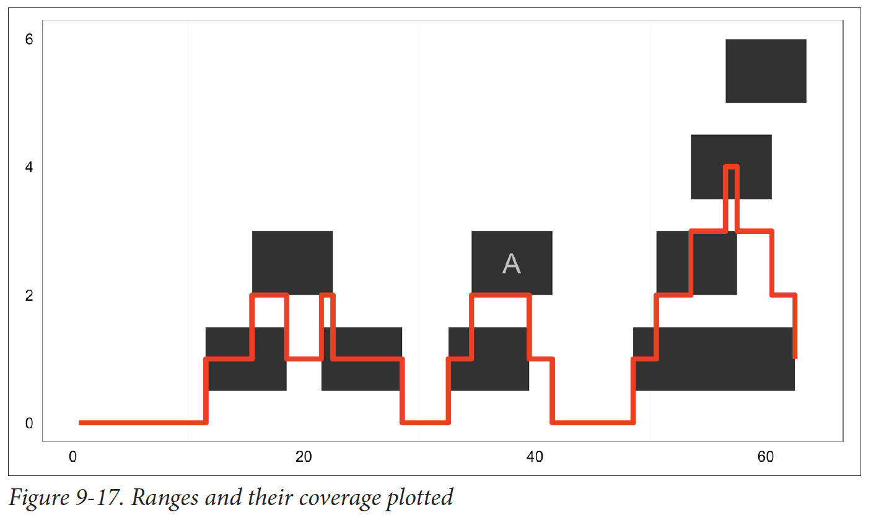
Other types of genomic data
Coverage – depth of overlap of ranges across length of sequence
how variants are discovered
Notes:
Counting how many times given nucleotide is within a given range

Slide 3
Storing Genomic Ranges
IRanges store ranges on a single sequence
GRanges store the sequence name and strand
also contain metadata columns, stored as dataframe
Structure: seq name , range , strand | metadata
Notes:
Stores metadata as well as the range

Slide 4
Example
> library(GenomicRanges)
> gr1 <- GRanges(seqname=c("chr1", "chr1", "chr2", "chr3"),
ranges=IRanges(start=5:8, width=10),
strand=c("+", "-", "-", "+"))
> gr1
> gr2 <- GRanges(seqname=c("chr1", "chr1", "chr2", "chr3"),
ranges=IRanges(start=5:8, width=10),
strand=c("+", "-", "-", "+"), gc=round(runif(4), 3))
> gr2

Slide 5
Commands in GRange data
Same as IRange: start(gr) end(gr) width(gr)
But adds new functions for the names/strands: seqnames(gr) strand(gr)
Can also return length(gr) of the Grange data container
Notes:
How many strands are reverse forwards can use strands
To see sequence names use seqnames
Length says how many ranges are there

Slide 6
Making use of familiar functions:
> gr[start(gr)>7]
Returns all ranges with start position greater than 7
Useful for skipping sections of low interest

Slide 7
Working with annotation data
More packages!
Allows us to “install” data as well (mouse transcript data)
> library(BiocInstaller)
> biocLite("GenomicFeatures")
> biocLite("TxDb.Mmusculus.UCSC.mm10.ensGene")
> library(TxDb.Mmusculus.UCSC.mm10.ensGene)
> txdb <- TxDb.Mmusculus.UCSC.mm10.ensGene
> txdb

Slide 8
Accessing specific regions
> mm_genes <- genes(txdb)
> head(mm_genes)
> length(mm_genes)
Can retrieve transcripts (transcripts()), exons (exons()), coding sequences (cds()), and promoters (promoters())

Slide 9
Quick vocab
Introns
basically, the whitespace of DNA
do not code for proteins, are removed during transcription
Exons
The coding regions of DNA
transcribed to mRNA to be translated into amino acid sequences
Promoter region
“prefix” to a gene where proteins (RNA polymerase) bind to initiate transcription

Slide 10
Real world problem
We want the promoter regions for protein coding genes:
> mm_gtf <- import('Mus_musculus.GRCm38.75_chr1.gtf.gz’)
Select genes
> table(mm_gtf$gene_biotype)
Create subset
> chr1_pcg <- mm_gtf[mm_gtf$type == "gene" &
mm_gtf$gene_biotype == "protein_coding"]
> summary(width(chr1_pcg))
Grab 3000 bp upstream of each gene (a.k.a. promoter region)
> chr1_pcg_3kb_up <- flank(chr1_pcg, width=3000)

Slide 11
Chapter 10 – Sequence Data
2 main types of sequence data:
FASTA - used for sequences not requiring base pair quality scoring - 2 parts: description line (starts with >) and the sequence itself
FASTQ - extends FASTA by including quality score to each base - begins with @ instead of >
Notes:
Quality scoring measures how well a base pair was identified.

Slide 12
Base qualities
Measure of how well base pair was identified
Represented as ASCII characters:
characters (alpha-numeric)
that represent numbers (033-126)
that need to be transformed to other numbers (0-93)
ASCII → Sanger → PHRED

Slide 13
Low-quality bases
Possibly misidentified
Can be trimmed (more packages!)
Run BaseTrim.R

Slide 14
Learning Outcomes
Access range, sequence, and strand data in Grange data containers
Access gene, transcript, exon, and promoter regions
Read FASTA/FASTQ data
Trim base data for utility

