Slide 1

Review of DNA & Central Dogma
Chapter 9

Slide 2
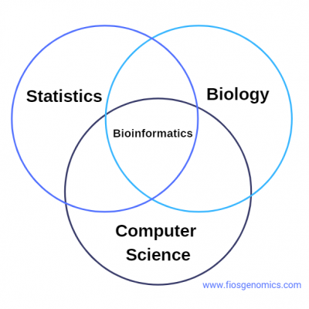
What is bioinformatics?
“Bioinformatics is defined as the application of tools of computation and analysis to the capture and interpretation of biological data.” (Bayat, 2002)
“Bioinformatics is the science of analyzing heaps of data” (Hansen, 2022)

Slide 3
In today’s cells
DNA stores genetic information
DNA is replicated using proteins
RNA also stores genetic information
RNA replicates itself

Slide 4
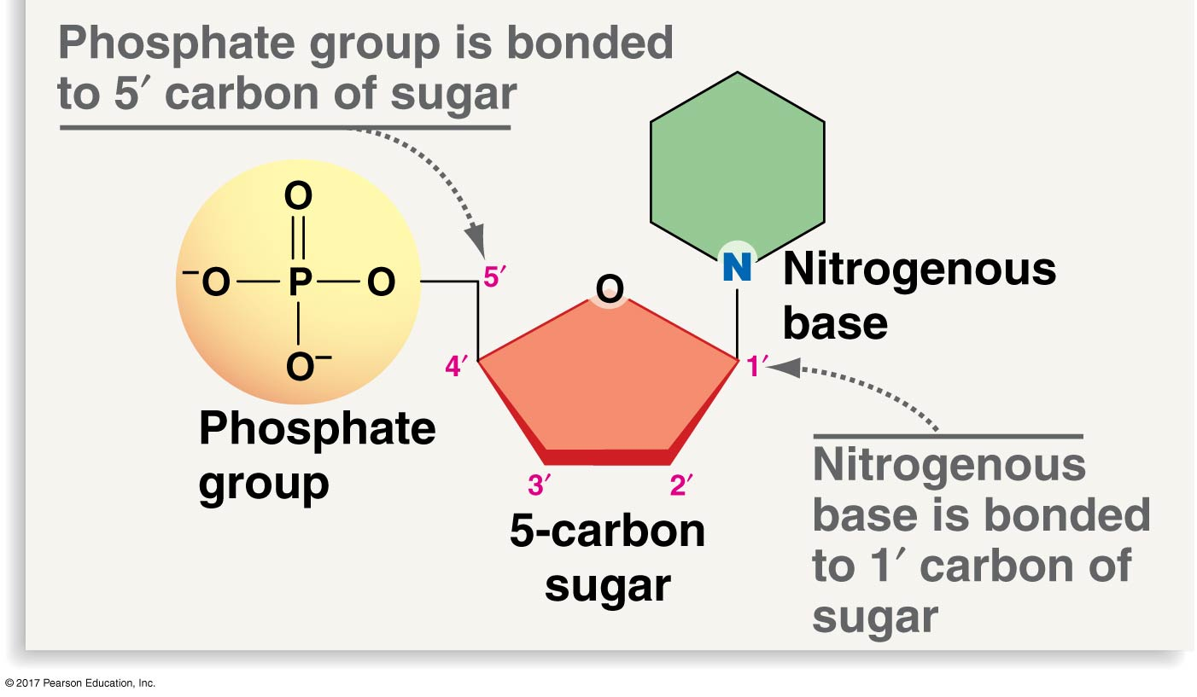
Nucleotides
Adenine (A), Guanine (C), Cytosine(C), and Thymine (T)
In RNA, Thymine is replaced with Uracil (U)
Phosphate group + 5-C Sugar + Nitrogenous base

Slide 5
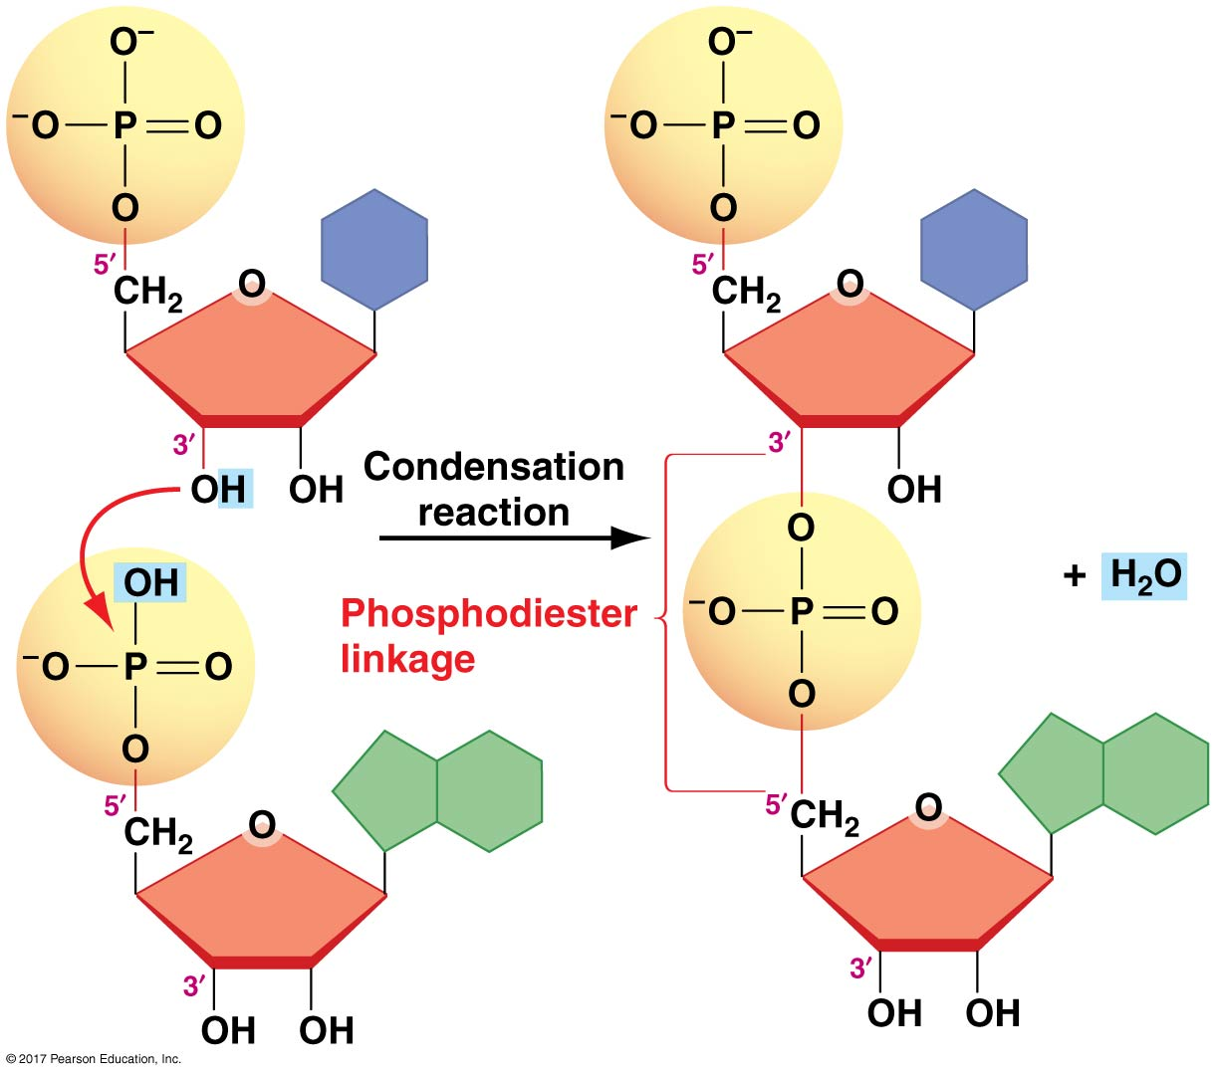
Nucleic Acids
Created by polymerization of nucleotides
Phosphodiester bond connects phosphate group to sugar
Creates sugar-phosphate backbone
Unlinked 5’ phosphate on one end, unlinked 3’ OH on other
gives strand direction

Slide 6
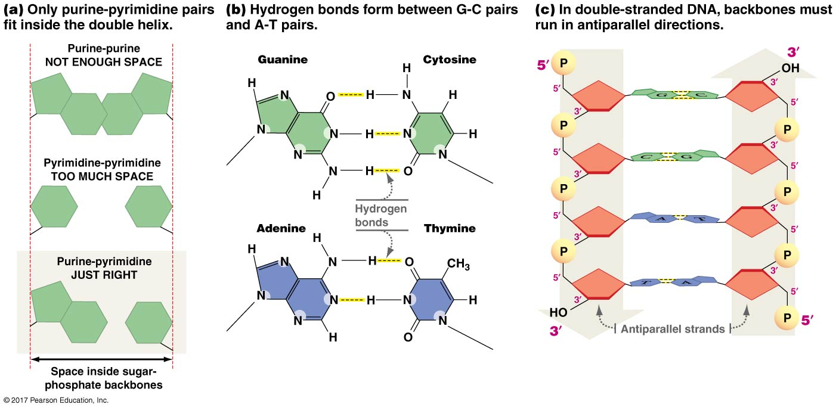
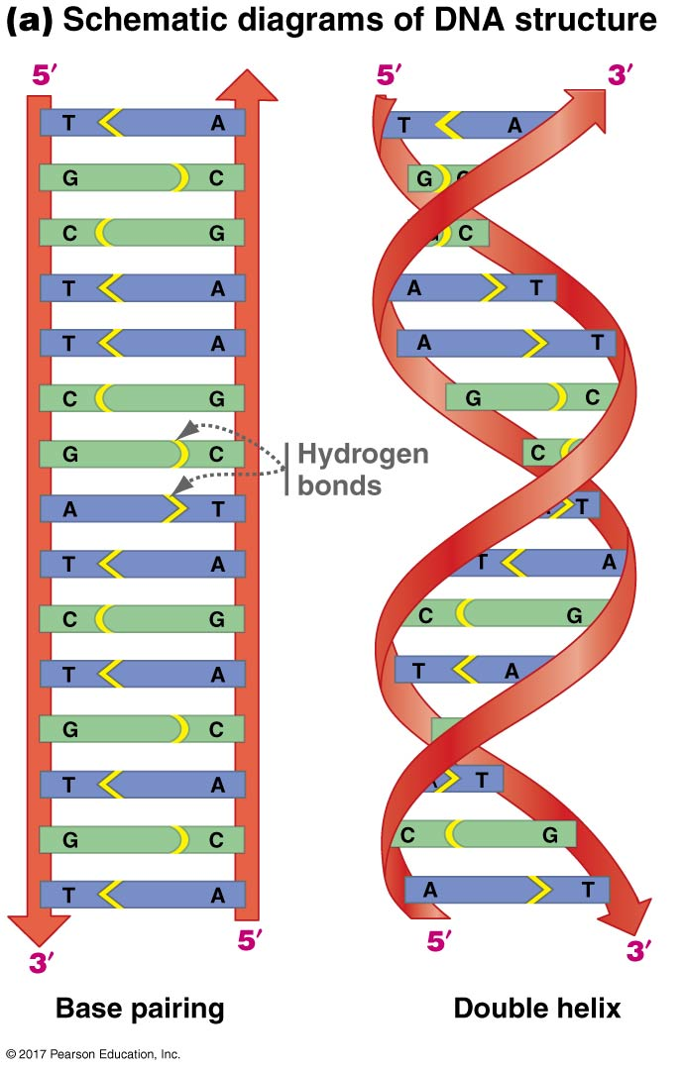
DNA structure
2 nucleic acid strands bound together
Nitrogenous bases bound by H-bonds
sugar-phosphate outward-facing
Run anti-parallel, and twist, forming helix
A bonds with T/U C bonds with G

Slide 7
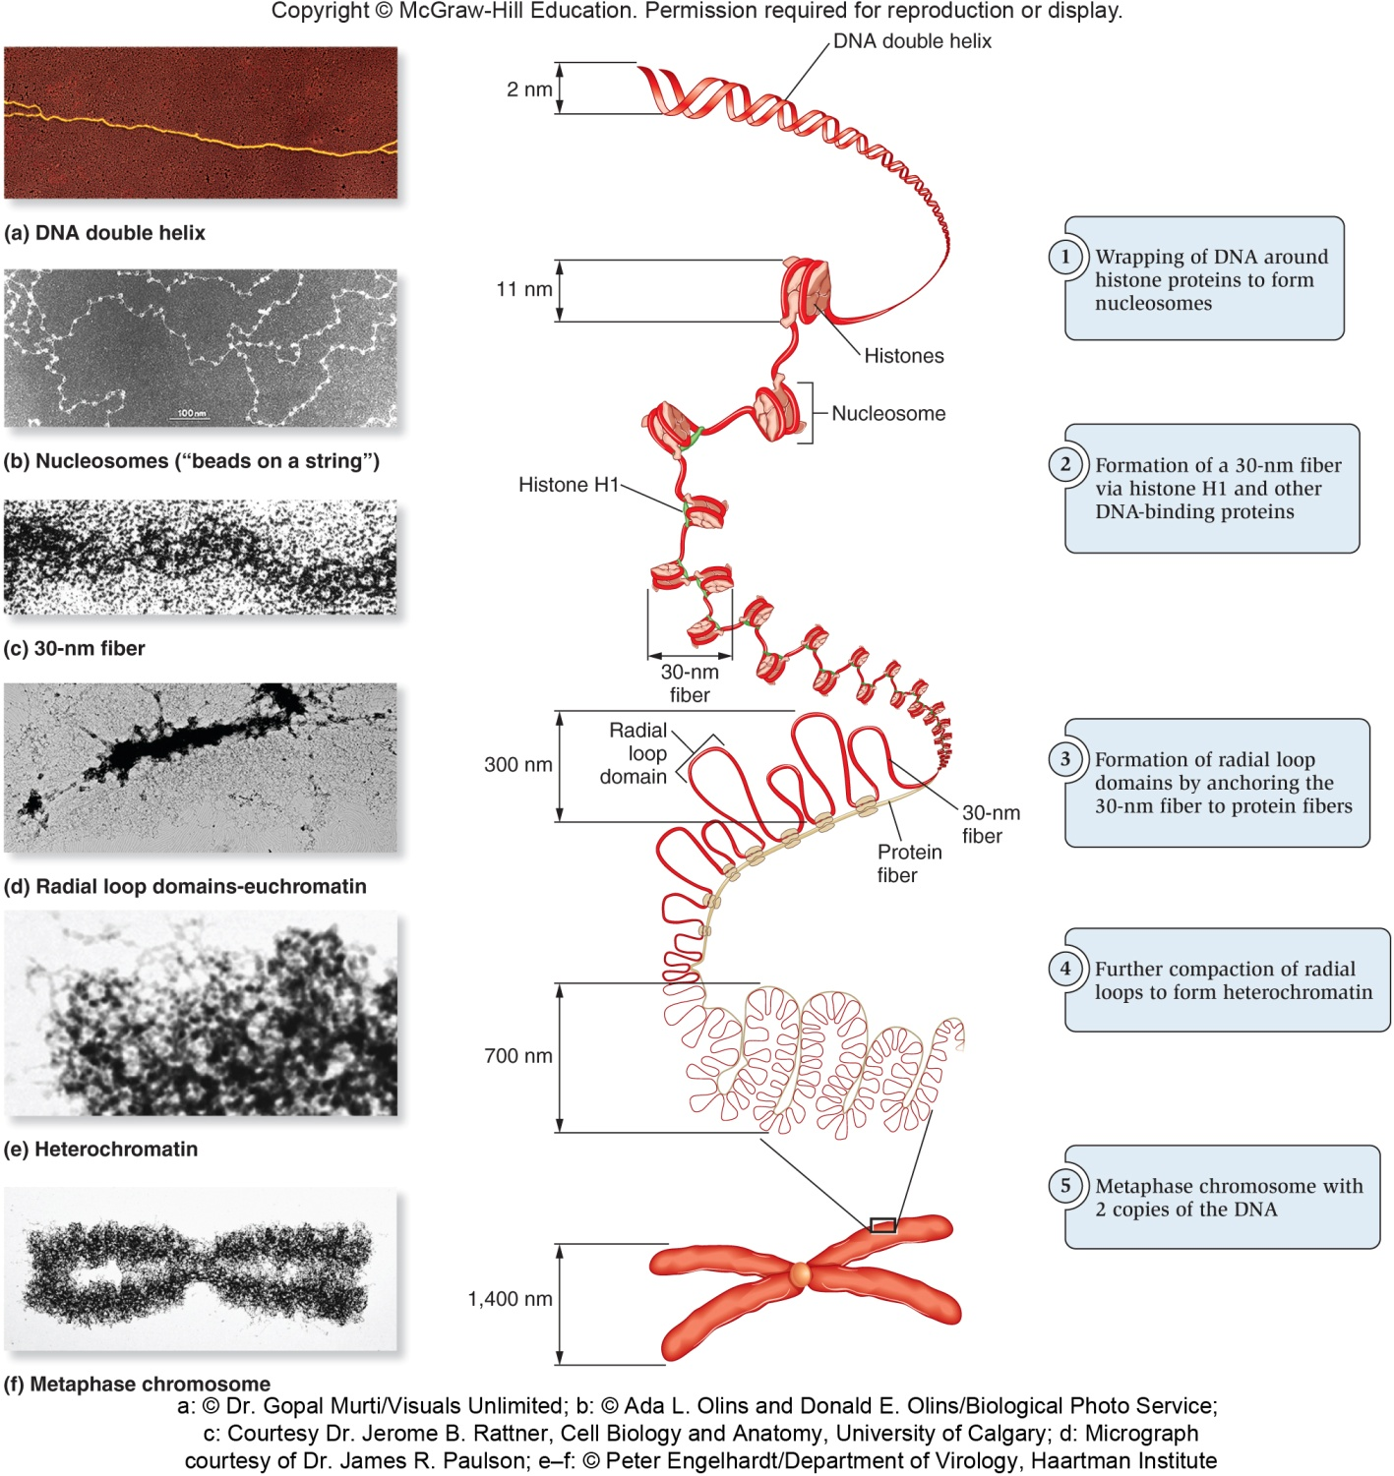
Tertiary structure of DNA
Wraps around histones, folds along protein fiber creates chromosomes
Creates “addresses” for genes

Slide 8
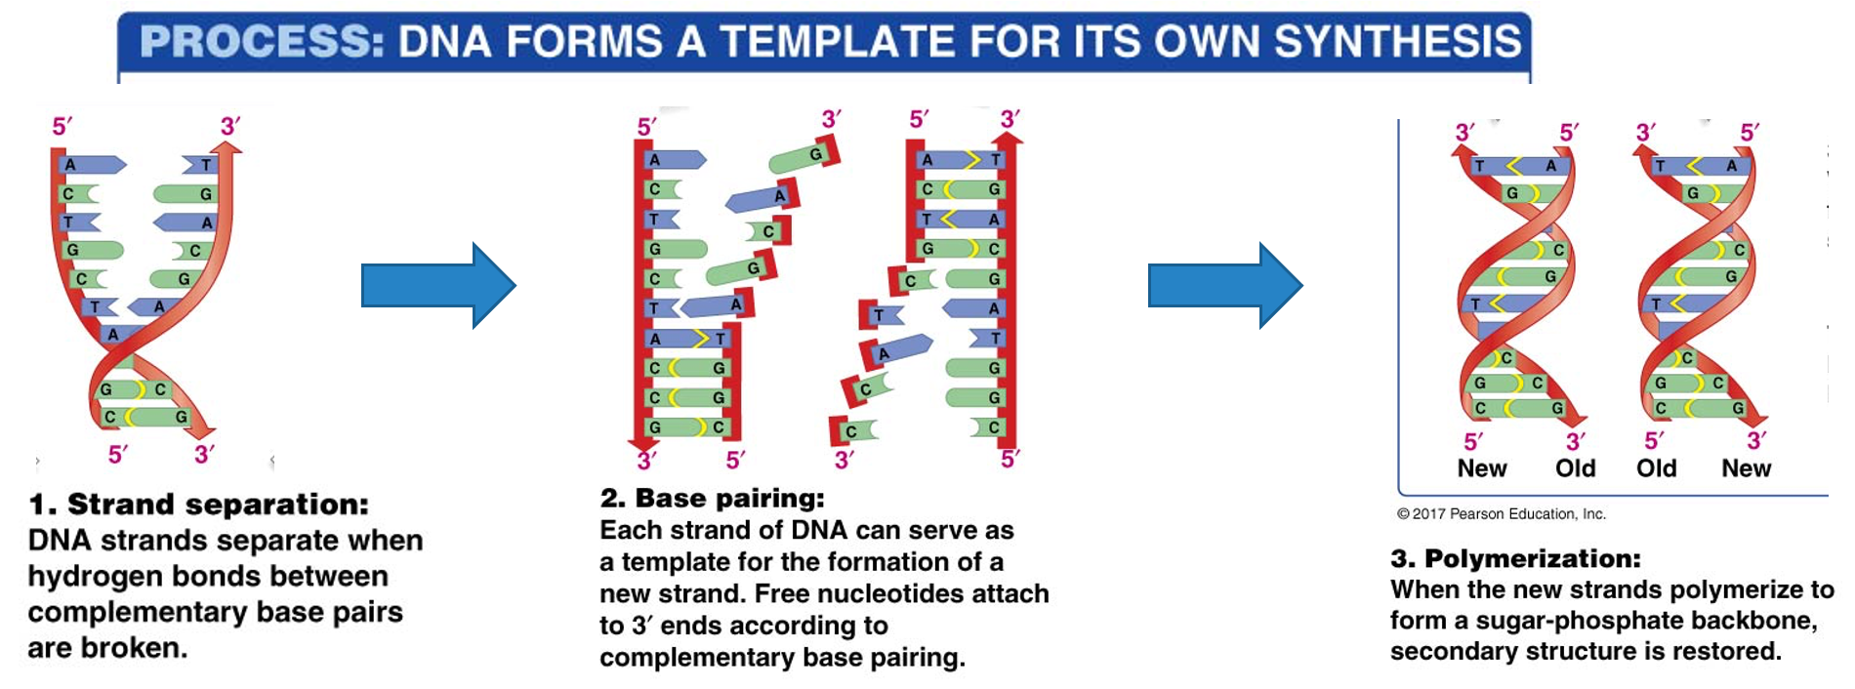
DNA replication

Slide 9
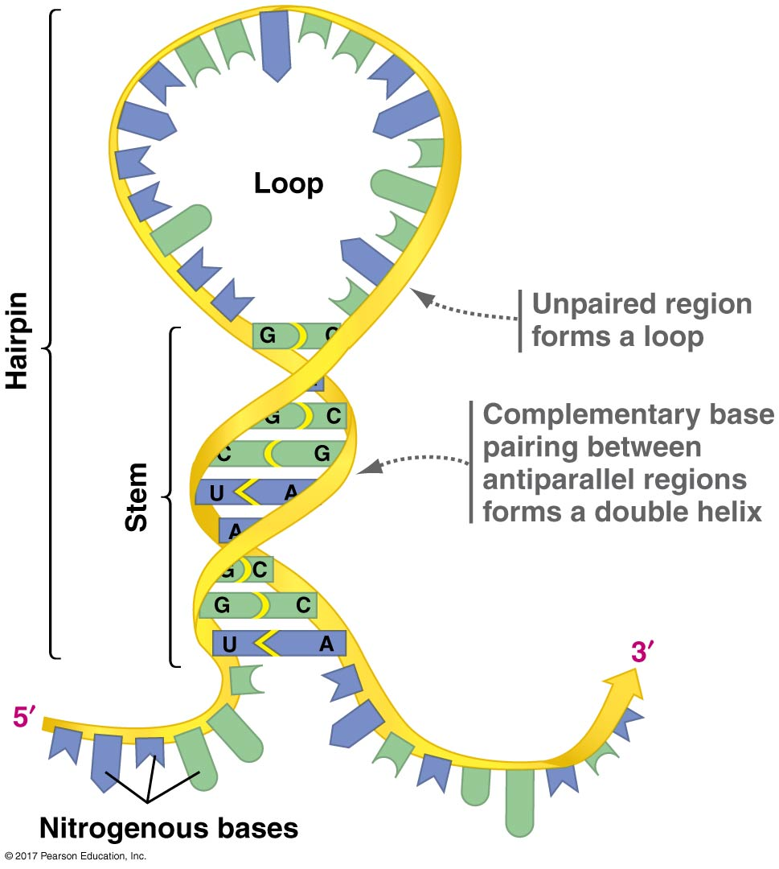
Introducing RNA
Much less stable than DNA
Single stranded (stem & loop structure)
Self-replicating
Can catalyze reactions like protein synthesis

Slide 10
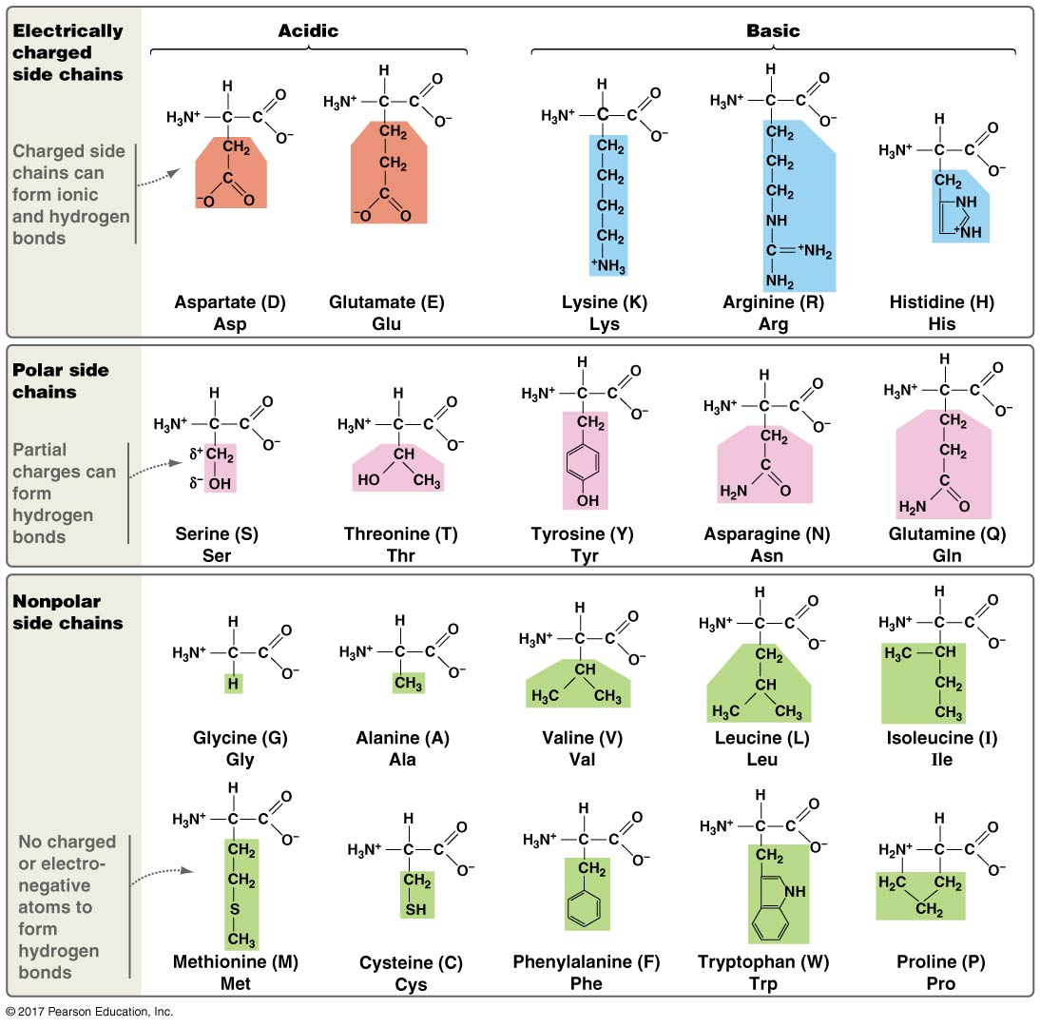
Proteins
Made up of polymers from 20 amino acids
Amino acids bond together in a polypeptide chain
Amino acid sequence determines how chain bonds to itself and other amino acid chains

Slide 11
How does this relate to bioinformatics?
Sequencing data is a common application of bioinformatics
Sequencing data is huge
Sequencing data gives us information about organisms
How?

Slide 12
Central Dogma
Summarizes the flow of information
DNA sequence specifies RNA sequence, which specifies amino acid chain for proteins
Transcription copies hereditary information from DNA to RNA
Translation uses RNA info to synthesize proteins
DNA RNA Protein

Slide 13
3 levels of genetic information: DNA, RNA, proteins
Transcription: Copies DNA segment, Uracil (U) replaces Thymine (T) → RNA
Translation: Nucleotide strands of RNA represent amino acids, the building blocks of proteins
DNA
Transcription
Translation
Protein
RNA
A | T | G | A | T | C | T | C | G | T | A | A
T | A | C | T | A | G | A | G | C | A | T | T
T | A | C | T | A | G | A | G | C | A | T | T
A | U | G | A | U | C | U | C | G | U | A | A
T | A | C | T | A | G | A | G | C | A | T | T
A | U | G | A | U | C | U | C | G | U | A | A
AUG AUC UCG UAA
Met
Ile
Ser
Stop
codons

Slide 14
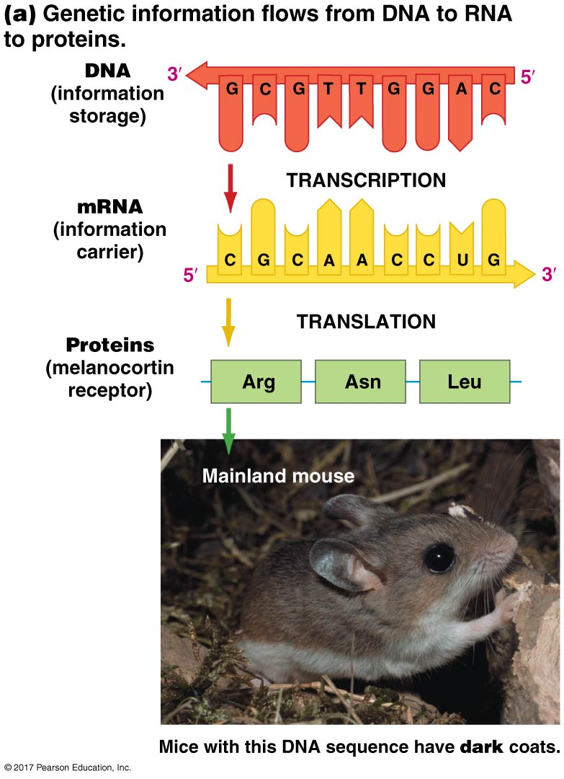
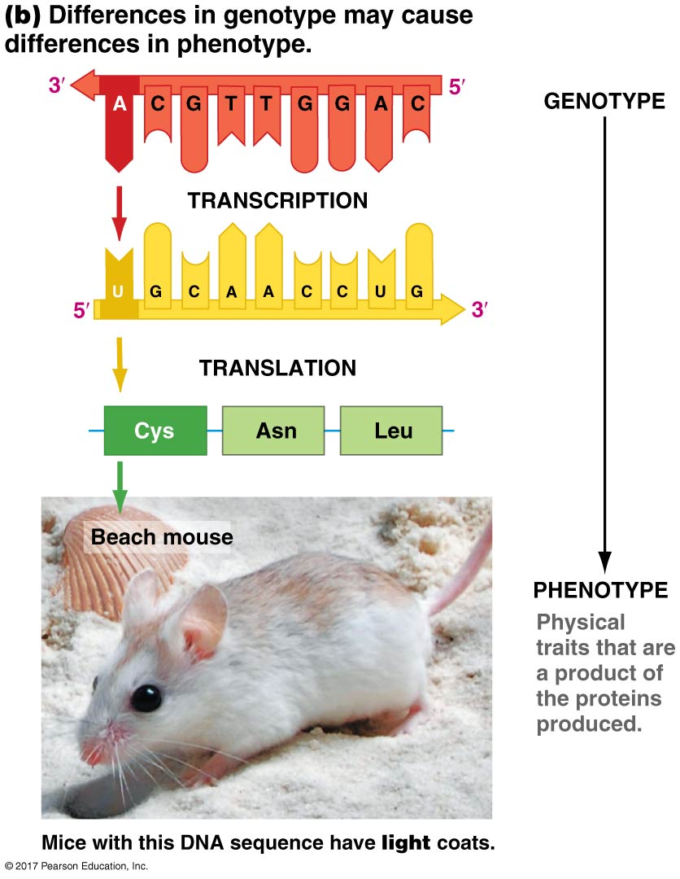

Slide 15
Exceptions to Central Dogma
Many genes code for RNA that are not translated to proteins (RNA is final product)
Sometimes information flows from RNA back to DNA
retroviruses use RNA as a template to make DNA

Slide 16
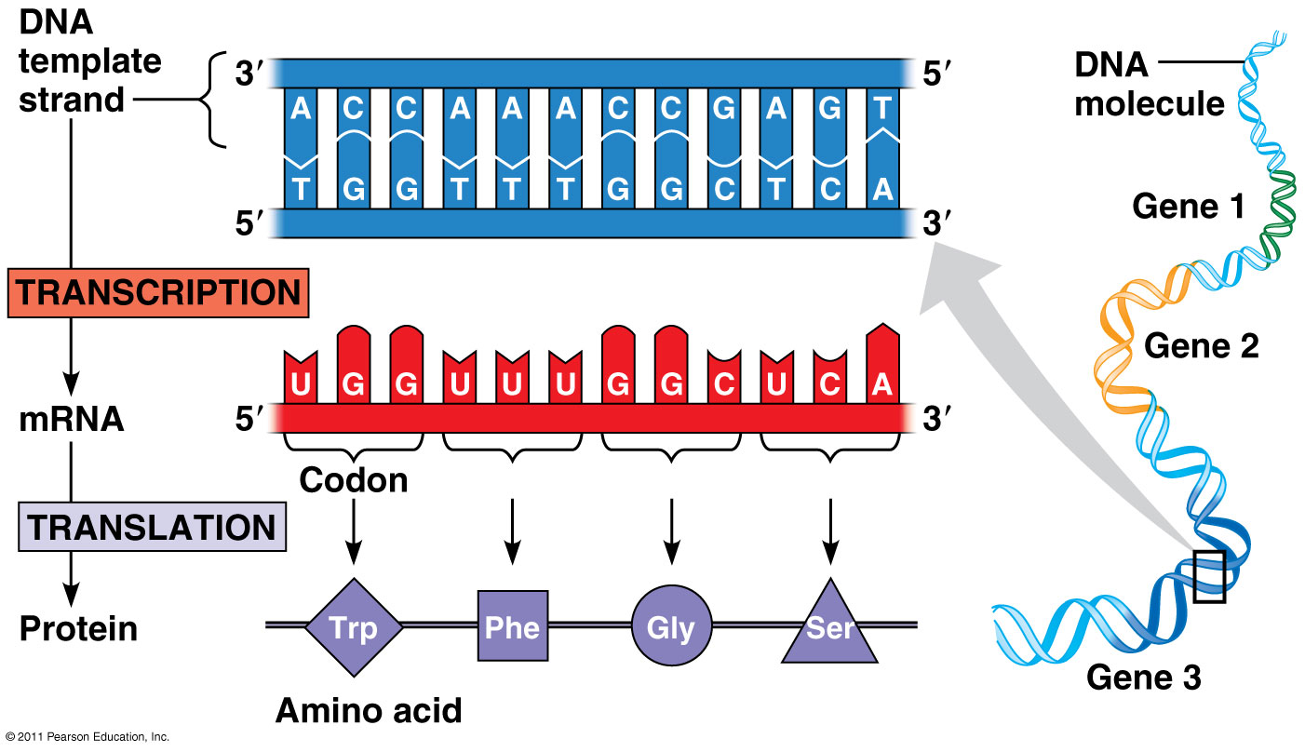
Genetic code
The rules that determine how RNA → proteins
Start codon (AUG) marks beginning of sequence AUG = Methionine
Stop codon (UAA/UAG/UGA) signals end of sequence
All amino acids except Met and Trp are coded by more than one codon
Universal – code is the same in all organisms
The first two bases are usually the same

Slide 17
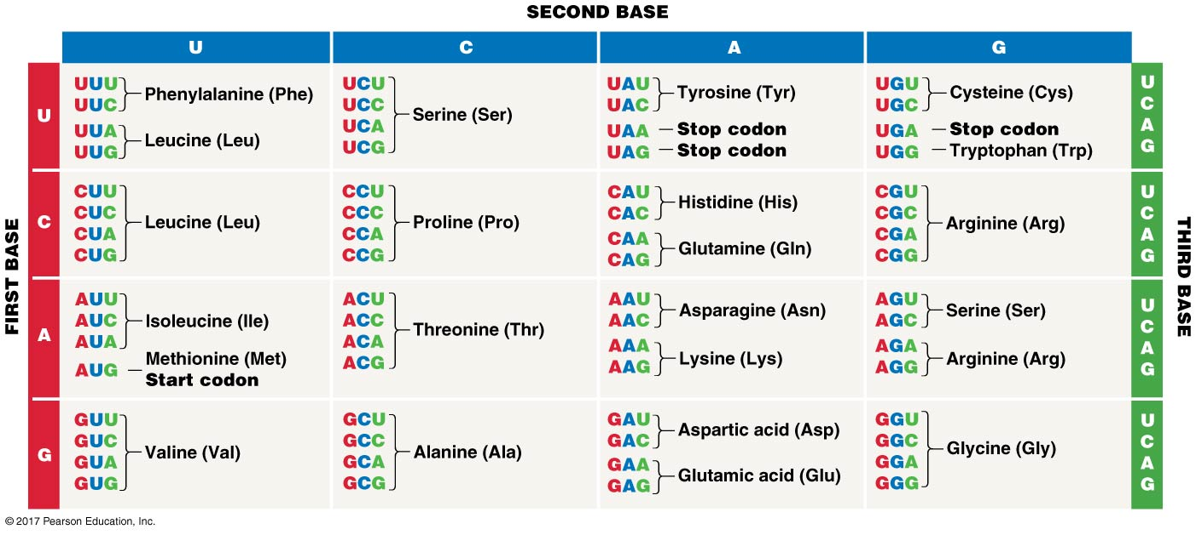

Slide 18
Point Mutations
A single base change in DNA or RNA
silent (neutral): CUC (Leu) becomes CUA (Leu)
missense (beneficial, neutral, deleterious): CUC (Leu) becomes CCC (Pro)
nonsense (creates premature stop codon – deleterious): UAC (Tyr) becomes UAA
frameshift (extra AA): sequence CGC AAC CUC becomes CGC ACA CCU C

Slide 19
Learning Outcomes
Distinguish between the structures and functions of DNA and RNA
Outline the flow of genetic information as described by the central dogma
Explain how genotype that is linked to phenotype (proteins) largely are responsible for an organism’s characteristics.
Explain how the genetic code specifies the relationship between the sequence of codons in RNA and the amino acid sequence of a polypeptide.

