Slide 1

Working with Range Data
Chapter 9

Slide 2
Refresh of DNA sequences
Each sequences represents a reference DNA molecule
These sequences act as a coordinate system
Within a sequence, can describe a region as a range AAGTCATCGCGTATTTCAGGATCTACGGAGACTAGCTAG
Many types of genomic data are linked to a certain range

Slide 3
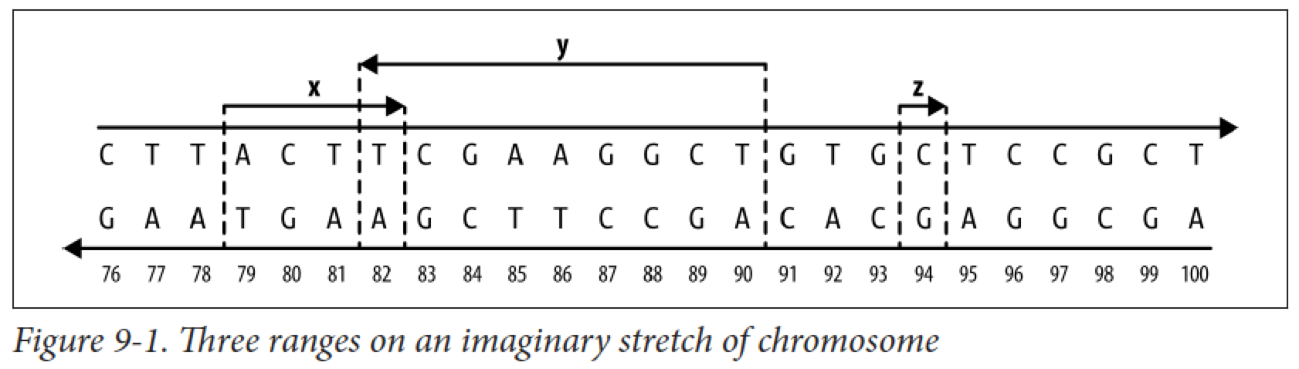
Ranges in bioinformatics
Ranges are how we specify a single subsequence on a chromosome sequence
Think of ranges like indexing a vector or dataframe:
df[1:30,]
like indexing, range data only give information about that specific sequence

Slide 4
Specify genomic position
Need 3 pieces of information:
Range (focus of this chapter)
Chromosome/sequence name (usually a number, e.g. CHR22)
Strand (forward or reverse)

Slide 5
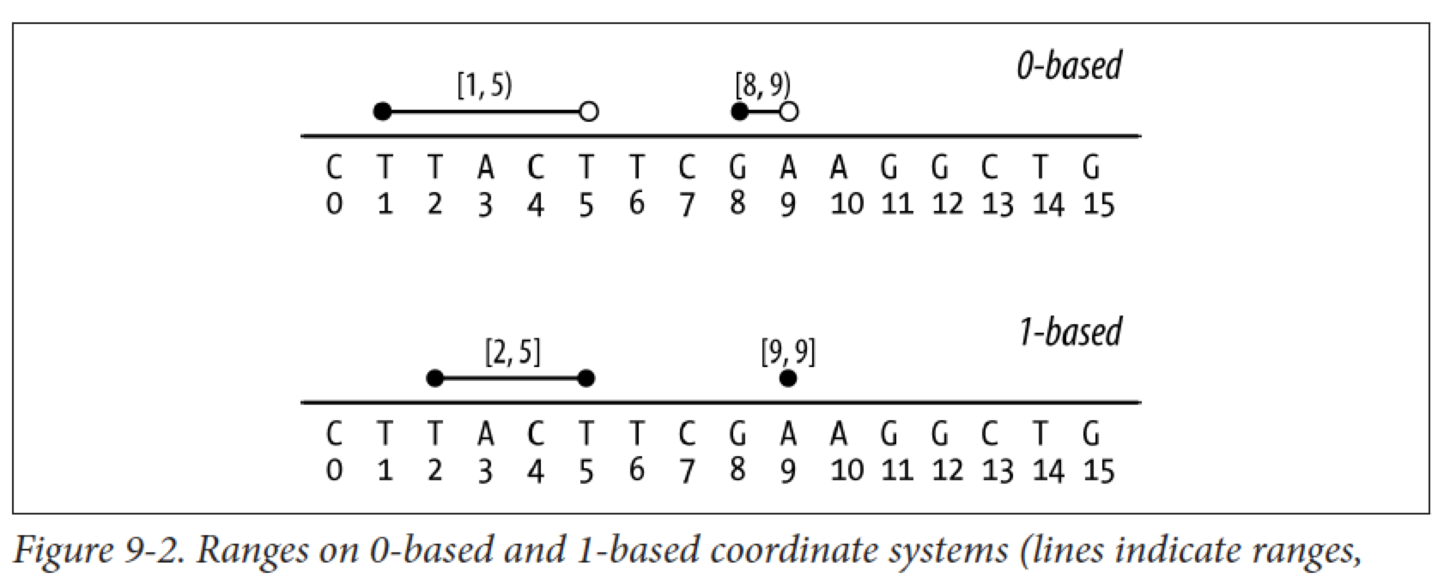
Range intervals
0-based [start, end)
1-based [start, end]*

Slide 6
Interactive Introduction
Upload Bioconductor, GenomicRanges, and Irange
Work through toy examples
Basic operations
Finding overlapping ranges
Finding distance between ranges

Slide 7
Install packages
if (!require("BiocManager", quietly = TRUE))
install.packages("BiocManager")
BiocManager::install()
BiocManager::install("GenomicRanges")
library(IRanges)

Slide 8
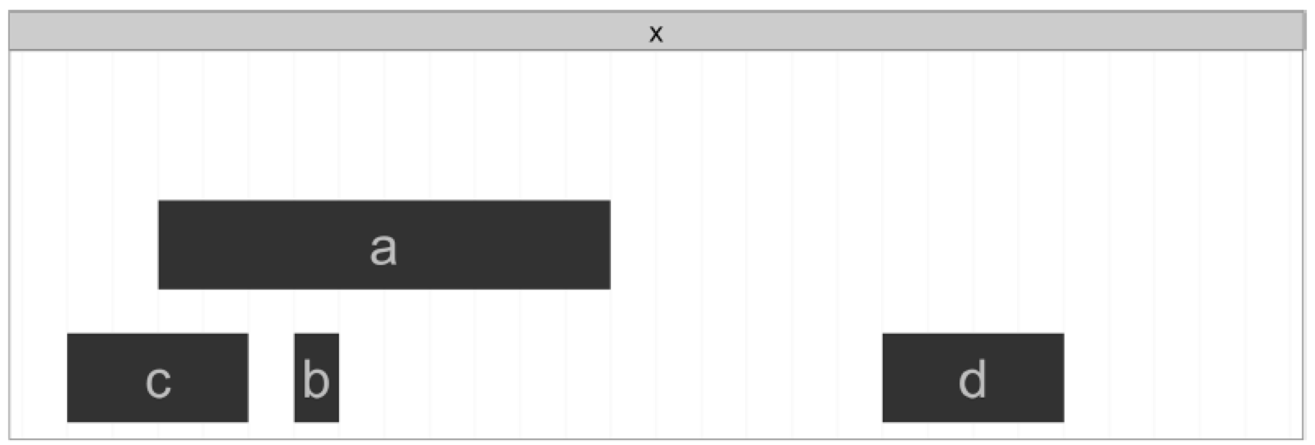
Toy examples
Define range by start/end rng1 <- IRanges(start=4, end=13)
Define range by start/length rng2 <- IRanges(start=4, width=3)
Define multiple ranges at once x <- IRanges(start=c(4, 7, 2, 20), end=c(13, 7, 2, 23))
Name ranges names(x) <- letters[1:4]

Slide 9
Basic operations
Grow/shrink a range x <- IRanges(start=c(40,80), end=c(67,114)) x + 4L
Restrict the neighborhood of ranges y <- IRanges(start=c(4, 6, 10, 12), width=13) restrict(y, 5, 10)
Flank (find ranges immediately before/after) flank(x, width=7) flank(x, width=7, start=FALSE)

Slide 10
Overlapping ranges
Having 2 ranges that overlap is redundant data
You can reduce ranges to be more continuous, easier to manage
set.seed(0) alns <- IRanges(start=sample(seq_len(50),20), width=5) head(alns, 4) reduce(alns)
May also want to know where there are gaps in the range data:
gaps(alns)

Slide 11
Defining the overlap
Maybe you want to know where the overlap is occurring
a <- IRanges(start=4, end=13) b <- IRanges(start=12, end=17) intersect(a, b)

Slide 12
Finding overlaps
Connects experimental data as aligned reads (i.e. organized sequences)
In RNA-seq, overlaps quantify cellular activity
qry <- IRanges(start=c(1, 26, 19, 11, 21, 7), end=c(16, 30, 19, 15, 24, 8), names=letters[1:6]) sbj <- IRanges(start=c(1, 19, 10), end=c(5, 29, 16), names=letters[24:26]) hts <- findOverlaps(qry, sbj)

Slide 13
Distance between ranges
Sometimes to want to search for ranges near a query
qry <- IRanges(start=6, end=13, name=‘query’) sbj <- IRanges(start=c(2, 4, 18, 19), end=c(4, 5, 21, 24), names=1:4)
Find the subject range closest to the query nearest(qry, sbj)
Find the subject range preceded by the query precede(qry, sbj)
Find the subject range followed by the query follow(qry, sbj)

Slide 14
But this seems so simple…
Why do we need specific tools for this?
Notes:
Speed, standardization, reference info that is defined ahead of time, robustness, automation

Slide 15
Learning Outcomes
Understand the importance/utility of range data
Use the IRange package to:
define ranges
reduce range data
search for specific ranges
analyze overlaps in range data

