Slide 1

Ideology: Data Skills, Robust and Reproducible Bioinformatics
Chapter 1

Slide 2
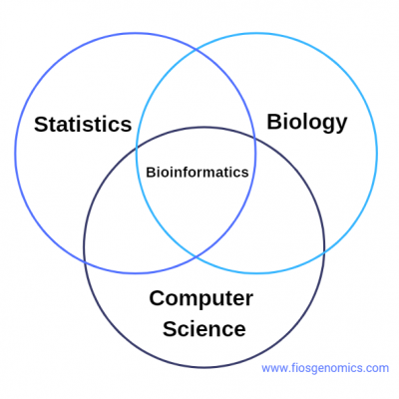
What is bioinformatics?
“Bioinformatics is defined as the application of tools of computation and analysis to the capture and interpretation of biological data.” (Bayat, 2002)
“Bioinformatics is the science of analyzing heaps of data” (Hansen, 2022)

Slide 3
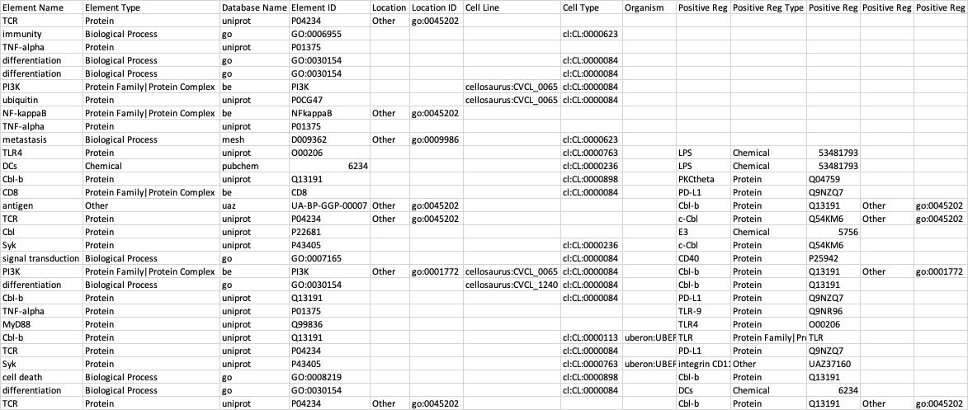
Where is bioinformatics?
Frequently used with genomics data
ATCTCTTGGCTCCAGCATCGATGAAGAACGCA
Methods can also be applied to microbiology, world modeling systems, etc.

Slide 4
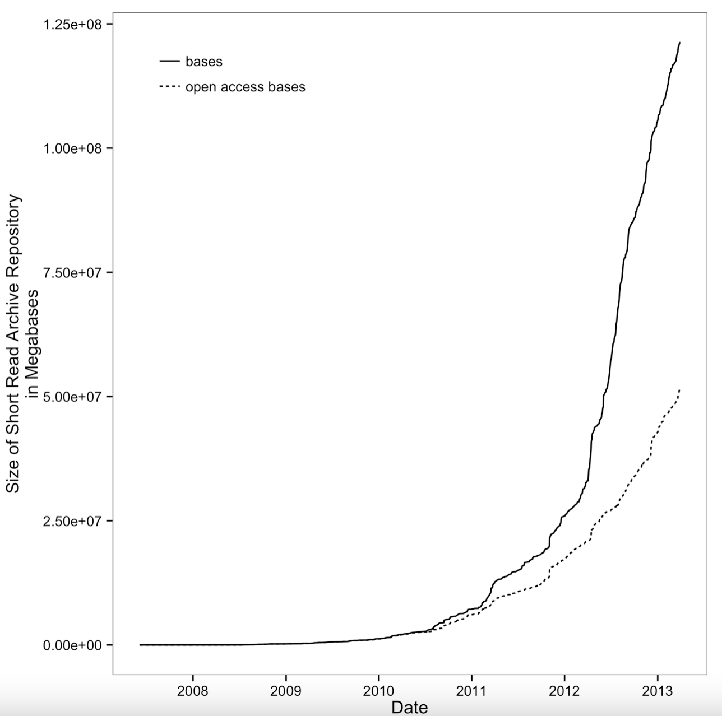
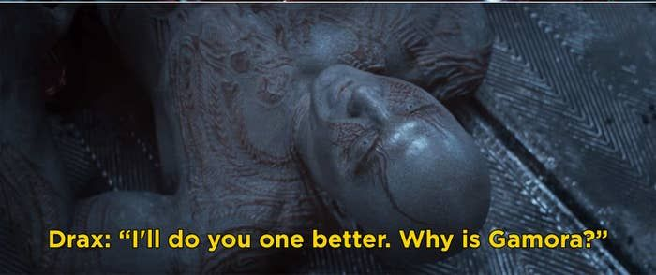
bioinformatics
© 2015 Vince Buffalo

Slide 5
An excess of data
Moore’s Law – the number of transistors in computer chips doubles every ~2 years
Faster speeds, more RAM, more powerful computers
Bioinformatics tools are built to address the growing data knowledge base
Too many tools, not properly benchmarked

Slide 6
Aim of course & textbook
Focus on skills rather than software
Explore and extract meaning from large, complex datasets
Building your toolbox:
Know basic programming language (R)
Use text editor
Basic Unix commands
Basic Biology
Basic regular expressions
Find help and read documentation

Slide 7
Data skills
“The set of computational skills that give you the ability to quickly improvise a way of looking at complex datasets, using a well-known set of tools”
Rule #1 – don’t recreate the wheel; use the available tools before trying to create your own

Slide 8
Reproducible & robust research
A must in bioinformatics
What does it mean?
“Non-producible single occurrences are of no significance to science” (Karl Popper, 1959)

Slide 9
Discussion
Think of examples that refute Popper’s postulation

Slide 10
in silico reproducibility
More than just functional code
Relies on details about the software versions, when data was downloaded, etc.
Metadata: data about the data

Slide 11
Think-Pair-Share
What are the pitfalls of in silico reproduction? (1 min)
Share with a neighbor, think of solutions to pitfalls (2 min)

Slide 12
Errors
“Common errors are simple, and simple errors are common” (Baggerly and Coombes)
Silent errors – when programs produce (erroneous) output instead of giving an error message
Important to be able to identify

Slide 13
Bioinformatics analysis
Produces prohibitively large intermedia data
Multiple steps
Impossible to form strong prior expectations*
Can be specific to system of interest

Slide 14
Murphy’s Law of Bioinformatics
OG: whatever can go wrong, will
You’ll have to run analysis multiple times, usually because of an upstream bug
You’ll look at previous work and be utterly flabbergasted
There’s typo somewhere and you can’t find it

Slide 15
Golden Rule of Bioinformatics:
NEVER TRUST YOUR TOOLS (OR DATA)

Slide 16
The “Duke saga”
https://www.youtube.com/watch?v=eV9dcAGaVU8

Slide 17
Duke saga discussion
Why was the proposed treatment a big deal in the first place?
Why did it take so long to find the mistake?
Is there anything that could have prevented this?

Slide 18
Recommendations for robustness
Pay attention to experimental design
Write code for humans, data for computers*
Let your computer to the work for you
Make assumptions/bias loud and proud
Test code, or let code test code
Use existing libraries when possible
Treat data as read-only
Spend time developing frequently used scripts into tools (Intro to Methods)
Let data prove it’s high quality
Notes:
Robust: to eliminate outside factors
Reproducible: proves truth of the results

Slide 19
1. Experimental design
Well defined hypothesis, clear independent/dependent variables, methods
Foundation for analysis
Bad experiment → wasted analysis
Great experiment → suggests analysis

Slide 20
2A. Code for humans
“Debugging is twice as hard as writing code in the first place…” (Kernighan)
Code should be built in a way that’s easy to pick up and work with
looking at it for the first time or continuing work
Style guides help with consistency
Helps with reproducibility

Slide 21
2B. Data for computers*
The computer is handling the data, so its functionality matters most
Computers do not “read” as humans do
*Can require intermediate transformation
Tools exist to automate this process

Slide 22
3. Let the computer do the work
Automate as much as possible
Minimize probability of human error
Save your effort for more important tasks
This does require some forethought (Chapter 2)

Slide 23
4. Declare assumptions/bias
All code is written with assumptions
Not all users make the same assumptions
Some assumptions can make errors (if/else)
Can write in checks to stop is assumption is false

Slide 24
5. Test the code
You show that code works by trying to make it fail
Test early, test often
Testing code by hand takes multiple users and a lot of time
Writing code to test code is faster, less subjective
Strangers are much better at finding errors than you are

Slide 25
6. Use existing libraries
Remember Rule #1
Rule #2: Spend your time where it will make the most impact
Someone else has already done the debugging (you hope)
Being able to search through existing libraries is a vital skill

Slide 26
7. Data is read-only
Rule #3: Never edit the data file!
Too easy to write over data (fabrication)
Editing original files inevitably causes data loss
Very easy to use a temporary copy in the code

Slide 27
8. Develop frequently used scripts into tools
Follow Rule #2
Scripts are usually informal, tools cleaner and more functional
Fewer chances for errors
Can be shared with collaborators

Slide 28
9. Let data prove its quality
Data analysis is part of the experiment, not a supplement to
Exploratory Data Analysis (EDA): method by which data quality is determined (Chapter 8)
Analyze not just the output data, but input data as well

Slide 29
Recommendations for reproducibility
Release your code & data*
Document everything
Make figures and statistics using scripts
Use code as documentation (comments, git)

Slide 30
1. Release code & data*
Transparency is part of reproducible and robust research
Creates good benchmarking input
Benchmark: a point of reference against which code can be validated
Simple input to prove functionality
Sometimes depends on publication timeline

Slide 31
2. Document everything (yes everything)
Makes code accessible to other users
Shows how to reproduce results
Helps prove robustness of code
Help track down errors

Slide 32
3. Make figures using scripts
Makes figures fast and consistent
No need to copy data
Make changes more easily (once you learn the process)

Slide 33
4. Code as documentation
The farther away your documentation is from what it’s documenting, the less accessible the code is
Comments help users follow the algorithm
README files and other documentation guide user
git documents the versions of codes (Chapter 5)

Slide 34
Next time…
Chapter 2: Setting up and Managing a Bioinformatics Project
Learn how to organize your work to make your (and my) life easier

Slide 35
Lab 1: Onboarding
Goals:
Become familiar with RStudio and software
Practice reading and following code, be able to make changes in existing script
Practice identifying what is robust and reproducible

Slide 36
NOTES
Robust VS reproducible
Robust: eliminate outside factors and show direct causation
Reproducible: proving truth of results that its not a fluke

