Slide 1

Introduction to git
Chapter 5

Slide 2
Traditional Versioning
Have files such as syllabus-vers4.docx, file_09202022.txt, data_newest (3).xlsx
Takes up a lot of memory/folder space
Not ideal for collaborative working
Who remembers which version is the correct one?
Dropbox and Google drive are terrible (Buffalo, 2015)

Slide 3
Why Git is necessary – keeping snapshots
If problem occurs during development, can rewind to last successful version
If output changes, easy to figure out why
Easy to roll back to previous versions, or see all versions at once
Can even see side-by-side comparisons
Makes work more reproducible

Slide 4
Why Git is necessary – tracking important changes to code
Track changes in code, down to the smallest detail
Easier to stay up-to-date with software/code changes
prevents you from using outdated/buggy code

Slide 5
Why Git is necessary – keeps software organized
All the work/versions/changes kept in a central location
Record of project’s history

Slide 6
However…
Git is incredibly useful and saves a lot of time, memory, and debugging
It’s still a pain in the butt

Slide 7
Exercise 1: installing Git
In UNIX terminal:
$ brew install git
or
$ apt-get install git

Slide 8
Using Git
We interact with Git with subcommands which we access via git <subcommand>
Set up Git for your use: $ git config --global user.name “Sewall Wright” $ git config --global user.email “swright@adaptivelandscape.org”
To enable terminal colors: $ git config --global color.iu true

Slide 9
Creating Repositories
A repository is a directory under version control
Contains both working files and snapshots of the project at certain points in time
These snapshots are called commits
Can initialize one from an existing directory, or cloning a repository that exists elsewhere

Slide 10
Exercise 2:
Navigate into your BIO247 directory
In that directory, initialize a Git repository: $ git init
Let’s clone a SEQuence ToolKit into your home folder: $ git clone git://github.com/lh3/seqtk.git $ cd seqtk $ ls

Slide 11
Cloning a repository
You can’t directly modify the original repository
You have access to a copy of the contents
You have access to retrieve new updates when they’re released

Slide 12
Tracking files
Git doesn’t automatically start tracking everything in the repository (useful for temporary files)
You need to tell Git what to track: $ git add <file or folder>
It is also good to check the git status periodically: $ git status

Slide 13
Exercise 3
Take your R script from yesterday’s lab:
make sure it’s in your directory
select it for tracking
check the git status of your directory

Slide 14
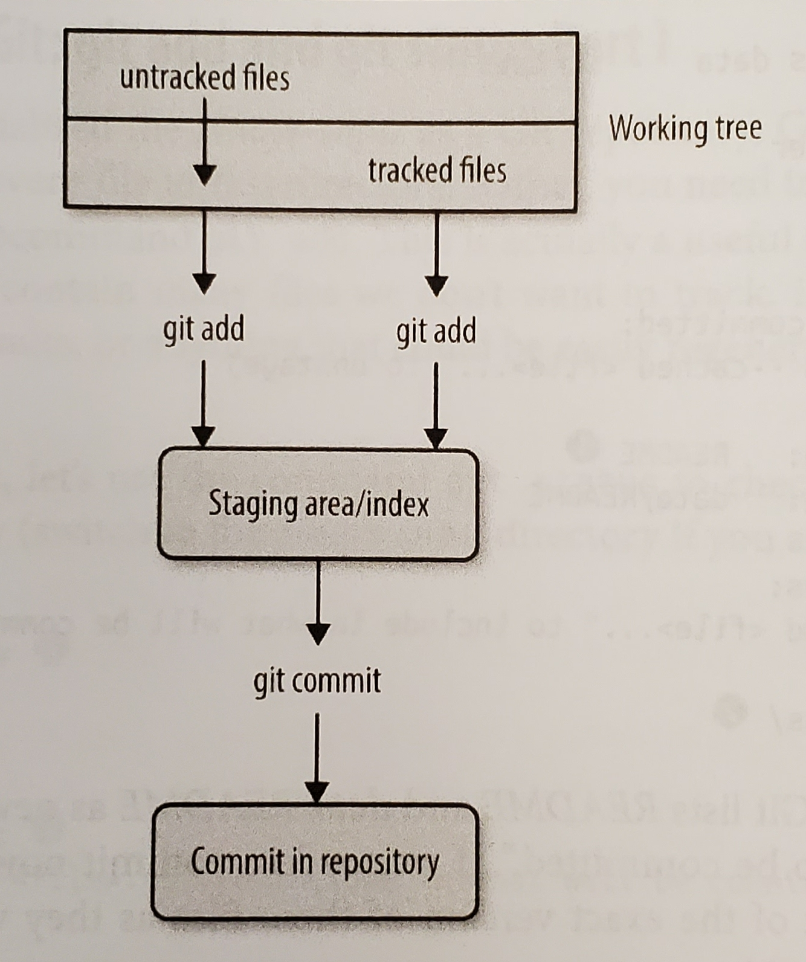
Staging files
Untracked files stay untracked until you add them

Slide 15
Committing changes
Committing the staged file creates a snapshot of its contents
When committing, include a short message describing the snapshot
For new files, quick description
For changed file, describe changes
$ git commit -m <commit message>

Slide 16
Exercise 4
Commit your initial R script, then check Git status
Change something in your R script (e.g. add a comment line), and check Git status again
Commit your changes

Slide 17
Comparing versions
Especially when debugging, it’s useful to see differences side-by-side
$ git diff
Shows difference between working directory and staged files
If nothing staged, shows difference between last commit and current version

Slide 18
Commit history
Sometimes you want to see all of the commits you’ve made (or make sure you actually made one!)
$ git log

Slide 19
Exercise 5
Make another change in your R script
First check the differences as is
Next, stage your changes and check the differences again
Commit your changes, and call your Git log

Slide 20
Negative Git commands
Sometimes files need altered or removed
move command can add a file extension: $ git mv README README.md
to remove it from the repository, use remove command $ git rm README2
Sometimes you know that you don’t want to track a specific file
create text file .gitignore, add files to ignore
commit this file to save changes

Slide 21
Exercise 6
Create a .gitignore file
Add your PDF files for ignoring

Slide 22
The “undo” Git
If you change your mind about a staged commit: $ git reset HEAD <filename>
If you feel like you’ve made a mess of your file and you’d like to undo all of the changes: $ git checkout -- <filename>

Slide 23
Learning Outcomes
Create or download a Git repository
Create a local branch of an online repository
Stage and commit changes to your files
View your commit history
Revert to a previous version of a file
Resolving different versions of a file

