Slide 1

Introduction to R-part 3
Chapter 8

Slide 2
Benefits of ggplot2
One of the least fussy visualization methods
more behind the scenes work
“Quick and pretty” instead of ”quick and dirty”
Good for a “quick check” to visualize data, while being complete

Slide 3
Installing the ggplot2 package
Follows the same steps as installing any package:
> install.packages(“ggplot2”)
> library(ggplot2)

Slide 4
Useage
Say you have a dataframe df with columns df$position and df$diversity
> ggplot(df) + geom_point(aes(x=position,y=diversity)
“upload” dataframe df to ggplot
create scatterplot from position and diversity values
use aes to specify that position and diversity come from the dataframe
> ggplot(df,aes(x=position,y=diversity)) + geom_point()

Slide 5
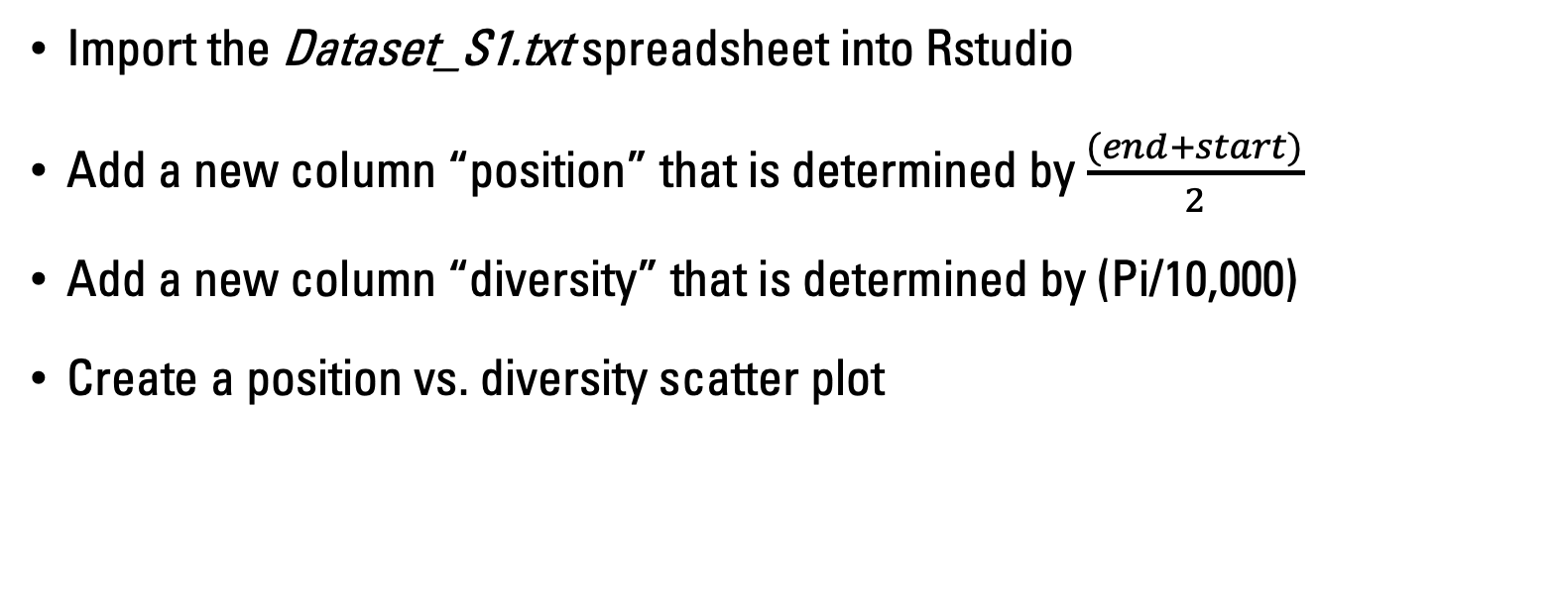
Exercise 1
Import the Dataset_S1.txt spreadsheet into Rstudio
Add a new column “position” that is determined by $\frac{(end+start)}{2}$
Add a new column “diversity” that is determined by (Pi/10,000)
Create a position vs. diversity scatter plot

Slide 6
Overplotting
Too many data, too little time
So much data on a plot that information is lost
ggplot2 gives you the option to use transparency to address this
Dr. Hansen prefers using colors/markers and increasing visibility (we’ll come back to this in advanced visualization)

Slide 7
Density Plots
Good for observing distribution of values
> ggplot(df) + geom_density(aes(x=diversity),fill=“black”)

Slide 8
Exercise 2
Upload Test_V_output.csv (if needed)
Plot the density of the Total Score
What can we say about the interactions based on the Total Score distribution?

Slide 9
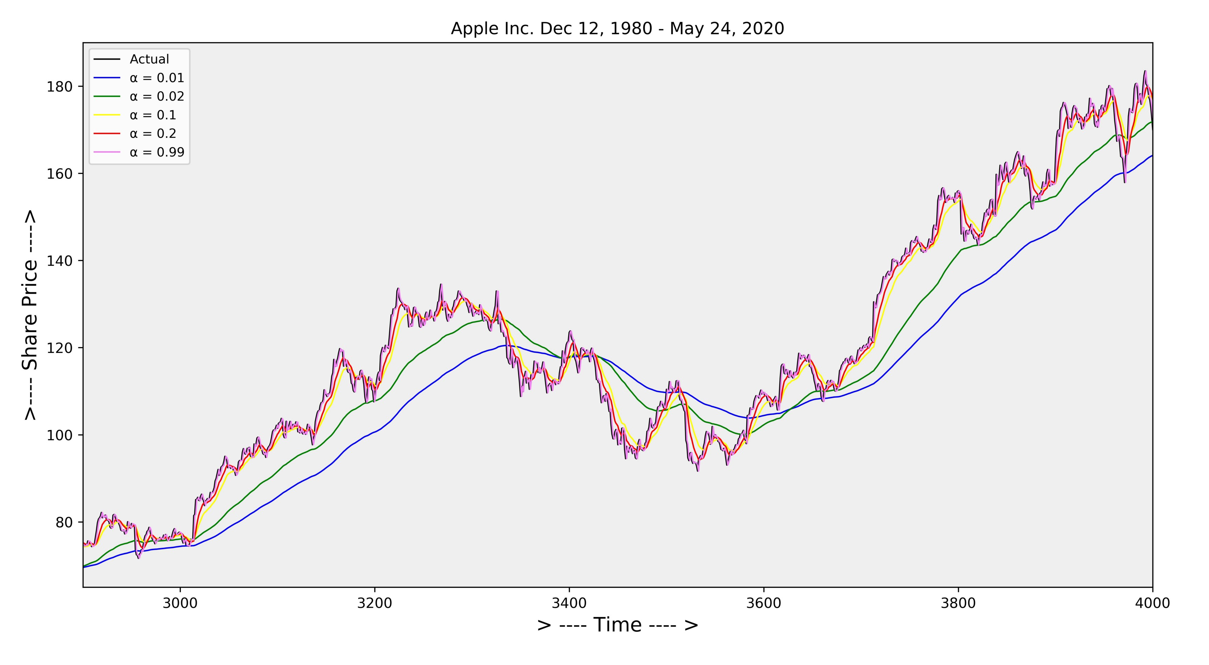
Smoothing
Smoothing is the trickster god of Data Science*
Can help make patterns in data clearer
Can also make you imagine patterns that aren’t there
Best practice: show smoothed and unsmoothed

Slide 10
Discretization
The act of creating a finite number of categories (or bins) to represent continuous (infinite) data
In EDA we use this to change resolution at which we look at data
Yes, discretization is its own type of smoothing
Can you think of real-world discretization?

Slide 11
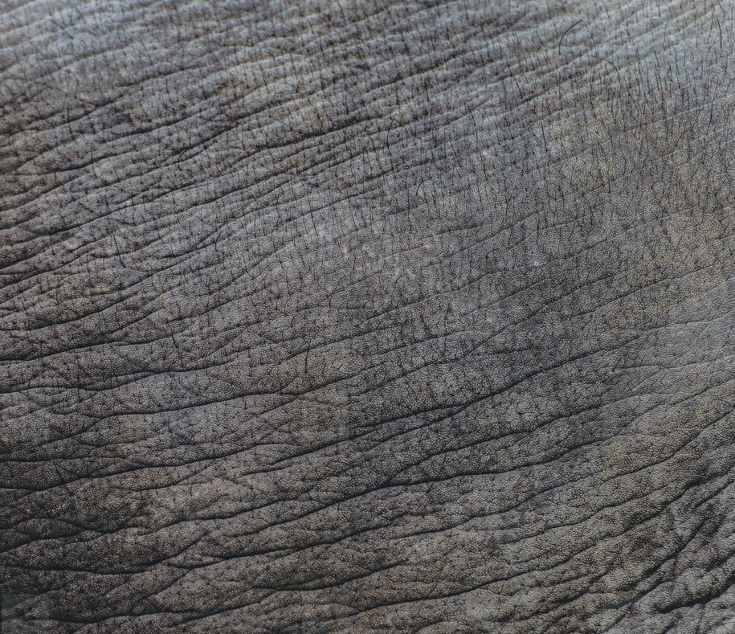
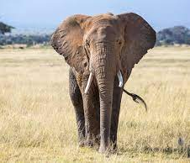
What’s the correct number of bins? Who knows!

Slide 12
Exercise 3
Work through example 8-4 in the textbook (page 216), using cut() function to bin content
How does the cut function work?
Notes:
Parenthesis means do not include
(0,9]
Bracket means to include

Slide 13
Learning Outcomes
Be able to create a figure using the gg2plot package
Be able to create a density plot
Be able to discretize data

