Slide 1
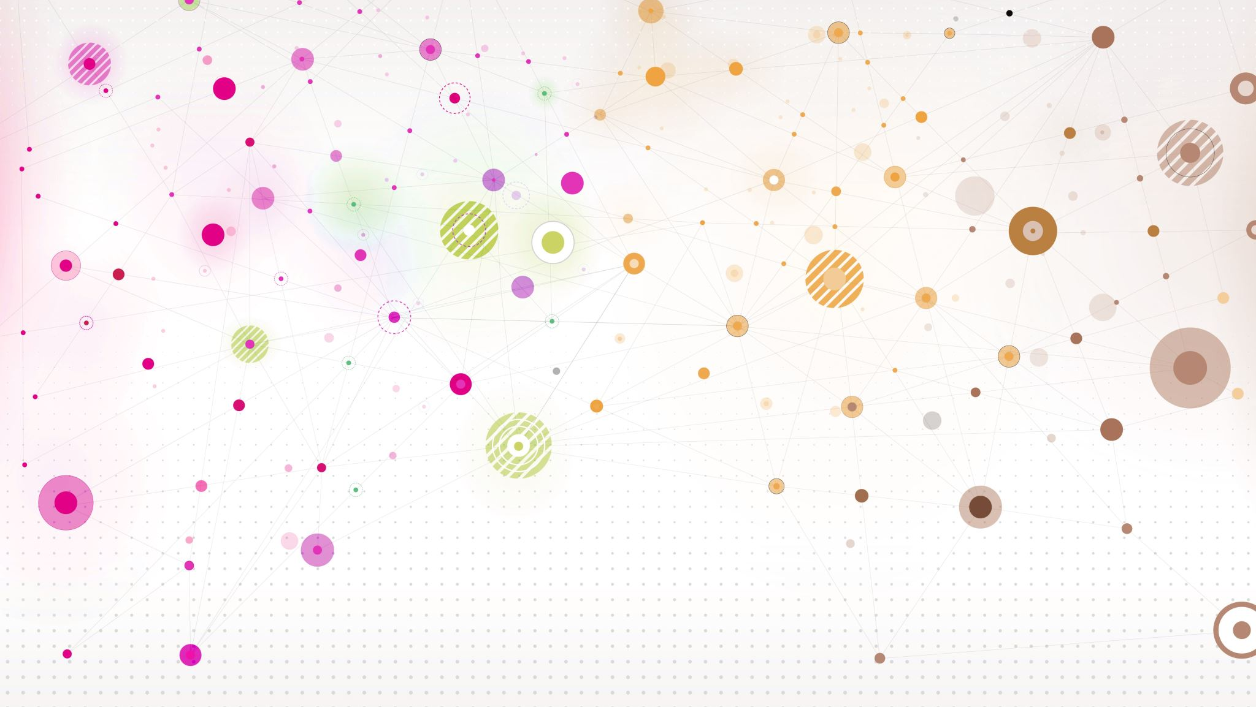
Special Topic - Databases
Chapter 8

Slide 2

Databases
Sometimes interchangeable with “knowledge base”
Meant to introduce order to the chaos
Organize vast amounts of knowledge in a way that makes it more useable

Slide 3
Assembly
Expert curation
User input
Sourced from literature
From other knowledge bases
Notes:
Expert curation: team of experts that choose info to go into the data base
User input assembly: hosting sites where users can add to data base
Sourced from lit: semi automated, machine scans through literature and looks for data
From other bases: consolidate info from other bases

Slide 4
Utility
Help standardize data
Reconcile different representations
Collect similar data in one place
Speed up in situ research
Collaboration
Transformation
Notes:
Standardize: have one way to represent somethins, protein IDs
Reconcile different representations: different coding languages/file types
XML + SBML is bio standard but impossible for humans to read

Slide 5
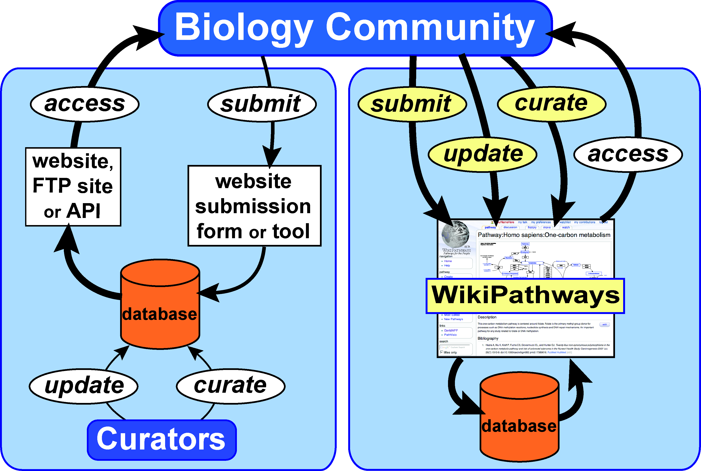
Pico AR, Kelder T, van Iersel MP, Hanspers K, Conklin BR, et al. (2008) WikiPathways: Pathway Editing for the People. PLOS Biology 6(7): e184. https://doi.org/10.1371/journal.pbio.0060184
Notes:
Current biological databases provide the community with data submission forms or tools and access to the compiled data via websites, FTP sites, and, sometimes, programmatic interfaces (API). Internal curation teams organize and update the data. A wiki model for biological databases, such as WikiPathways, provides a single, intuitive interface for submitting, updating, organizing, and accessing data, allowing the community to participate in the curation process and keep up with the influx of new data. The widths of the arrows represent the relative capacity for data management in the two models.
Wiki allows for faster information into the data base which allows people to access information faster

Slide 6
Sometimes a knowledge base uses other knowledge bases
Data Source | Size* | Focus (species)
BioGRID | 347,508 interactions | Model organisms
Cancer Cell Map | 10 pathways/2,104 interactions | Human
HPRD | 40,618 interactions | Human
HumanCyc | 266 pathways/4,879 interactions | Human
IMID | 1,729 Interactions | Human
IntAct | 154,567 interactions | All
MINT | 117, 202 interactions | All
NCI/Nature PID | 186 pathways/13,879 interactions | Human
Reactome | 1,015 pathways/5,397 interactions | Human
All Integrated | 1,477 pathways/687,883 interactions | Multiple
Table adapted from Cerami EG, Gross BE, Demir E, Rodchenkov I, Babur O, Anwar N, Schultz N, Bader GD, Sander C. Pathway Commons, a web resource for biological pathway data. Nucleic Acids Res. 2011 Jan;39(Database issue):D685-90. doi: 10.1093/nar/gkq1039. Epub 2010 Nov 10. PMID: 21071392; PMCID: PMC3013659.

Slide 7
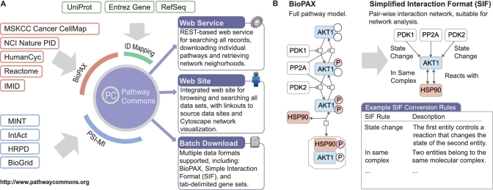
Cerami EG, Gross BE, Demir E, Rodchenkov I, Babur O, Anwar N, Schultz N, Bader GD, Sander C. Pathway Commons, a web resource for biological pathway data. Nucleic Acids Res. 2011 Jan;39(Database issue):D685-90. doi: 10.1093/nar/gkq1039. Epub 2010 Nov 10. PMID: 21071392; PMCID: PMC3013659.
Notes:
Pathway commons integrates information found in BioPax and PSI-MI

Slide 8
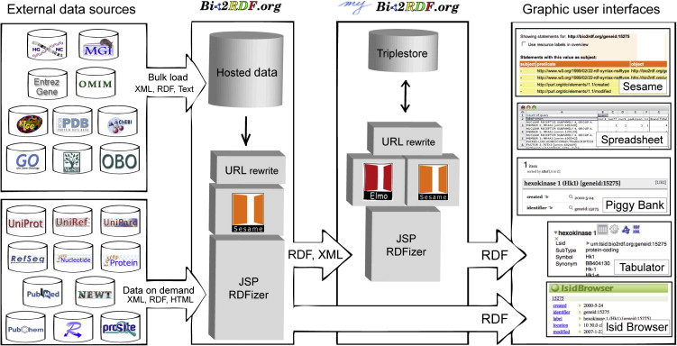
Belleau F, Nolin MA, Tourigny N, Rigault P, Morissette J. Bio2RDF: towards a mashup to build bioinformatics knowledge systems. J Biomed Inform. 2008 Oct;41(5):706-16. doi: 10.1016/j.jbi.2008.03.004. Epub 2008 Mar 21. PMID: 18472304.

Slide 9
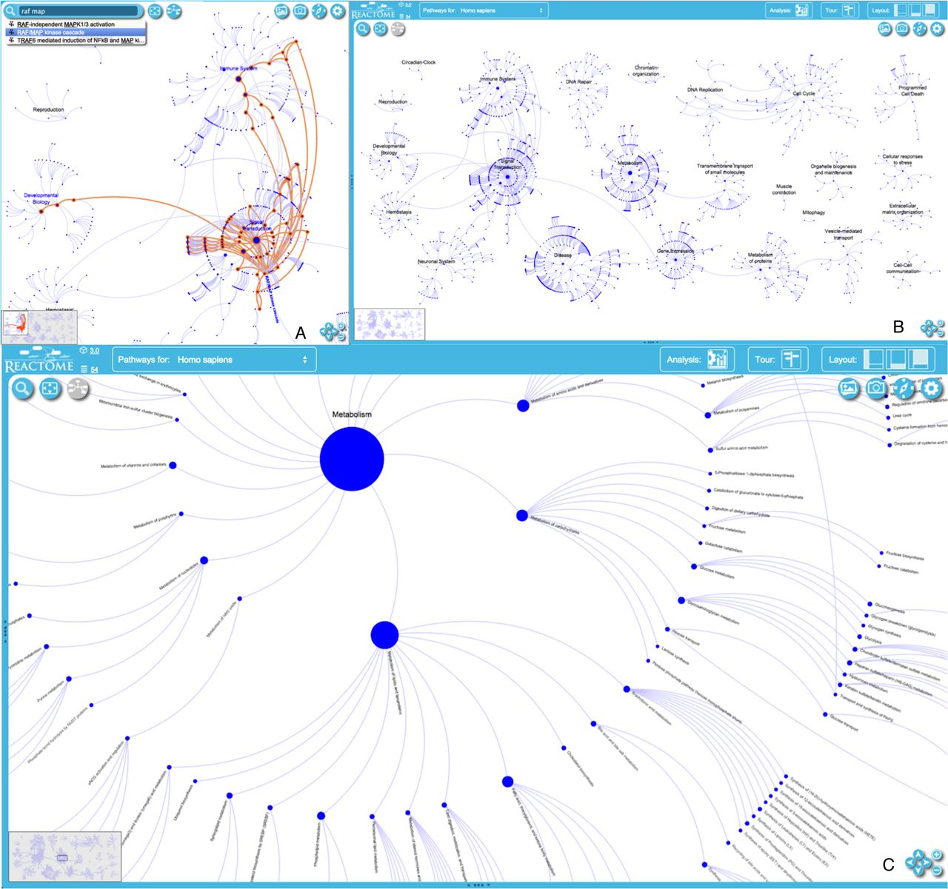

Multiple Viewpoints
Nucleic Acids Res, Volume 44, Issue D1, 4 January 2016, Pages D481–D487, https://doi.org/10.1093/nar/gkv1351

Slide 10
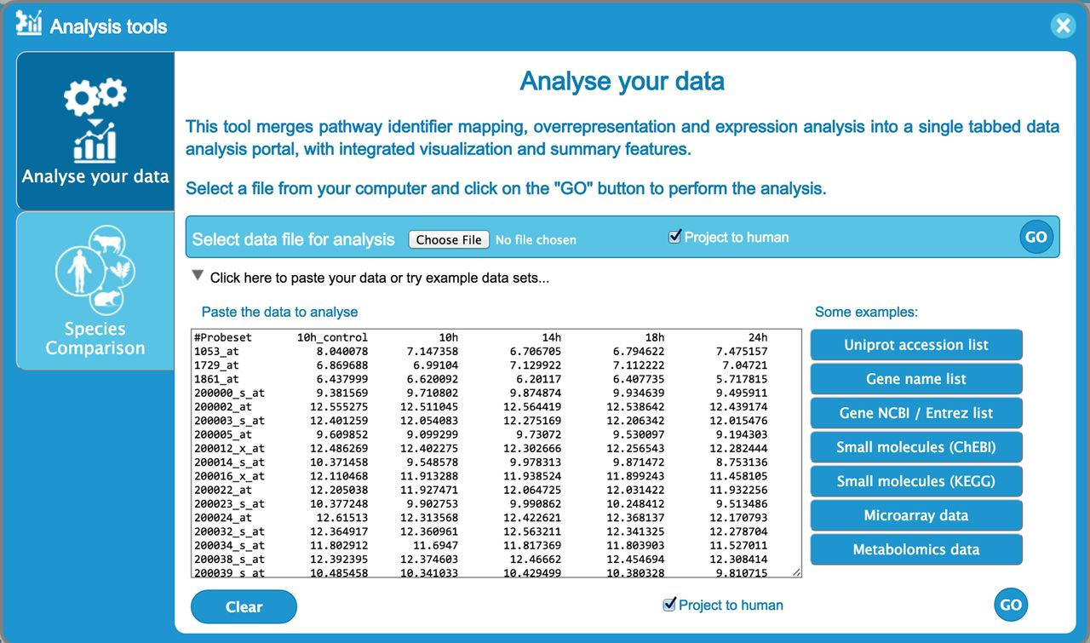
Some databases provide analysis
Nucleic Acids Res, Volume 44, Issue D1, 4 January 2016, Pages D481–D487, https://doi.org/10.1093/nar/gkv1351
Notes:
REACTOME Figure 4. Analysis tool user data submission interface, showing time-series data. Each row represents data for a different gene. Columns contain an identifier (probe set, gene name, etc.) on the left and expression values for four time points to the right, entered as tab-delimited text. UniProt identifiers, gene names and Affimetrix identifiers, among others, can be submitted. The ‘project to human’ box at the bottom of the form, which is selected by default, causes any non-human identifiers in the data to be replaced by their human equivalents and the latter to be used for the analysis. Instructions for formatting data and lists of acceptable identifiers are provided in the users’ guide (Figure 3).

Slide 11
Challenges
Very difficult to maintain
Level of detail
Data still growing every day
bailing a ship with a teaspoon
Different knowledge bases use different representation
no universal standardization
Making them accessible to human and machine

Slide 12
Useful Resources
List of Biological Databases – Wikipedia
Ecological Data Wiki
Reading2_DatabaseList.xlsx
GenBank and European Molecular Biology Laboratory (EMBL)-Bank (sequence data)
Protein Data Bank (PDB) (structures)
Gene Expression Omnibus (GEO) and ArrayExpress (microarrays)

Slide 13
Class Exercise
Create your own spreadsheet of databases, based on your major or area of interest

