Slide 1

Bioinformatics Data
Chapter 6

Slide 2
Thus far…
Organizing a directory
Intermediate UNIX (terminal work)
Intermediate R
Version control (Git)

Slide 3
Now: ~*Data*~
“We further our understanding of complex (biological) systems by refining a large amount of data to a point where we can extract meaning from it” – Buffalo 2015

Slide 4
Challenges for large & complex data sets
Retrieving data
can require special tools/skills
Ensuring data integrity
data can become corrupted or altered
Compression
data is often in zipped files

Slide 5
Retrieving bioinformatics data
Data sets can be too large for web browsers to handle
Usually requires special tools
wget
curl
rsync
scp

Slide 6
wget
Useful for quick downloading
Progress indicator
HTTP: hyper-text transfer protocol
FTP: file transfer protocol
Can download data recursively (for nested files, advanced)
Notes:
Used to download large files

Slide 7
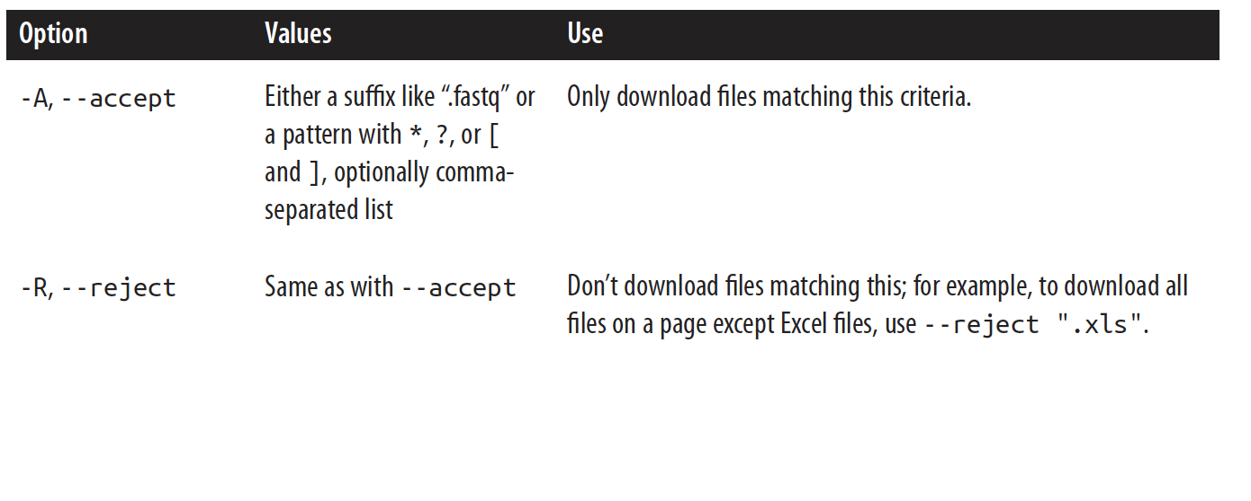
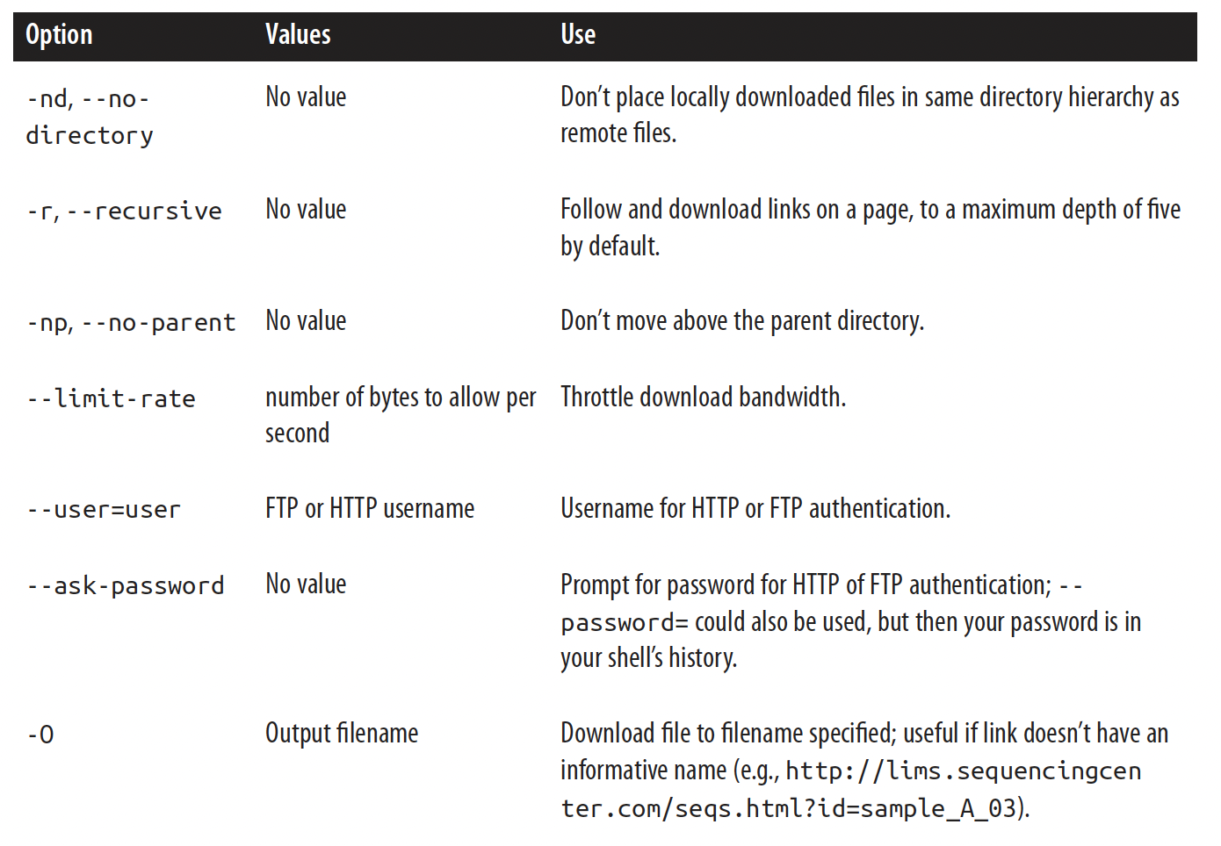

Slide 8
curl
wget downloads files, curl writes to standard output (i.e. prints at terminal)
Can use more transfer protocols (SFP, SCP)
Can follow page redirects
Wrapped in Rcurl and pycurl libraries
Notes:
Curl will start to spit out contents of text file in terminal
Can call curl from r studio console

Slide 9
rsync & scp
Synchronizing entire directories
Can compress files during transfer
Archive option (good for data backup)
$ rsync –avz –e ssh zea_mays/data/ vinceb@[...}:/home/deborah/ze_mays/data
scp is for copying only one file
Notes:
Good to download whole directory

Slide 10
Data integrity
When files take a long time to transfer, network connects can drop and data is lost
Data files are too big for git tracking
Checksums are employed as version control to maintain integrity
compressed summaries of data, will change if the data is changed

Slide 11
Common checksum algorithms
SHA-1
newer, generally preferred
what Git uses for commit IDs
MD5
more common
Checksum is deterministic – output only changes if input changes
Notes:
Stochastic vs deterministic
Stochastic means each time input is put in, different output is given out

Slide 12
Exercise 1
At terminal
$ echo “bioinformatics is fun” | shasum
$ echo “bioinformatic is fun” | shasum
Note: may need to use “sha1sum” instead of “shasum”

Slide 13
Checksum against file contents
$ shasum <file>
$ shasum <files in directory> > checksums.sha
$ shasum –c checksums.sha
Why?
can’t commit to git – too much space required
still need to keep track of potential changes
However, checksum only identifies if different, not how
Notes:
Can check to see if CONTENTS are the same. Does not matter about the file name

Slide 14
Checking differences between data
UNIX diff command $ diff –u <file1> <file2>
-u calls “unified diff format”, same as git diff
returns hunks, blocks of different file contents

Slide 15
Compressing Data
Condensing files so it takes up less disk space (.zip)
Solid tools can take compressed files as input

Slide 16
gzip/gunzip
Command line compressions/decompression system
Can compress results from standard output
Can also compress files on disk
convert to .gz instead of making a copy
Can also concatenate files into single compression

Slide 17
Places to get data
Databases
Papers (supplemental data)
Tools/models
machine reading output
model traces

Slide 18

Getting the data you want
Know your journals
Using tags/keywords
Connection software like Research Rabbit

Slide 19
Exercise 2
New files have been added to the Class Repository. Pull them into your local branch
Use checksums to determine if filter.R is the same as mystery_script.R
Use diff to find the differences between the two python scripts

Slide 20
Learning Outcomes
Have toolbox of methods for downloading data
Use Checksums to maintain data integrity
Search through existing knowledgebases for relevant data

