Slide 1
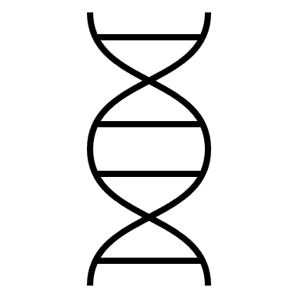

Reverse Transcriptase (RT) is an enzyme that is used by HIV viruses in its replication cycle
Viral DNA
Viral RNA
Viral RT
HIV carries three of its own proteins into the cell, including RT

Slide 2


HIV has a high mutation rate– meaning its reverse transcriptase also mutates, possibly leading to drug resistance
Viral DNA code for RT
…GCATGTATACACTGT…
…GCATGTCTACACTGT…
…GCATGTC_ACACTGT…
…GCATGTGCTACACTGT…
These mutations can be tracked by sequencing over time

Slide 3
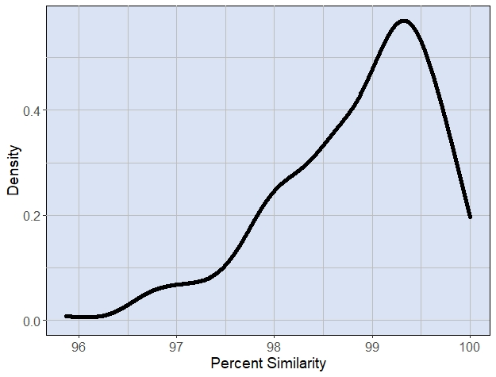
This graph shows the similarity (the amount that didn’t mutate) between RT sequences at the beginning and end of the study¹ for each patient
Nearly all patients had a percent similarity above 96% (high fidelity)

Slide 4

What could cause these results?
Some possibilities:
Too many genetic mutations occurred, making the protein non-functional, stopping the replication cycle
The length of the study didn’t allow for more mutation
Treatments lowered the replication of HIV, leading to a lower mutation rate
Or something else!

Slide 5
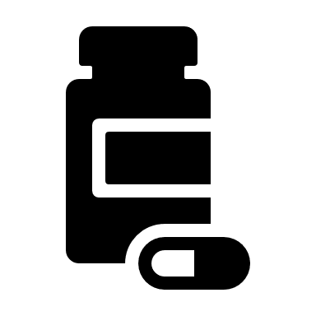

Do patients’ treatments affect how much RT mutates?
PIs, NRTIs, NNRTIs, and INIs are different types of HIV treatments– they interrupt HIV’s replication at different parts of the process.

Slide 6
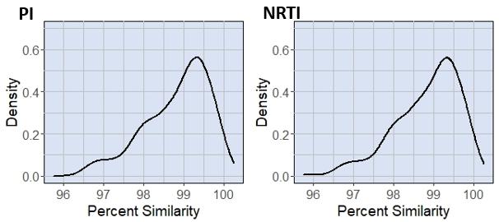
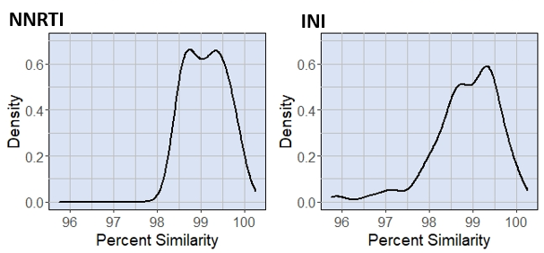
The distributions have different shapes, but similar ranges and means! This could be caused by treatment overlap– many patients take multiple treatments at once.

Slide 7


Doctors use two blood tests to track patients’ health:
Viral load measures the amount of HIV virus
CD4 count measures the amount of T white blood cells
2

Slide 8
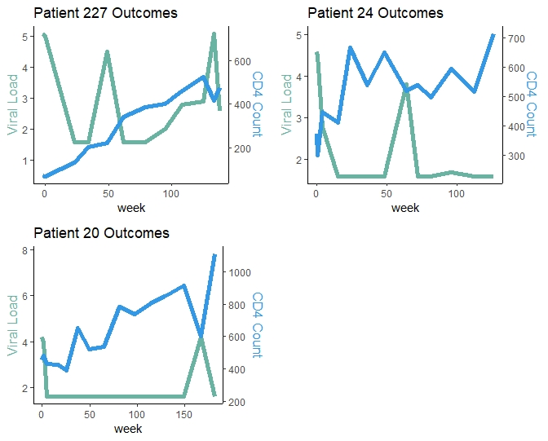
Do patients with different mutation rates have different outcomes?
Patient 227– 95.9% Similarity
Patient 24– 96.8% Similarity
Patient 20– 98.7% Similarity
The CD4 count goes up over time.
There is no clear trend over time for viral load, but higher mutation rate is associated with higher viral load.

Slide 9

What else can we explore?
If we account for patients taking multiple drugs, how do our results change?
What happens to RT sequences that go below 96% similarity rate?
What are common mutations that occur in RT?

Slide 10


Created by Rowan Angstadt and Nagendra Dhanikonda
Data used was downloaded via the Stanford University HIV Drug Resistance Database, from the ACTG 5257 clinical trial.
White blood cell image: Flaticon.com
References from original poster and research can be found here: bit.ly/3Fs5ZZh

