Slide 1

Setting up and Managing a Bioinformatics Project
Chapter 2

Slide 2
Why?
“Directory structures are the lab safety of computational biology” (Hansen, 2022)

Slide 3
Benefits of a good project setup
Easier for users/graders/collaborators
Easier to automate processes
Lower probability of mistakes or analysis errors
Creates foundation of reproducibility

Slide 4

Welcome to the elaborate house analogy
(C) Random House, Inc.

Slide 5
Think of directories like building a house…
First list everything that needs to fit in the house
Choose themes (one theme for house, theme for each room, theme for each wall…)
Set you budget (usually GB)
Have detailed instructions for contractors
Blueprints help
You want what’s in your head to come to life!
You can build your house any way you like, so long as it stands up to wind, rain, and burglars
Notes:
Budget is space on computer

Slide 6
Working example – Bio247
What things do we need for the course?
Who are the contractors?

Slide 7
1. Frame the house
Each project gets its own ”dwelling” (directory)
Everything related to that project lives in that house
You decide how many rooms:
documentation
input/output
analysis
“trash”*
testing/tutorials
figures/metadata
Notes:
Trash folder saves code that you don’t think you need. Might be useful in the future.

Slide 8
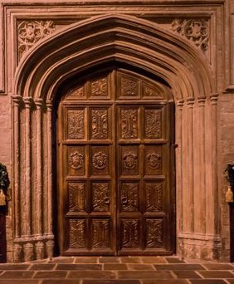
2. Rooms
More or fewer, so long as it makes sense
You want good feng shui in each room
Fewer rooms – easy to direct, hard to look through
More rooms – harder to direct, easier to find files
(C) Warner Bros.
The use of this image does not condone or agree with any of the statements made by one J.K.R against members of the trans community

Slide 9
Working example – frame & rooms
What does this directory encompass?
What “rooms” should we have?

Slide 10
3. Furniture (files)
What’s in a name?
file names have a HUGE impact on accessibility and functionality
you’re naming for you, for the computer, for other users
hard rule: NO SPACES IN FILE NAMES
learn your file extensions (.ppt, .pdf, .txt, .csv, .xlsx, etc)
be descriptive, but short, but easy to read, but don’t leave out details…got it?

Slide 11
Working example - files
Practice making a file name for each folder

Slide 12
4. Blueprints (documentation)
Help ”visitors” get around
Explain each rooms’ contents
Created before, during, and after project
Can be in README (.txt), ReadtheDocs, spreadsheets, markdown, or some combination thereof

Slide 13
What belongs in the blueprint
Methods and workflow
Origin of all data
Dates of download/assembly*
Data version information
How data was downloaded assembled
Relevant software versions

Slide 14
5. Putting additions on the house
Sometimes projects create spinoffs
Creating a fully separate directory can be messy
You can create sub-directories
may need to copy some files

Slide 15
In-class activity
Create a directory for your wardrobe

Slide 16
Lab 2
Setting up directories for semester
planning for 7 labs + project, 10 reading assignments
Brief introduction to github
Creating a README file

