Slide 1

Finale to R & Machine Readers
Chapter 8
Notes:
Only need to know how to draw a coding diagram not machine readers for test

Slide 2
Solving coding quandaries
Not all coding problems are simple
Sometimes its prudent to PLAN
For this, we create a coding diagram

Slide 3
Coding Diagram
Initial word
Reverse word completely
Is word a palindrome?
If initial word is the same as reverse word, YES
If initial word is not the same as reverse word, NO
A type of flowchart describing, organizing, or outlining computational steps
Can be created ahead of code to sketch out solution, or after to illustrate functionality

Slide 4
Benefits of coding diagrams
Creates “shopping list”
Measure twice, code once
Can make code more efficient, catch errors
Helps organized nested loops
You can design a solution even if you don’t know the exact code

Slide 5
Exercise 1
Create a coding diagram for the “Counting Papers” problem from previous lectures

Slide 6
Learning Outcomes
Assemble a coding diagram for a given computational problem, with or without the necessary skills to execute
The End

Slide 7
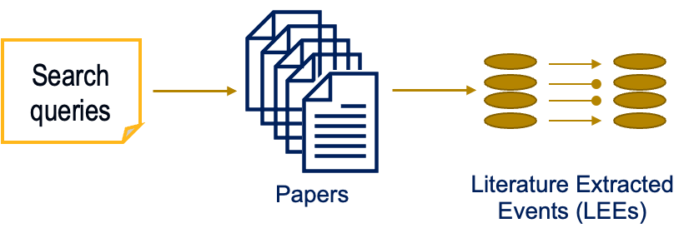
Machine Reading Engines
Automatically parse through text and identify relationships between entities
Can ”read” from published papers or user input text
Some output results, some assemble into file
Uses grammar, known syntax, and key words to identify relationships

Slide 8
Different types of readers
Biological machine readers
Look for molecular interactions
Usually concerned about activation versus inhibition
World Modelers
Look for associations
Some can identify causal relationships, some cannot

Slide 9
Example: TRIPS/DRUM
http://trips.ihmc.us/parser/cgi/drum

Slide 10
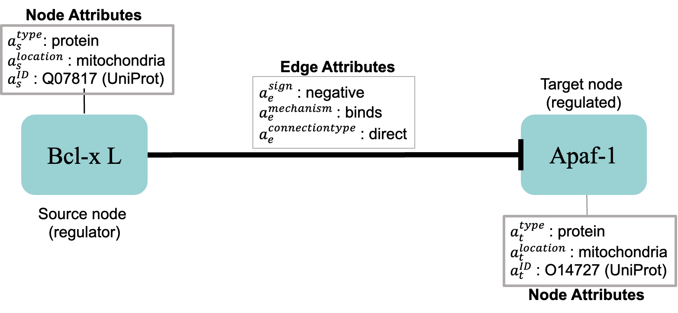
Attributes

Slide 11
Pitfalls
Variability of language
Incomplete language
Vagueness of language
…in short, language is the problem.

Slide 12
Attempts to address issues
Believability scores (Epistemic Value)
Using existing databases to verify
Keeping count of frequency of “extraction”
Notes:
Indra machine reader

