Slide 1

Unix Data Tools
Chapter 7

Slide 2
Why?
Often helpful to know about file contents
Sometimes file needs adjusted
Doing these things through the file directly break Rule #3: Data is Read-only

Slide 3
Goals
Parse
Manipulate
Summarize

Slide 4
When to use Unix Approach
Initial explorations
Quick pictures
Transform formats
Looks for problems
One-step analysis, deciding analysis options

Slide 5
Inspecting data with head and tail
To check the top of the file: $ head <filename> $ head –n 3 <filename>
To check the end of the file $ tail <filename> $ tail –n 3 <filename>
Both at once: $ (head -n 2; tail -n 2) < <filename>
Notes:
Head function gives top of the file, first 5 lines
Or you can tell how many lines you want to see
Tail gives you bottom of the file

Slide 6
Inspecting with less
Opens an application-like environment
Allows you to look at whole file
Only works for text files (.txt, .csv, .fastq, etc.)
$ less <filename>
Notes:
File viewing application that allows you to open file and scroll through it

Slide 7
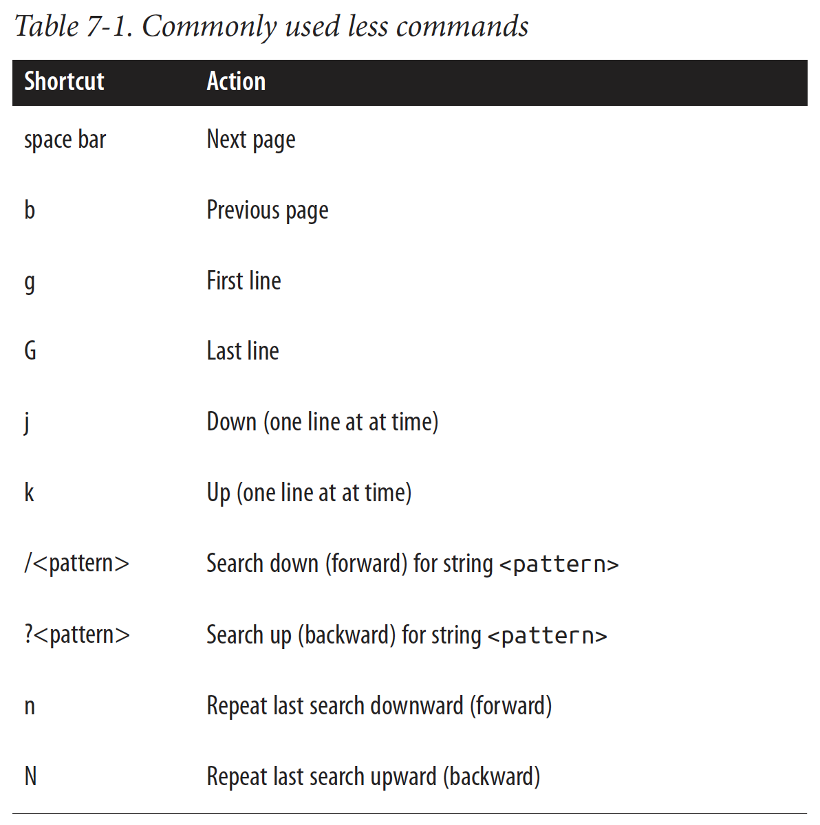

Slide 8
Data summary with wc and ls
wc give the word count, returning: # words, # lines, # characters
Good or catching hidden whitespace
$ wc –l <filename>
ls can give information about file size
$ ls -l <filename>
$ ls -lh <filename>
Notes:
Wc file name gives all 3
-l gives just number of lines
Ls can give information about file size

Slide 9
Making delimited files readable with column
Usually, first order of inspection is to open the file in Excel or Rstudio
To give first 3 lines of a file organized with columns: $ column –t <filename> | head -n 3
Default is tab-separated file, to use comma-separated: $ column -s”,” -t <filename> | head -n 3
Notes:
Head does not organize it into columns but column makes it more organized

Slide 10
Exercise 1
Explore the file ModelA.csv, looking at the contents (head/tail) and size (wc/ls)
Use less to look around the larger file
Use column to look around the file as well

Slide 11
The all-powerful grep
Fastest terminal tool
Requires 2 arguments:
What you’re looking for
Where you’re looking for it
You can add the option --color=auto to highlight the desired string
Can also do “null search”, looking for lines without a string
Can also search using regular expressions
Notes:
Wants to know what you are looking for and where you are looking for it

Slide 12
Examples
Search for first instance of desired string: $ grep ‘string search’ <filename> | head -n 1
Search for all lines without ‘bioinfo’ string anywhere: $ grep -v bioinfo example.txt
Search for all lines without the word ‘bioinfo’ grep -v -w bioinfo example.txt
Notes:
If string has spaces you need quotes if it doesn’t you don’t need to put quotes
If you only want first instance use | head -n 1
-w only wants the word by itself not when its part of larger word the, them, they

Slide 13
Exercise 2
Inspect example.txt to see its contents
Run through the examples on the previous slide to see outcomes
In RC1_reading.csv, find the first instance of the protein “Akt”

Slide 14
Sorting plain-text data with sort
Sorting data in excel is tedious (also breaks Rule #3)
Why is terminal better?
no alteration of file
can save from terminal into new file
sorting is useful for thresholding data (makes sub-setting easier)

Slide 15
Examples
Sort alphabetically by line $ sort <filename>
Sort by column number # (alphabetically) $ sort -k1,# <filename>
Sort by column number # (numerically) $ sort -k1,#n <filename> or $ sort k1,#nr <filename>
Sort by 2 columns: $ sort -k1,# -k2,# <filename>

Slide 16
Exercise 3
Use column to inspect RC1_reading.csv
Sort RC1_reading.csv by any of the columns that make sense to you. Protein name? PMCID?
You can even sort Test_V_output.csv by the Match or Kind Scores

Slide 17
Subshells
Running multiple commands in the same line
Reduces need for intermediate files
Sequential commands: && or ;
run one command after another
Piped commands: |
use the output of the first command as the input for the second

Slide 18
Learning Outcomes
Further expand your computational toolbox
Manipulate, parse, and summarize data files without having to alter the file itself

