Slide 1

Advance Exploratory Data Analysis
8 November 2022

Slide 2
EDA cycle
Generate questions about data
Search for answers by visualizing, transforming, modeling data
Refine questions and/or generate new questions

Slide 3
EDA is not a formal process with a strict set of rules – EDA is a state of mind
(Wickham & Grolemund)

Slide 4
Understanding your data
Good first questions:
What type of variation occurs?
What type of covariation occurs?

Slide 5
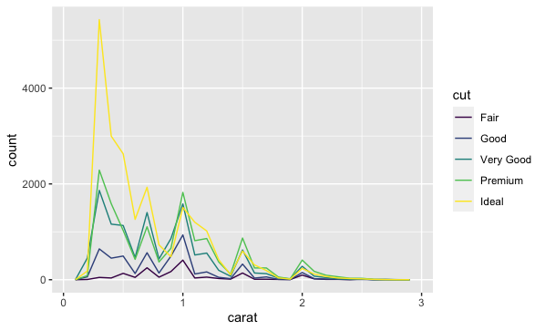
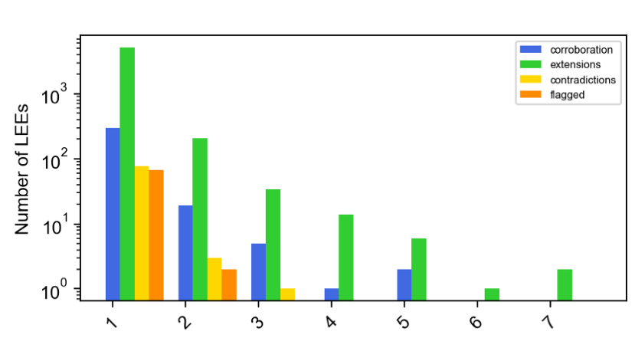
Same Data, Different Story

Slide 6
Good Questions for Histograms
Which values are most common?
Which values are rare? Why? Does that match expectations?
Any unusual pattens? What might have caused them?
Do there seem to be clusters?
What might they mean?
How might they be misleading?

Slide 7
Exercise – investigating diamond data
Open Advanced-EDA.rmd
Run the “typical values” chunk

Slide 8
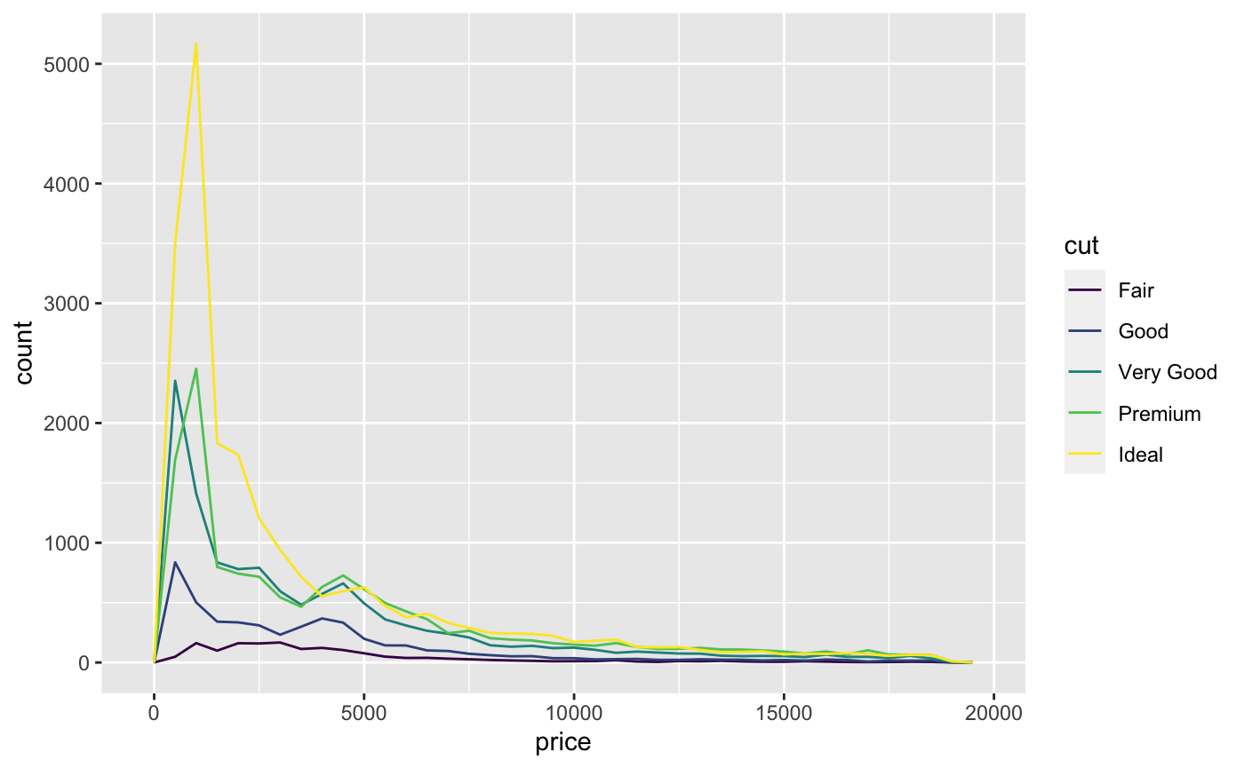
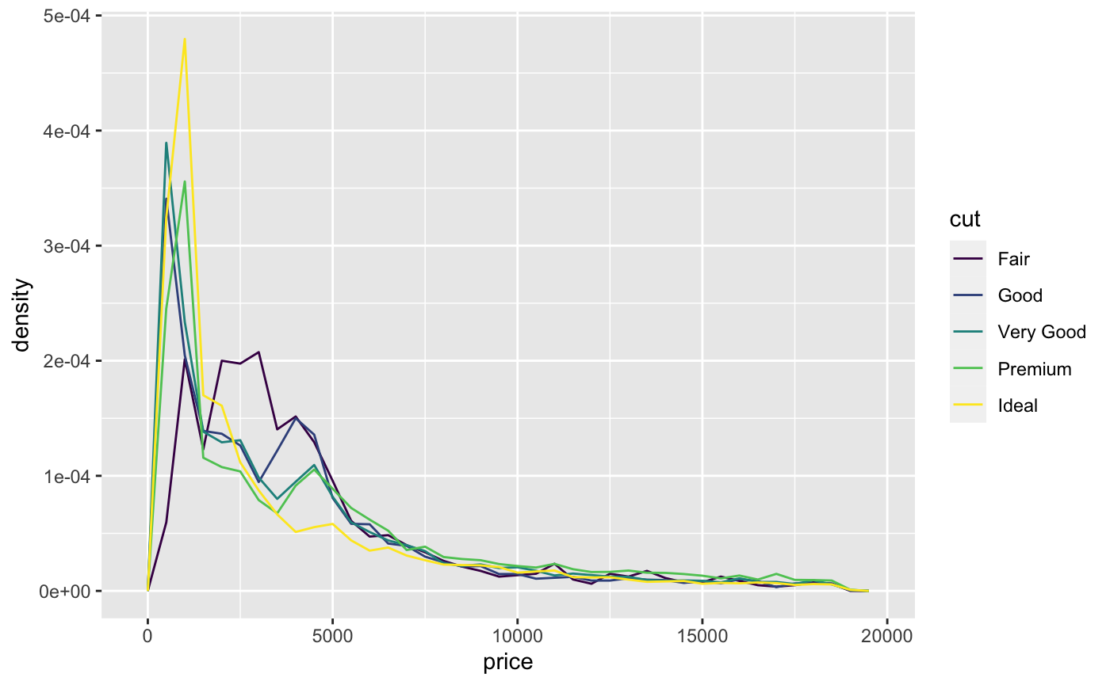
Histogram v. Density
Histogram
Density

Slide 9
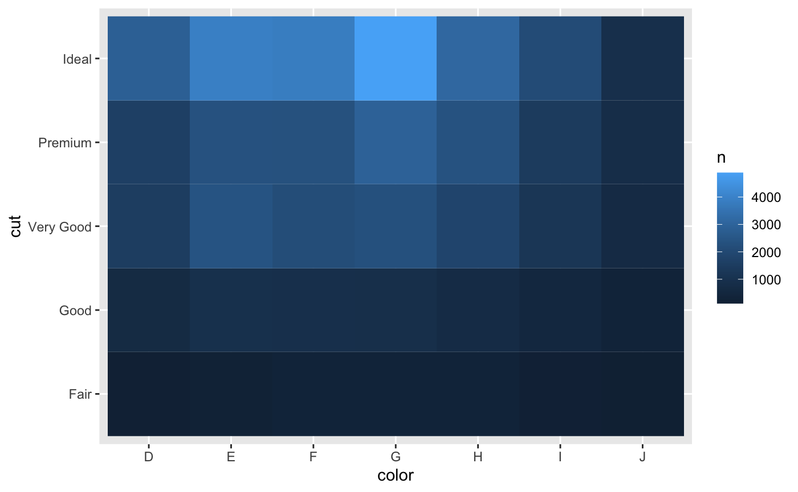
Heatmaps
Transforms numbers into color gradient
Generally showing covariance between variables

Slide 10
Vital questions for patterns
Could this pattern be a coincidence?
How can I describe the relationship implied by the pattern?
How strong is the implied relationship? (spoiler, it may depend)
Doe the relationship change if you look at subgroups?

