Slide 1



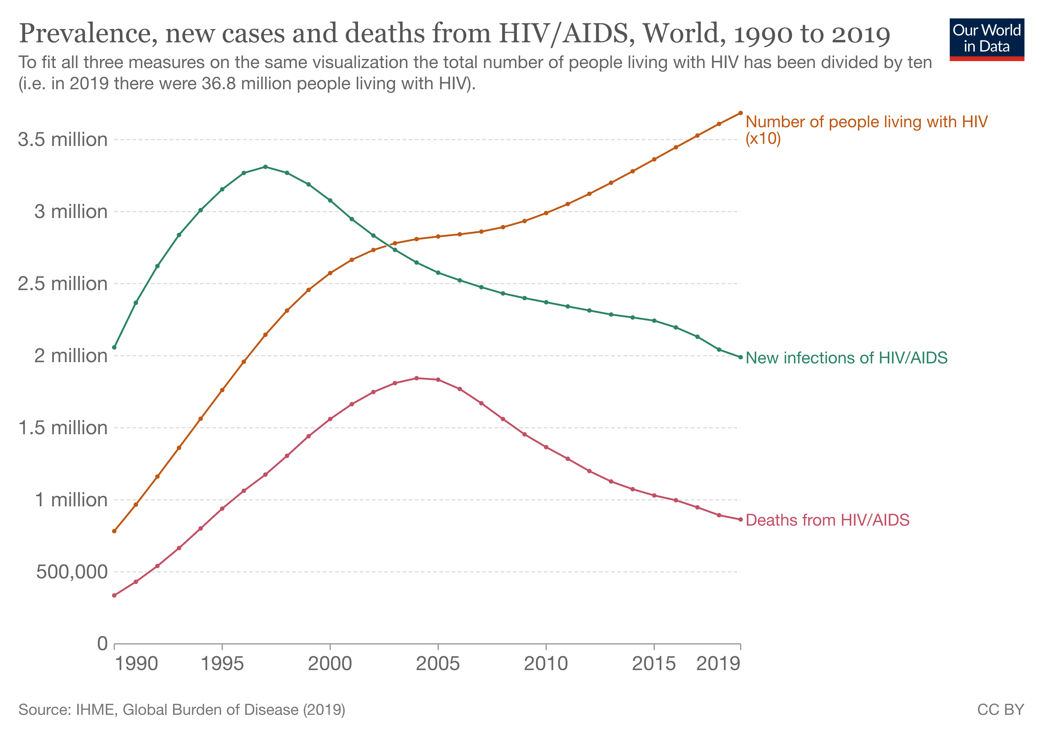

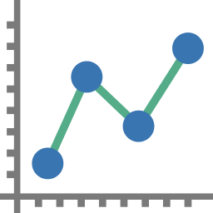

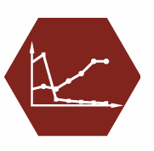
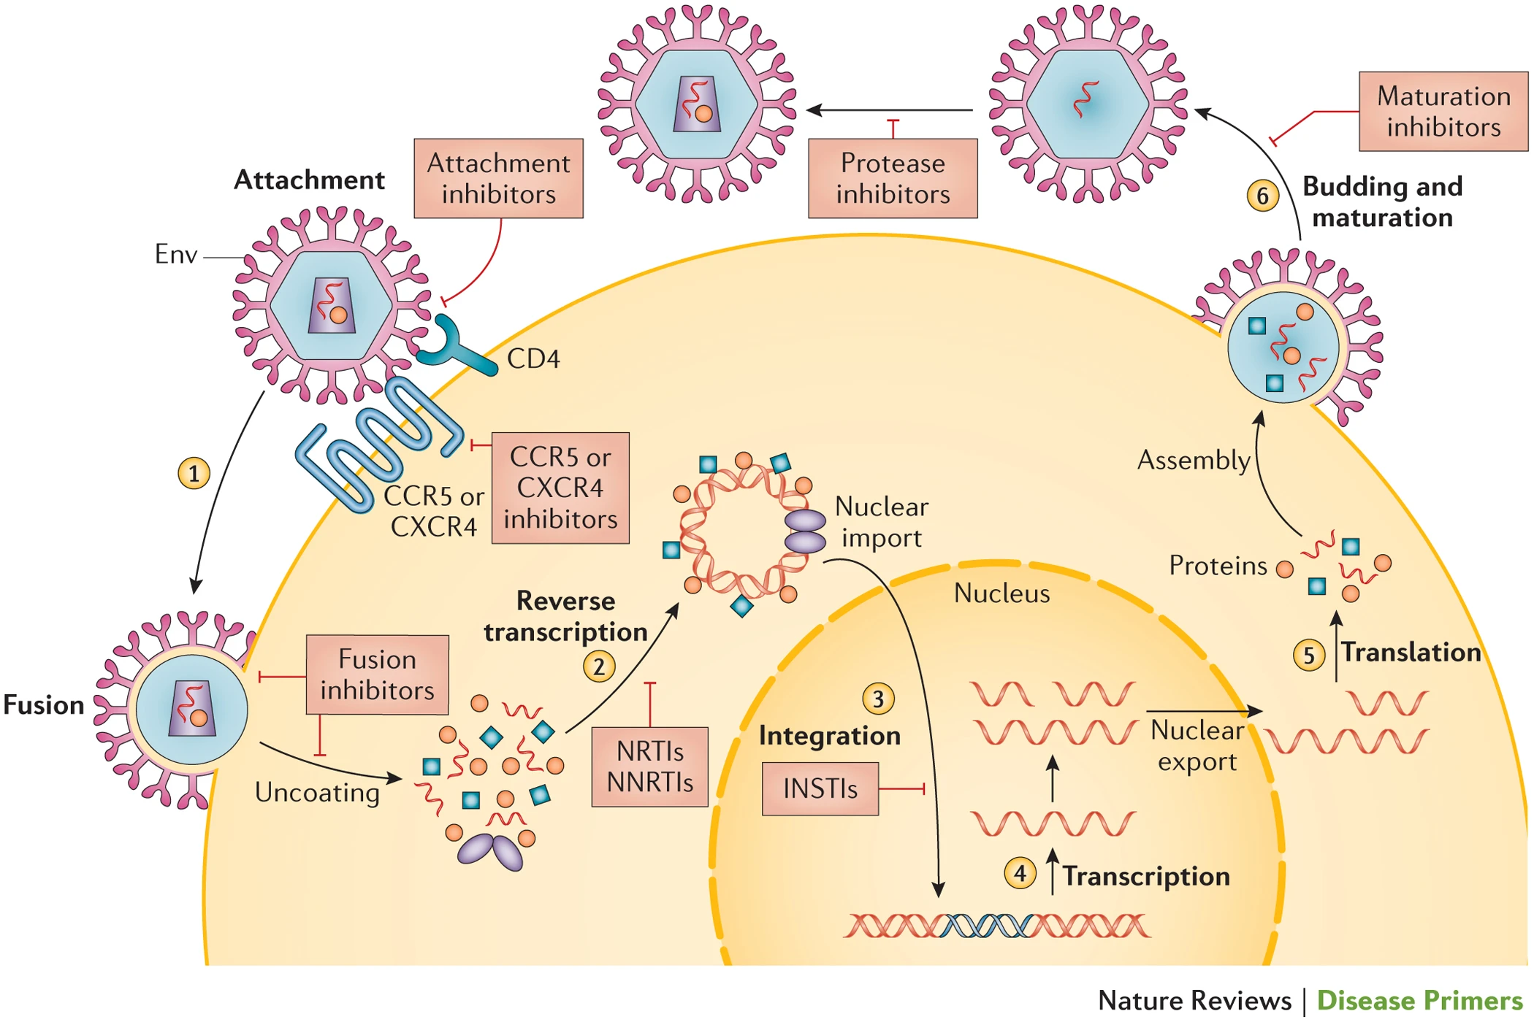
Using High-Plex Imaging to determine the relationship between NFκB and Renal Cell Carcinoma Immune Landscape
Nagendra Dhanikonda, Rowan Angstadt
Introduction
Results
Workflow diagram
HIV is a member of the retrovirus family of enveloped, single-stranded RNA viruses. Has very high mutation rate.
HIV mainly infects CD4⁺ T cells. Leads to the development of acquired immunodeficiency syndrome (AIDS).
Patients with AIDS have severely suppressed immune systems which leads to opportunistic infections.
No cure exists but progression to AIDS can be drastically delayed or stopped through the use of antiretroviral therapies (ART).
ARTs are used in combination therapies due to rapid adaptability of HIV.
This analysis hopes to explore the relationship between reverse transcriptase mutations and patient outcomes using longitudinal data.
Download raw data from Stanford University’s HIV Drug Resistance data base
Data was cleaned with R
NCBI BLAST used to compare similarity between start and end RT sequences
Graphs were made with cleaned data
Graph adapted from Our World in Data
CD5
DAPI
CD7
Data
Figure 1: HIV global prevalence (orange), incidence (green), and deaths (red) from 1990 to 2019.
Note that the HIV prevalence values have been divided by ten to fit all three metrics on the same plot
Figure 2: Multiplexed image of a germinal center in a tonsil, showing three markers out of a fifty-marker panel; imaged using CODEX.
HIV Viral Lifecycle
Clinical Outcome Data: genotype, treatment, CD4 count, plasma viral RNA levels
ACTG 5257 clinical trial
HIV-1 infected adults in USA and Puerto Rico
Plasma HIV-1 RNA >1000 copies per milliliter
No more than 10 days of ART prior to start of study
Note: Data was only opened and cleaned in R.
Raw files were never modified
Future Directions/conclusions
This work was supported in part by the Merck Internships for Excellence in Science program, funded by a gift from the Merck Institute for Science Education to Washington and Jefferson College.
Special thanks to:
Dr. Sizun Jiang for providing the opportunity
Yao Yu Yeo for the mentoring
https://doi.org/10.1038/nrdp.2015.35
Figure 2: HIV lifecycle
1. Virion attaches to receptors which leads to fusion pore formation
2. Capsid uncoats and RNA genome is converted to DNA by reverse transcriptase (RT)
3. Viral DNA is imported into the nucleus and integrated into host genome by integrase (IT)
4-5. Viral proteins and genome are manufactured with host machinery
6. Capsids assemble around new viral RNA and bud from host membrane
Figure 3: IHC stains of germinal centers in tonsil tissues at 20x. They were stained for the following markers: A) Phospho-NF-κB p105 (Ser932), B) NF-κB RelB, C) NF-κB p65, D) Phospho- NF-κB p65 (Ser536)
References
For further information please contact:
Nagendra Dhanikonda- Dhanikondana@washjeff.edu

