Slide 1

Factors – further investigation
10 November 2022

Slide 2
Recall
Factors are categorical variable values
chromosomes
cut/color from diamonds example
low, medium, high
Factors are a method of
discretizing continuous data
quantifying qualitative data

Slide 3
Utility of factors
library(tidyverse)
library(forcats)
x1 <- c(’Dec’,’Apr’,’Jan’,’Mar’)
can introduce typos
default sort alphabetical
month_levels <- c(‘Jan’,’Feb’,’Mar’,’Apr’,’May’,’Jun’,’Jul’,’Aug’,’Sep’,’Oct’,’Nov’,’Dec’)
y1 <- factor(x1,levels=month_levels)
can be sorted relative to level definition

Slide 4
Catching errors
x2 <- c(‘Dec’,’Apr’,’Jam’,’Mar’)
y2 <- factor(x2, levels = month_levels)
What does “Jam” become?

Slide 5
General Social Survey
Data is more social than biological, but good example of qualitative data
species survey
molecular interactions
gss_cat %>%
count(marital)
ggplot(gss_cat, aes(marital)) + geom_bar()

Slide 6
Exercise
Plot income from GSS
What is the most common partyid?
Which religion does denom apply to?
How can you find out with a table?
How can you find out with a visualization?

Slide 7
Reordering Factors
Change order, change story
Can change with respect to another variable
Exercise: Open Factors.Rmd
run ”Reordering Factors” chunk
change aes() code to aes(tvhours, fct_reorder(relig, tvhours)))+geom_point

Slide 8
Reordering Factors – make it make sense!
If factor already has a principled order, it’s not a good idea to change
Run the “Bad Reordering chunks”
Why doesn’t this reordering make sense?

Slide 9
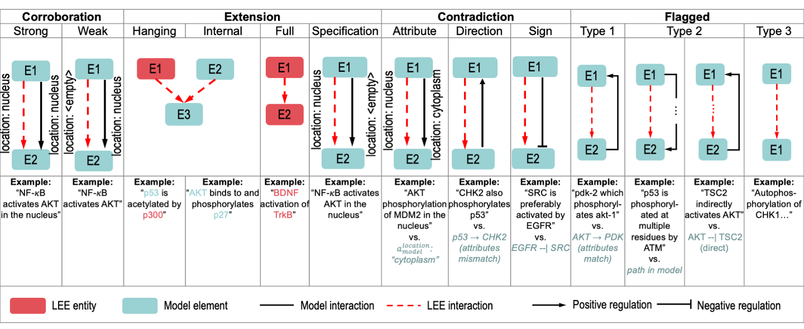
Modifying Factor Levels

Slide 10
Current definition
kind = c('strong corroboration','weak corroboration1','weak corroboration2','weak corroboration3',
'full extension','hanging extension','internal extension','specification',
'direction contradiction','sign contradiction','attribute contradiction',
'flagged1','flagged2','flagged3’)
How could you make a better, clearer levels? Try it in the “Modifying factor levels” coding chunk

Slide 11
Exercise
Open dubjay_bioinformatics > Test_V_output.csv
alternatively, can use Project data
Think of one way to define/use factors to analyze data

