Slide 1
Featureize MVC
Feature Controllers with
ASP.Net MVC

Slide 2
Agenda
Why would we want to change MVC?
What is a feature / component?
How do we implement features with MVC?
What possibilities do we have?
Potential problems with this solution?

Slide 3
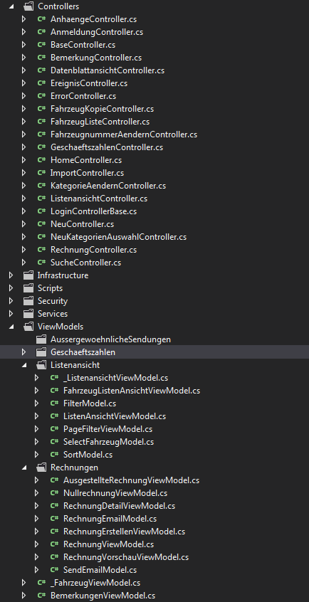
Why change MVC?
Typical solution has a special folder for "everything"
      + You know where to put "stuff"
      Low cohesion between elements in the folder
Lots of scrolling / looking for stuff when implementing a "change"
  Tools like R#/VS mask the problem
Notes:
Scripts, Controllers, Content, Views, Models,...

Slide 4
Ok, but why change?
Enter the CQRS mindset
  Task based UI
"I want to implement a new view"
  Usually no/low impact on existing parts
  Often no domain logic/knowledge needed
  Pure UI views (store data for display purposes only)
Try to create a less monolithic „system“

Slide 5
Parts of a simple change
Projection
Dto
Controller
(View model)
View
(JavaScript)
(CSS)
Projections.dll
/Controllers
/Models
/Views/Foo/
/Scripts/app.js
/Content/CSS/foo.css

Slide 6
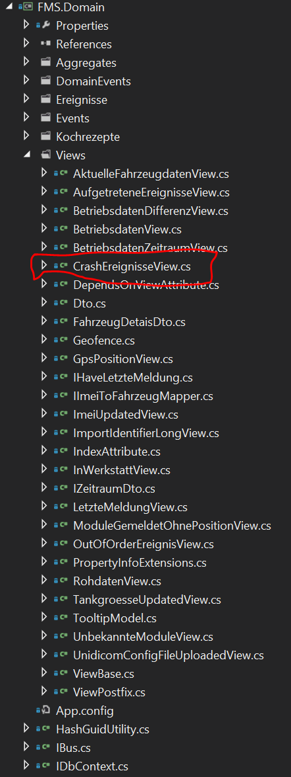
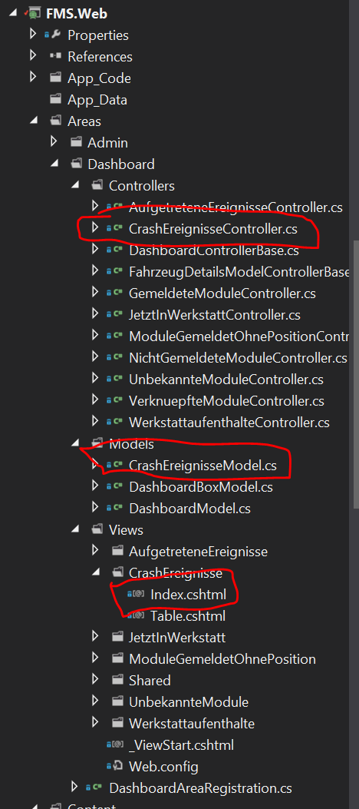
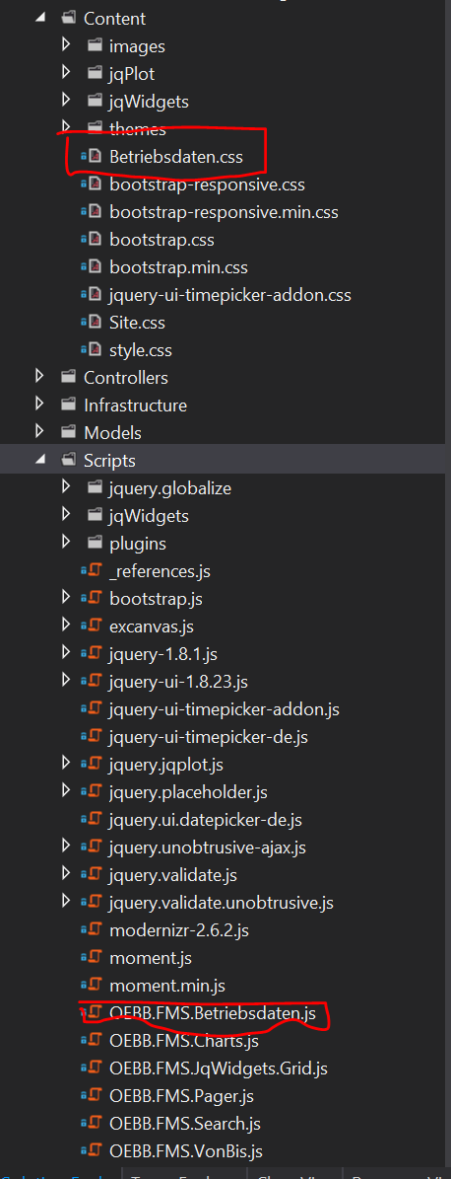
Changes scattered over Solution
Small portions of code in 4 - 7 places
Hard to maintain / bug fix
Lots of searching / scrolling for files

Slide 7
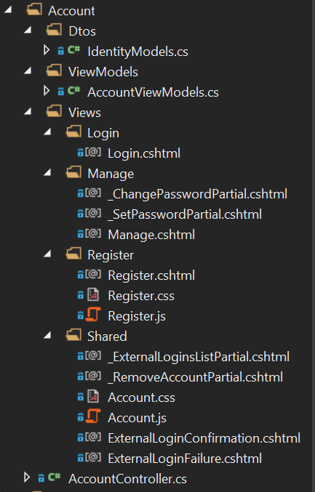
Introduce "feature"
Small component handling an aspect of the application
  User story
  Use case
  Task
Treat it as an application within the application
  "Vertical slicing“
Also known as component

Slide 8
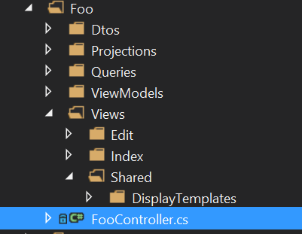
Vertical slicing?
Typical layered architecture
  All [data|ui|...] components in a specific layer
Use layers within the feature
  „A component is often a combination of a number of classes in different layers“ – Simon Brown
  Domain Logic?
Each feature is structured similar
Notes:
Include or exclude Domain Logic?
Current Example excludes it
By

Slide 9

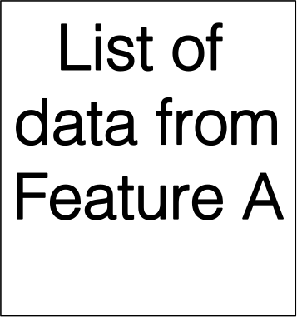
Combination of features?
Usually UI composition is enough
  Start features over "actions"
  Display a widget
  Pages of a wizard
If it is "hard" your feature might be to big
View of Feature A
Start X in Feature B
Display Data from Feature C
Notes:
Composition over Child Actions, Ajax Call

Slide 10
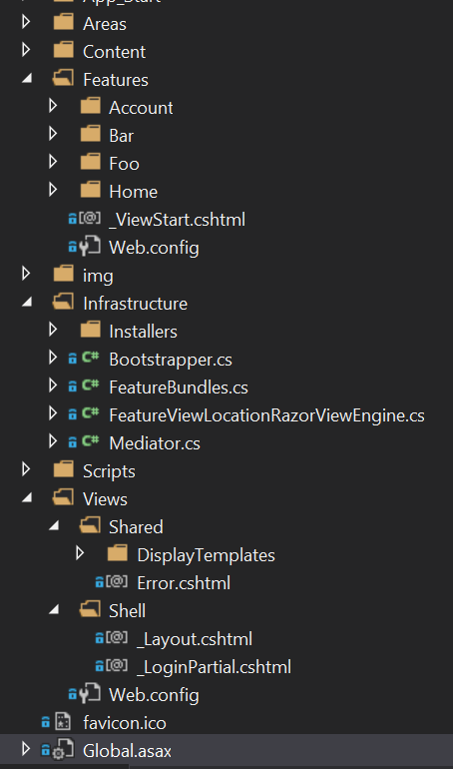
Modify MVC
Create "Features" folder
  Copy "/Views/web.config" and modify it to serve content files
Create custom view engine and register it at startup
  Define additional lookup paths for Razor views
  ~/Features/{Controller}/Views/{Action}.cshtml
  ~/Features/{Controller}/Views/{Action}/{Action}.cshtml
  ~/Features/{Controller}/Views/Shared/{Action}.cshtml
  Override FindPartialView function to search in action subfolders
Find JS/CSS files in~/Features/{Controller}/Views/{Action}/ folders
  Create bundles per feature, render it in the layout
Notes:
Get rid of the /Shared/ Folder
Migth have problems with child actions

Slide 11
What's with non feature stuff?
/Views
  Layout
  Common display/edit templates
/Scripts, /Content
  All common scripts, libraries, styles

Slide 12
Benefits of Features
Parallel / Isolated Development
Good separation between “business” and infrastructure parts
Facilitates usage of Feature Toggles
“Dynamic Loading”
Notes:
Permission for certain actions

Slide 13
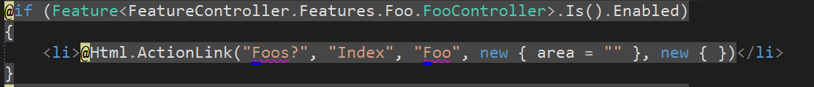
Feature Toogles
  Reduce need for branching during development
Implement feature
  Wrap a toggle (=fancy if) around the feature
  Hides the feature until you are “ready”
  Dynamically enable/disable it
Use FeatureSwitcher for implementing the toggles
Notes:
e.g. enable feature after successful replay

Slide 14
“Dynamic Composability” of features
Define a new empty (Web) project
Implement the feature there
Define NuGet package
  Include Views/Content and project DLL
Reference NuGet package in „Shell“
  Local development over virtual directories in IIS-Express
Notes:
Nuget:
Create a post-build event to automatically package your web project into the nuget package and copy it into a special folder, e.g \artifacts\pkg
Modify solution wide nuget.targets to include this file for restores <PackageSource Include="$(SolutionDir)artifacts\pkg" />

Slide 15
Problems / Open Stuff
Find a „good“ size for features
  Workflow, „Entity Admistration“
Not usual MVC-Layout
  Essential parts remain the same

Slide 16
References
Jimmy Bogard
http://lostechies.com/jimmybogard/2013/10/10/put-your-controllers-on-a-diet-redux/
Tim G. Thomas
http://timgthomas.com/2013/10/feature-folders-in-asp-net-mvc/
Simon Brown
http://www.codingthearchitecture.com/
FeatureSwitcher – Max Malook
https://github.com/mexx/FeatureSwitcher
Feature Controller Source
https://github.com/Nagelfar/FeatureController

