Slide 1
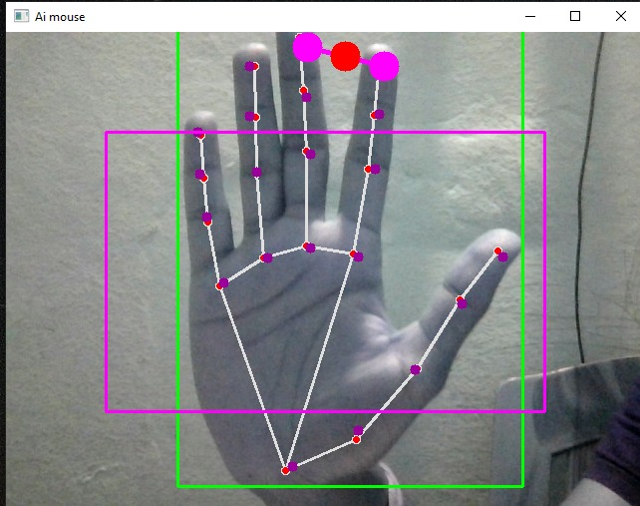
Virtual mouse using ai
S.SAI AJEETH 1602-20-733-097
N.TARUN KUMAR 1602-20-733-114

Slide 2
INTRODUCTION:-
As computer technology continues to develop, people have smaller and smaller electronic devices.
Increasingly we are recognizing the importance of human computing interaction (HCI), and particularly vision-based gesture and object recognition.
In our project, we propose a novel approach that uses a video device to control the mouse system(Mouse tasks).
We employ several image processing algorithms to implement this.
PROJECT SCOPE :-
For most laptop touchpad is not the most comfortable and convenient.
Virtual mouse , known as Virtual Multitask Mouse. This is real time application.
User friendly application. This project removes the requirement of having a physical mouse.

Slide 3
GOALS AND OBJECTIVE :-
The goal is to manage computers and other devices with gestures rather than pointing and clicking a mouse or touching a display directly.
Backers believe that the approach can make it not only easier to carry out many existing chores but also take on trickier tasks such as creating 3-D models, browsing medical imagery during surgery without touching anything.

Slide 4
HARDWARE AND SOFTWARE:-
Web Cam.
Python programming languages.(Modules=pyautogy ,mediapipe ,NumPy)
OpenCV (Open Source Computer Vision Library) is a library of programming functions mainly aimed at real-time computer vision, developed by Intel.
OpenCV runs on Windows, Linux and Mac OS.
ADVANTAGES:-
The main advantage of using hand gestures is to interact with computer as a non-contact human computer input modality
Reduce hardware cost by eliminating use of mouse.
Convenient for users not comfortable with touchpad.
The framework may be useful for controlling different types of games and other applications dependent on the controlled through user defined gestures.

Slide 5
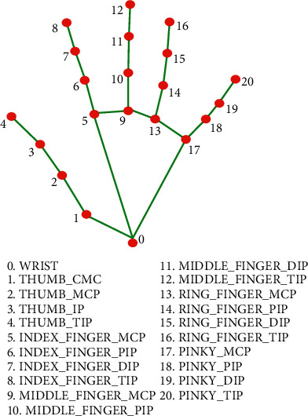
PROBLEM STATEMENT:-
To design virtual mouse which detects hand gestures patterns instead of physical mouse.

Slide 6
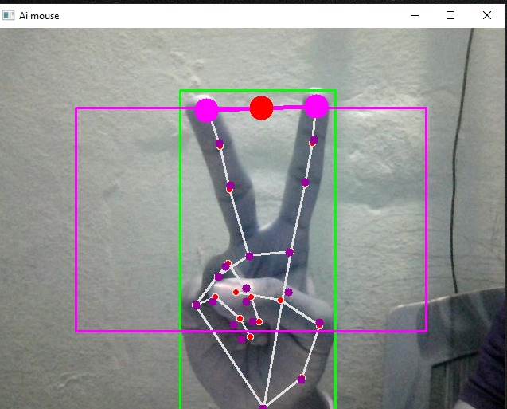
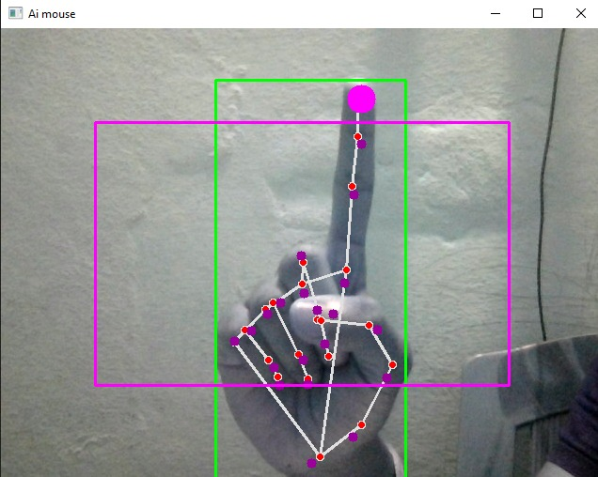
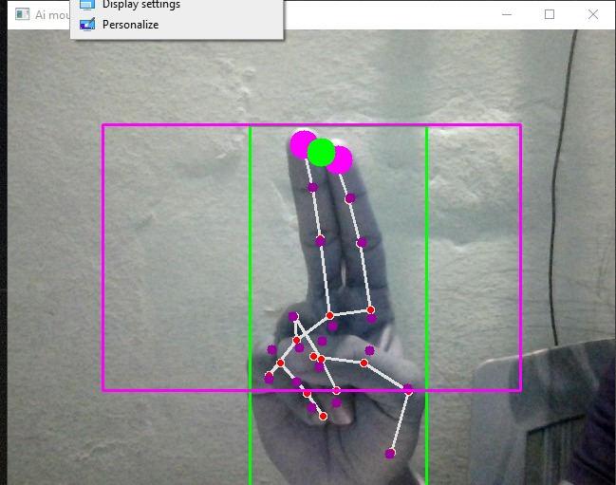
Activating Click
Cursor Moving mode
Left click

Slide 7
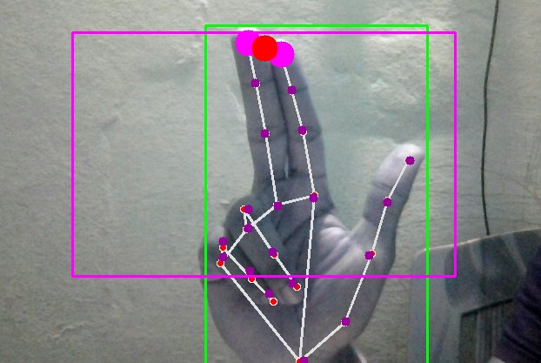
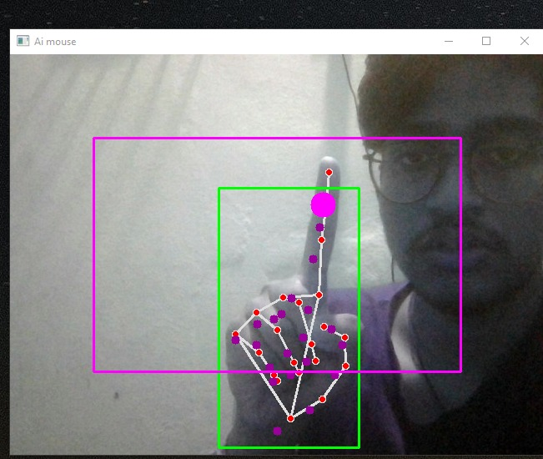
Right Click

Slide 8
LIMITATIONS
• If background contains colors similar to skin, then the algorithm will loose track of the hand or falsely report its location.
• When the camera's height is changed, the system has reported false pose detection. A better way to detect pointing pose is to use Machine learning algorithm .
• The mouse cursor movement on the screen required more smoothing. Also user is not able to cover the entire screen.

Slide 9
CONCLUSION
We are developing a system to control the mouse cursor using a real-time camera.
• This system is based on computer vision algorithms and can do all mouse tasks.
• However, it is difficult to get stable results because of the variety of lighting and skin colors of human races.
• This system could be useful in presentations and to reduce work space.

Slide 10
THANK YOU !!!

