Slide 1
AI-Powered Tesco Retail Media Creative Builder
Retail Media Creative Tool Hackathon
AI-driven creative automation

Slide 2
Problem Statement
• Advertisers struggle with creative production
• Agency dependency increases cost
• Risk of non-compliant ads
• Slow turnaround time

Slide 3
Solution Overview
• AI-powered creative builder
• Generates Tesco-compliant creatives
• No design expertise required

Slide 4
Project Overview
• Simple input-based UI
• AI creative generation
• Compliance validation
• Instant preview

Slide 5
Key Technical Features
• Generative AI text creation
• Tesco rules engine
• Retail-grade UI
• Scalable architecture

Slide 6
Technology Stack
Frontend: HTML, CSS, JavaScript
Backend: Python, Flask
AI: Rule-based

Slide 7
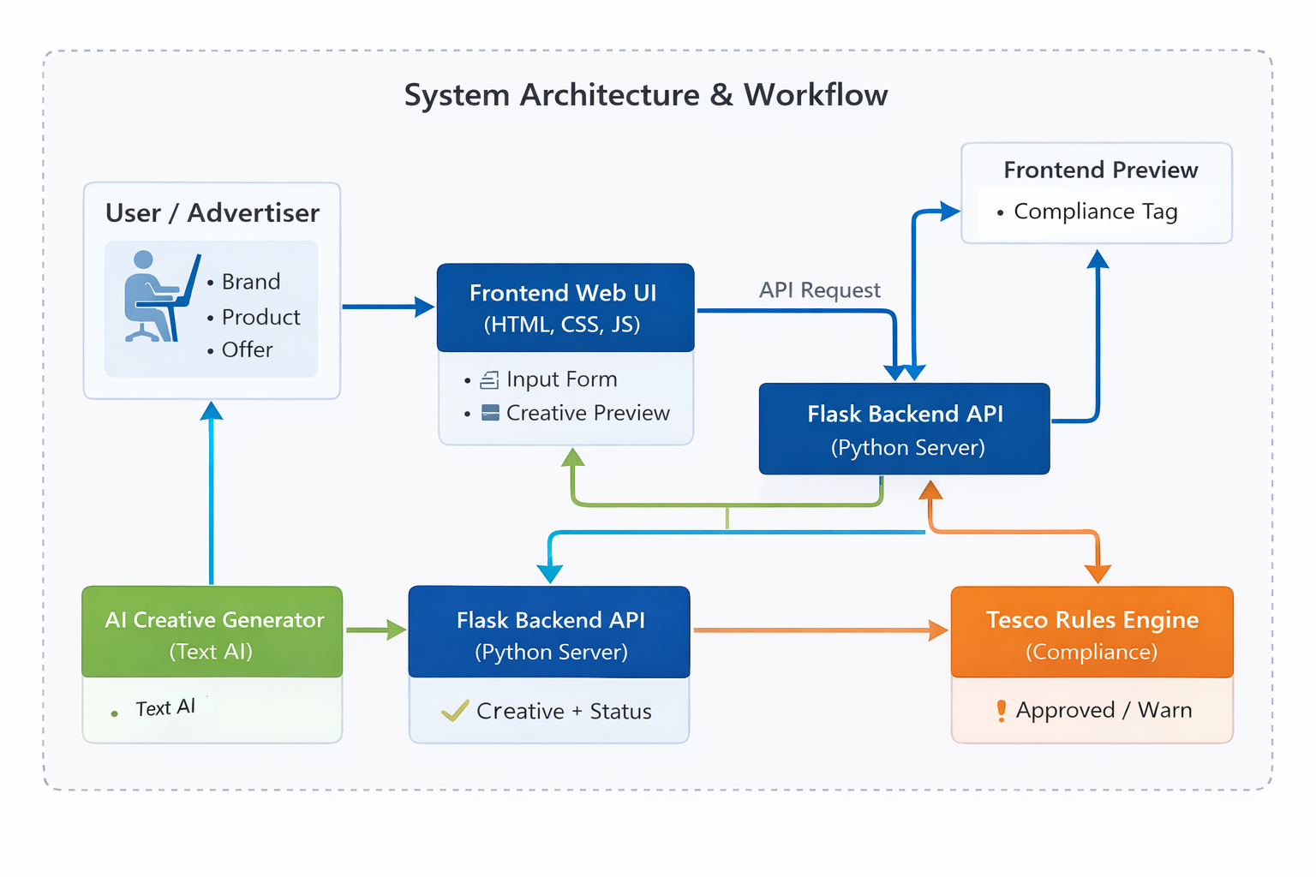
Architecture / Workflow

Slide 8
Challenges Faced
• Encoding compliance rules
• Balancing creativity & policy
• Hackathon time constraints

Slide 9
Future Improvements
• Image generation
• Drag & drop banners
• Brand pack upload
• Advanced AI models

Slide 10
Conclusion
• Faster creative generation
• Guaranteed compliance
• Scalable for Tesco Retail Media

