Slide 1
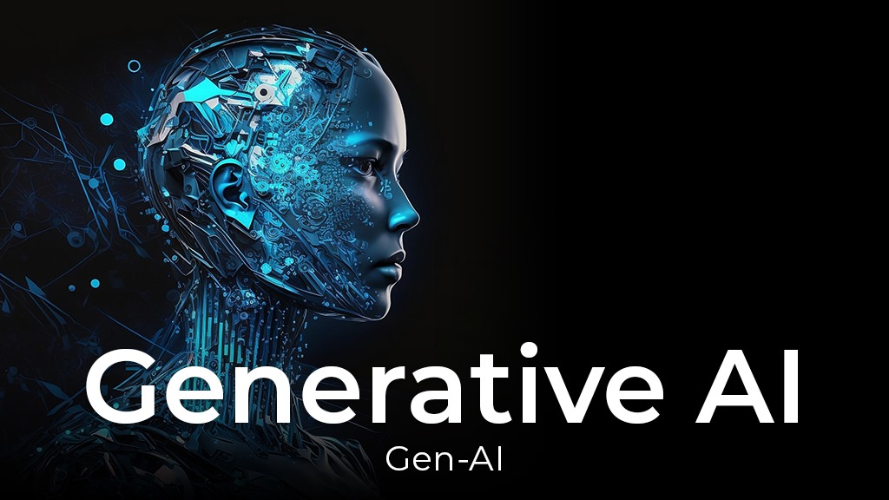

Slide 2
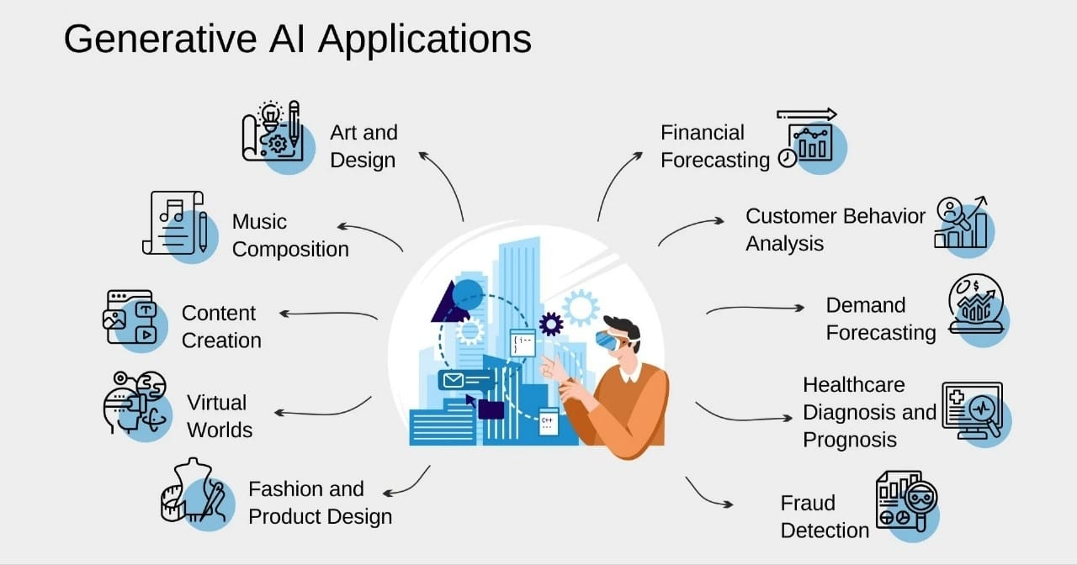
What is Generative AI
Generative AI refers to a class of artificial intelligence algorithms and models that are designed to generate new content, such as images, text, audio, or even video, that is similar to, but not identical to, the data it was trained on.
Generative AI techniques often rely on deep learning architectures, such as Generative Adversarial Networks (GANs), Variational Autoencoders (VAEs), and autoregressive models like Transformers.
Gen AI can be used for various purposes like chatbot ,media creation, product development and design.

Slide 3
What are some types of Generative AI?
Generative AI covers a range of machine learning and deep learning techniques, including:
Transformer models:
Transformers are neural networks that learn context by identifying and tracking relationships in sequential data, such as words in a sentence. They’re commonly used for natural language processing (NLP) tasks.
Generative Adversarial Networks (GANs):
GANs use two neural networks, a generator and a discriminator. The generator creates new content that it presents to the discriminator, which tries to determine whether it’s real or fake.
Variational Autoencoders (VAEs):
VAEs learn to generate new content by analyzing patterns in a dataset. They do this by compressing data into a lower- dimensional space and then learning how to generate new data by sampling from this compressed space.
From chatbots to virtual assistants to music composition and beyond, these models underpin various business applications—and companies are using them to approach tasks in entirely new ways.

Slide 4
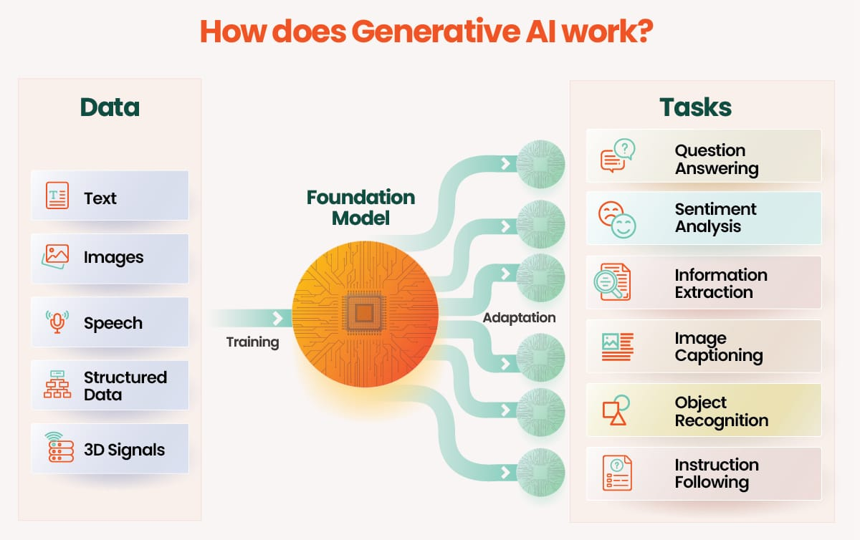
How does Generative AI models work?
Generative AI models use neural networks to identify patterns in existing data to generate new content. Trained on unsupervised and semi-supervised learning approaches, organizations can create foundation models from large, unlabeled data sets, essentially forming a base for AI systems to perform tasks .

Slide 5
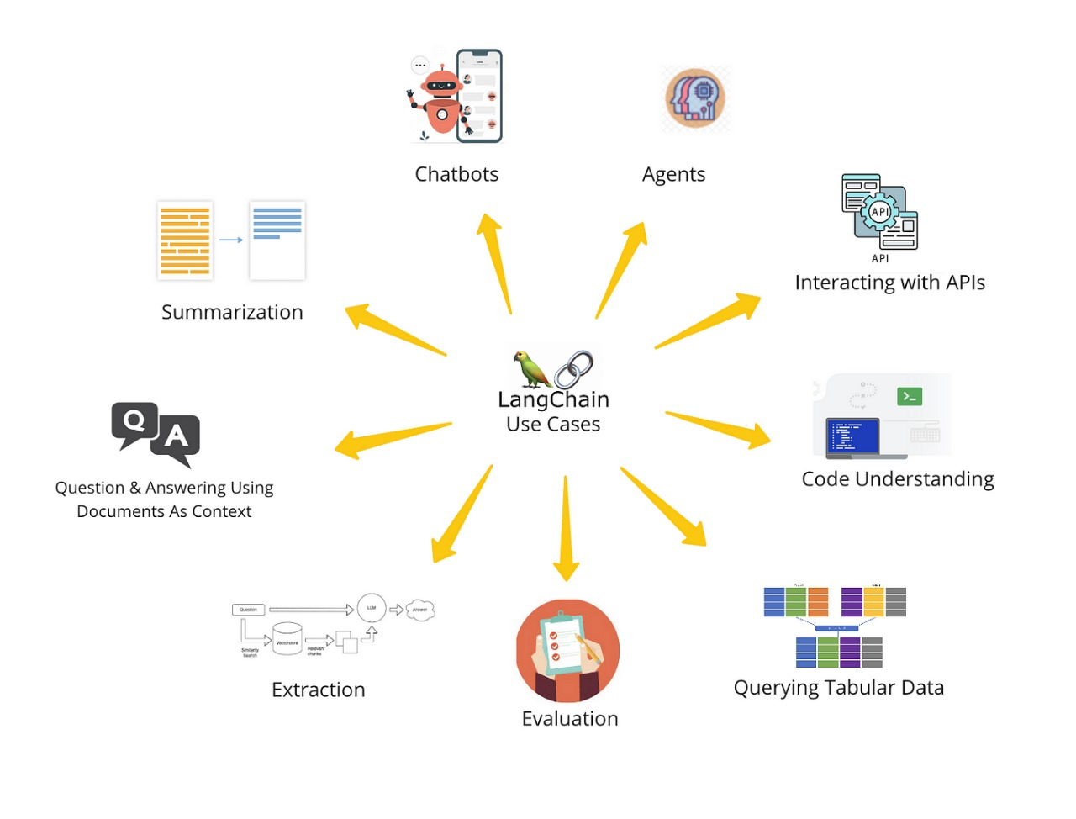
LangChain
LangChain is a framework for developing applications powered by language models. It enables applications that
Are context-aware: connect a language model to sources of context (prompt instructions, few shot examples, content to ground its response in, etc.)
Reason: rely on a language model to reason (about how to answer based on provided context, what actions to take, etc.)
LangChain modules:
Model I/O
Interface with language models
Retrieval
Interface with application-specific data
Agents
Let models choose which tools to use given high-level directives

Slide 6
Use cases
Walkthroughs and techniques for common end-to-end use cases, like:
Document question answering
Chatbots
Analyzing structured data
LLM
LLMs are deep learning models that consume and train on massive datasets to excel in language processing tasks. They create new combinations of text that mimic natural language based on its training data.
LangChain provides Prompt Template to help create parametrized prompts for language models. A Prompt Template allows creating a template string with placeholders, like {adjective} or {content} that can be formatted with input values to create the final prompt string.
Some key features: Validation of input variables against the template Flexible input values — can pass dictionaries, data classes, etc.
Prompt Template

Slide 7
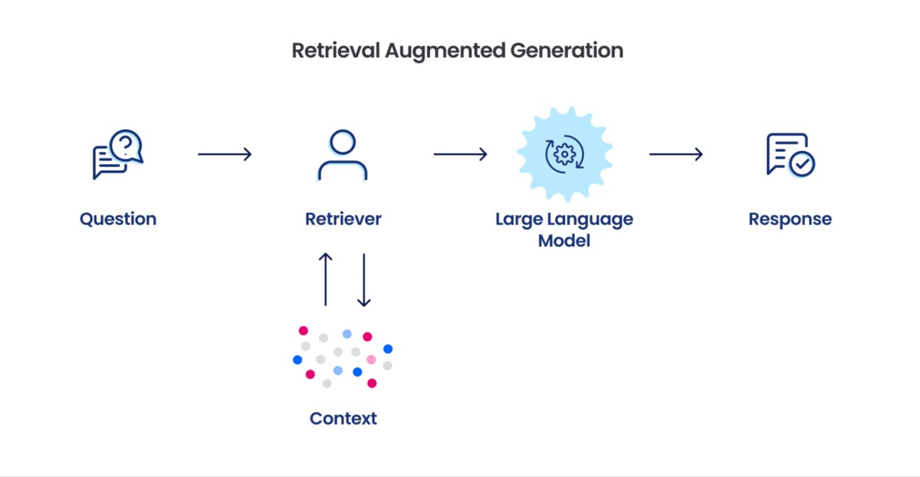
RAG
RAG is a technique for augmenting LLM knowledge with additional data. A typical RAG application has two main components:
Indexing: a pipeline for ingesting data from a source and indexing it. This usually happens offline.
Retrieval and generation: the actual RAG chain, which takes the user query at run time and retrieves the relevant data from the index, then passes that to the model.

Slide 8
Task : Created a chat bot which integrates with Internet using Gen-AI
We developed a Streamlit chat interface integrating OpenAI's GPT-3.5 model for dynamic responses. The interface, with session state management, prompts users for input and displays processed messages. OpenAI generates responses, maintaining conversational flow and enabling seamless interaction. This setup creates a user-friendly environment for natural language conversations with the chat bot.
Task :Created a Chatbot which integrates with user uploaded PDF file using FAISS vector database
To accomplish this we’ve created a chatbot that integrates with user-uploaded PDF files. Users could upload PDFs, ask questions via a chat interface, and receive answers generated using an AI model. The text from PDFs was processed for efficient searching, and relevant information was displayed to users in the interface, enabling interactive exploration.
Task : Created a Chatbot application which helps user to connect with various SQL related databases in user friendly approach
To accomplish this we’ve built a chatbot app facilitating user interaction with SQL databases. Environment setup and model initialization enable seamless integration. Streamlit's session state manages user inputs and responses. The interface provides a user-friendly environment for database interaction

Slide 9
Task : Created a Chatbot which integrates with both FAISS Vector Database and SQL Database which lets user to retrieve data from both the databases basically its summation of both 2nd and 3rd task.
So, we’ve developed a comprehensive chatbot application integrating PDF processing, chat interface, AI assistant response generation, and database interaction. Users can upload PDF documents for text extraction and interact with the chat interface. The system leverages both MySQL database and OpenAI model to provide contextually relevant responses based on user queries. Responses are displayed in the chat interface, facilitating seamless interaction and enhancing user experience. Overall, the application combines various technologies to create an intelligent and interactive chat interface capable of processing PDF documents and retrieving data from databases.
USING GOOGLE GEMINI
Task : Created a chatbot which integrates with Internet using Gen-AI.
This python code sets up a Streamlit application called "GEMINI LLM APPLICATION" for interacting with a Generative AI model named “Gemini-pro" model using the Google Generative AI API key. The main agenda of this code creates a simple chat interface where users can interact with the Generative Model by asking questions or providing input, and the model responds accordingly, with the conversation history displayed in the Streamlit application.

Slide 10
Task : Integrates with Google's Generative AI, specifically the ‘Gemini-pro-vision' model (Image-to-text)
The main agenda of this code is to create a Streamlit application that interacts with the Google Generative AI model named “Gemini-pro-vision" to generate a textual description or response based on an input prompt and an uploaded image. The code sets up a simple web application where users can input a prompt and upload an image, and the Generative Model generates a textual description or response based on these inputs, which is then displayed to the user.
Task : Chat with Multi documents using Vector Database in LangChain LLM models with Gemini Pro.
This code is a Streamlit application designed for interacting with multiple documents like(pdf, word, txt) uploaded by users through a chat interface. This code creates a user-friendly interface for interacting with uploaded documents through a chat interface powered by a Generative AI model. Users can ask questions or provide prompts, and the model generates responses based on the content of the uploaded documents.

Slide 11
Task : Chat with YouTube Video Transcribe Summarizer LLM App With Google Gemini Pro.
And This is for a Streamlit application that takes a YouTube video URL as input, extracts the transcript of the video using the YouTube Transcript API, summarizes the transcript using Google's Generative AI model called “Gemini-pro," and displays the detailed notes or summary. This code creates a simple web application that allows users to input a YouTube video link, extracts the transcript of the video, summarizes it using a Generative AI model, and presents the detailed notes or summary to the user.
Task : Chat with CSV file Document using Vector Database in LangChain LLM models with Gemini Pro.
This code is a Streamlit application that allows users to upload a CSV file, input a question or query, and receive responses based on the content of the CSV file. The responses are generated using Google's Generative AI model “Gemini-pro" and a question-answering pipeline. Overall, this code creates a user-friendly interface for interacting with CSV data using Google's Generative AI model “Gemini-pro." Users can upload CSV files containing information, input their questions or queries, and receive responses based on the content of the CSV file.

Slide 12
THANKYOU

