Slide 1
RAJARAJESWARI COLLEGE OF ENGINEERING MYSORE ROAD BENGALURU-74
PROJECT ON
EXPLAINABLE AI: SCENE CLASSIFICATION AND GRADCAM VISUALIZATION
STUDENT NAME REGISTER NUMBER
Nagendra kumar K S 1RR22MC029
UNDER THE GUIDANCE OF
Dr.t. subburaj
Hod, Department of mca

Slide 2

Agenda
Abstract
Literature survey
Existing system
Problem STATEMENT
Proposed system
Results
conclusions

Slide 3
abstract
Objective: To build a machine learning model capable of classifying scenes (e.g., buildings, forest, glacier, mountain, sea, and street) and providing visual explanations using Grad-CAM to highlight key image regions that influenced the model’s decision.
Approach: A pre-trained ResNet50 model is used to classify scenes, and Grad-CAM (Gradient-weighted Class Activation Mapping) is integrated to make the model’s decision-making process more interpretable. The results are showcased via a web-based application built using Streamlit.
Outcome: An interactive AI system that not only classifies images but also helps users visualize and understand the key factors behind the classification.

Slide 4
LITERATURE SURVEY
"Advances in Scene Classification Using Deep Learning" by Kumar et al. (2019)
"Transfer Learning for Scene Classification" by Brown and Davis (2020)
"Scene Classification with Attention Mechanisms" by Chen et al. (2021)
"The Evolution of Scene Classification: From Traditional Methods to Deep Learning" by Roberts and Kim (2020)
"Accessibility in Scene Classification Models" by Gupta et al. (2021)

Slide 5
Existing system
Overview:
Traditional scene classification models use convolutional neural networks (CNNs) to classify images but lack interpretability.
State-of-the-art CNN architectures like ResNet50 have demonstrated high accuracy in image classification but do not provide insight into how the predictions are made.
Limitations:
Black-box nature of deep learning models leads to a lack of transparency.
Users have little understanding of why certain decisions are made by AI models.
Difficulties in building trust for applications where interpretability is crucial (e.g., healthcare, autonomous driving).

Slide 6
Problem Statement
Challenge: The need for models that not only achieve high classification accuracy but also offer interpretability in their decision-making process.
Scene classification models are widely used in areas such as remote sensing, surveillance, and navigation. However, without a clear understanding of how the model reaches a decision, the system may face trust and transparency issues.
Traditional CNN-based models provide limited insight into the factors influencing their predictions.
Key Problems:
Lack of visual explanation for predictions.
Trust and transparency issues in critical AI systems.
Difficulty in debugging or improving the model due to opacity in decision-making.

Slide 7
PROPOSED SYSTEM
Solution: The development of an explainable AI model using a pre-trained ResNet50 architecture for scene classification, combined with Grad-CAM to visualize the regions of the image that contribute most to the classification decision.
Model Overview:
The ResNet50 model, pre-trained on ImageNet, is fine-tuned for our dataset.
The model classifies scenes into six categories: buildings, forest, glacier, mountain, sea, and street.
Grad-CAM is used to generate heatmaps that highlight important areas of the image that influenced the model’s classification decision.
Web-based Interface:
A Streamlit-powered application allows users to interact with the model, upload images, view predictions, and visualize heatmaps showing which regions of the image were most influential in making the prediction.

Slide 8
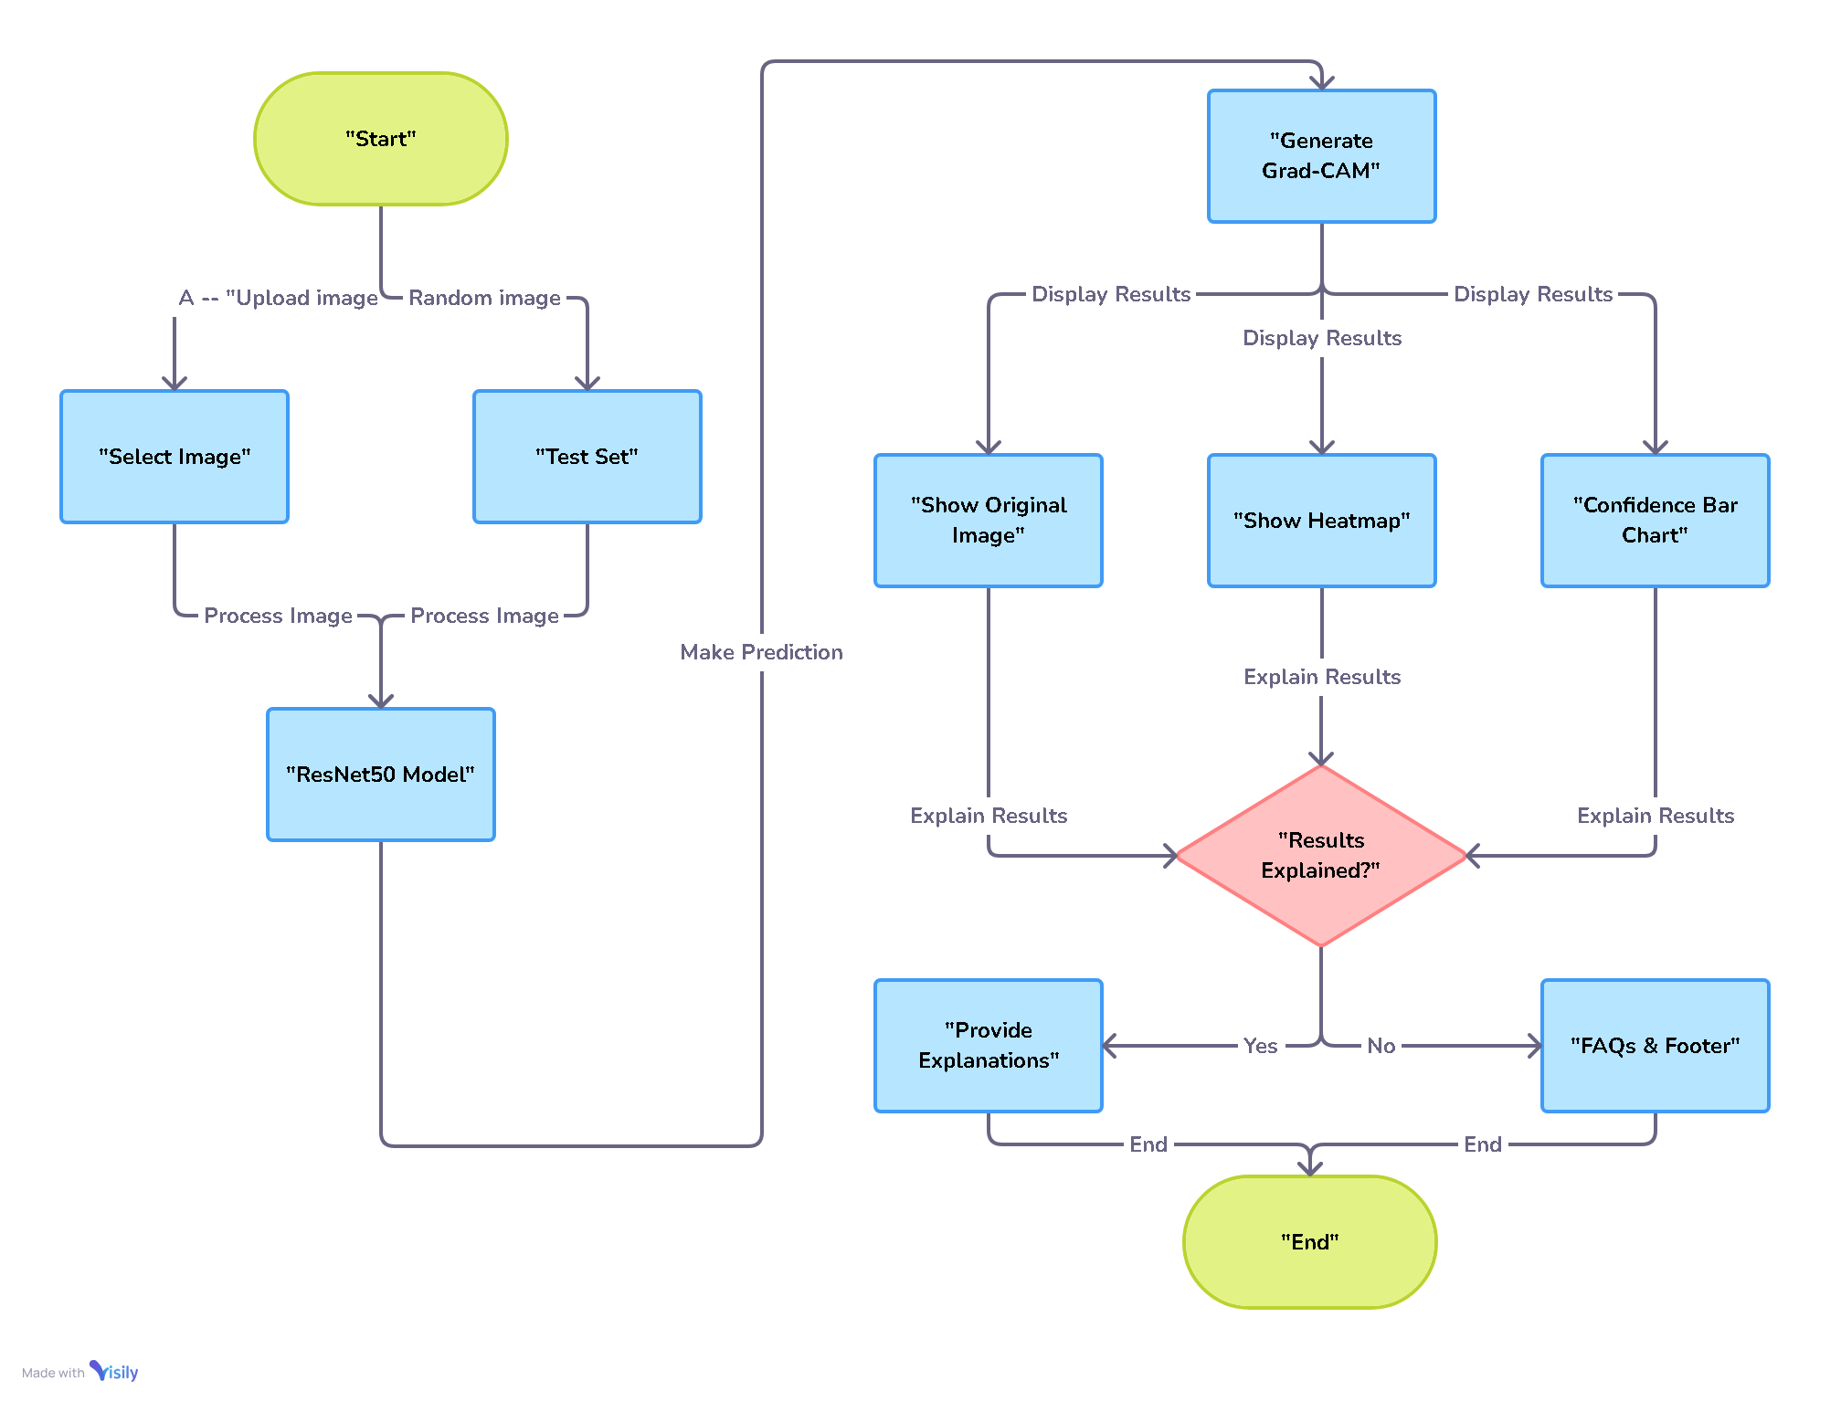
SYSTEM ARCHITECTURE

Slide 9
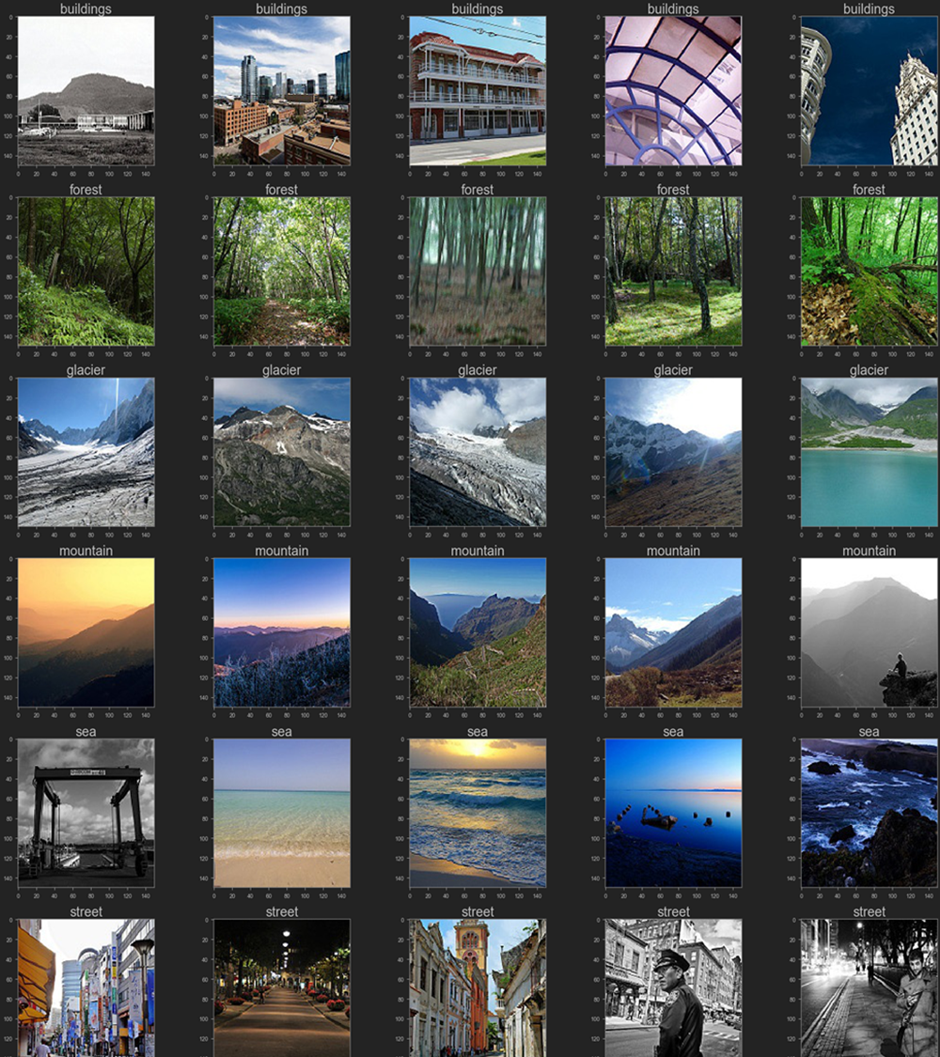
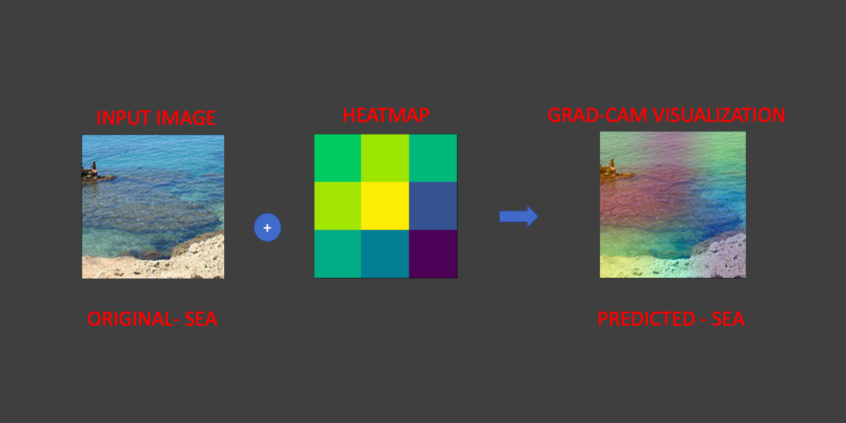
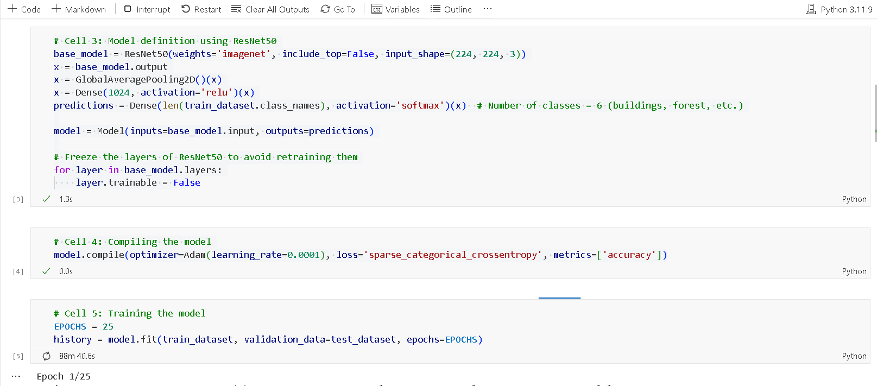
SCREENSHOTs

Slide 10

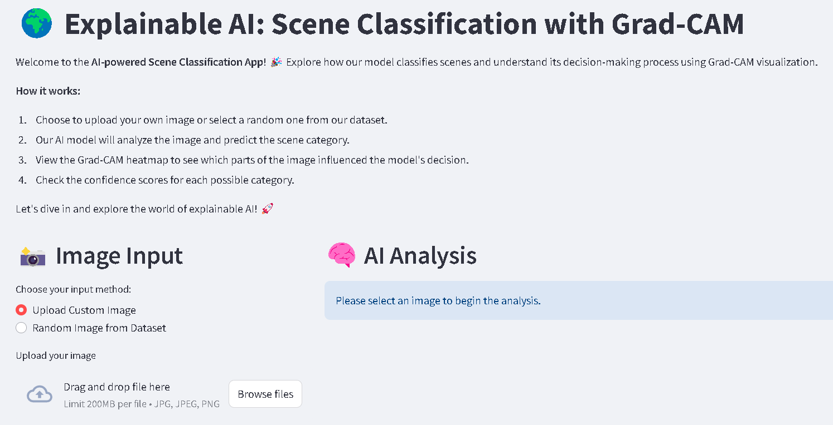

Slide 11
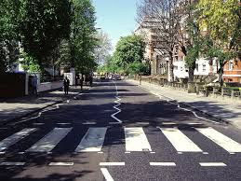
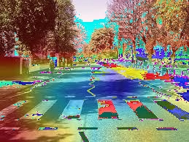
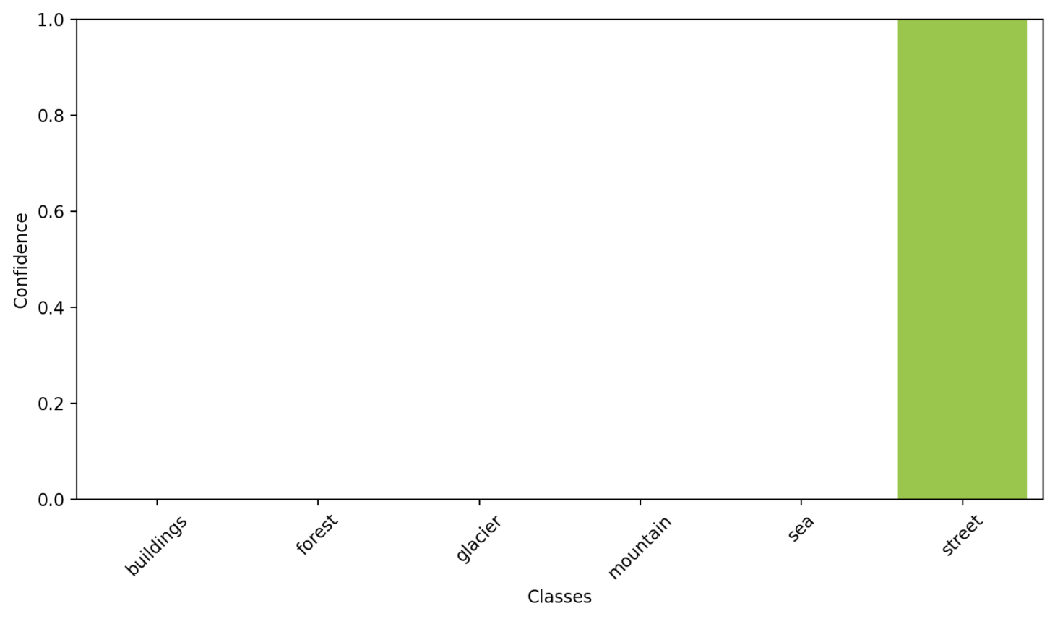
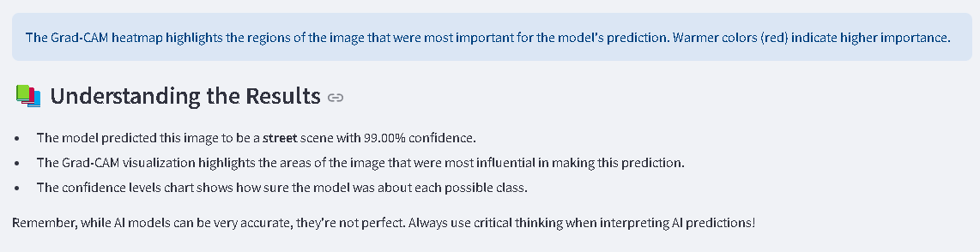

Slide 12
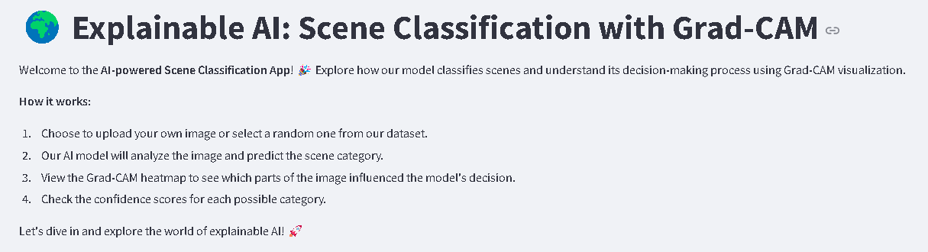
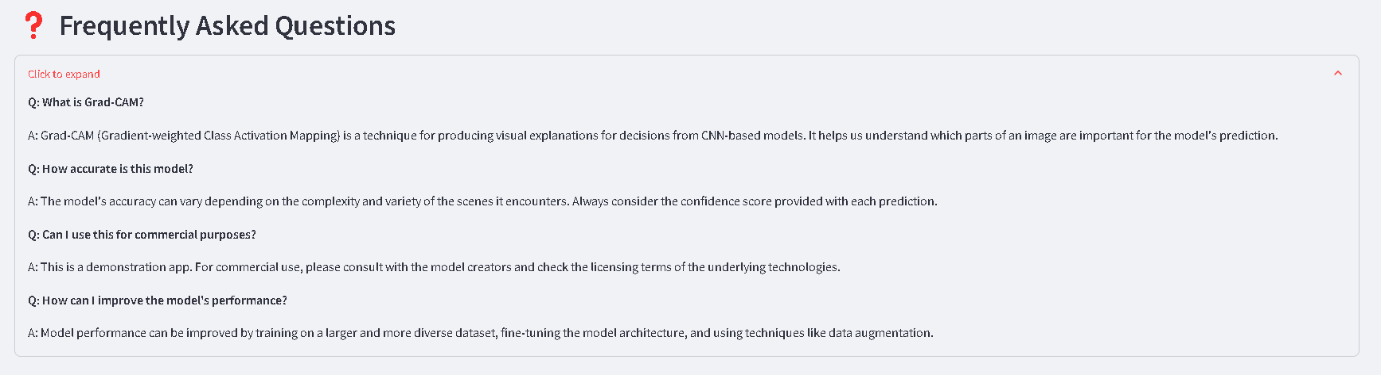

Slide 13
conclusions
Summary:
Our explainable AI model successfully classifies scenes and provides visual insights using Grad-CAM.
This system bridges the gap between accuracy and interpretability, allowing users to trust and understand the model’s decisions.
Future Work:
Explore transfer learning with other architectures (e.g., EfficientNet, MobileNet).
Enhance Grad-CAM visualizations by integrating more advanced techniques like Grad-CAM++.
Expand the dataset and fine-tune the model for additional scene categories.
Deploy the system on a larger scale with real-time processing capabilities.

Slide 14


